Slide 1
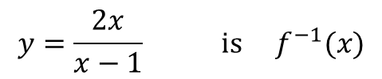
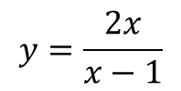
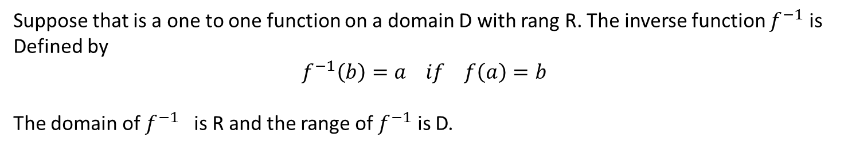
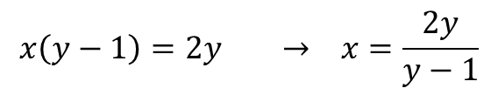


Second semester
Inverse function
Suppose that is a one to one function on a domain D with rang R. The inverse function $f^{−1}$ is
Defined by
$$f^{−1}\left(b\right)=a if f\left(a\right)=b$$
The domain of $f^{−1}$ is R and the range of $f^{−1}$ is D.
Note: The symbol $f^{−1}$ for the inverse of $f$is read $f$ inverse. The -1 in $f^{−1}$ is not an exponent;
$f^{−1}$(x) dose not mean $\frac{1}{f(x)}$ . Notice that the domain and range of $f$ and $f^{−1}$ are interchanged.
Example: Let $f\left(x\right)=\frac{x}{x−2} find f^{−1}(x)$
$$y=\frac{x}{x−2} → yx−2y=x$$
$$x\left(y−1\right)=2y → x=\frac{2y}{y−1}$$
Replace x by y to obtain
$$y=\frac{2x}{x−1}$$
$$y=\frac{2x}{x−1} is f^{−1}(x)$$

Slide 2
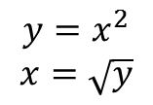

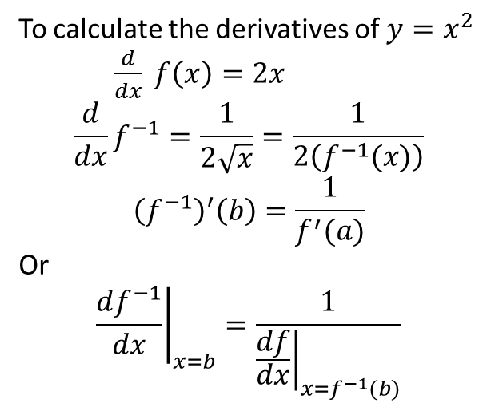

Example: Find the inverse of the function $y=x^{2} , x≥0$ expressed as a function of x
$$y=x^{2}$$
$$x=\sqrt{y}$$
$$∴ inverse → y=\sqrt{x}$$
To calculate the derivatives of $y=x^{2}$
$\frac{d}{dx} f\left(x\right)=2x$
$$\frac{d}{dx}f^{−1}=\frac{1}{2\sqrt{x}}=\frac{1}{2\left(f^{−1}(x)\right)}$$
$${\left(f^{−1}\right)}^{′}\left(b\right)=\frac{1}{f^{′}(a)}$$
Or
$${\left.\frac{df^{−1}}{dx}\right|}_{x=b}=\frac{1}{{\left.\frac{df}{dx}\right|}_{x=f^{−1}(b)}}$$
$$, b=f(a)$$

Slide 3
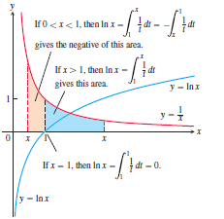
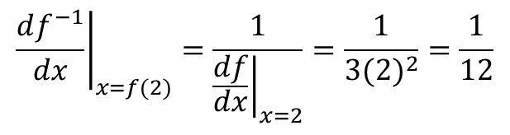
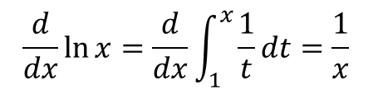
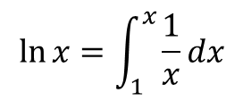
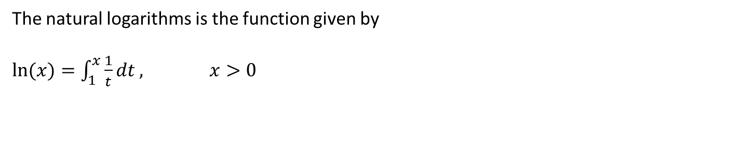
Example: Let $f\left(x\right)=x^{3}−2 . Find the value of \frac{df^{−1}}{dx} at x=6=f\left(2\right)without finding$
a formula for $f^{−1}\left(x\right).$
$${\left.\frac{df^{−1}}{dx}\right|}_{x=f(2)}=\frac{1}{{\left.\frac{df}{dx}\right|}_{x=2}}=\frac{1}{3(2)^{2}}=\frac{1}{12}$$
Natural Logarithms
The natural logarithms is the function given by
$ln⁡(x)=\int_{1}^{x}{\frac{1}{t}dt , x>0}$
$$\ln{x=\int_{1}^{x}{\frac{1}{x}dx}}$$
$$\frac{d}{dx}\ln{x=\frac{d}{dx}\int_{1}^{x}{\frac{1}{t}dt=\frac{1}{x}}}$$

Slide 4
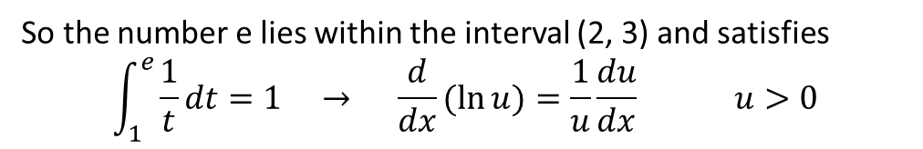
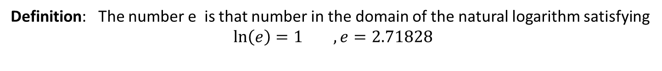


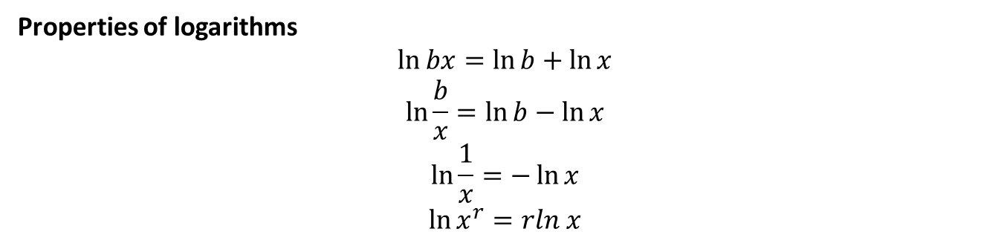
Definition: The number e is that number in the domain of the natural logarithm satisfying
$$\ln\left(e\right)=1 ,e=2.71828$$
So the number e lies within the interval (2, 3) and satisfies
$$\int_{1}^{e}{\frac{1}{t}dt=1 → \frac{d}{dx}(\ln{u)=\frac{1}{u}\frac{du}{dx}}} u>0$$
Properties of logarithms
$$\ln{bx=\ln{b+\ln{x}}}$$
$$\ln{\frac{b}{x}=\ln{b−\ln{x}}}$$
$$\ln{\frac{1}{x}=−\ln{x}}$$
$$\ln{x^{r}=rln x}$$
The integral $\int{\frac{1}{u}du}$
If u is differential function that is never zero
$$\int{\frac{1}{u}du=ln\left|u\right|+c}$$

Slide 5

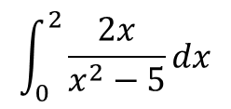
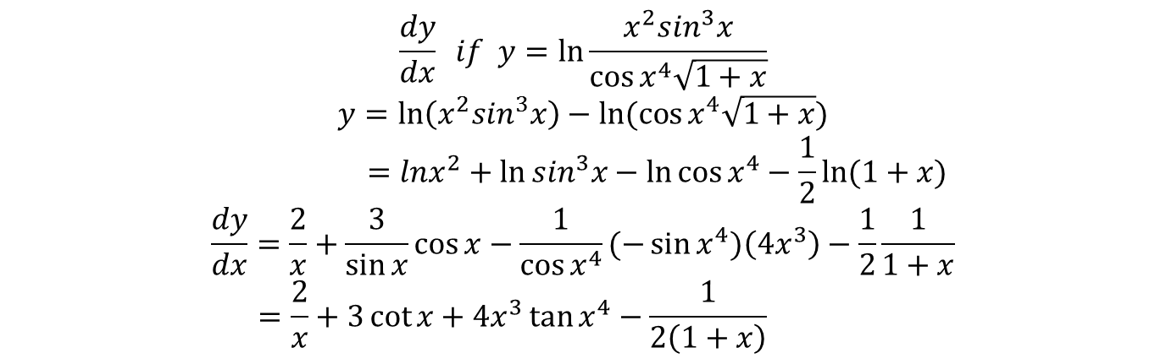
Example: Evaluate
$$\int_{0}^{2}{\frac{2x}{x^{2}−5}dx}$$
$$u=x^{2}−5 → du=2xdx$$
$$\int_{−5}^{−1}{\frac{du}{u}}={\left.\ln{u}\right|}_{−5}^{−1}=\ln\left|−1\right|−\ln\left|−5\right|$$
$$=\ln{1−\ln{5=−\ln{5}}}$$
Example: Find
$$\frac{dy}{dx} if y=\ln{\frac{x^{2}\sin^{3}x}{\cos{x^{4}\sqrt{1+x}}}}$$
$$y=\ln\left(x^{2}\sin^{3}x\right)−ln⁡(\cos{x^{4}\sqrt{1+x}})$$
$$=lnx^{2}+\ln{\sin^{3}x−\ln{\cos{x^{4}−\frac{1}{2}ln⁡(1+x)}}}$$
$$\frac{dy}{dx}=\frac{2}{x}+\frac{3}{\sin{x}}\cos{x}−\frac{1}{\cos{x^{4}}}(−\sin{x^{4})\left(4x^{3}\right)−\frac{1}{2}\frac{1}{1+x}}$$
$$=\frac{2}{x}+3\cot{x+4x^{3}\tan{x^{4}−\frac{1}{2\left(1+x\right)} }}$$

Slide 6


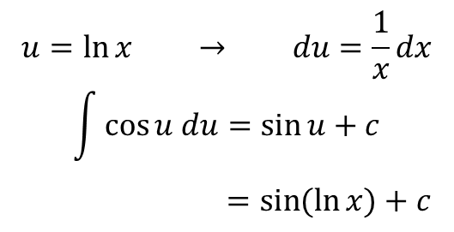
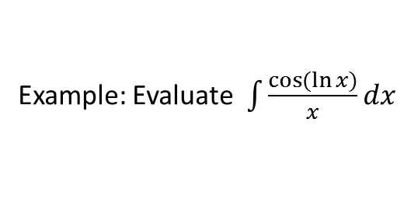
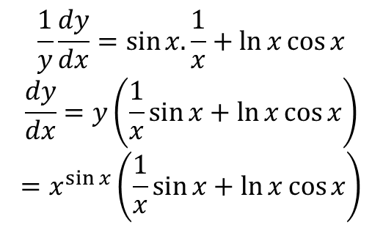
Example: Find $\frac{dy}{dx} for y=x^{\sin{x}}$
$$\ln{y=\sin{x\ln{x}}}$$
$$\frac{1}{y}\frac{dy}{dx}=\sin{x. \frac{1}{x}+\ln{x\cos{x}}}$$
$$\frac{dy}{dx}=y\left(\frac{1}{x}\sin{x+\ln{x\cos{x}}}\right)$$
$$=x^{\sin{x}}\left(\frac{1}{x}\sin{x+\ln{x\cos{x}}}\right)$$
Example: Evaluate $\int{\frac{\cos{(\ln{x)}}}{x}dx}$
$$u=\ln{x → du=\frac{1}{x}dx}$$
$$\int{\cos{u du=\sin{u+c}}}$$
$=\sin{(\ln{x)+c}}$

Slide 7
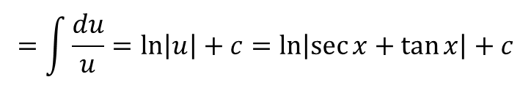
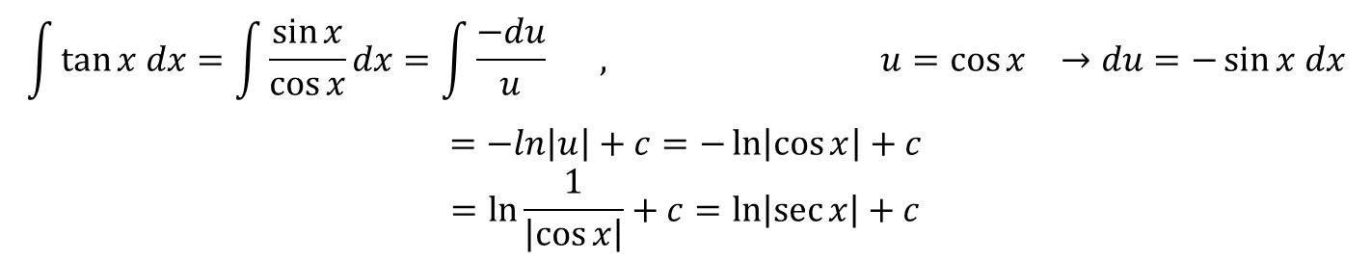
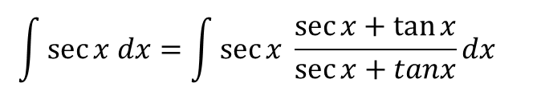
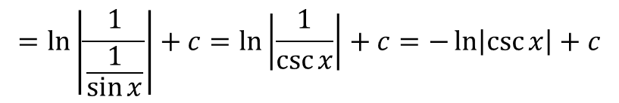
The integrals of tan x, cot x, sec x, and csc x
$$\int{\tan{x dx=\int{\frac{\sin{x}}{\cos{x}}dx=\int{\frac{−du}{u} , u=\cos{x →du=−\sin{x dx}}}}}}$$
$$=−ln\left|u\right|+c=−\ln\left|\cos{x}\right|+c$$
$$=\ln{\frac{1}{\left|\cos{x}\right|}+c=\ln\left|\sec{x}\right|}+c$$
$$\int{\cot{x dx=\int{\frac{\cos{x}}{\sin{x}}dx=\int{\frac{du}{u}=\ln\left|u\right|+c=\ln\left|sinx\right|+c , u=\sin{x →du=\cos{x dx}}}}}}$$
$$=\ln\left|\frac{1}{\frac{1}{\sin{x}}}\right|+c=\ln\left|\frac{1}{\csc{x}}\right|+c=−\ln\left|\csc{x}\right|+c$$
$$\int{\sec{x dx=\int{\sec{x \frac{\sec{x+\tan{x}}}{\sec{x+tanx}}dx }}}}$$
$$=\int{\frac{\sec^{2}x+\sec{x\tan{x}}}{\sec{x+\tan{x}}}dx , u=\sec{x+\tan{x → du=(sec{x\tan{x+\sec^{2}x)}}}}}dx$$
$$=\int{\frac{du}{u}=\ln\left|u\right|}+c=\ln\left|\sec{x+\tan{x}}\right|+c$$

Slide 8
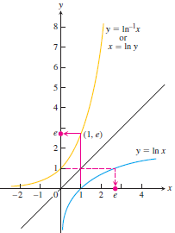
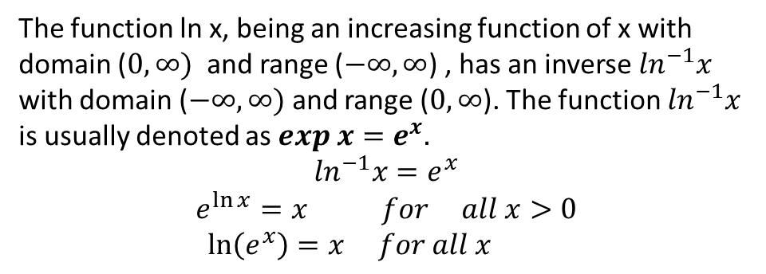
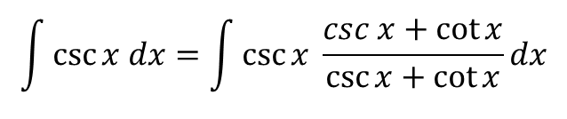

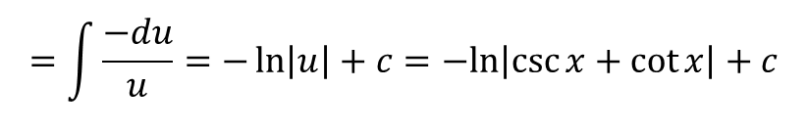
$$\int{\csc{x dx=\int{\csc{x \frac{csc x+\cot{x}}{\csc{x+\cot{x}}}dx}}}}$$
$$=\int{\frac{\csc^{2}x+\csc{x\cot{x}}}{\csc{x+\cot{x}}}dx , u=\csc{x+\cot{x → du=(−csc{x\cot{x+{−csc}^{2}x)}}}}}dx$$
$$=\int{\frac{−du}{u}=−\ln\left|u\right|}+c=−ln\left|\csc{x}+\cot{x}\right|+c$$
Exponential functions , $exp x=e^{x}$
The function ln x, being an increasing function of x with
domain ($0, ∞)$ and range ($−∞, ∞$) , has an inverse $\ln^{−1}x$
with domain ($−∞, ∞)$and range ($0, ∞$). The function $\ln^{−1}x$
is usually denoted as $exp x=e^{x}.$
$$\ln^{−1}x=e^{x}$$
$$e^{\ln{x}}=x for all x>0$$
$$\ln\left(e^{x}\right)=x for all x$$

Slide 9




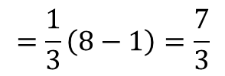

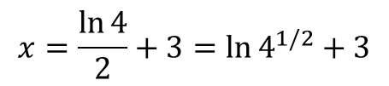
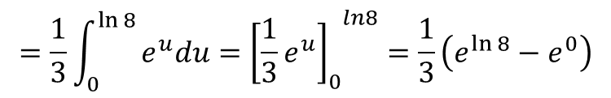

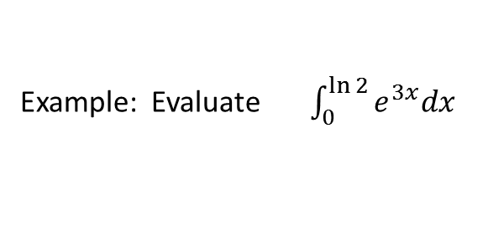

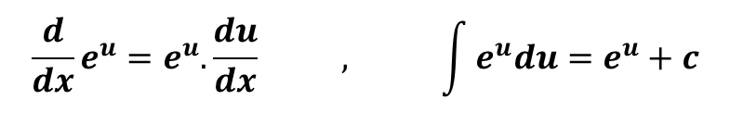
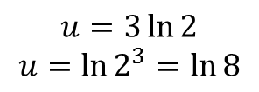
Example: Solve the equation $e^{2x−6}=4 for x$
$$\ln{e^{2x−6}=\ln{4}}$$
$$2x−6=\ln{4}$$
$$2x=\ln{4+6}$$
$$x=\frac{\ln{4}}{2}+3=\ln{4^{1/2}+3}$$
$$=\ln{2+3}$$
$$\frac{d}{dx}e^{u}=e^{u}. \frac{du}{dx} , \int{e^{u}du=e^{u}+c}$$
Example: $\frac{d}{dx} e^{\sin{x}}=e^{\sin{x}}.\cos{x}$
Example: Evaluate $\int_{0}^{\ln{2}}{e^{3x}dx}$
$$u=3x →du=3dx$$
$$=\frac{1}{3}\int_{0}^{\ln{8}}{e^{u}du={{\left[\frac{1}{3}e^{u}\right]}_{0}}^{ln8}=\frac{1}{3}\left(e^{\ln{8}}−e^{0}\right)}$$
$$u=3\ln{2}$$
$$u=\ln{2^{3}=\ln{8}}$$
$$=\frac{1}{3}\left(8−1\right)=\frac{7}{3}$$

Slide 10

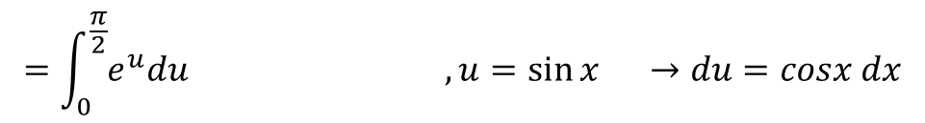
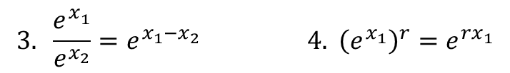





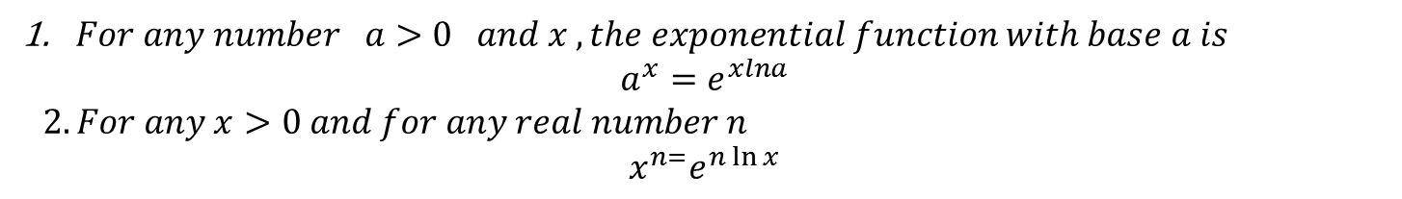
Example: Evaluate $\int_{0}^{\frac{π}{2}}{e^{\sin{x}}.\cos{x dx}}$
$$=\int_{0}^{\frac{π}{2}}{e^{u}du , u=\sin{x →du=cosx dx}}$$
$$={{\left[e^{u}\right]}_{0}}^{1}=e^{1}−e^{0}=e−1$$
$$Laws of Exponents$$
1 - $e^{x_{1}}.e^{x_{2}}=e^{x_{1}+x_{2}} 2. e^{−x}=\frac{1}{e^{x}}$
$$3. \frac{e^{x_{1}^{}}}{e^{x_{2}}}=e^{x_{1}−x_{2}} 4. {\left(e^{x_{1}}\right)}^{r}=e^{{rx}_{1}}$$
$$Definition$$
$For any number a>0 and x , the exponential function with base a is$
$$a^{x}=e^{xlna}$$
$$2. For any x>0 and for any real number n$$
$$x^{n=}e^{n\ln{x}}$$
The derivative of $a^{u}$
To find this derivative, we start the defining equation $a^{x}=e^{xln a}$
$$\frac{d}{dx}\left(a^{x}\right)=\frac{d}{dx}e^{xln a}=e^{xln a}.\frac{d}{dx}\left(xln a\right)=e^{xln a}.\ln{a=a^{x}.\ln{a}}$$

