Slide 1

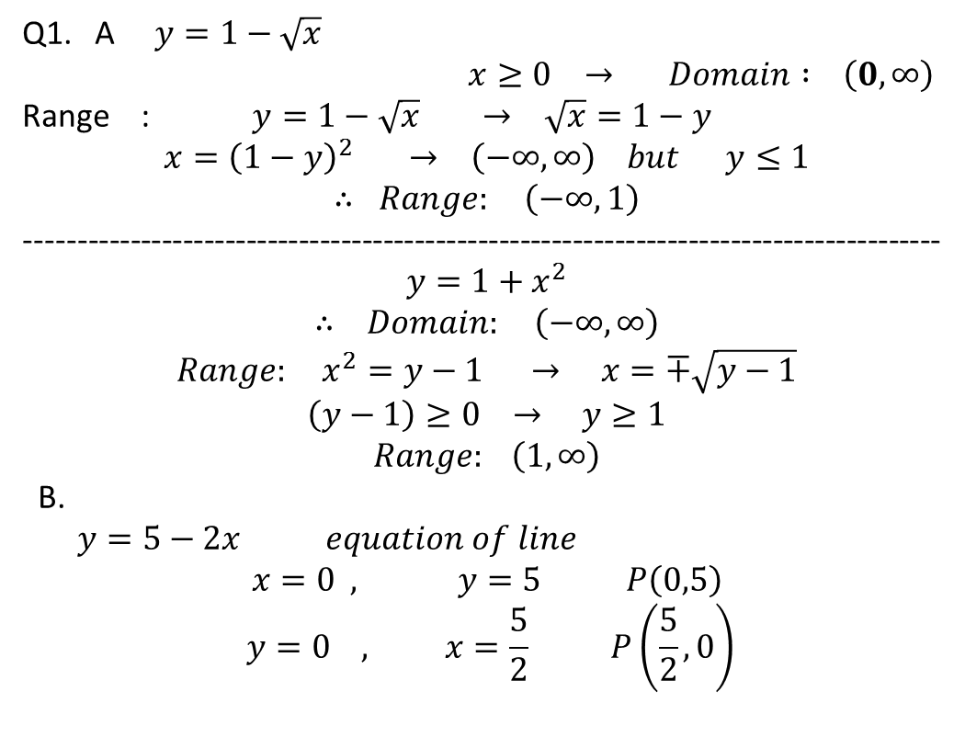
Answers for mid year exam of year 2021-2022
Q1. A $y=1−\sqrt{x}$
$$x≥0 → Domain : \left(0, ∞\right)$$
Range : $y=1−\sqrt{x} → \sqrt{x}=1−y$
$$x={\left(1−y\right)}^{2} → \left(−∞, ∞\right) but y≤1$$
$$∴ Range: \left(−∞,1\right)$$
---------------------------------------------------------------------------------------
$$y=1+x^{2}$$
$$∴ Domain: \left(−∞, ∞\right)$$
$$Range: x^{2}=y−1 → x=∓\sqrt{y−1}$$
$$\left(y−1\right)≥0 → y≥1$$
$$Range: \left(1, ∞\right)$$
B.
$y=5−2x equation of line$
$$x=0 , y=5 P\left(0,5\right)$$
$$y=0 , x=\frac{5}{2} P\left(\frac{5}{2}, 0\right)$$
(0,5)
($\frac{5}{2},$0)

Slide 2
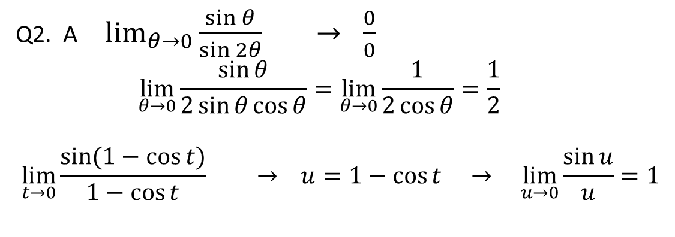
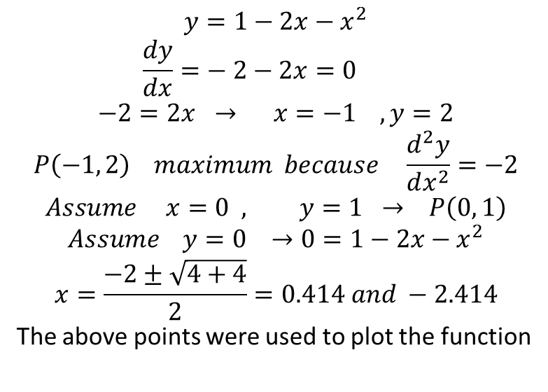
$$y=1−2x−x^{2}$$
$$\frac{dy}{dx}=− 2−2x=0$$
$$−2=2x → x=−1 , y=2$$
$$P\left(−1, 2\right) maximum because \frac{d^{2}y}{dx^{2}}=−2$$
$$Assume x=0 , y=1 → P\left(0, 1\right)$$
$$Assume y=0 →0=1−2x−x^{2}$$
$$x=\frac{−2±\sqrt{4+4}}{2}=0.414 and −2.414$$
The above points were used to plot the function
2
0,1
-2.414, 0
-1
0.414, 0
Q2. A $\lim_{θ→0}{\frac{\sin{θ}}{\sin{2θ}} → \frac{0}{0}}$
$$\lim_{θ→0}{\frac{\sin{θ}}{2\sin{θ\cos{θ}}}=\lim_{θ→0}{\frac{1}{2\cos{θ}}=\frac{1}{2} }}$$
$$\lim_{t→0}{\frac{\sin{(1−\cos{t)}}}{1−\cos{t}}} → u=1−\cos{t → \lim_{u→0}{\frac{\sin{u}}{u}=1}}$$

Slide 3
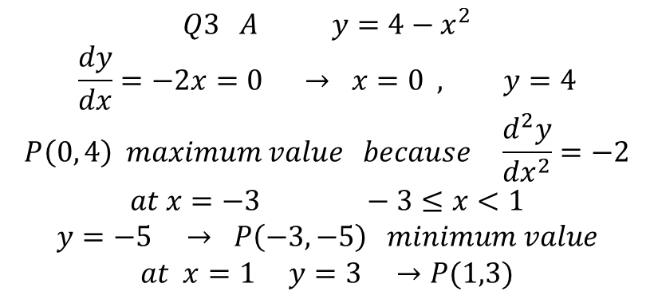
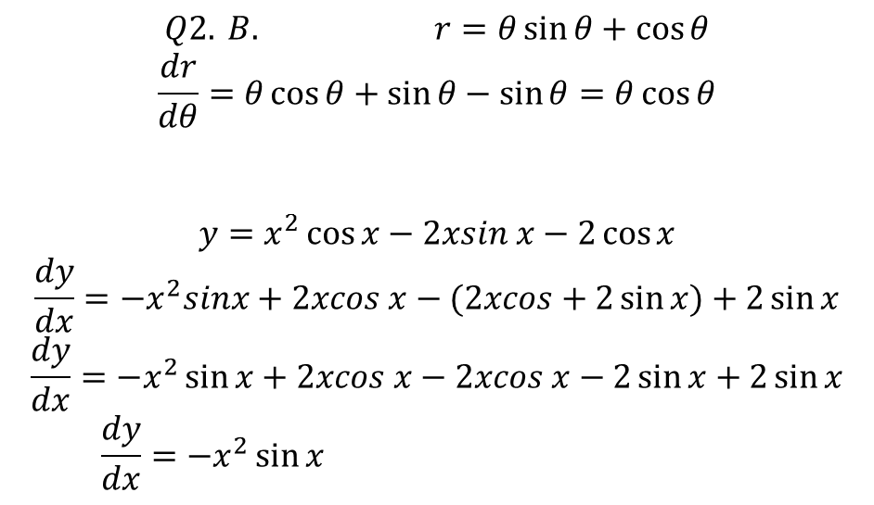
$$Q2. B. r=θ\sin{θ+\cos{θ}}$$
$$\frac{dr}{dθ}=θ\cos{θ+\sin{θ−\sin{θ=θ\cos{θ}}}}$$
$$y=x^{2}\cos{x−2xsin x−2\cos{x}}$$
$$\frac{dy}{dx}=−x^{2}sinx+2xcos x−(2xcos+2\sin{x)+2\sin{x}}$$
$$\frac{dy}{dx}=−x^{2}\sin{x+2xcos x−2xcos x−2\sin{x+2\sin{x}}}$$
$$\frac{dy}{dx}=−x^{2}\sin{x }$$
$$Q3 A y=4−x^{2}$$
$$\frac{dy}{dx}=−2x=0 → x=0 , y=4$$
$$P\left(0, 4\right) maximum value because \frac{d^{2}y}{dx^{2}}=−2$$
$$at x=−3 −3≤x<1$$
$$y=−5 → P\left(−3, −5\right) minimum value$$
$$at x=1 y=3 →P(1,3)$$
0, 4
1, 3
-3,-5

Slide 4

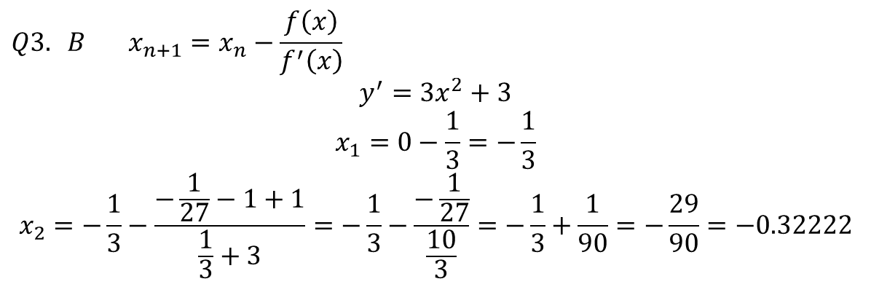


$$Q3. B x_{n+1}=x_{n}−\frac{f\left(x\right)}{f^{′}\left(x\right)}$$
$$y^{′}=3x^{2}+3$$
$$x_{1}=0−\frac{1}{3}=−\frac{1}{3}$$
$$x_{2}=−\frac{1}{3}−\frac{−\frac{1}{27}−1+1}{\frac{1}{3}+3}=−\frac{1}{3}−\frac{−\frac{1}{27}}{\frac{10}{3}}=−\frac{1}{3}+\frac{1}{90}=−\frac{29}{90}=−0.32222$$
$$Q4. A A=\int_{0}^{1}{xdy}$$
$$=\int_{0}^{1}{\left(y^{2}−y^{3}\right)dy}$$
$$={\left[\frac{y^{3}}{3}−\frac{y^{4}}{4}\right]}_{0}^{1}$$
$$=\frac{1}{3}−\frac{1}{4}=\frac{1}{12}$$
$$x=y^{3}$$
$$x=y^{2}$$

Slide 5
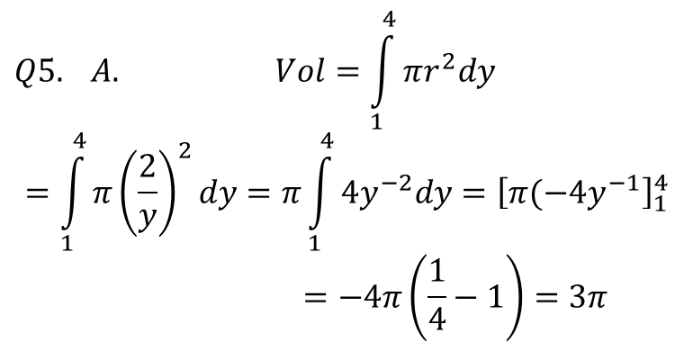
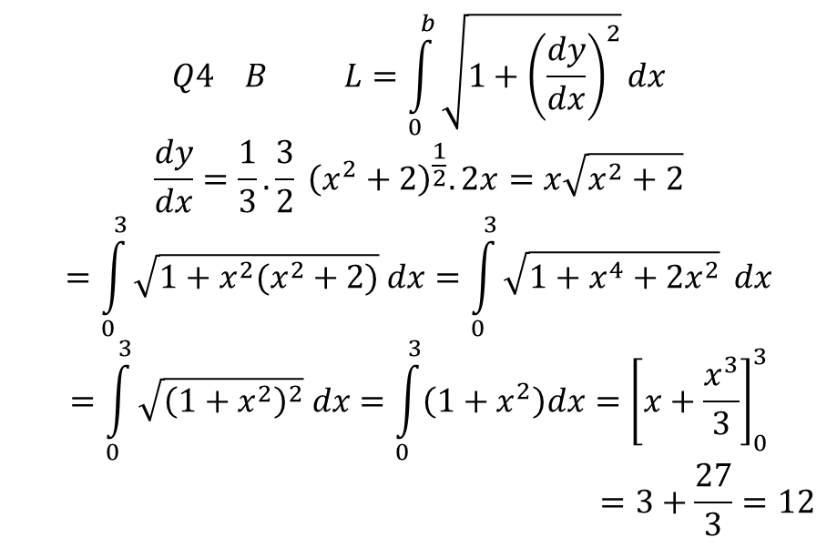
$$Q4 B L=\int_{0}^{b}{\sqrt{1+{\left(\frac{dy}{dx}\right)}^{2}}}dx$$
$$\frac{dy}{dx}=\frac{1}{3}. \frac{3}{2} {\left(x^{2}+2\right)}^{\frac{1}{2}}. 2x=x\sqrt{x^{2}+2}$$
$$=\int_{0}^{3}{\sqrt{1+x^{2}(x^{2}+2)} dx=\int_{0}^{3}{\sqrt{1+x^{4}+2x^{2}}}} dx$$
$$=\int_{0}^{3}{\sqrt{{\left(1+x^{2}\right)}^{2}} dx=\int_{0}^{3}{\left(1+x^{2}\right)dx={\left[x+\frac{x^{3}}{3}\right]}_{0}^{3}}}$$
$$=3+\frac{27}{3}=12$$
$$Q5. A. Vol=\int_{1}^{4}{πr^{2}dy}$$
$$=\int_{1}^{4}{π{\left(\frac{2}{y}\right)}^{2}dy=π\int_{1}^{4}{4y^{−2}dy={\left[π(−4y^{−1}\right]}_{1}^{4}}}$$
$$=−4π\left(\frac{1}{4}−1\right)=3π$$

Slide 6
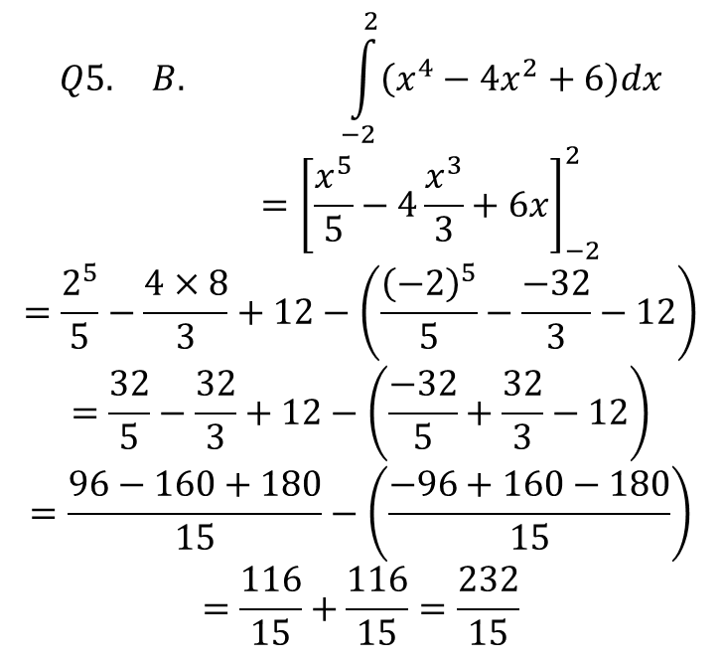
$$Q5. B. \int_{−2}^{2}{\left(x^{4}−4x^{2}+6\right)dx}$$
$$={\left[\frac{x^{5}}{5}−4\frac{x^{3}}{3}+6x\right]}_{−2}^{2}$$
$$=\frac{2^{5}}{5}−\frac{4×8}{3}+12−\left(\frac{{\left(−2\right)}^{5}}{5}−\frac{−32}{3}−12\right)$$
$$=\frac{32}{5}−\frac{32}{3}+12−\left(\frac{−32}{5}+\frac{32}{3}−12\right)$$
$$=\frac{96−160+180}{15}−\left(\frac{−96+160−180}{15}\right)$$
$$=\frac{116}{15}+\frac{116}{15}=\frac{232}{15}$$

