Slide 1
Fluid Mechanics
Bernoullis Equation
Highway and Transportation Engineering
Mustansiriyah University
Second Year
2021-2022
Asst. Prof. Nidaa A. Jasim Dr. Rana Amir Yousif

Slide 2
Syllabus:
Introduction:
Properties of fluids
Archimedes theory.
Atmosphere and gage pressure, measuring the fluid pressure on a point
Calculating the fluid force on gates, dams.
Forces consideration in fluids on inclined surfaces.
Fluids in motion (Continuity & Bernoullis equations).
Flow in pipeline (pressure, velocity, head).
Methods for connecting the pipelines.
Classification of channels at roads

Slide 3
References
Fluid mechanics, Victor L. Streeter E. Bemjamin Wylie 7th edition ,Mc Graw Hill, 1979.
Fluid Mechanics with Applications ANTHONY ESPOSITO Prentice Hall-1998

Slide 4
Bernoullis equation
Bernoullis Equation is based on the conservation of Energy Law, which states that energy can be neither created nor destroyed. The total energy possessed by a given mass of fluid can be considered to consist of three type: Potential, Kinetic and flow Energy.
Fig.3 shows fluid flowing from left to right, the total energy by a given weight w of fluid entering CV at sta.1 and the same weight of fluid leaving CV at sta.2.

Slide 5
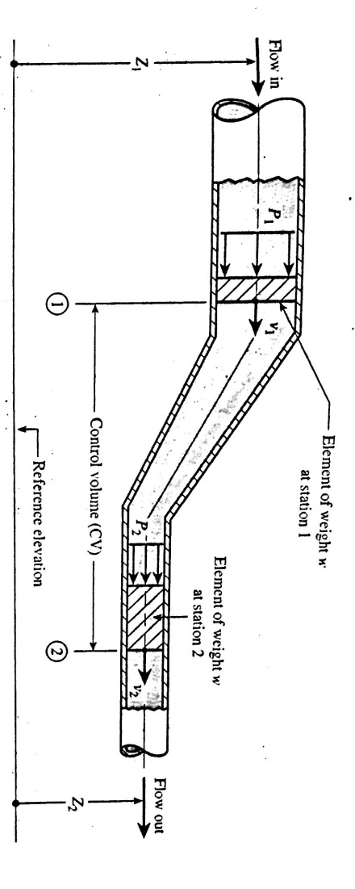
Fig.3

Slide 6
الطاقــة الكامنــة Potential Energy:
The fluid element of weight w has a potential energy due to its elevation Z related to a reference plane.
PE= wz
الطاقــة الحركيــة Kinetic Energy:
The fluid element of weight w moving with a velocity.
KE=$\frac{1}{2}$ mv2

Slide 7
الطاقــة الجريــــان Flow Energy:
It is the amount of work that pressure accomplishes by pushing the element of weight w at sta.1 into the CV or pushing the element of weight w at sta.2 out of CV.
FE= $\frac{Pw}{γ}$

Slide 8
Statement of Bernoullis Equation:
Daniel Bernoulli an eighteen century Swiss scientist, formulated his equation by noting that the total energy possessed by the fluid in CV does not change with respect to time.
Total energy in element at 1 = Total energy in element at 2
(PE+KE+FE)1=(PE+KE+FE)2
wZ₁+$\frac{1}{2}\frac{w}{g}$v₁²+$\frac{P _{1 W}}{γ}$= wZ₂ +$\frac{1}{2}\frac{w}{g}v{ _{2}}^{2}+\frac{P _{2}}{γ}w$ (divide by w)
Z₁+$\frac{v _{1} ^{2}}{2g}+\frac{P _{1}}{γ}$ = Z₂ +$\frac{v{ _{2}}^{2}}{2g}+\frac{P _{2}}{γ}$

Slide 9
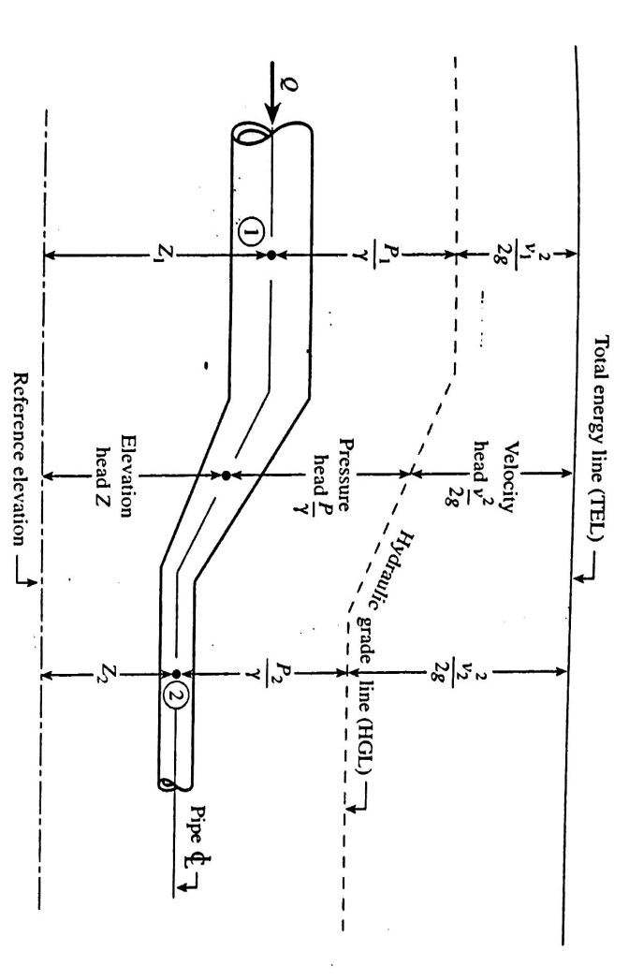

$\frac{P _{1}}{γ}+\frac{v _{1} ^{2}}{2g}+$ Z₁ = $\frac{P _{2}}{γ}$ $\frac{v{ _{2}}^{2}}{2g}+$ Z₂
Z: elevation head.
$\frac{P}{γ}$: pressure head.
$$\frac{v{ _{2}}^{2}}{2g}:velocity head$$
Fig.4

Slide 10
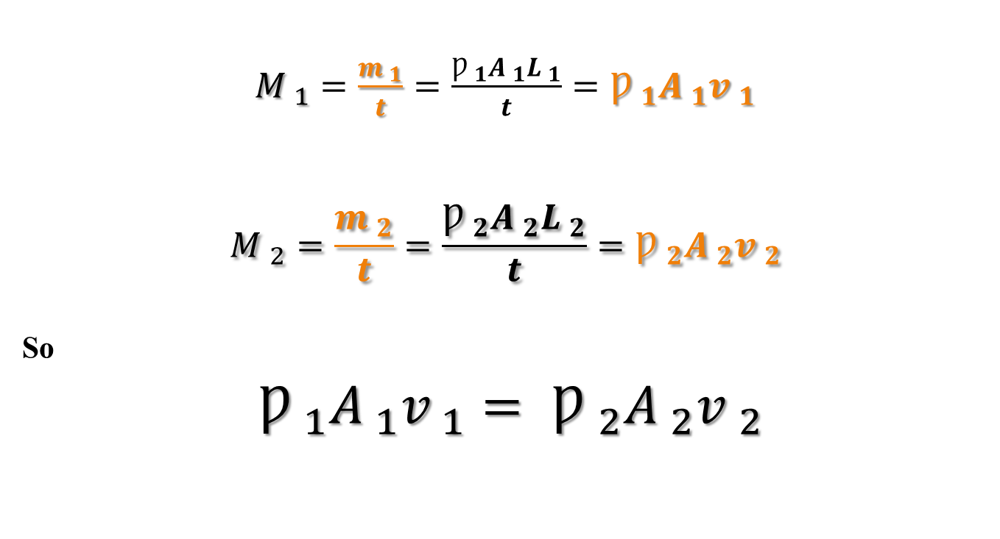
Properties of Fluids
$M _{1}=\frac{m _{1}}{t}=\frac{Ƿ _{1}A _{1}L _{1}}{t}=Ƿ _{1}A _{1}v _{1}$
$$M _{2}=\frac{m _{2}}{t}=\frac{Ƿ _{2}A _{2}L _{2}}{t}=Ƿ _{2}A _{2}v _{2}$$
So
$Ƿ _{1}A _{1}v _{1}= Ƿ _{2}A _{2}v _{2}$

Slide 11
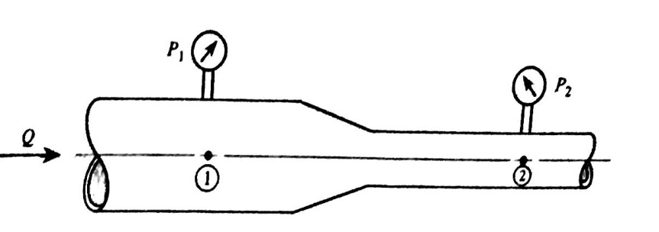
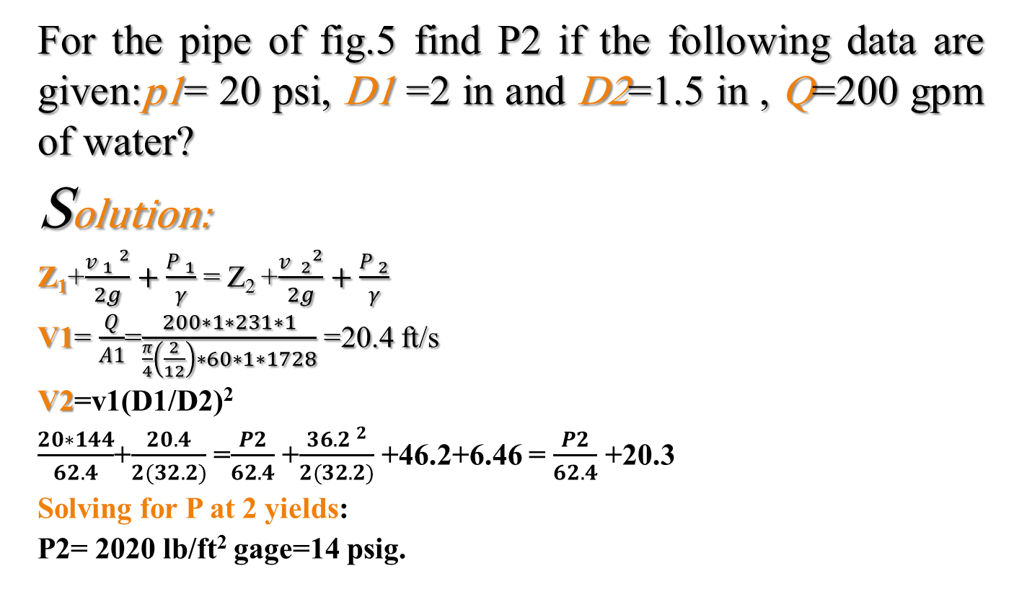
Example 5
For the pipe of fig.5 find P2 if the following data are given:p1= 20 psi, D1 =2 in and D2=1.5 in , Q=200 gpm of water?
Solution:
Z₁+$\frac{v _{1} ^{2}}{2g}+\frac{P _{1}}{γ}$ = Z₂ +$\frac{v{ _{2}}^{2}}{2g}+\frac{P _{2}}{γ}$
V1= $\frac{Q}{A1}$=$\frac{200∗1∗231∗1}{\frac{π}{4}\left(\frac{2}{12}\right)∗60∗1∗1728}$ =20.4 ft/s
V2=v1(D1/D2)²
$\frac{20∗144}{62.4}$+$\frac{20.4}{2(32.2)}$ =$\frac{P2}{62.4}$ +$\frac{36.2 ^{2}}{2(32.2)}$ +46.2+6.46 = $\frac{P2}{62.4}$ +20.3
Solving for P at 2 yields:
P2= 2020 lb/ft² gage=14 psig.
Fig.5

Slide 12
Thanks For Attention

