Slide 1
Fluid Mechanics
Introduction
Highway and Transportation Engineering
Mustansiriyah University
Second Year
2021-2022
Asst. Prof. Nidaa A. Jasim Dr. Rana Amir Yousif

Slide 2
Syllabus:
Introduction:
Properties of fluids
Archimedes theory.
Atmosphere and gage pressure, measuring the fluid pressure on a point
Calculating the fluid force on gates, dams.
Forces consideration in fluids on inclined surfaces.
Fluids in motion (Continuity & Bernoullis equations).
Flow in pipeline (pressure, velocity, head).
Methods for connecting the pipelines.
Classification of channels at roads

Slide 3
References
Fluid mechanics, Victor L. Streeter E. Bemjamin Wylie 7th edition ,Mc Graw Hill, 1979.
Fluid Mechanics with Applications ANTHONY ESPOSITO Prentice Hall-1998

Slide 4
Fluids in motion (Continuity & Bernoullis Equations).
Fluid in motion : The behavior of fluid in motion is very complex due to the large number of variables involved. Since viscosity introduces a great complexity to fluid flow behavior, we assume the fluid is an ideal one, this means no viscosity and no shear stress as it flows. We also assume incompressible flow التدفق غير القابل للضغط which mean that the density of fluid does not change throughout the system.

Slide 5
Properties of Flow:
Steady Flow: when there is no change in flow properties(Q, v, h) with time.
Unsteady flow: when there is change in flow properties with time.
Uniform flow: when there is no change in fluid properties with distance.
Non-uniform flow(2D): flow with two directions (x,y) and velocity distribution become parabola section with maximum value at the center and minimum at the wall of pipe.
Three-dimensions flow(3D): flow with 3 directions (x, y, z) as flow through orifice.

Slide 6
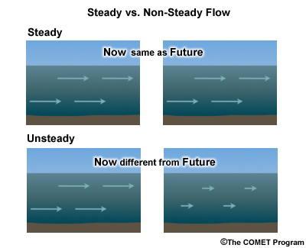
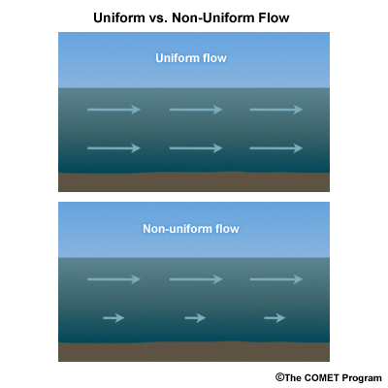

Slide 7
The Continuity Equation
This theorem state that the mass can neither be created nor destroyed. For steady flow the rate which mass enters a control volume equals the rate at which mass leaves this volume. in fig.1, fluid is flowing from left to right the pipe has two different size (A1 and A2) the volume between 1 and 2 is the control volume (CV), the rate at which the mass enter equals the rate at which the mass leaves CV.

Slide 8
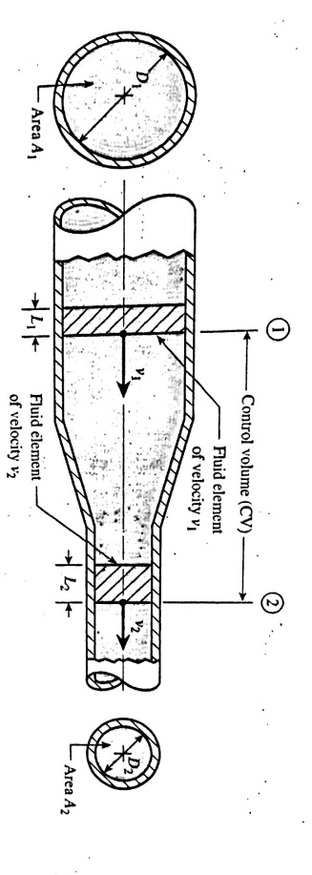
Maas Flow Rate
From fig.1 let M represent the rate at which mass enter or leave the CV, we have M1=M2, thus for steady flow the mass flow rate at the inlet to the CV equals mass flow rate at the exit from the CV.
Fig.1

Slide 9
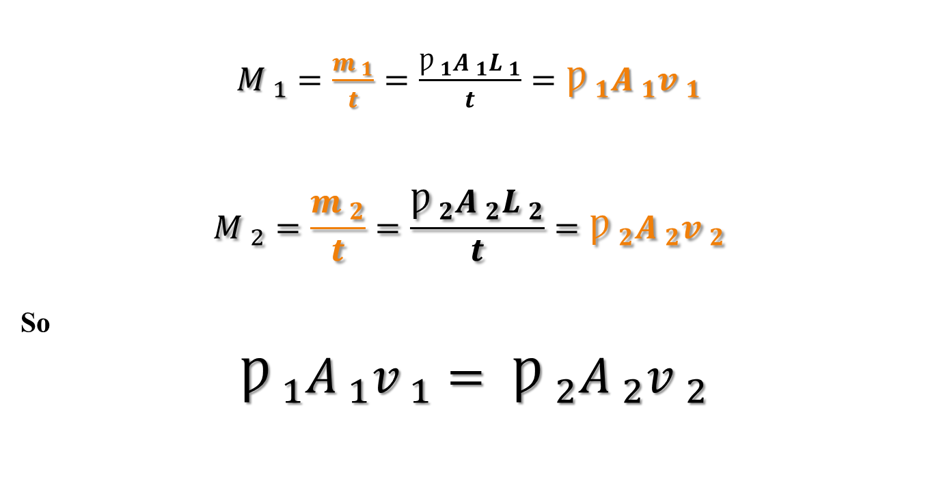
Properties of Fluids
$M _{1}=\frac{m _{1}}{t}=\frac{Ƿ _{1}A _{1}L _{1}}{t}=Ƿ _{1}A _{1}v _{1}$
$$M _{2}=\frac{m _{2}}{t}=\frac{Ƿ _{2}A _{2}L _{2}}{t}=Ƿ _{2}A _{2}v _{2}$$
So
$Ƿ _{1}A _{1}v _{1}= Ƿ _{2}A _{2}v _{2}$

Slide 10
Weight Flow Rate
Since specific weight equals times the acceleration of gravity (γ=Ƿ*g)
The continuity equation shows that we also have equality of weight flow rates entering and leaving the CV,
W1=W2
γ ₁A ₁v₁= γ ₁A ₁v ₁

Slide 11
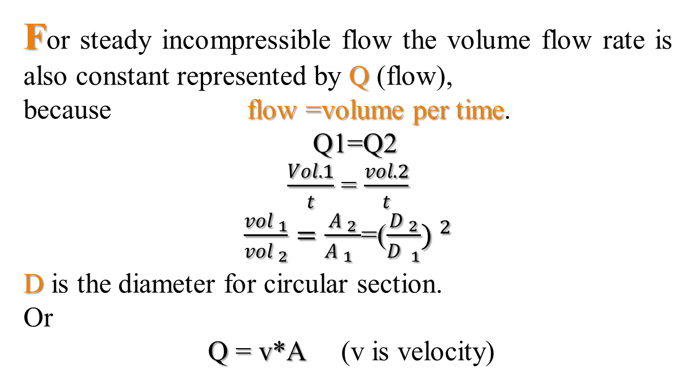
Volume Flow Rate
For steady incompressible flow the volume flow rate is also constant represented by Q (flow),
because flow =volume per time.
Q1=Q2
$\frac{Vol.1}{t}$ = $\frac{vol.2}{t}$
$\frac{vol _{1}}{vol _{2}}=\frac{A _{2}}{A _{1 _{ }}}$=($\frac{D _{2}}{D _{1}}) ^{2}$
D is the diameter for circular section.
Or
Q = v*A (v is velocity)

Slide 12
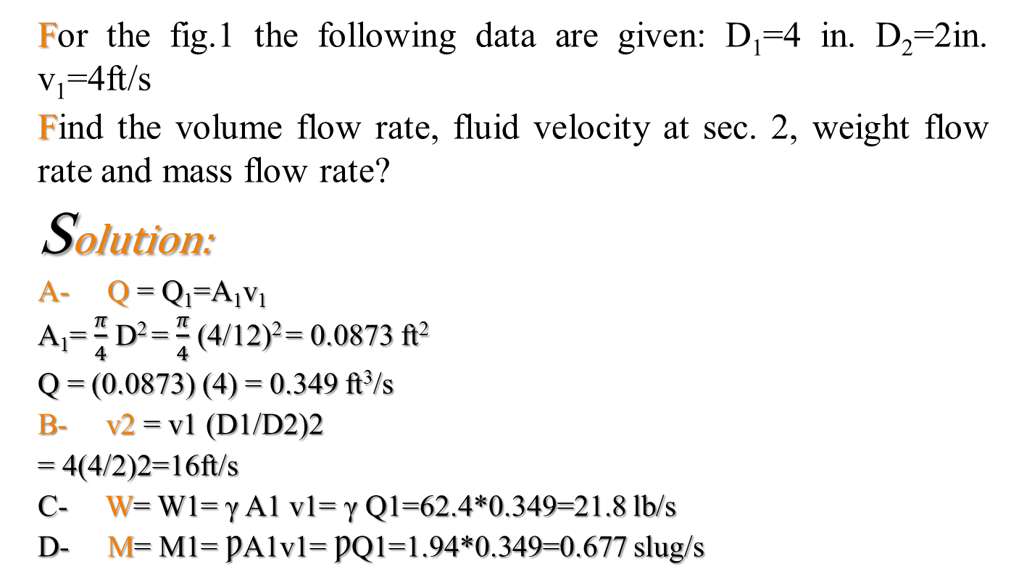
Example 1
For the fig.1 the following data are given: D₁=4 in. D₂=2in. v₁=4ft/s
Find the volume flow rate, fluid velocity at sec. 2, weight flow rate and mass flow rate?
Solution:
A- Q = Q₁=A₁v₁
A₁= $\frac{π}{4}$ D² = $\frac{π}{4}$ (4/12)² = 0.0873 ft²
Q = (0.0873) (4) = 0.349 ft³/s
B- v2 = v1 (D1/D2)2
= 4(4/2)2=16ft/s
C- W= W1= γ A1 v1= γ Q1=62.4*0.349=21.8 lb/s
D- M= M1= ǷA1v1= ǷQ1=1.94*0.349=0.677 slug/s

Slide 13
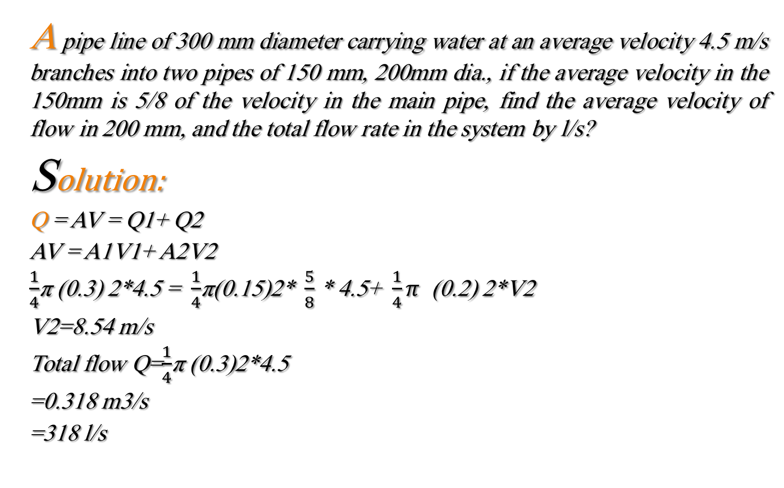
Example 2
A pipe line of 300 mm diameter carrying water at an average velocity 4.5 m/s branches into two pipes of 150 mm, 200mm dia., if the average velocity in the 150mm is 5/8 of the velocity in the main pipe, find the average velocity of flow in 200 mm, and the total flow rate in the system by l/s?
Solution:
Q = AV = Q1+ Q2
AV = A1V1+ A2V2
$\frac{1}{4}$π (0.3) 2*4.5 = $\frac{1}{4}$π(0.15)2* $\frac{5}{8}$ * 4.5+ $\frac{1}{4}π$ (0.2) 2*V2
V2=8.54 m/s
Total flow Q=$\frac{1}{4}$π (0.3)2*4.5
=0.318 m3/s
=318 l/s

Slide 14
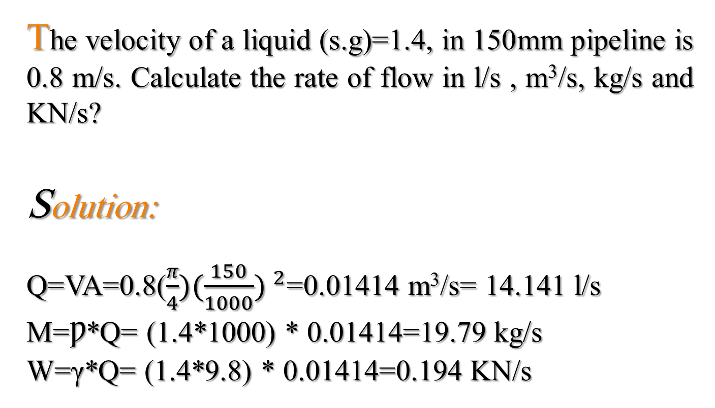
Example 3
The velocity of a liquid (s.g)=1.4, in 150mm pipeline is 0.8 m/s. Calculate the rate of flow in l/s , m³/s, kg/s and KN/s?
Solution:
Q=VA=0.8($\frac{π}{4})(\frac{150}{1000}) ^{2}$=0.01414 m³/s= 14.141 l/s
M=Ƿ*Q= (1.4*1000) * 0.01414=19.79 kg/s
W=γ*Q= (1.4*9.8) * 0.01414=0.194 KN/s

Slide 15
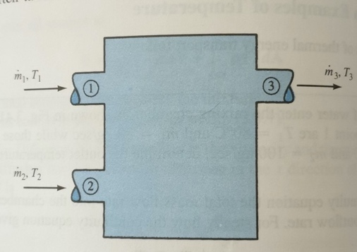
Example 4
(fig. 2) Two stream of water enter the mixing chamber if the inlet velocity 80 kg/sec. and find the outlet mass flow? And outlet weight flow?
Solution:
Total mass flow rate= m₁+m₂
80 +100 =180 kg/sec.
W = mass * g
180 * g =180 * 9.8 = 1764 N/sec
Fig. 2

Slide 16
Thanks For Attention

