Slide 1

Fluid Mechanics Lectures
2nd year/2nd semester/2019-2020/Al-Mustansiriyah unv./College of engineering/Highway &Transportation Dep.Lec.1

Slide 2
.
Fluid in motion
The behavior of fluid in motion is very complex due to the large number of variable involved. Since viscosity introduces a great complexity to fluid flow behavior, we assume the fluid is an ideal one, this mean no viscosity and no shear stress as it flow. We also assume incompressible flow which mean that the density of fluid does not change throughout the system.
Q( flow )….V(velocity)…..t (time)…..A(section area)….viscosity
Properties of flow:
Steady flow: when there is no change in flow properties(Q,v,h) with time.
Unsteady flow: when there is change in flow properties with time.
Uniform flow :when there is no change in fluid properties with distance.
Non-uniform flow(2D):flow with two directions (x,y) and velocity distribution become parabola section with maximum value at the center and minimum at the wall of pipe.
Three-dimensions flow(3D): flow with 3 diractions (x, y, z)as flow through orifice.

Slide 3
The continuity equation
This theorem state that the mass can neither be created nor destroyed . For steady flow the rate which mass enters a control volume equals the rate at which mass leaves this volume . in fig.1, fluid is flowing from left to right the pipe has two different size (A1 and A2) the volume between 1 and 2 is the control volume (CV), the rate at which the mass enter equals the rate at which the mass leaves CV.
.

Slide 4
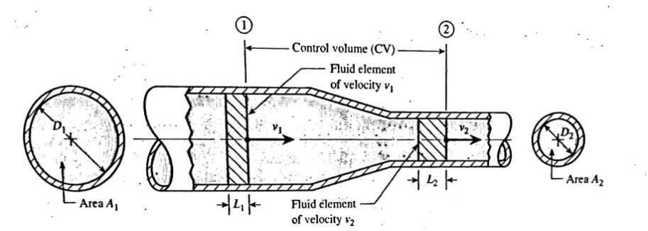
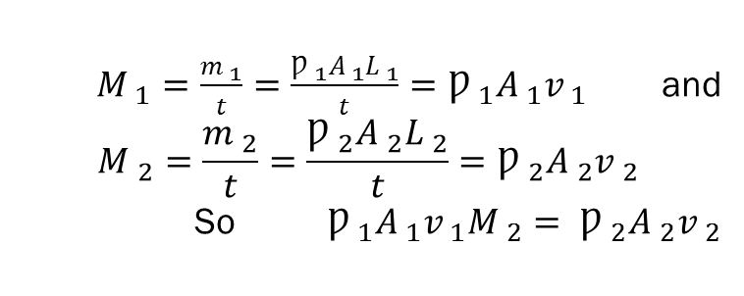
Maas flow rate
From fig.1 let M represent the rate at which mass enter or leave the CV , we have M1=M2, thus for steady flow the mass flow rate at the inlet to the CV equals mass flow rate at the exit from the CV.
$M _{1}=\frac{m _{1}}{t}=\frac{Ƿ _{1}A _{1}L _{1}}{t}=Ƿ _{1}A _{1}v _{1}$ and
$$M _{2}=\frac{m _{2}}{t}=\frac{Ƿ _{2}A _{2}L _{2}}{t}=Ƿ _{2}A _{2}v _{2}$$
So $Ƿ _{1}A _{1}v _{1}M _{2}= Ƿ _{2}A _{2}v _{2}$

Slide 5
Weight flow rate
Since specific weight equals times the acceleration of gravity(γ=Ƿ*g)
The continuity equation shows that we also have equality of weight flow rates entering and leaving the CV, W1=W2
γ ₁A ₁v₁=γ ₁A ₁v ₁

Slide 6
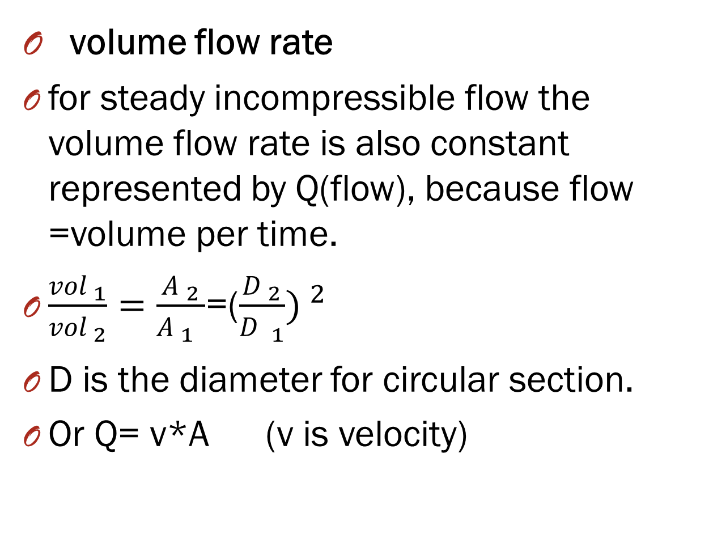
volume flow rate
for steady incompressible flow the volume flow rate is also constant represented by Q(flow), because flow =volume per time.
$\frac{vol _{1}}{vol _{2}}=\frac{A _{2}}{A _{1 _{ }}}$=($\frac{D _{2}}{D _{1}}) ^{2}$
D is the diameter for circular section.
Or Q= v*A (v is velocity)
-

Slide 7

Examples:
Ex1:
For the fig.1 the following data are given:D₁=4 in. D₂=2in. v₁=4ft/s
Find the volume flow rate, fluid velocity at sec. 2 , weight flow rate and mass flow rate?
Q=Q₁=A₁v₁
A₁=$\frac{π}{4}$D²=$\frac{π}{4}$(4/12)²=0.0873 ft²
Q=(0.0873)(4)=0.349 ft³/s
b-v₁₌v₂(D₁/D₂)²
=4(4/2)²=16ft/s
c-W=W₁=γ A₁ v₁=γ Q₁=62.4*0.349=21.8 lb/s
d-M=M₁=ǷA₁v₁=ǷQ₁=1.94*0.349=0.677 slug/s

Slide 8
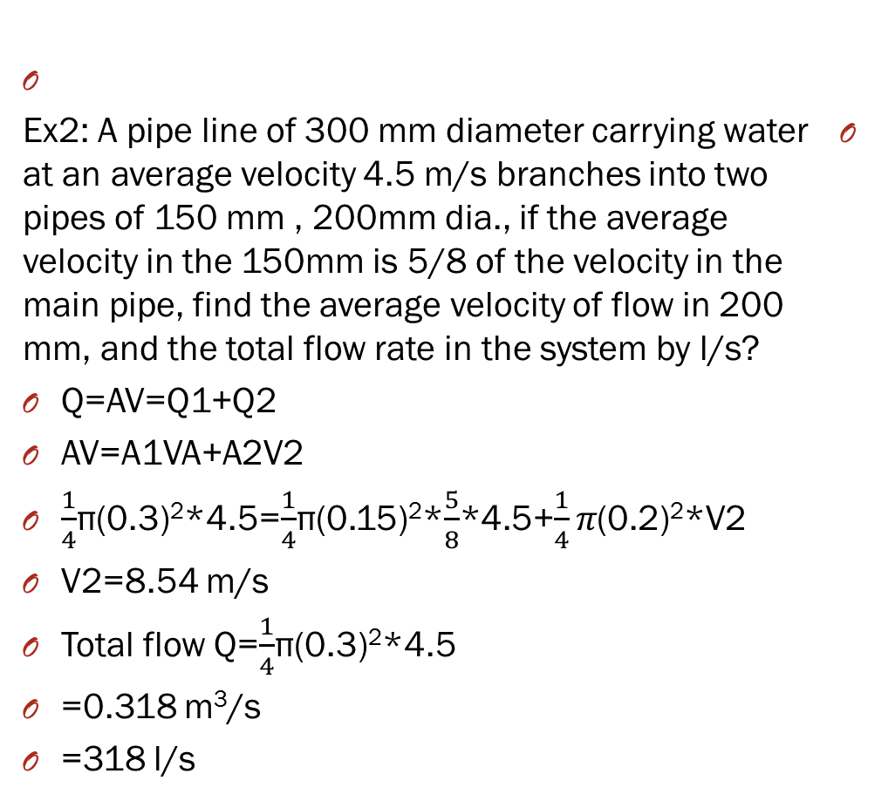
Ex2: A pipe line of 300 mm diameter carrying water at an average velocity 4.5 m/s branches into two pipes of 150 mm , 200mm dia., if the average velocity in the 150mm is 5/8 of the velocity in the main pipe, find the average velocity of flow in 200 mm, and the total flow rate in the system by l/s?
Q=AV=Q1+Q2
AV=A1VA+A2V2
$\frac{1}{4}$π(0.3)²*4.5=$\frac{1}{4}$π(0.15)²*$\frac{5}{8}$*4.5+$\frac{1}{4}π$(0.2)²*V2
V2=8.54 m/s
Total flow Q=$\frac{1}{4}$π(0.3)²*4.5
=0.318 m³/s
=318 l/s

Slide 9

.
Ex3:
The velocity of a liquid (s.g)=1.4, in 150mm pipeline is 0.8 m/s. Calculate the rate of flow in l/s , m³/s, kg/s and KN/s?
Q=VA=0.8($\frac{π}{4})(\frac{150}{1000}) ^{2}$=0.01414 m³/s= 14.141 l/s
M=Ƿ*Q=(1.4*1000)*0.01414=19.79 kg/s
W=γ*Q=(1.4*9.8)*0.01414=0.194 KN/s
.

Slide 10

Thanks

