Slide 1
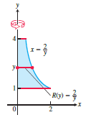
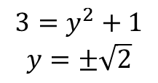

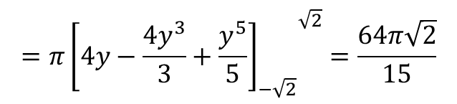
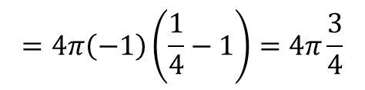
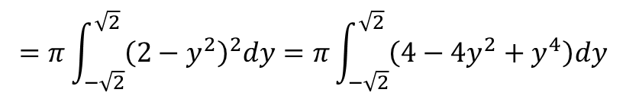
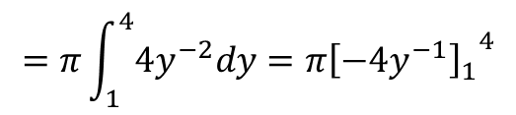
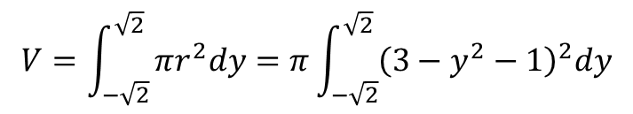
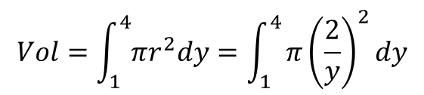
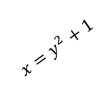
Example: Find the volume of the solid generated by revolving the region between y-axis
and the curve $x=\frac{2}{y} , 1≤y≤4$ about y-axis.
$$Vol=\int_{1}^{4}{πr^{2}dy}=\int_{1}^{4}{π{\left(\frac{2}{y}\right)}^{2}dy}$$
$$=π\int_{1}^{4}{4y^{−2}dy={{π\left[−4y^{−1}\right]}_{1}}^{4}}$$
$$=4π\left(−1\right)\left(\frac{1}{4}−1\right)=4π\frac{3}{4}$$
$$=3π$$
Example : Find the volume of the solid generated by revolving the region between the
parabola $x=y^{2}+1$ and the line $x=3$ about the line $x=3$
$$V=\int_{−\sqrt{2}}^{\sqrt{2}}{πr^{2}dy=π\int_{−\sqrt{2}}^{\sqrt{2}}{{\left(3−y^{2}−1\right)}^{2}dy}}$$
$$3=y^{2}+1$$
$$y=±\sqrt{2}$$
$$x=y^{2}+1$$
$$=π\int_{−\sqrt{2}}^{\sqrt{2}}{{\left(2−y^{2}\right)}^{2}dy=π\int_{−\sqrt{2}}^{\sqrt{2}}{\left(4−4y^{2}+y^{4}\right)dy}}$$
1
$$=π{{\left[4y−\frac{4y^{3}}{3}+\frac{y^{5}}{5}\right]}_{−\sqrt{2}}}^{\sqrt{2}}=\frac{64π\sqrt{2}}{15}$$
X=3

Slide 2

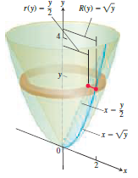
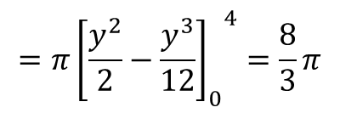
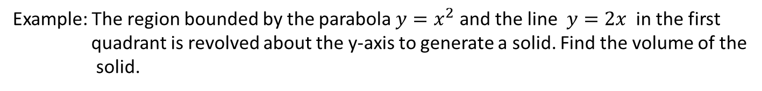
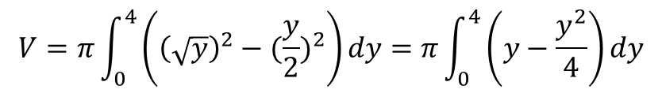



Washer method
If the region we revolve to generate a solid does not border on or cross the axis of revolution
, the solid has a hole. The cross sections are washers instead of disks.
Example: The region bounded by the parabola $y=x^{2}$ and the line $y=2x$ in the first
quadrant is revolved about the y-axis to generate a solid. Find the volume of the
solid.
$y=$2x
$$2x=x^{2} → x^{2}−2x=0$$
$$y=x^{2}$$
$$x\left(x−2\right)=0 → x=0, x=2$$
$$V=π\int_{0}^{4}{\left({\left(\sqrt{y}\right)}^{2}−({\frac{y}{2})}^{2}\right)dy=π\int_{0}^{4}{\left(y−\frac{y^{2}}{4}\right)}}dy$$
$$=π{{\left[\frac{y^{2}}{2}−\frac{y^{3}}{12}\right]}_{0}}^{4}=\frac{8}{3}π$$

Slide 3

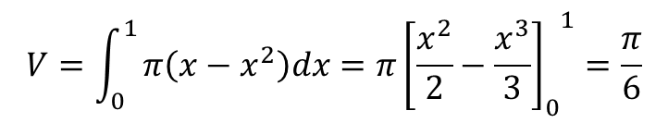

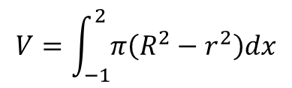
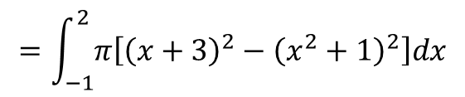


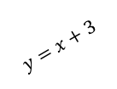

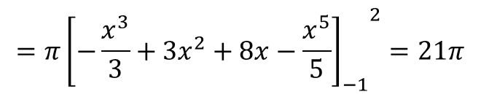
Example: Find the volume generated by revolving the area enclosed by $y=x^{2}+1 , y=x+3$
about the x-axis
$$x^{2}+1=x+3$$
$$y=x^{2}+1$$
$$V=\int_{−1}^{2}{π\left(R^{2}−r^{2}\right)dx}$$
$$x^{2}−x−2=0$$
$$x=2, x=−1$$
$$y=x+3$$
$$=\int_{−1}^{2}{π\left[{\left(x+3\right)}^{2}−{\left(x^{2}+1\right)}^{2}\right]dx}$$
-1
2
$$=\int_{−1}^{2}{π\left[x^{2}+6x+9−x^{4}−2x^{2}−1\right]dx=\int_{−1}^{2}{π\left[−x^{2}+6x+8−x^{4}\right]dx}}$$
$$=π{{\left[−\frac{x^{3}}{3}+3x^{2}+8x−\frac{x^{5}}{5}\right]}_{−1}}^{2}=21π$$
Example: Find the volume of solid generated by revolving the region by $x=y^{2}$ and $x=y$
about the x-axis.
$$y^{2}=y → y=1, x=1$$
1,1
$$V=\int_{0}^{1}{π\left(x−x^{2}\right)dx=π{{\left[\frac{x^{2}}{2}−\frac{x^{3}}{3}\right]}_{0}}^{1}}=\frac{π}{6}$$

Slide 4
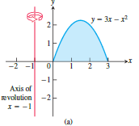
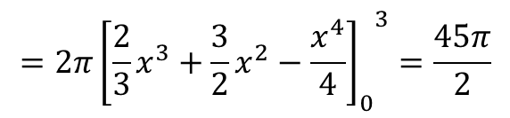
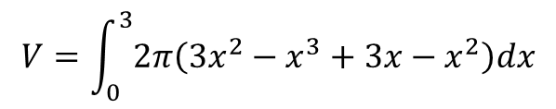
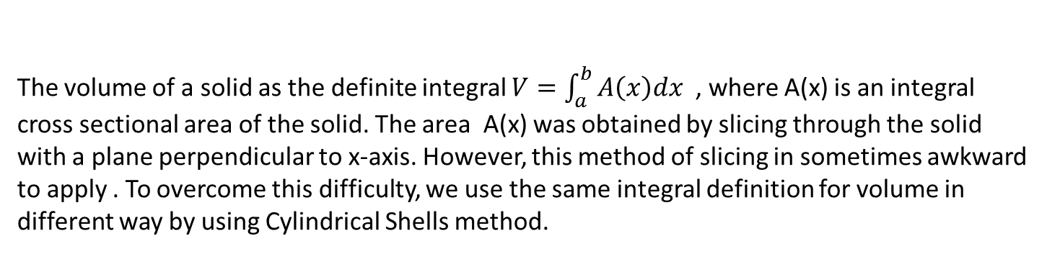
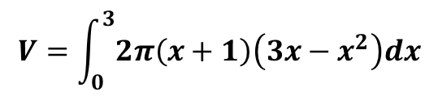
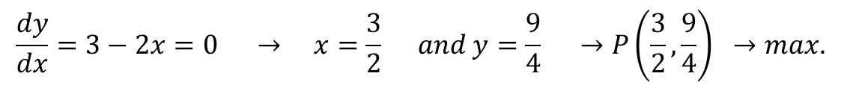

Volumes using Cylindrical Shells
The volume of a solid as the definite integral $V=\int_{a}^{b}{A\left(x\right)dx }$, where A(x) is an integral
cross sectional area of the solid. The area A(x) was obtained by slicing through the solid
with a plane perpendicular to x-axis. However, this method of slicing in sometimes awkward
to apply . To overcome this difficulty, we use the same integral definition for volume in
different way by using Cylindrical Shells method.
Example: Find the volume generated by revolving the region enclosed by the parabola
$y=3x−x^{2} about the x=−1$
$$\frac{dy}{dx}=3−2x=0 → x=\frac{3}{2} and y=\frac{9}{4} →P\left(\frac{3}{2}, \frac{9}{4}\right) →max.$$
$$3x−x^{2}=0 → x\left(3−x\right)=0 → x=0 and x=3$$
$$Area=2π×shell radius×shell height$$
-1
x
y
$$Area=2π\left(x+1\right)y$$
$$V=\int_{0}^{3}{2π\left(x+1\right)\left(3x−x^{2}\right)dx}$$
0
$$V=\int_{0}^{3}{2π\left(3x^{2}−x^{3}+3x−x^{2}\right)dx}$$
$$=2π{{\left[\frac{2}{3}x^{3}+\frac{3}{2}x^{2}−\frac{x^{4}}{4}\right]}_{0}}^{3}=\frac{45π}{2}$$

Slide 5
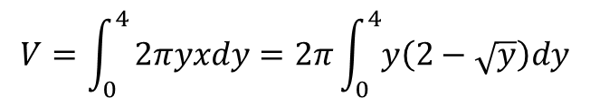

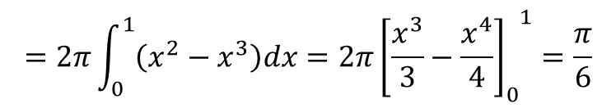
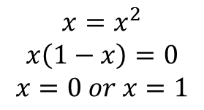
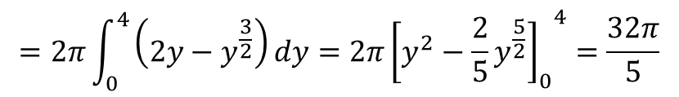
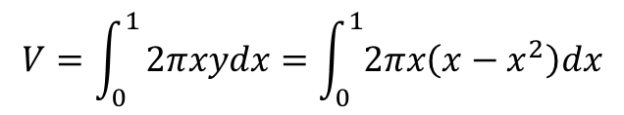
Example: Use cylindrical shell method to find the volume of the solid generated when the
region enclosed by $y=x and y=x^{2}$ is revolved about y-axis.
$$x=x^{2}$$
$$x\left(1−x\right)=0$$
$$x=0 or x=1$$
y=x
$$V=\int_{0}^{1}{2πxydx=\int_{0}^{1}{2πx\left(x−x^{2}\right)dx}}$$
x
$$y=x^{2}$$
$$=2π\int_{0}^{1}{\left(x^{2}−x^{3}\right)dx=2π{{\left[\frac{x^{3}}{3}−\frac{x^{4}}{4}\right]}_{0}}^{1}}=\frac{π}{6}$$
Example: Use Cylindrical Shell to find the volume of the solid generated when the region
under $y=x^{2}$ over the interval (0, 2) is revolved about x-axis.
$$V=\int_{0}^{4}{2πyxdy=2π\int_{0}^{4}{y\left(2−\sqrt{y}\right)dy}}$$
x
y
$$=2π\int_{0}^{4}{\left(2y−y^{\frac{3}{2}}\right)dy=2π{{\left[y^{2}−\frac{2}{5}y^{\frac{5}{2}}\right]}_{0}}^{4}}=\frac{32π}{5}$$
0
2

