Slide 1
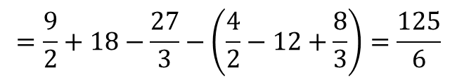


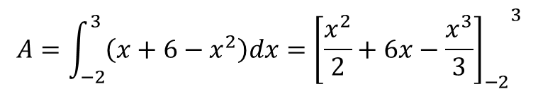
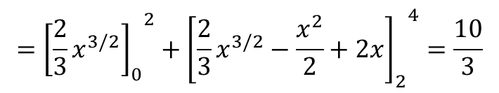


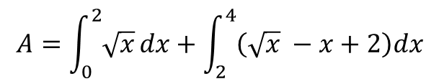




Example: Find the area between the curves $y=x^{2}$ and $y=x+6$
$$x^{2}=x+6$$
6
$$x^{2}−x−6=0 → \left(x−3\right)\left(x+2\right)=0$$
$$y=x^{2}$$
$$x=3 or x=−2$$
-6
3
-2
$$A=\int_{−2}^{3}{\left(x+6−x^{2}\right)dx}={{\left[\frac{x^{2}}{2}+6x−\frac{x^{3}}{3}\right]}_{−2}}^{3}$$
$$=\frac{9}{2}+18−\frac{27}{3}−\left(\frac{4}{2}−12+\frac{8}{3}\right)=\frac{125}{6}$$
Example: Find the area of the region in the first quadrant that is bounded by $y=\sqrt{x}$ ,
the line $y=x−2$ and the x-axis.
$$\sqrt{x}=x−2$$
$$A=A_{1}+A_{2}$$
$$x=x^{2}−4x+4$$
4, 2
$$A=\int_{0}^{2}{\sqrt{x}}dx+\int_{2}^{4}{\left(\sqrt{x} −x+2\right)dx}$$
$$x^{2}−5x+4=0$$
$$x=4, x=1$$
$$={{\left[\frac{2}{3}x^{3/2}\right]}_{0}}^{2}+{{\left[\frac{2}{3}x^{3/2}−\frac{x^{2}}{2}+2x\right]}_{2}}^{4}=\frac{10}{3}$$
2
-2

Slide 2



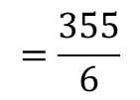


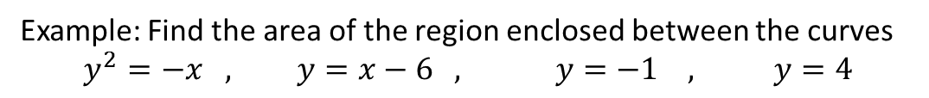

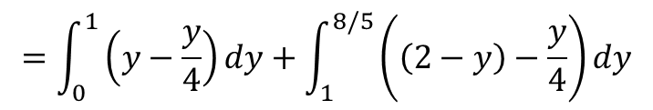
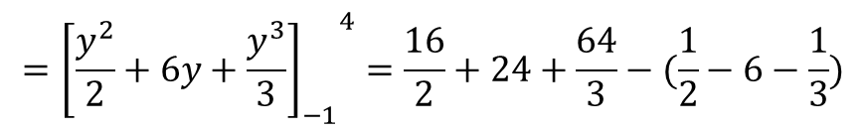

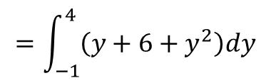



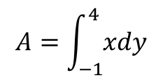

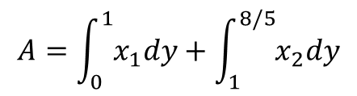
Example: Find the area of the region enclosed between the curves
$$y^{2}=−x , y=x−6 , y=−1 , y=4$$
$$A=\int_{−1}^{4}{xdy}$$
$$y=x−6$$
y= 4
$$=\int_{−1}^{4}{\left(y+6+y^{2}\right)dy}$$
$$={{\left[\frac{y^{2}}{2}+6y+\frac{y^{3}}{3}\right]}_{−1}}^{4}=\frac{16}{2}+24+\frac{64}{3}−(\frac{1}{2}−6−\frac{1}{3})$$
y= -1
$$=\frac{355}{6}$$
Example: Find the area of the region enclosed between the curves $y=x, y=4x ,$
$y=−x+2$
$$y=4x$$
$$y=x$$
$$x=−x+2$$
$$A=A1+A2$$
$$x=1, y=1$$
$$\frac{2}{5},8/5$$
$$A=\int_{0}^{1}{x_{1}dy}+\int_{1}^{8/5}{x_{2}dy}$$
$$4x=−x+2$$
A2
$$1,1$$
$$x=\frac{2}{5},y=8/5$$
A1
$$=\int_{0}^{1}{\left(y−\frac{y}{4}\right)dy+\int_{1}^{8/5}{\left(\left(2−y\right)−\frac{y}{4}\right)dy}}$$
$$y=−x+2$$

Slide 3

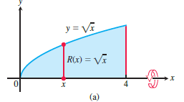
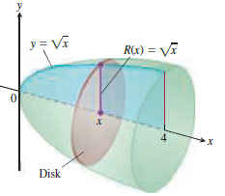
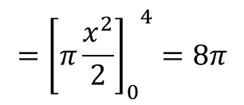

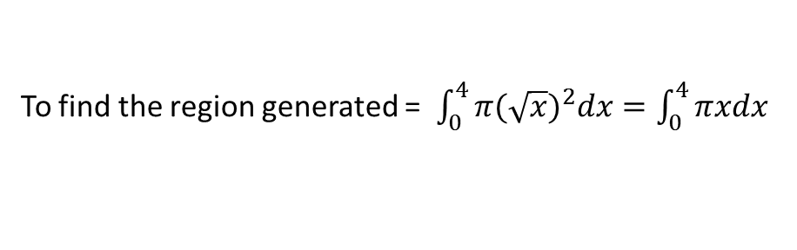
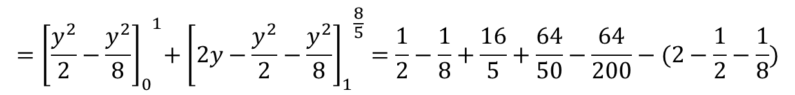
$${{=\left[\frac{y^{2}}{2}−\frac{y^{2}}{8}\right]}_{0}}^{1}+{{\left[2y−\frac{y^{2}}{2}−\frac{y^{2}}{8}\right]}_{1}}^{\frac{8}{5}}=\frac{1}{2}−\frac{1}{8}+\frac{16}{5}+\frac{64}{50}−\frac{64}{200}−(2−\frac{1}{2}−\frac{1}{8})$$
$$=\frac{3}{5}$$
Application of Integrals (Volume by revolution)
The disk method
To find the region generated = $\int_{0}^{4}{π{(\sqrt{x})}^{2}dx=\int_{0}^{4}{πxdx}}$
$$={{\left[π\frac{x^{2}}{2}\right]}_{0}}^{4}=8π$$

Slide 4
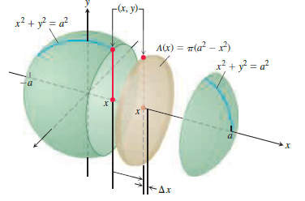


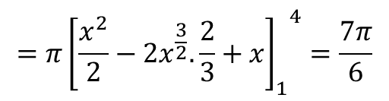
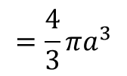
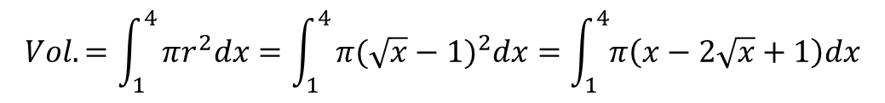
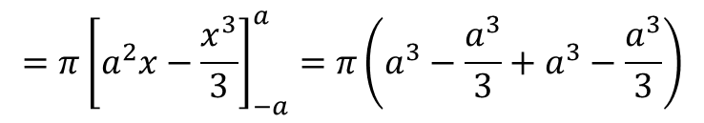


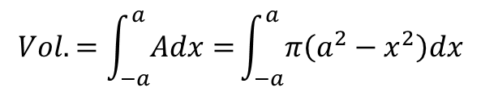


Example: The circle $x^{2}+y^{2}=a^{2}$ is rotated about the x-axis to generate a sphere. Find
its volume.
$$x^{2}+y^{2}=a^{2}$$
$$a$$
$$a$$
$$Vol.=\int_{−a}^{a}{Adx=}\int_{−a}^{a}{π\left(a^{2}−x^{2}\right)dx}$$
$$=π{\left[a^{2}x−\frac{x^{3}}{3}\right]}_{−a}^{a}=π\left(a^{3}−\frac{a^{3}}{3}+a^{3}−\frac{a^{3}}{3}\right)$$
$$=\frac{4}{3}πa^{3}$$
Example: Find the volume of the solid generated by revolving the region bounded by
$y=\sqrt{x}$ and the lines $y=1 , x=4$ about the line $y=1$
$$y=\sqrt{x}$$
$$Vol.=\int_{1}^{4}{πr^{2}dx=\int_{1}^{4}{π(\sqrt{x}−1)^{2}dx=\int_{1}^{4}{π\left(x−2\sqrt{x}+1\right)dx}}}$$
$$y=1$$
$$=π{{\left[\frac{x^{2}}{2}−2x^{\frac{3}{2}}. \frac{2}{3}+x\right]}_{1}}^{4}=\frac{7π}{6}$$
$x=$4

