Slide 1
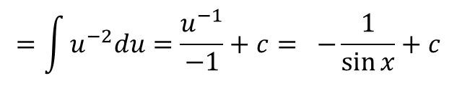


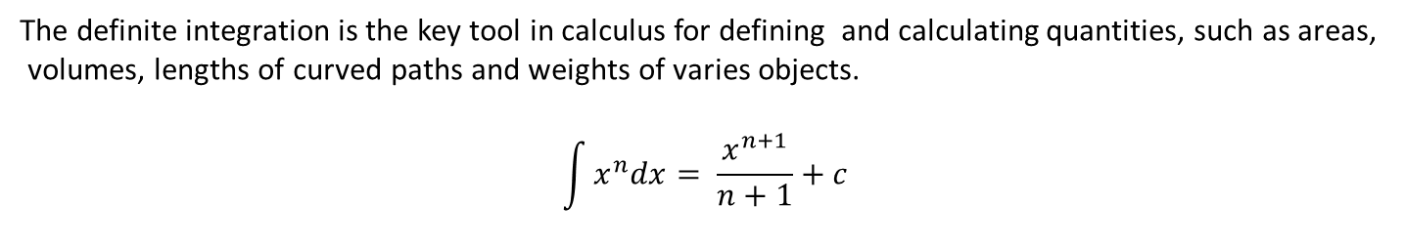
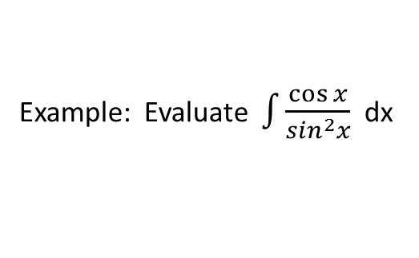
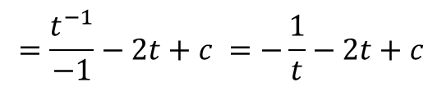
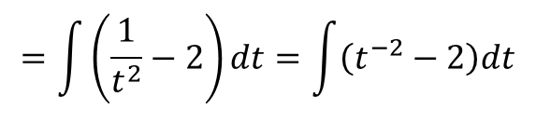
Integration
The definite integration is the key tool in calculus for defining and calculating quantities, such as areas,
volumes, lengths of curved paths and weights of varies objects.
$$\int{x^{n}dx= \frac{x^{n+1}}{n+1}+c}$$
Example: Evaluate $\int{\frac{t^{2}−2t^{4}}{t^{4}} dt}$
$$=\int{\left(\frac{1}{t^{2}}−2\right)dt=\int{\left(t^{−2}−2\right)dt}}$$
$$=\frac{t^{−1}}{−1}−2t+c =−\frac{1}{t}−2t+c$$
Example: Evaluate $\int{\frac{\cos{x}}{\sin^{2}x}}$ dx
u= sin x $→ du=\cos{x dx}$
$$=\int{u^{−2}du=\frac{u^{−1}}{−1}+c= −\frac{1}{\sin{x}}+c}$$

Slide 2
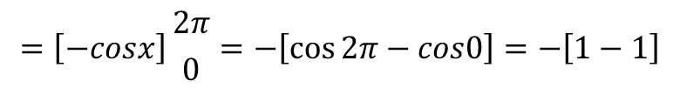
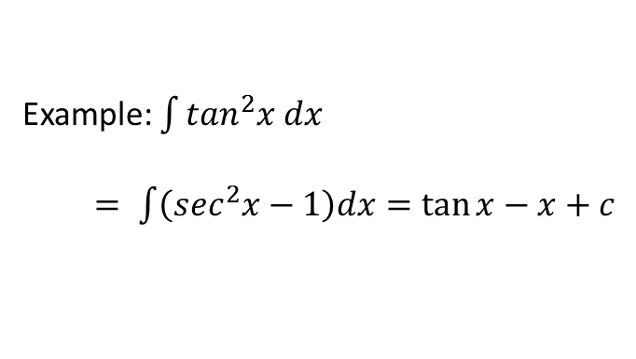
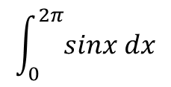
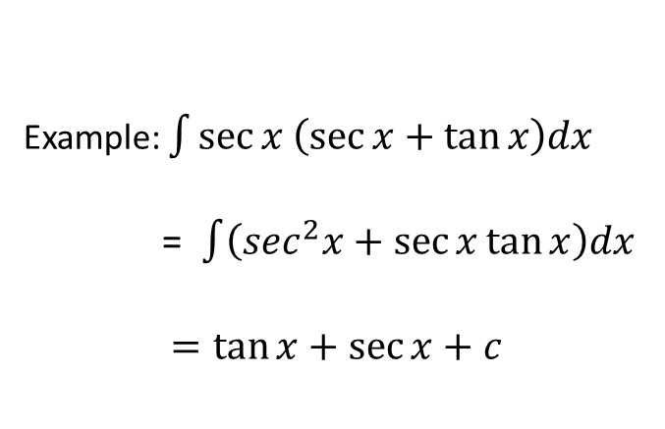


Example: $\int{\sec{x \left(\sec{x+\tan{x}}\right)dx}}$
= $\int{\left(\sec^{2}x+\sec{x\tan{x}}\right)dx}$
$$=\tan{x+\sec{x+c}}$$
Example: $\int{\tan^{2}x dx }$
$= \int{\left(\sec^{2}x−1\right)dx}=\tan{x−x+c}$
Example: Find the area between the graph of $y=sinx$ between $x=0 and x=2π$
$$\int_{0}^{2π}{sinx dx}$$
0
$$π$$
$$2π$$
$$=\left[−cosx\right]{2π \atop 0}=−\left[\cos{2π−cos0}\right]=−\left[1−1\right]$$
=0 (because the portions of the
graph above and below x-axis)

Slide 3
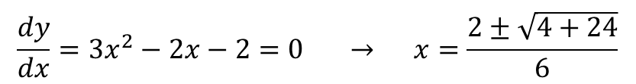
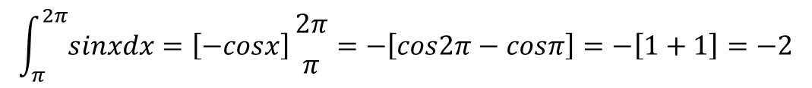
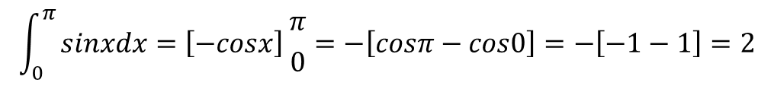
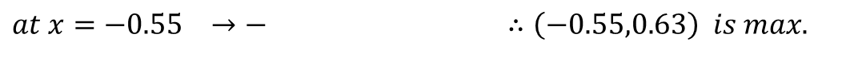

$$\int_{0}^{π}{sinxdx=\left[−cosx\right]{π \atop 0}=−\left[cosπ−cos0\right]}=−\left[−1−1\right]=2$$
$$\int_{π}^{2π}{sinxdx=\left[−cosx\right]}{2π \atop π}=−\left[cos2π−cosπ\right]=−\left[1+1\right]=−2$$
Area=$\left|2\right|+\left|−2\right|=4$
Example: Find the area of the region between the x-axis and the graph of
$$f\left(x\right)=x^{3}−x^{2}−2x , −1≤x≤2$$
$$x^{3}−x^{2}−2x=x(x^{2}−x−2)=x(x+1)(x−2)$$
$$x=0 , x=−1 , x=2, P\left(0, 0\right), P\left(−1, 0\right), P(2, 0)$$
$$\frac{dy}{dx}=3x^{2}−2x−2=0 → x=\frac{2±\sqrt{4+24}}{6}$$
$$x=1.215 and x=−0.55 → \left(1.215,−2.11\right) and (−0.55,0.63)$$
$\frac{d^{2}y}{dx^{2}}=6x−2 →at x=1.215 → + ∴\left(1.215,−2.11\right) is min.$
$at x=−0.55 →− ∴\left(−0.55,0.63\right) is max.$

Slide 4
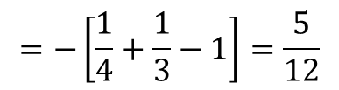
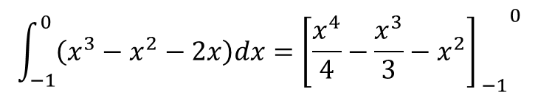

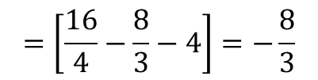
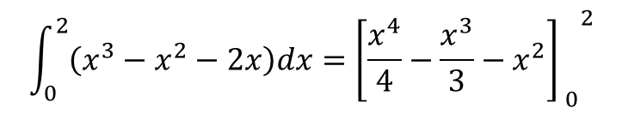
$$\int_{−1}^{0}{\left(x^{3}−x^{2}−2x\right)dx={{\left[\frac{x^{4}}{4}−\frac{x^{3}}{3}−x^{2}\right]}_{ −1}}^{0}}$$
0.63
-1
2
$$=−\left[\frac{1}{4}+\frac{1}{3}−1\right]=\frac{5}{12}$$
-2.11
$$\int_{0}^{2}{\left(x^{3}−x^{2}−2x\right)dx={{\left[\frac{x^{4}}{4}−\frac{x^{3}}{3}−x^{2}\right]}_{ 0}}^{2}}$$
$$=\left[\frac{16}{4}−\frac{8}{3}−4\right]=−\frac{8}{3}$$
Area= $\frac{5}{12}+\left|−\frac{8}{3}\right|=\frac{37}{12}$

Slide 5
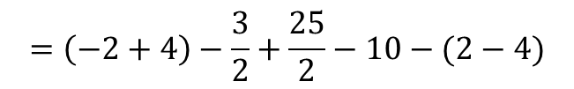
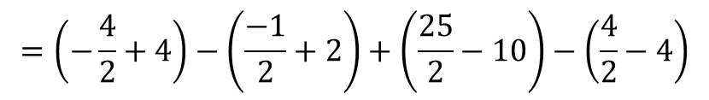
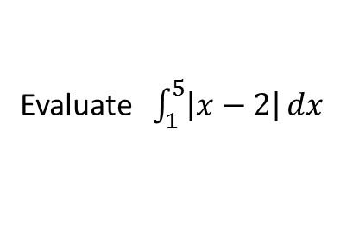
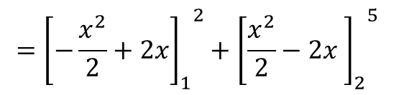
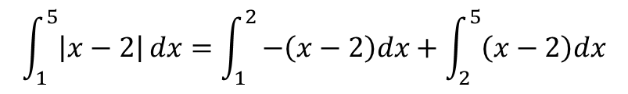
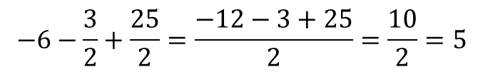
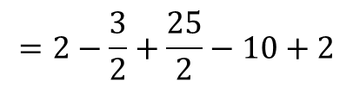
Evaluate $\int_{1}^{5}{\left|x−2\right|}dx$
$$\left(x−2\right) \left(x−2\right) >0 → x>2$$
Or $−\left(x−2\right) \left(x−2\right)<0 → x<2$
$$\int_{1}^{5}{\left|x−2\right|}dx=\int_{1}^{2}{−\left(x−2\right)dx+\int_{2}^{5}{\left(x−2\right)dx}}$$
$$={{\left[−\frac{x^{2}}{2}+2x\right]}_{1}}^{2}+{{\left[\frac{x^{2}}{2}−2x \right]}_{2}}^{5}$$
$$=\left(−\frac{4}{2}+4\right)−\left(\frac{−1}{2}+2\right)+\left(\frac{25}{2}−10\right)−\left(\frac{4}{2}−4\right)$$
$$=\left(−2+4\right)−\frac{3}{2}+\frac{25}{2}−10−(2−4)$$
$$=2−\frac{3}{2}+\frac{25}{2}−10+2$$
$$−6−\frac{3}{2}+\frac{25}{2}=\frac{−12−3+25}{2}=\frac{10}{2}=5$$

Slide 6
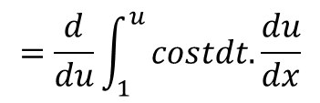
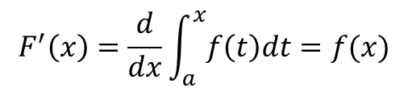

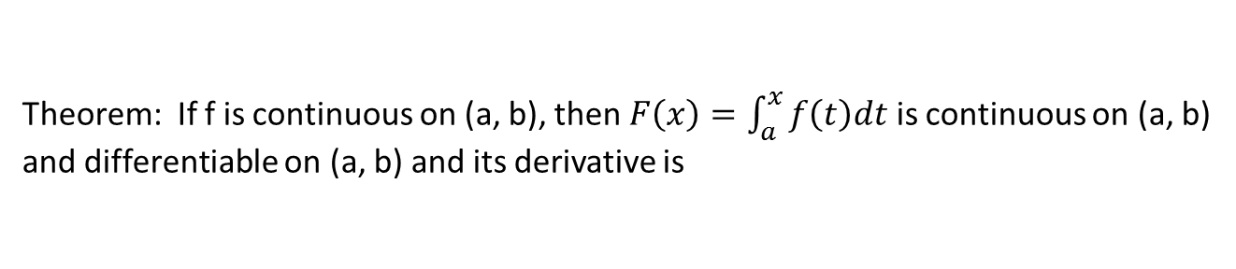


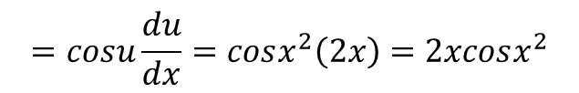
Theorem: If f is continuous on (a, b), then $F\left(x\right)=\int_{a}^{x}{f\left(t\right)dt}$ is continuous on (a, b)
and differentiable on (a, b) and its derivative is
$$F^{′}\left(x\right)=\frac{d}{dx}\int_{a}^{x}{f\left(t\right)dt=f(x)}$$
Example: $\frac{d}{dx}\int_{a}^{x}{\left(t^{3}+1\right)dt=x^{3}+1}$
Example: $\frac{d}{dx}\int_{x}^{5}{3tsintdt=\frac{d}{dx}\left(−\int_{5}^{x}{3tsintdt}\right)=−3xsinx}$
Example: $\frac{d}{dx}\int_{1}^{x^{2}}{costdt}$
Assume $u=x^{2} → \frac{dy}{dx}=\frac{dy}{du}.\frac{du}{dx}$
$$=\frac{d}{du}\int_{1}^{u}{costdt.\frac{du}{dx}}$$
$$=cosu\frac{du}{dx}=cosx^{2}\left(2x\right)=2xcosx^{2}$$

Slide 7
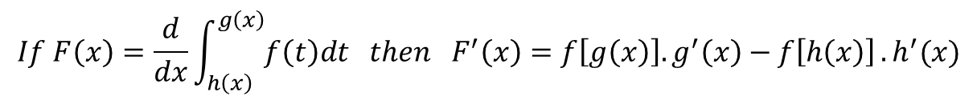

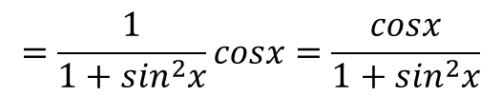

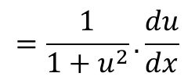
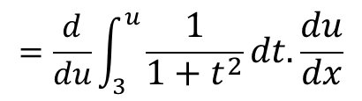

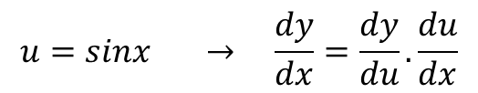
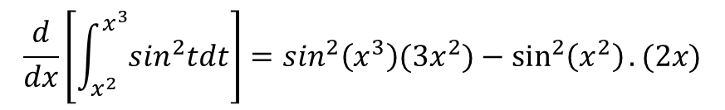
Example: $\frac{d}{dx}\left(\int_{0}^{x}{\frac{dt}{1+\sqrt{t}}}\right)=\frac{1}{1+\sqrt{x}}$
Example: $\frac{d}{dx}\left[\int_{3}^{sinx}{\frac{1}{1+t^{2}}dt}\right]$
$$u=sinx → \frac{dy}{dx}=\frac{dy}{du}.\frac{du}{dx}$$
$$=\frac{d}{du}\int_{3}^{u}{\frac{1}{1+t^{2}}dt. \frac{du}{dx}}$$
$$=\frac{1}{1+u^{2}}. \frac{du}{dx}$$
$$=\frac{1}{1+\sin^{2}x}cosx=\frac{cosx}{1+\sin^{2}x}$$
$$If F\left(x\right)=\frac{d}{dx}\int_{h\left(x\right)}^{g\left(x\right)}{f\left(t\right)dt then F^{′}\left(x\right)=f\left[g\left(x\right)\right].g^{′}\left(x\right)−f\left[h\left(x\right)\right]}.h^{′}(x)$$
Example:
$$\frac{d}{dx}\left[\int_{x^{2}}^{x^{3}}{\sin^{2}tdt}\right]=\sin^{2}\left(x^{3}\right)(3x^{2})−\sin^{2}\left(x^{2}\right).(2x)$$
$$=3x^{2}\sin^{2}\left(x^{3}\right)−2x \sin^{2}⁡(x^{2})$$

