Slide 1

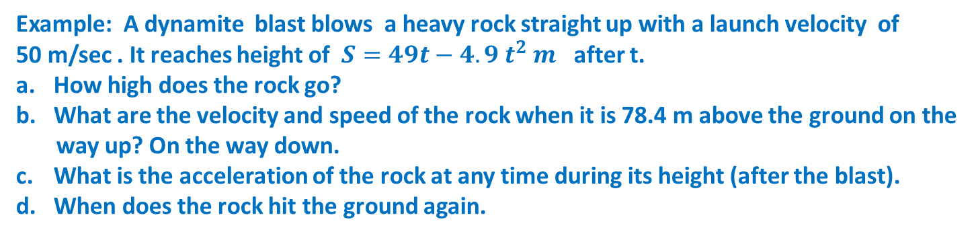

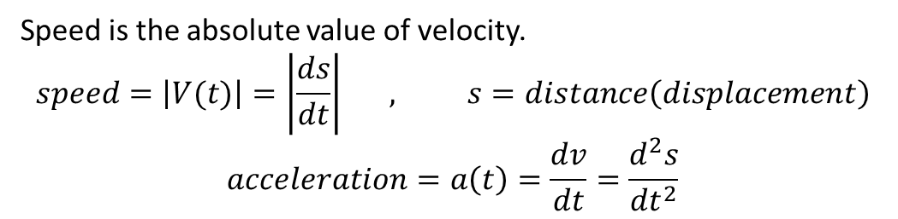
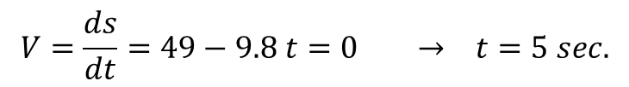
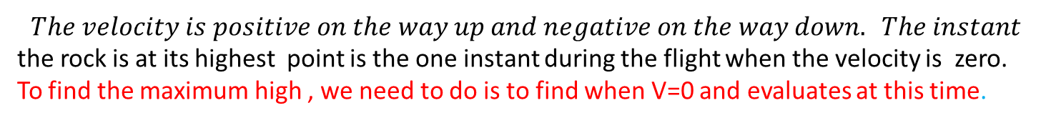
Motion along a line : Displacement , velocity, speed and acceleration
Speed is the absolute value of velocity.
$$speed=\left|V(t)\right|=\left|\frac{ds}{dt}\right| , s=distance\left(displacement\right)$$
$$acceleration=a\left(t\right)=\frac{dv}{dt}=\frac{d^{2}s}{{dt}^{2}}$$
Example: A dynamite blast blows a heavy rock straight up with a launch velocity of
50 m/sec . It reaches height of $S=49t−4.9 t^{2} m$ after t.
How high does the rock go?
What are the velocity and speed of the rock when it is 78.4 m above the ground on the
way up? On the way down.
What is the acceleration of the rock at any time during its height (after the blast).
When does the rock hit the ground again.
$$The velocity is positive on the way up and negative on the way down. The instant$$
the rock is at its highest point is the one instant during the flight when the velocity is zero.
To find the maximum high , we need to do is to find when V=0 and evaluates at this time.
V=0
a.
$$V=\frac{ds}{dt}=49−9.8 t=0 → t=5 sec.$$
$$S_{max.}=49t−4.9 t^{2}$$
$$=49\left(5\right)−4.9{\left(5\right)}^{2}=122.5 m$$

Slide 2

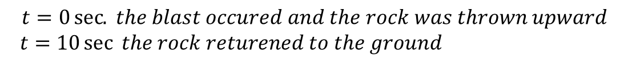





b.
$$S=49t−4.9t^{2}$$
$$78.4=49t−4.9 t^{2} → 4.9 t^{2}−49t+78.4=0$$
$$4.9\left(t^{2}−10t+16\right)=0$$
$$\left(t−2\right)\left(t−8\right)=0$$
$$t=2 sec. for way up and t=8\sec{ for way down}$$
$$V\left(2\right)=49−9.8 t=49−9.8\left(2\right)=29.4 \frac{m}{sec} upward$$
$$V\left(8\right)=49−9.8\left(8\right)=−29.4 \frac{m}{sec} downward$$
c.
$$V= 49−9.8 t$$
$$a=\frac{dv}{dt}=−9.8 \frac{m}{s^{2}} the acceleration is always downward.$$
d.
$$The rock hit the ground at the positive time for which S=0$$
$$S=49t−4.9 t^{2}=0$$
$$4.9t\left(10−t\right)=0 → t=0 or t=10 sec$$
$$t=0\sec{. }the blast occured and the rock was thrown upward$$
$$t=10\sec{ the rock returened to the ground }$$

Slide 3





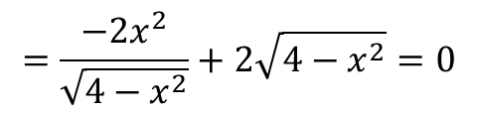

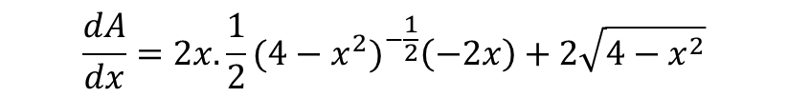

Example: A rectangle is to be inscribed in semicircle of radius 2. What is the largest area
the rectangle can have, and what are its dimensions?
$$A=2x\sqrt{4−x^{2}}$$
$$\frac{dA}{dx}=2x. \frac{1}{2}(4−x^{2})^{−\frac{1}{2}}\left(−2x\right)+2\sqrt{4−x^{2}}$$
$$=\frac{−2x^{2}}{\sqrt{4−x^{2}}}+2\sqrt{4−x^{2}}=0$$
$$−2x^{2}+2\left(4−x^{2}\right)=0$$
$$−2x^{2}+8−2x^{2}=0 →−4x^{2}+8=0$$
$x=±\sqrt{2} → x=\sqrt{2}$
$$A=2x\sqrt{4−x^{2}}$$
$$=2\sqrt{2} \sqrt{4−2} =4$$
Dimensions: $2x=2\sqrt{2} length$
$$\sqrt{4−x^{2}}=\sqrt{2} height$$

Slide 4
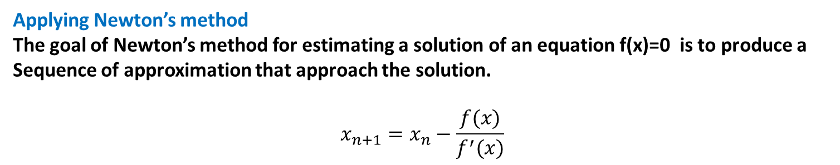

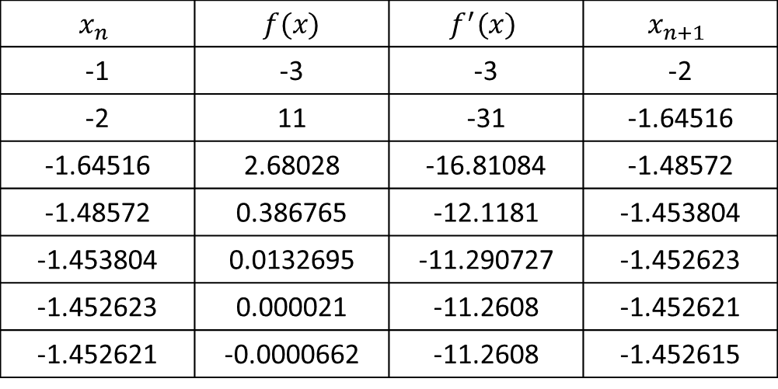

Applying Newton’s method
The goal of Newton’s method for estimating a solution of an equation f(x)=0 is to produce a
Sequence of approximation that approach the solution.
$$x_{n+1}=x_{n}−\frac{f(x)}{f^{′}(x)}$$
Example: Use Newton’s method to approximate the solution of $f\left(x\right)=x^{4}+x−3=0 .$
Start with $x_{o}=−1$
$$f^{′}\left(x\right)=4x^{3}+1$$
$$x_{n}$$ | $$f(x)$$ | $$f^{′}(x)$$ | $$x_{n+1}$$
-1 | -3 | -3 | -2
-2 | 11 | -31 | -1.64516
-1.64516 | 2.68028 | -16.81084 | -1.48572
-1.48572 | 0.386765 | -12.1181 | -1.453804
-1.453804 | 0.0132695 | -11.290727 | -1.452623
-1.452623 | 0.000021 | -11.2608 | -1.452621
-1.452621 | -0.0000662 | -11.2608 | -1.452615
$$x=\text{−1.452621}$$

