Slide 1
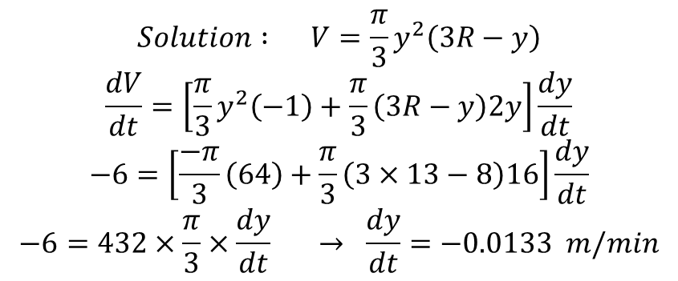
Example:
$$Solution : V=\frac{π}{3}y^{2}\left(3R−y\right)$$
$$\frac{dV}{dt}=\left[\frac{π}{3}y^{2}\left(−1\right)+\frac{π}{3}\left(3R−y\right)2y\right]\frac{dy}{dt}$$
$$−6=\left[\frac{−π}{3}\left(64\right)+\frac{π}{3}\left(3×13−8\right)16\right]\frac{dy}{dt}$$
$$−6=432×\frac{π}{3}×\frac{dy}{dt} → \frac{dy}{dt}=−0.0133 m/min$$

Slide 2
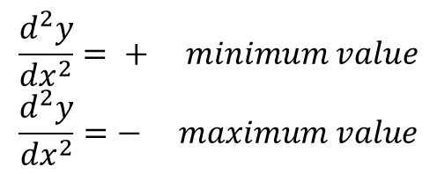
$$b.$$
$$13−y$$
13
$${\left(13−y\right)}^{2}+r^{2}=169$$
r
$$169−26y+y^{2}+r^{2}=169$$
y
$$r^{2}=26y−y^{2}$$
$$r=\sqrt{26y−y^{2}}$$
c.
$$−\frac{dr}{dt}=\frac{1}{2}{\left(26y−y^{2}\right)}^{−\frac{1}{2}}\left(26−2y\right)\frac{dy}{dt}$$
$$=\frac{1}{2}(26×8−64)^{−\frac{1}{2}}\left(26−16\right)0.0133$$
$$=−5.542×{10}^{−3} m/min$$
Extreme values
$$Maximum and minimum values are called extreme values of the function at \frac{dy}{dx}=0$$
$$\frac{d^{2}y}{{dx}^{2}}= + minimum value$$
$$\frac{d^{2}y}{{dx}^{2}}=− maximum value$$
Mix.
Min.

Slide 3
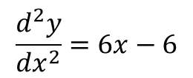
$$Example:Find extreme values of y=x^{3}−3x^{2}+1 and calculate minimum$$
$$vale or maximum value.$$
$$\frac{dy}{dx}=3x^{2}−6x=0$$
$$x\left(3x−6\right)=0 → x=0 ∴ P(0, 1)$$
$$or x=2 ∴y=8−12+1=−3 → P(2,−3)$$
$$\frac{d^{2}y}{{dx}^{2}}=6x−6$$
$$at x=0 →\frac{d^{2}y}{{dx}^{2}}=−6 the point \left(0, 1\right) is maximum$$
$$at x=2 →\frac{d^{2}y}{{dx}^{2}}=6 the point \left(2,−3\right)is minimum$$
$$Example: Find extreme values and inflection points of the function$$
$$y=x^{4}−8x^{2}+16 and find which points maximum or minimum.$$
$$\frac{dy}{dx}=0=4x^{3}−16 x →4x\left(x^{2}−4\right)=0$$
$$x=0 or x=±2$$
$$The extreme values are \left(0,16\right) , \left(2, 0\right), (−2,0)$$

Slide 4
$$\frac{d^{2}y}{{dx}^{2}}=12x^{2}−16=0 →x^{2}=\frac{4}{3}$$
$$x=±\frac{2}{\sqrt{3}} →two inflection points :p\left(\frac{2}{\sqrt{3}} , 7.1\right) and P\left(−\frac{2}{\sqrt{3}}, 7.1\right)$$
$$at x=0 →\frac{d^{2}y}{{dx}^{2}}=−16 → P\left(0,16\right) is maximum$$
$$at x=2 →\frac{d^{2}y}{{dx}^{2}}=32 → P\left(2,0\right) is minimum$$
$$at x=−2 →\frac{d^{2}y}{{dx}^{2}}=32 →P\left(−2,0\right) is minimum$$

