Slide 1
Graphs of the trigonometric functions

Slide 4
Limits and continuity

Slide 5
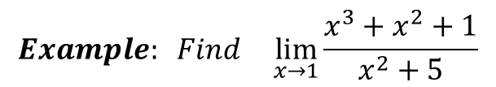
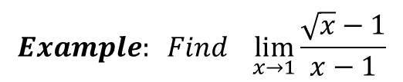
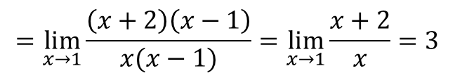
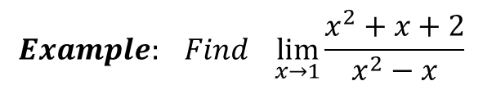
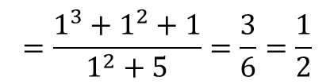
$$Example: Find \lim_{x→1}{\frac{x^{3}+x^{2}+1}{x^{2}+5}}$$
$$=\frac{1^{3}+1^{2}+1}{1^{2}+5}=\frac{3}{6}=\frac{1}{2}$$
$$Example: Find \lim_{x→1}{\frac{x^{2}+x+2}{x^{2}−x}}$$
$$=\lim_{x→1}{\frac{\left(x+2\right)\left(x−1\right)}{x(x−1)}=\lim_{x→1}{\frac{x+2}{x}=3}}$$
$$Example: Find \lim_{x→1}{\frac{\sqrt{x}−1}{x−1}}$$

Slide 6

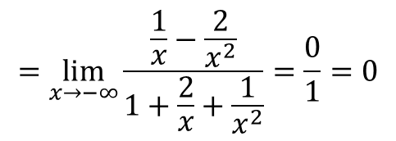
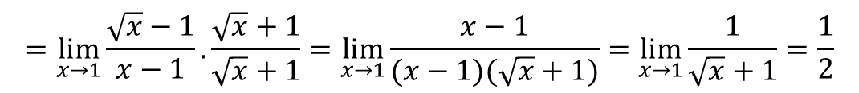
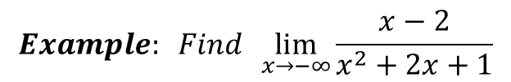

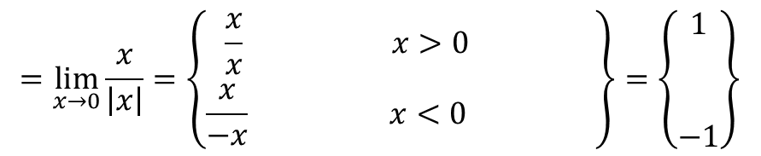
$$=\lim_{x→1}{\frac{\sqrt{x}−1}{x−1}.\frac{\sqrt{x}+1}{\sqrt{x}+1}=\lim_{x→1}{\frac{x−1}{(x−1)(\sqrt{x}+1)}=\lim_{x→1}{\frac{1}{\sqrt{x}+1}=\frac{1}{2}}}}$$
$$Example: Find \lim_{x→0}{\frac{x}{\left|x\right|}}$$
$$=\lim_{x→0}{\frac{x}{\left|x\right|}=\left\{\begin{aligned}\frac{x}{x} x>0 \\ \frac{x}{−x} x<0 \end{aligned} \right\}=\left\{\begin{aligned}1 \\ \\ \\ −1\end{aligned}\right\}}$$
$$The limit does not exist$$
$$Example: Find \lim_{x→−∞}{\frac{x−2}{x^{2}+2x+1}}$$
$$=\lim_{x→−∞}{\frac{\frac{1}{x}−\frac{2}{x^{2}}}{1+\frac{2}{x}+\frac{1}{x^{2}}}=\frac{0}{1}=0}$$

