Slide 1


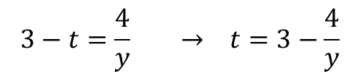

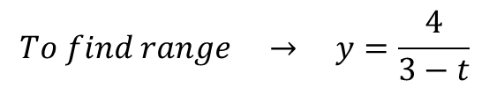


Example: Find domain and range for $f\left(t\right)=\frac{4}{3−t}$
$$\left(3−t\right)≠0$$
$$t≠3$$
$$Domain t≠3 or (−∞,3)∪(3,∞)$$
$$To find range → y=\frac{4}{3−t}$$
$$3−t=\frac{4}{y} → t=3−\frac{4}{y}$$
$$Range y≠0 or (−∞, 0)∪(0, ∞)$$
f(t)
t
3

Slide 2

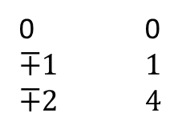
Graphs of function
The graph of a function f is useful picture of its behavior. If (x, y) is a point on the graph,
Then y=f(x) is the height of the graph above the point x.
Example: Graph the function $y=x+2$
x
y
0 2
-2 0
Example: Graph the function $y=x^{2}$ over the interval (-2, 2)
X y
0 0
$$∓1 1$$
$$∓2 4$$

Slide 3




Graph of function $y=\sqrt{x}$
Graph of function $y=\sqrt{x} +1$
1
0
Graph of function $y=\sqrt{x}−1$
-1

Slide 4



Sketch the functions
$$x^{2}+y^{2}=1$$
$$y=\sqrt{1−x^{2}}$$
$$y=−\sqrt{1−x^{2}}$$

