Slide 1
إعادة تدوير الرصف الإسفلتي واستخدامه في مشاريع الطرق
زينب القيسي

Slide 2
Why is asphalt sustainable
100% Recyclable
Can use other recycled materials
Low carbon footprint pavement
Long life & Fast resurfacing
Warm‐Mix Asphalt
Porous pavement for storm water
Notes:
Asphalt is the No. 1 reused material

Slide 3
Asphalt Pavement Life Cycle

Slide 4
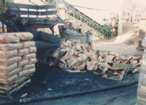
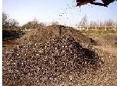
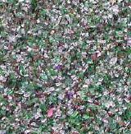
Recycled Materials
Crumb rubber (from tires)
Steel slag
Glass

Slide 5
What is the three most important requirements of recycling pavement
Cost effectiveness.
Environmentally responsible.
Perform well.

Slide 6
Effect of Foundry Sand on Performance of Asphalt Pavement Published research 4 July 2018
recycled foundry sand to improve the performance of asphalt concrete mixture by replacement fine aggregate by waste foundry sand substitute for normal.
The experimental work conducted for (4) different proportions (5, 15, 20 and 25)% as fine aggregate .
(35) samples was prepared to examine the Marshall stability and flow and moisture damage for asphalt mixture.

Slide 8
Plate (1): Foundry Sand Used

Slide 9
Figure (1) Effect of Foundry Sand on IDT.

Slide 10
Figure (2) Effect of Foundry Sand on TSR.

Slide 11
Figure (3). Number of Load Repetitions to Prevent Fatigue Cracking versus Pavements

Slide 12
Figure (4). Fatigue Damage for Asphalt Pavement

Slide 13
Figure 5. Rutting Damage Asphalt Pavement

Slide 14
Conclusions
Using FS in hot asphalt is more efficient and results in higher values for strength. mixture. This may be due to the high strengths provided by FS material.
Environmental effects from wastes and disposal problems of waste can be reduced through this research. Which consider as an important key in the sustainability of using hot asphalt mixture.
The used foundry sand is recommended as a good sustainable material for HMA used in
pavement Construction.

Slide 15
Thanks for Listening

