Slide 1
Key Management and Distribution
Symmetric Key Distribution Using Symmetric Encryption
Symmetric Key Distribution Using Asymmetric Encryption
Distribution of Public Keys

Slide 2
Symmetric Key Distribution Using Symmetric Encryption
For symmetric encryption to work, the two parties to an exchange must share the same key.
That key must be protected from access by others.
Furthermore, frequent key changes are usually desirable to limit the amount of data compromised if an attacker learns the key.
Therefore, the strength of any cryptographic system rests with the key distribution technique,
A term that refers to the means of delivering a key to two parties who wish to exchange data without allowing others to see the key.

Slide 3
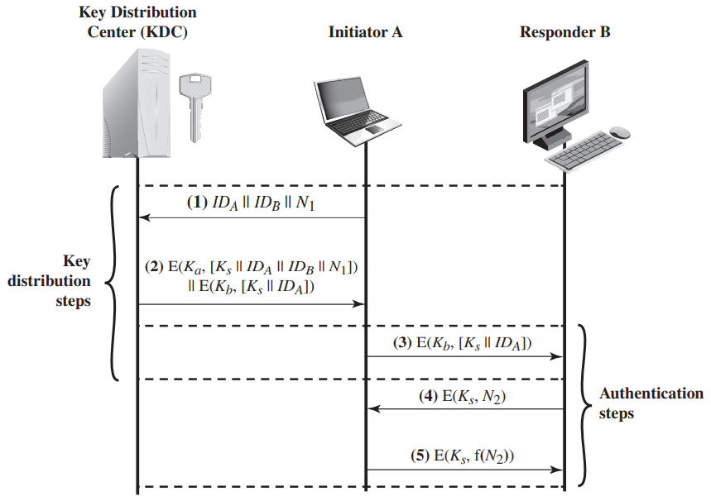
Key Distribution Scenario
The key distribution concept can be deployed in a number of ways. A typical scenario is illustrated in Figure.
The scenario assumes that each user shares a unique master key with the key distribution center (KDC).

Slide 4
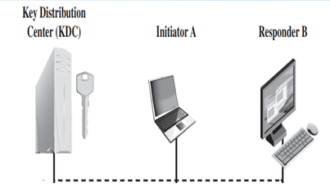
Let us assume that user A wishes to establish a logical connection with B and requires a one-time session key to protect the data transmitted over the connection.
A has a master key, K_{a}, known only to itself and the KDC.
Similarly, B shares the master key K_{b} with the KDC.

Slide 5
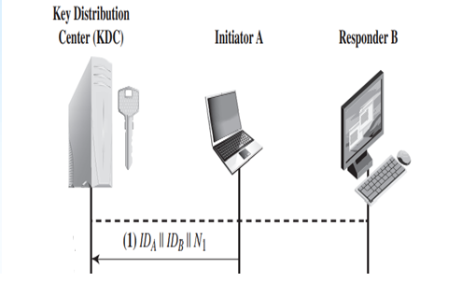
The following steps occur.
A issues a request to the KDC for a session key to protect a logical connection to B. The message includes the identity of A and B and a unique identifier, N₁, for this transaction, which we refer to as a nonce.
The nonce may be a timestamp, a counter, or a random number.
The minimum requirement is that it differs with each request.
It should be difficult for an opponent to guess the nonce. Thus, a random number is a good choice for a nonce.

Slide 6
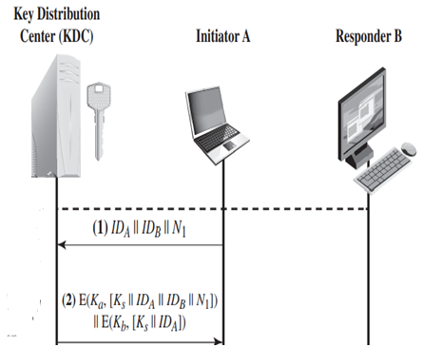
The KDC responds with a message encrypted using K_{a}. Thus, A is the only one who can successfully read the message, and A knows that it originated at the KDC.
The message includes two items intended for A:
The one-time session key, K_{s}, to be used for the session
The original request message, including the nonce, to enable A to match this response with the appropriate request.
Thus, A can verify that its original request was not altered before reception by the KDC and, because of the nonce, that this is not a replay of some previous request.

Slide 7
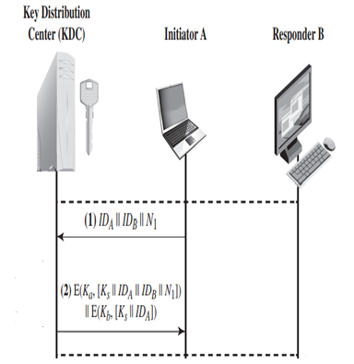
In addition, the message includes two items intended for B:
The one-time session key, K_{s}, to be used for the session.
An identifier of A (e.g., its network address), ID_{A}
These last two items are encrypted with K_{b} (the master key that the KDC shares with B). They are to be sent to B to establish the connection and prove A’s identity.

Slide 8
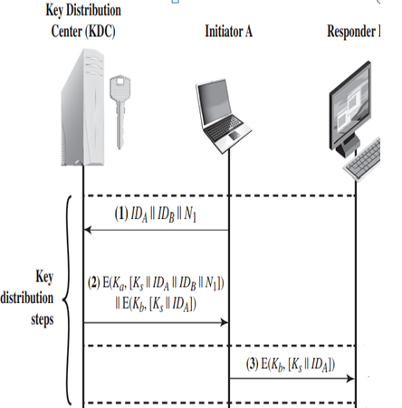
A stores the session key for use in the upcoming session and forwards to B the information that originated at the KDC for B, namely, E(K_{b},[K_{s}||ID_{A}]). Because this information is encrypted with K_{b}, it is protected from eavesdropping. B now knows the session key (K_{s}), knows that the other party is A (from ID_{A}), and knows that the information originated at the KDC (because it is encrypted using K_{b}).
At this point, a session key has been securely delivered to A and B, and they may begin their protected exchange.

Slide 9
However, two additional steps are desirable:
Using the newly minted session key for encryption, B sends a nonce, N₂, to A.
Also, using K_{s}, A responds with f(N₂), where f is a function that performs some transformation on N₂ (e.g., adding one).
These steps assure B that the original message it received (step 3) was not a replay.
Note that the actual key distribution involves only steps 1 - 3, but that steps 4 and 5, as well as step 3, perform an authentication function.

Slide 10
Hierarchical Key Control
For very large networks, it may not be practical to limit the key distribution function to a single KDC.
As an alternative, a hierarchy of KDCs can be established.
For example, there can be local KDCs, each responsible for a small domain of the overall internetwork, such as a single LAN or a single building.
For communication among entities within the same local domain, the local KDC is responsible for key distribution.

Slide 11
If two entities in different domains desire a shared key, then the corresponding local KDCs can communicate through a global KDC.
In this case, any one of the three KDCs involved can actually select the key.
The hierarchical concept can be extended to three or even more layers, depending on the size of the user population and the geographic scope of the internetwork.

Slide 12
Symmetric Key Distribution Using Asymmetric Encryption
Simple Secret Key Distribution
An extremely simple scheme was put forward by Merkle and as illustrated in Figure. If A wishes to communicate with B, the following procedure is employed:
A generates a public/private key pair {PU_{a}, PR_{a}} and transmits a message to B consisting of PU_{a} and an identifier of A, ID_{A}.
B generates a secret key, K_{s}, and transmits it to A, which is encrypted with A’s public key.

Slide 13
A computes D(PR_{a}, E(PU_{a}, K_{s})) to recover the secret key. Because only A can decrypt the message, only A and B will know the identity of K_{s}.
A discards PU_{a} and PR_{a} and B discards PU_{a}.
A and B can now securely communicate using conventional encryption and the session key K_{s}.
At the completion of the exchange, both A and B discard K_{s}.
Despite its simplicity, this is an attractive protocol.
No keys exist before the start of the communication and none exist after the completion of communication.
Thus, the risk of compromise of the keys is minimal.
At the same time, the communication is secure from eavesdropping.

Slide 14
This protocol is insecure against an adversary who can intercept messages and then either relay the intercepted message or substitute another message.
Such an attack is known as a man-in-the-middle attack.
If an adversary, D, has control of the intervening communication channel, then D can compromise the communication in the following fashion without being detected:
A generates a public/private key pair {PU_{a}, PR_{a}} and transmits a message intended for B consisting of PU_{a} and an identifier of A, ID_{A}.
D intercepts the message, creates its own public/private key pair {PU_{d}, PR_{d}} and transmits PU_{s} ||ID_{A} to B.

Slide 15
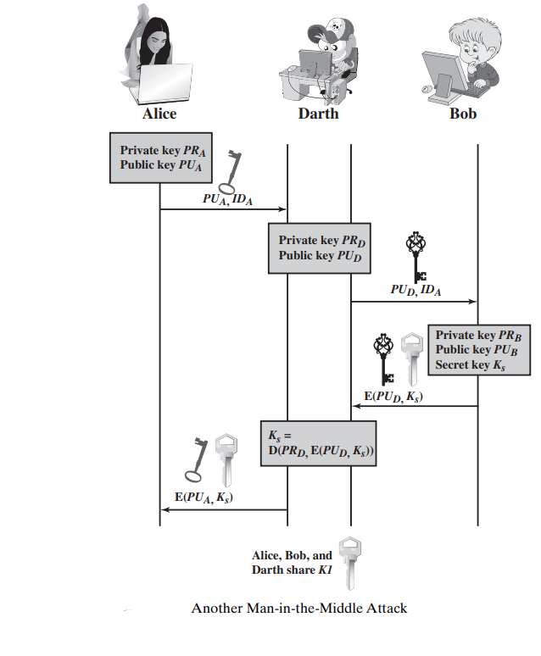
B generates a secret key, K_{s}, and transmits E(PU_{s}, K_{s}).
D intercepts the message and learns K_{s} by: D(PR_{d}, E(PU_{d}, K_{s})).
D transmits E(PU_{a}, K_{s}) to A.

Slide 16
The result is that both A and B know K_{s} and are unaware that K_{s} has also been revealed to D.
A and B can now exchange messages using K_{s}.
D no longer actively interferes with the communications channel but simply eavesdrops.
Knowing K_{s}, D can decrypt all messages, and both A and B are unaware of the problem.
Thus, this simple protocol is only useful in an environment where the only threat is eavesdropping

Slide 17
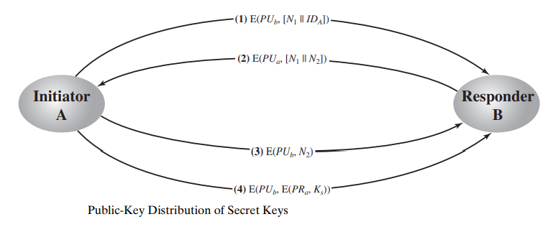
Secret Key Distribution with Confidentiality and Authentication
The approach shown in the Figure provides protection against both active and passive attacks.
We begin at a point when it is assumed that A and B have exchanged public keys by one of the described schemes.

Slide 18
Then the following steps occur.
A uses B’s public key to encrypt a message to B containing an identifier of A(ID_{A}) and a nonce (N₁), which is used to identify this transaction uniquely.
B sends a message to A encrypted with PU_{a} and containing A’s nonce (N₁) as well as a new nonce generated by B (N₂). Because only B could have decrypted message (1), the presence of N₁ in message (2) assures A that the correspondent is B.

Slide 19
A returns N₂, encrypted using B’s public key, to assure B that its correspondent is A.
A selects a secret key K_{s} and sends M = E(PU_{b}, E(PR_{a}, K_{s})) to B. Encryption of this message with B’s public key ensures that only B can read it; encryption with A’s private key ensures that only A could have sent it.
B computes D(PU_{a}, D(PR_{b}, M)) to recover the secret key.
The result is that this scheme ensures both confidentiality and authentication in the exchange of a secret key

Slide 20
Distribution Of Public Keys
Several techniques have been proposed for the distribution of public keys. Virtually all these proposals can be grouped into the following general schemes:
Public announcement
Publicly available directory
Public-key authority
Public-key certificates

Slide 21
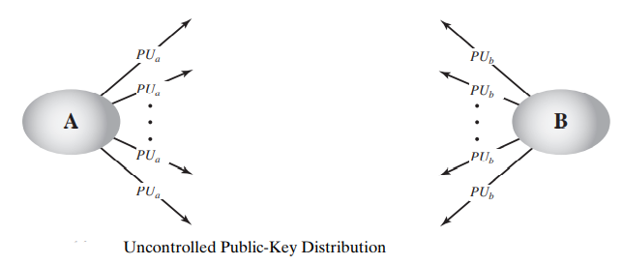
Public Announcement of Public Keys
In a public-key encryption, any participant can send his or her public key to any other participant or broadcast the key to the community at large as shown in the figure. This approach has a major weakness:
Anyone can forge such a public announcement.
That is, some user could pretend to be user A and send a public key to another participant or broadcast such a public key.
Until such time as user A discovers the forgery and alerts other participants, the forger is able to read all encrypted messages intended for A and can use the forged keys for authentication

Slide 22
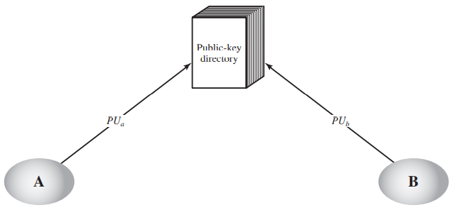
Publicly Available Directory
A greater degree of security can be achieved by maintaining a publicly available dynamic directory of public keys.
Maintenance and distribution of the public directory would have to be the responsibility of some trusted entity or organization.
This scheme is clearly more secure than individual public announcements but still has vulnerabilities.

Slide 23
Public-Key Authority
Stronger security for public-key distribution can be achieved by providing tighter control over the distribution of public keys from the directory.
A typical scenario is illustrated in the figure.
As before, the scenario assumes that a central authority maintains a dynamic directory of public keys of all participants.
In addition, each participant reliably knows a public key for the authority, with only the authority knowing the corresponding private key.
The following steps occur.

Slide 24
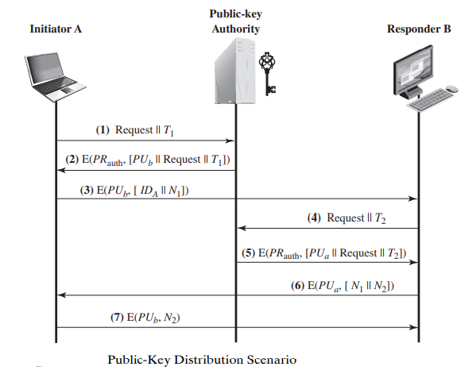
A sends a timestamped message to the public-key authority containing a request for the current public key of B.
The authority responds with a message that is encrypted using the authority’s private key, PR_{auth}. Thus, A is able to decrypt the message using the authority’s public key.

Slide 25
Therefore, A is assured that the message originated with the authority. The message includes the following:
B’s public key, PU_{b}, which A can use to encrypt messages destined for B
The original request used to enable A to match this response with the corresponding earlier request and to verify that the original request was not altered before reception by the authority
The original timestamp given so A can determine that this is not an old message from the authority containing a key other than B’s current public key

Slide 26
3. A stores B’s public key and also uses it to encrypt a message to B containing an identifier of A (ID_{A}) and a nonce (N₁), which is used to identify this transaction uniquely.
4, 5. B retrieves A’s public key from the authority in the same manner as A retrieved B’s public key.

Slide 27
However, two additional steps are desirable:
6. B sends a message to A encrypted with PU_{a} and containing A’s nonce (N₁) as well as a new nonce generated by B (N₂). Because only B could have decrypted message (3), the presence of N₁ in message (6) assures A that the correspondent is B.
7. A returns N₂, which is encrypted using B’s public key, to assure B that its correspondent is A.

