Slide 1
Message Authentication Functions

Slide 2
Any message authentication or digital signature mechanism has two levels of functionality.
At the lower level, there must be some sort of function that produces an authenticator: a value to be used to authenticate a message.
This lower-level function is then used as a primitive in a higher-level authentication protocol that enables a receiver to verify the authenticity of a message.

Slide 3
Types of functions that may be used to produce an authenticator:
Hash function: A function that maps a message of any length into a fixed length hash value, which serves as the authenticator (discussed in the previous lecture).
Message encryption: The ciphertext of the entire message serves as its authenticator
Message authentication code (MAC): A function of the message and a secret key that produces a fixed-length value that serves as the authenticator

Slide 4
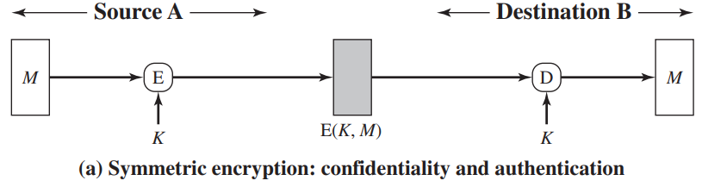
Message Encryption
Message encryption by itself can provide a measure of authentication.
The analysis differs for symmetric and public-key encryption schemes.
Symmetric Encryption
Consider the straightforward use of symmetric encryption (Fig. (a)).
A message M transmitted from A to B is encrypted using a secret key K shared by A and B. If no other party knows the key, then confidentiality is provided: No other party can recover the plaintext of the message.

Slide 5
In addition, B is assured that the message was generated by A. Why? because A is the only other party that possesses K and therefore the only other party with the information necessary to construct ciphertext that can be decrypted with K.
Furthermore, if M is recovered, B knows that none of the bits of M have been altered, because an opponent that does not know K would not know how to alter bits in the ciphertext to produce the desired changes in the plaintext.
There must be some internal structure to plaintext so that the receiver can distinguish between well-formed plaintext and random bits.
So symmetric encryption provides authentication and confidentiality.

Slide 6
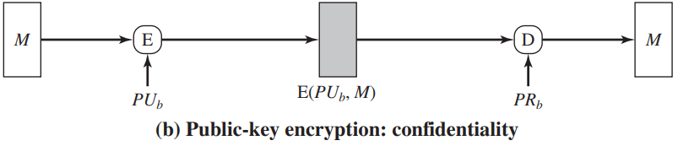
Public-Key Encryption
The straightforward use of public-key encryption (Fig (b)) provides confidentiality but not authentication.
The source (A) uses the public key PU_{b} of (B) to encrypt M.
Because only B has the corresponding private key PR_{b}, only B can decrypt the message.
This scheme provides no authentication, because any opponent could also use B’s public key to encrypt a message and claim to be A.

Slide 7
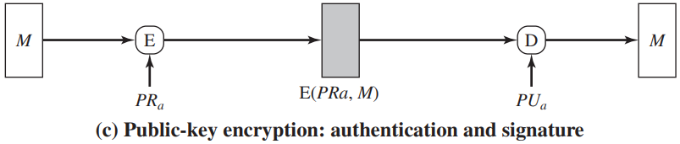
To provide authentication, A uses its private key to encrypt the message, and B uses A’s public key to decrypt (Fig.(c)).
The reasoning is as in the symmetric encryption case: The message must have come from A because A is the only party that possesses PR_{a} and therefore the only party with the information necessary to construct ciphertext that can be decrypted with PU_{a}.
There must be some internal structure to the plaintext so that the receiver can distinguish between well-formed plaintext and random bits.

Slide 8
Assuming there is such structure, then the scheme of Fig. (c) does provide authentication.
It also provides what is known as digital signature.
Only A could have constructed the ciphertext because only A possesses PR_{a}.
Therefore, if B is in possession of the ciphertext, B has the means to prove that the message must have come from A.
In effect, A has “signed” the message by using its private key to encrypt. Note that this scheme does not provide confidentiality. Anyone in possession of A’s public key can decrypt the ciphertext.

Slide 9
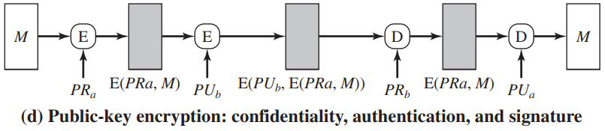
To provide both confidentiality and authentication:
A can encrypt M first using its private key, which provides the digital signature, and then using B’s public key, which provides confidentiality (Fig. (d)).
The disadvantage of this approach is that the public-key algorithm, which is complex, must be exercised four times rather than two in each communication.

Slide 10
Message Authentication Code
An authentication technique makes use of a secret key to generate a small fixed-size block of data, known as a cryptographic checksum or MAC, that is appended to the message.
This technique assumes that two communicating parties, say A and B, share a common secret key K.
  When A has a message to send to B, it calculates the MAC as a function of the message and the key:
  MAC = C(K, M) (message authentication code)
  where M = input message
  C = MAC function
  K = shared secret key

Slide 11
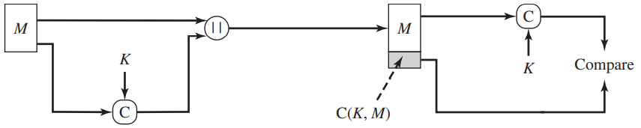

The message plus MAC are transmitted to the intended recipient.
The recipient performs the same calculation on the received message, using the same secret key, to generate a new MAC.
The received MAC is compared to the calculated MAC (Figure 12.4a).

Slide 12
If we assume that only the receiver and the sender know the identity of the secret key, and if the received MAC matches the calculated MAC, then
The receiver is assured that the message has not been altered.
  The receiver is assured that the message is from the alleged sender. Because no one else knows the secret key, no one else could prepare a message with a proper MAC.
  If the message includes a sequence, then the receiver can be assured of the proper sequence because an attacker cannot successfully alter the sequence number.

Slide 13
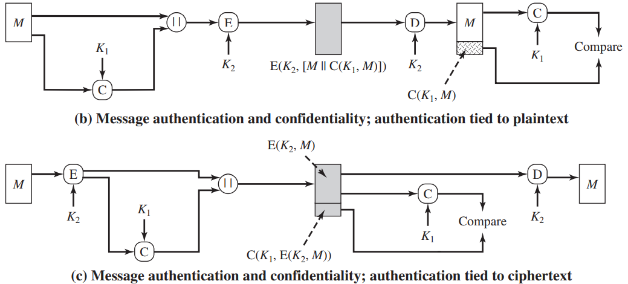
The process of Fig. (a) provides authentication but not confidentiality, because the message as a whole is transmitted in the clear.
Confidentiality can be provided by performing message encryption either after MAC algorithm (Fig. (b)) or before it (Fig. (c)).

Slide 14
In both these cases, two separate keys are needed, each of which is shared by the sender and the receiver.
In the first case, the MAC is calculated with the message as input and is then concatenated to the message. The entire block is then encrypted.
In the second case, the message is encrypted first. Then the MAC is calculated using the resulting ciphertext and is concatenated to the ciphertext to form the transmitted block.
Typically, it is preferable to tie the authentication directly to the plaintext, so the method of Fig. (b) is used.
Finally, note that the MAC does not provide a digital signature, because both sender and receiver share the same key.

Slide 15
MACs Based on Hash Functions: HMAC
A hash function such as SHA was not designed for use as a MAC and cannot be used directly for that purpose, because it does not rely on a secret key.
There have been a number of proposals for the incorporation of a secret key into an existing hash algorithm.
The approach that has received the most support is HMAC.
HMAC has been issued as RFC 2104, has been chosen as the mandatory-to-implement MAC for IP security, and is used in other Internet protocols, such as SSL (secure sockets layer protocol).
An RFC (Request for Comments) is a pure technical document published by the Internet Engineering Task Force (IETF).

Slide 16
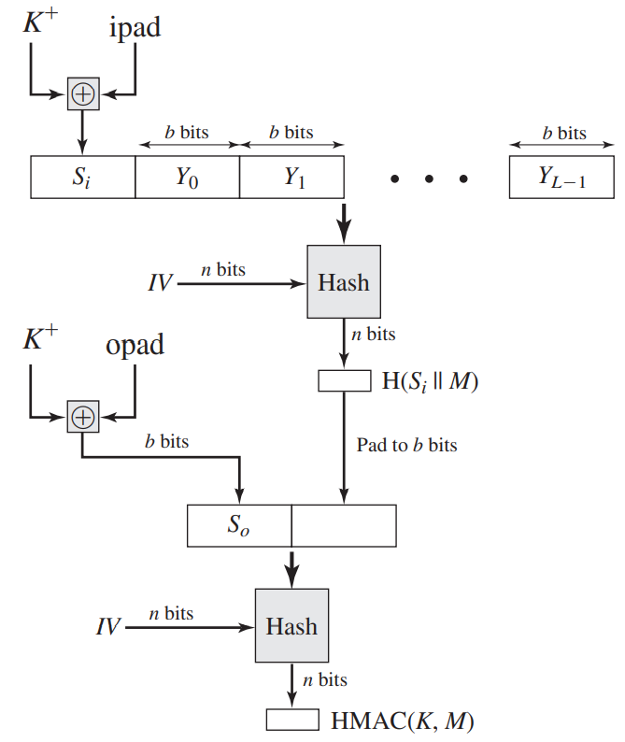
HMAC Algorithm
Hash = embedded hash function
(MD5, SHA-1, RIPEMD-160)
Yi = ith block of M, 0 ≤ i ≤ (L-1)
K+ = K padded with 0 on left so that the result is b bits in length
L = number of blocks in M
b = number of bits in a block
n = length of hash code produced by H

Slide 17
Append zero to the left end of K to create a b-bit string K⁺
if K is of length 160 bits and b = 512, K will be appended with 44 zero bytes 0×00.
K⁺ = K padded with 0 on left so that the result is b bits in length
XOR K+ with ipad to produce the b-bit block Si
  ipad=00110110
(repeated b/8 times)
Append M to S_{i}

Slide 18
Apply H to the stream generated in step 3.
XOR K+ with opad to produce the b-bit block S_{o} .
  opad = 01011100
  (repeated b/8 times)
Append the hash result from step 4 to S_{o} .
Apply H to the stream generated in step 6 and output result.
Note that the XOR with ipad results in flipping one-half of the bits of K. Similarly, the XOR with opad results in flipping one-half of the bits of K, using a different set of bits

Slide 19
HMAC should execute in approximately the same time as the embedded hash function for long messages.
HMAC adds three executions of the hash compression function (for S_{i}, S_{o}, and the block produced from the inner hash).
A more efficient implementation is possible
Two quantities are precomputed: f(IV, (K⁺ ⊕ ipad))
f(IV, (K⁺ ⊕ opad))
These quantities only need to be computed initially and every time the key changes.
The precomputed quantities substitute for the initial value.
Only one additional instance of the compression function is added to the processing.

Slide 20
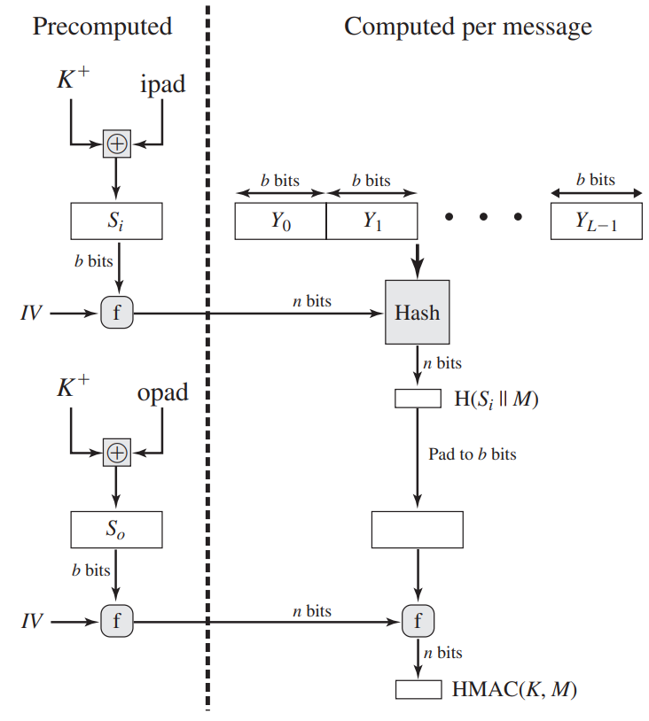
Efficient Implementation of HMAC

