Slide 1
Diffie-Hellman Key Exchange
Man-in-the-Middle Attack
Elgamal Cryptographic System

Slide 2
Diffie-Hellman
Key Exchange

Slide 3
The first published public-key algorithm appeared in the seminal paper by Diffie and Hellman that defined public-key cryptography [1976] and is generally referred to as Diffie-Hellman key exchange.
A number of commercial products employ this key exchange technique.
The purpose of the algorithm is to enable two users to securely exchange a key that can then be used for subsequent symmetric encryption of messages.
The algorithm is limited to the exchange of secret values.

Slide 4
The Diffie-Hellman algorithm depends for its effectiveness on the difficulty of computing discrete logarithms.
Briefly, we can define the discrete logarithm in the following way:
a primitive root of a prime number p is one whose powers modulo p generate all the integers from 1 to p - 1.
That is, if a is a primitive root of the prime number p, then the numbers a mod p, a² mod p, …, a^{p-1} mod p are distinct and consist of the integers from 1 through p - 1 in some permutation.

Slide 5
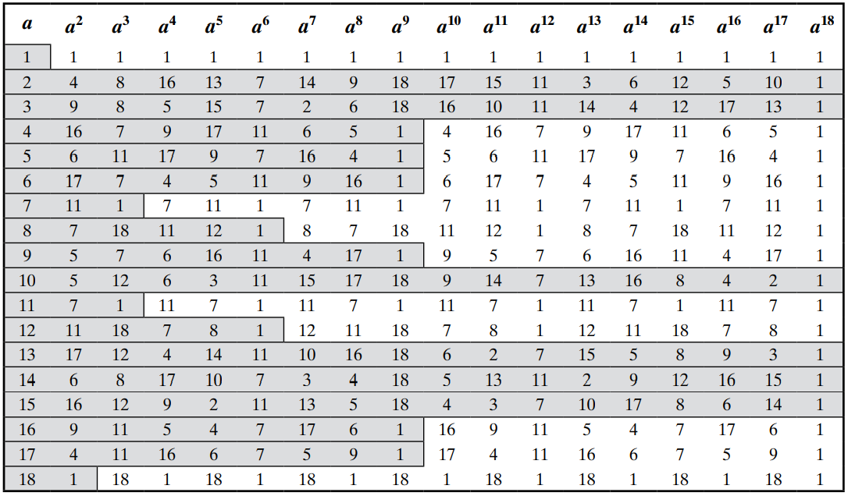
Example: Powers of Integers, Modulo 19
For the prime number 19, its primitive roots are 2, 3, 10, 13, 14, and 15.

Slide 6
For any integer b and a primitive root a of prime number p, we can find a unique exponent i such that:
b ≡ a^{i} (mod p), where 0 ≤ i ≤ (p - 1)
The exponent i is referred to as the discrete logarithm of b for the base a, mod p.
We express this value as dlog_{a,p}(b) = i.
Example:
dlog_{2,19}(1) = 18
→ 2¹⁸ mod 19 = 262144 mod 19 = 1

Slide 7
The Algorithm of Diffie-Hellman key exchange
There are two publicly known numbers: a prime number q and an integer α that is a primitive root of q.
Suppose the users A and B wish to create a shared key.
User A selects a random integer X_{A} < q and computes:
Y_{A} = α^X_{A} mod q.
Similarly, user B independently selects a random integer X_{B} < q and computes
Y_{B} = α^X_{B} mod q.

Slide 8
Each side keeps the X value private and makes the Y value available publicly to the other side.
Thus, X_{A} is A’s private key and Y_{A} is A’s corresponding public key, similarly for B.
User A computes the key as
K = (Y_{B})^X_{A} mod q
and user B computes the key as
K = (Y_{A})^X_{B} mod q.

Slide 9
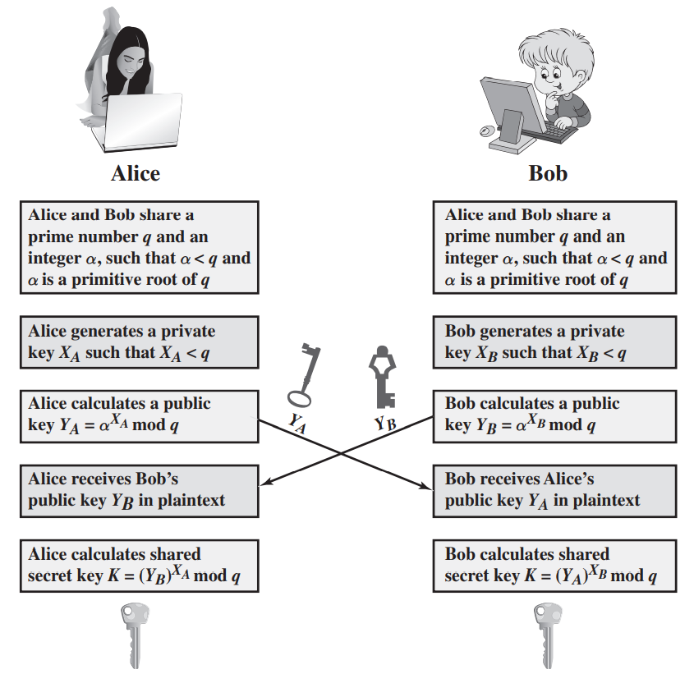

Slide 10
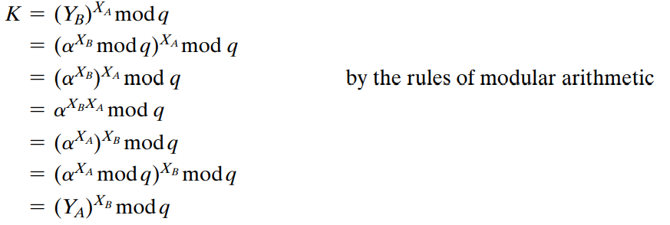
User A computes the key as: and user B computes the key as:
K = (Y_{B})^X_{A} mod q K = (Y_{A})^X_{B} mod q.
The result is that the two sides have exchanged a secret value. Typically, this secret value is used as shared symmetric secret key.

Slide 11
For an adversary who wishes to determine the secret key K.
Because X_{A} and X_{B} are private, an adversary only has the following ingredients to work with: q, α, Y_{A}, and Y_{B}.
Thus, the adversary is forced to take a discrete logarithm to determine the key.
For example, to determine the private key of user B, an adversary must compute X_{B} = dlog_{α,q}(Y_{B})
The adversary can then calculate the key K in the same manner as user B calculates it.
That is, the adversary can calculate K as K = (Y_{A})^X_{B} mod q
The security of the Diffie-Hellman key exchange lies in the fact that, while it is relatively easy to calculate exponentials modulo a prime, it is very difficult to calculate discrete logarithms.
For large primes, the latter task is considered infeasible.

Slide 12
Example: Key exchange is based on the use of the prime number q = 353 and a primitive root of 353, in this case α = 3.
A and B select private keys X_{A} = 97 and X_{B} = 233, respectively.
A computes its public key :
Y_{A} = 3⁹⁷ mod 353 = 40.
B computes its public key:
Y_{B} = 3²³³ mod 353 = 248.
A computes K = (Y_{B})^X_{A} mod 353 = 248⁹⁷ mod 353 = 160.
B computes K = (Y_{A})^X_{B} mod 353 = 40²³³ mod 353 = 160.

Slide 13
We assume an attacker would have available the following information: q = 353; α = 3; Y_{A} = 40; Y_{B} = 248
In this simple example, it would be possible by brute force to determine the secret key 160.
In particular, an attacker E can determine the common key by discovering a solution to the equation: 3ª mod 353 = 40 or the equation 3^{b} mod 353 = 248.
The brute-force approach is to calculate powers of 3 modulo 353, stopping when the result equals either 40 or 248.
The desired answer is reached with the exponent value of 97, which provides 3⁹⁷ mod 353 = 40.
With larger numbers, the problem becomes impractical.

Slide 14
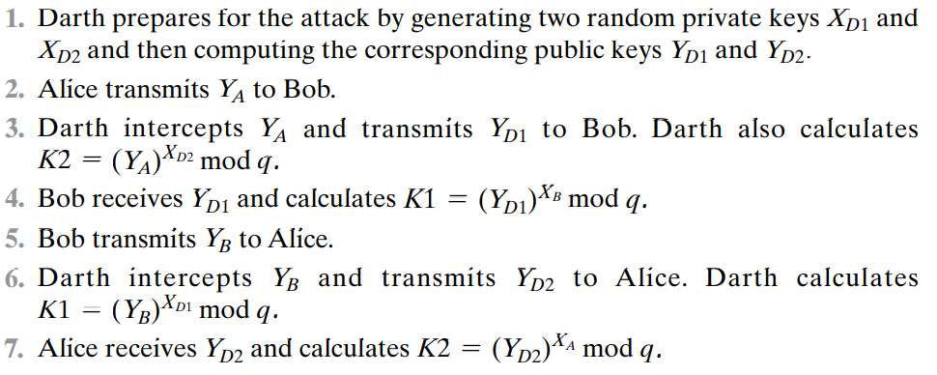
Man-in-the-Middle Attack
Suppose Alice and Bob wish to exchange keys, and Darth is the adversary. The attack proceeds as follows

Slide 15
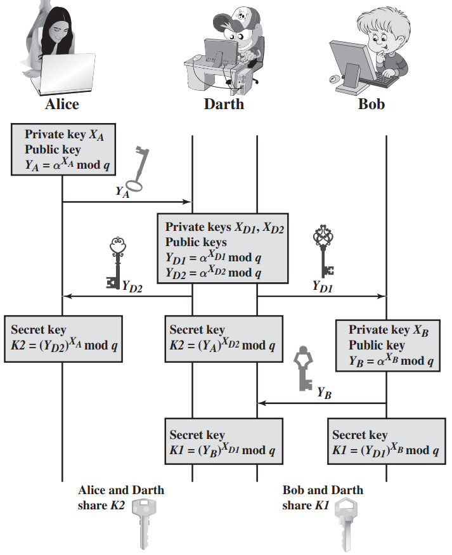
Man-in-the-Middle Attack

Slide 16
At this point, Bob and Alice think that they share a secret key, but instead Bob and Darth share secret key K1 and Alice and Darth share secret key K2.
All future communication between Bob and Alice is compromised in the following way.
Alice sends an encrypted message M: E(K2, M).
Darth intercepts the encrypted message and decrypts it to recover M.
Darth sends Bob E(K1, M) or E(K1, M′), where M′ is any message.
In the first case, Darth simply wants to eavesdrop on the communication without altering it.
In the second case, Darth wants to modify the message going to Bob.

Slide 17
The key exchange protocol is insecure against a man-in-the-middle attack and vulnerable to such an attack because it does not authenticate the participants.
This vulnerability can be overcome with the use of digital signatures and public-key certificates; these topics are explored later.

Slide 18
Elgamal Cryptographic System
In 1984, T. Elgamal announced a public-key scheme based on discrete logarithms, closely related to the Diffie-Hellman technique.
The Elgamal cryptosystem is used in some form in a number of standards including the digital signature standard (DSS), and the S/MIME e-mail standard.
As with Diffie-Hellman, the global elements of Elgamal are a prime number q and α, which is a primitive root of q.

Slide 19
User A generates a private/public key pair as follows:
Generate a random integer X_{A}, such that 1 < X_{A} < q - 1.
Compute Y_{A} = α^X_{A} mod q.
A’s private key is X_{A} and A’s public key is {q, α, Y_{A}}.
User B that has access to A’s public key can encrypt a message as:
Represent the message as an integer M in the range 0 < M < q - 1. Longer messages are sent as a sequence of blocks, with each block being an integer less than q.
Choose a random integer k such that 1 ≤ k ≤ q - 1.
Compute a one-time key K = (Y_{A})^{k} mod q.
Encrypt M as the pair of integers (C₁, C₂) where C₁ = α^{k} mod q; C₂ = KM mod q

Slide 20
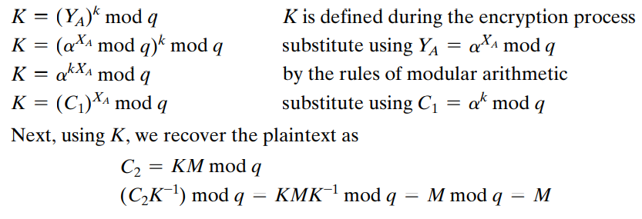
User A recovers the plaintext as follows:
Recover the key by computing K = (C₁)^X_{A} mod q.
Compute M = (C₂K⁻¹ ) mod q.
In these steps : Alice generates a public/private key pair;
Bob encrypts using Alice’s public key;
Alice decrypts using her private key.
Let us demonstrate why the Elgamal scheme works.
=

Slide 21
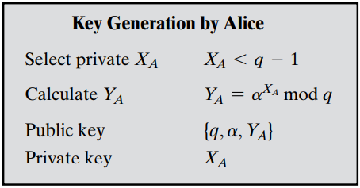
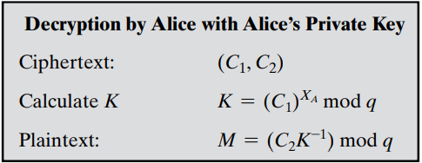
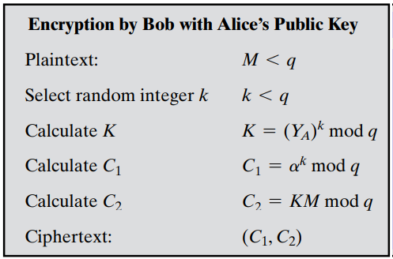
K functions as a one-time key, used to encrypt and decrypt the message.

Slide 22
Example: let q = 19. It has primitive roots {2, 3, 10, 13, 14, 15}.
We choose α = 10.
Alice generates a key pair as follows:
Alice chooses X_{A} = 5.
Then Y_{A} = α ^X_{A} mod q = α⁵ mod 19 = 3.
Alice’s private key is 5 and Alice’s public key is {q, α, Y_{A}}= {19, 10, 3}.
Suppose Bob wants to send the message with the value M = 17. Then:
Bob chooses k = 6.
Then K = (Y_{A}) k mod q = 3⁶ mod 19 = 729 mod 19 = 7.
So C₁ = α^{k} mod q = α⁶ mod 19 = 11
C₂ = KM mod q = 7 * 17 mod 19 = 119 mod 19 = 5
Bob sends the ciphertext (11, 5).
For decryption:
Alice calculates K=(C₁)^X_{A} mod q = 11⁵ mod 19 = 161051 mod 19=7
Then K⁻¹ is 7⁻¹ mod 19 = 11 → K⁻¹=(1+n*19)/7 (take the integer result)
Finally, M = (C₂K⁻¹ ) mod q = 5 * 11 mod 19 = 55 mod 19 = 17.

Slide 23
If a message must be broken up into blocks and sent as a sequence of encrypted blocks, a unique value of k should be used for each block.
If k is used for more than one block, knowledge of one block M1 of the message enables the user to compute other blocks as follows, Let
C_{1,1} = α^{k} mod q; C_{2,1} = KM₁ mod q
C_{1,2} = α ^{k} mod q; C_{2,2} = KM₂ mod q
Then,
C_{2,1} / C_{2,2} = (KM₁ mod q) / KM₂ mod q = M₁ mod q / M₂ mod q
If M₁ is known, then M₂ is easily computed as
M₂ = (C_{2,1})⁻¹ C_{2,2} M₁ mod q
The security of Elgamal is based on the difficulty of computing discrete logarithms.

Slide 24
To recover A’s private key, an adversary would have to compute
X_{A} = dlog_{a,q}(Y_{A}).
Alternatively, to recover the one-time key K, an adversary would have to determine the random number k, and this would require computing the discrete logarithm
k = dlog_{a,q}(C₁).
It is points out that these calculations are regarded as infeasible if p is at least 300 decimal digits and q - 1 has at least one “large” prime factor.

