Slide 1
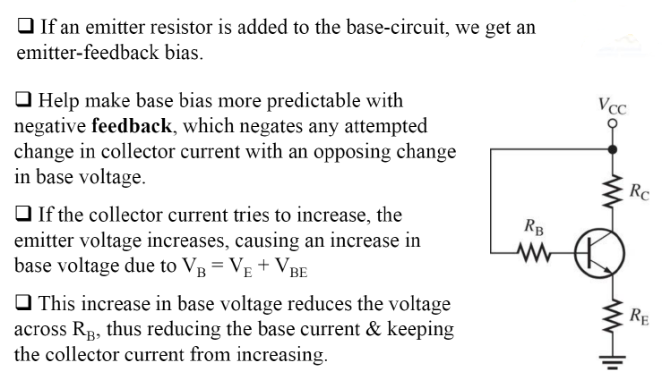
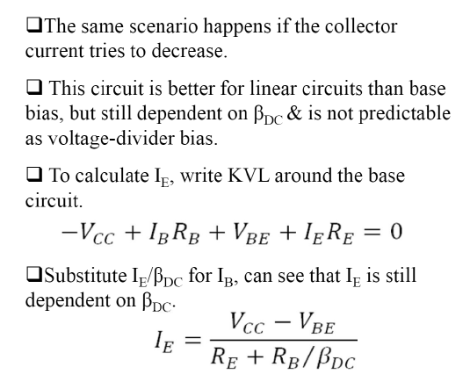
Term 2, Lecture 7: Emitter-Feedback & Collector-
Feedback biases
Emitter-Feedback bias:
1

Slide 2

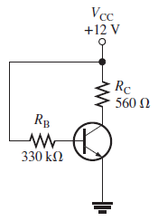
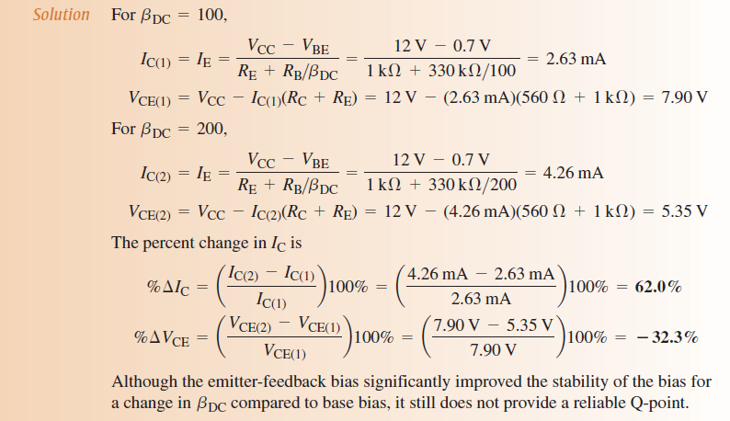
2

Slide 3
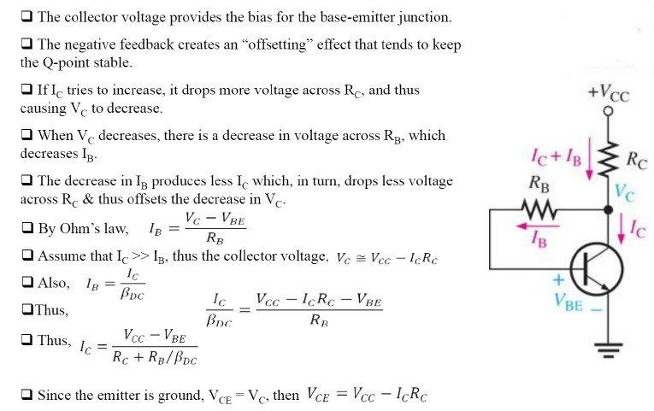
Collector-Feedback bias:
3

Slide 4
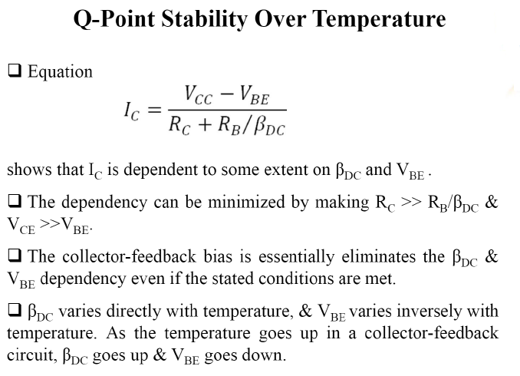
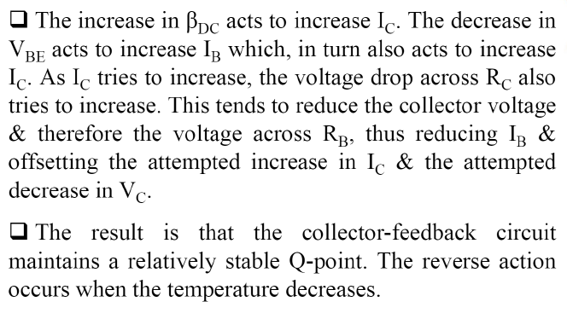
4

Slide 5
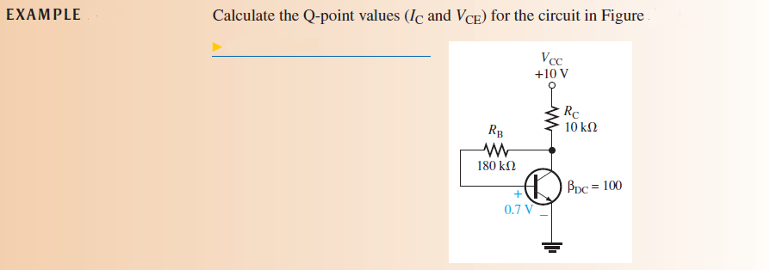

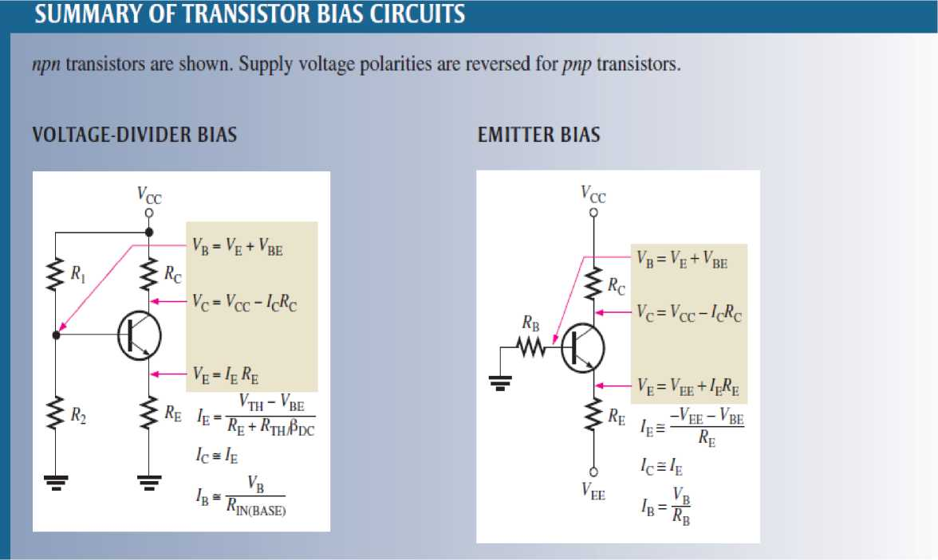
Solution:
5

Slide 6
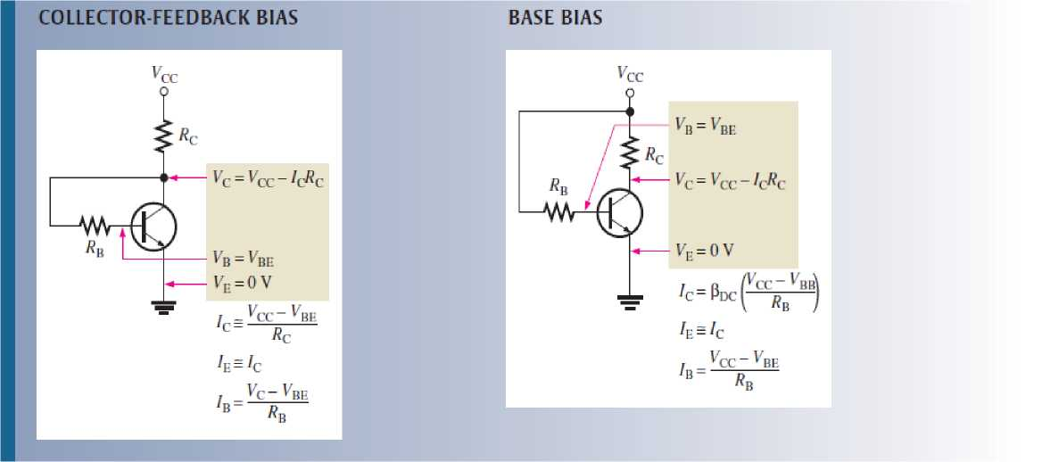
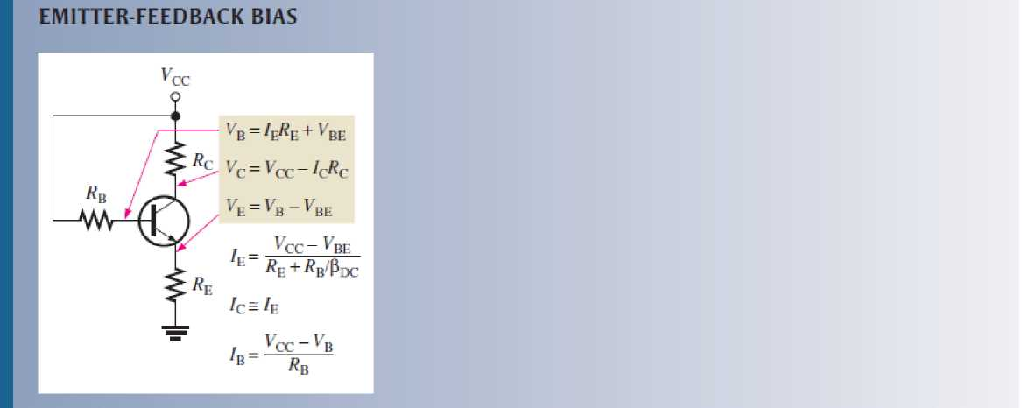
Review Questions:
1. How does emitter-feedback bias improve on base bias?
2. Explain how an increase in beta DC causes a reduction in base current in a collector-feedback circuit.
6

