Slide 1
Term 2, Lecture 6: Emitter and Base Biases
Emitter Bias:
1

Slide 2
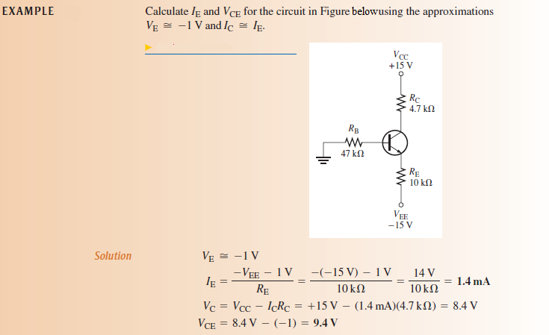
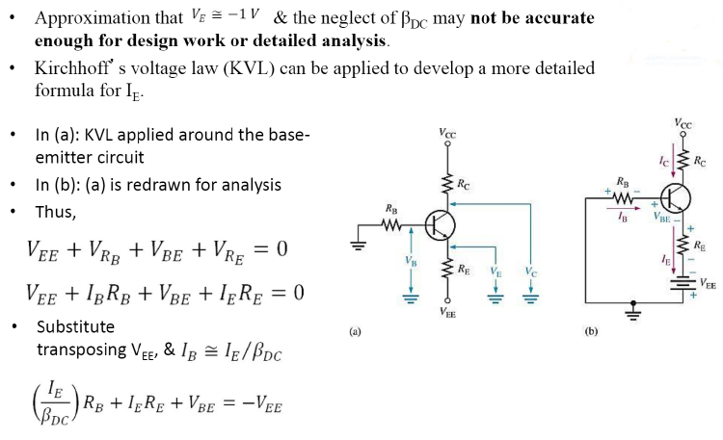
2

Slide 3
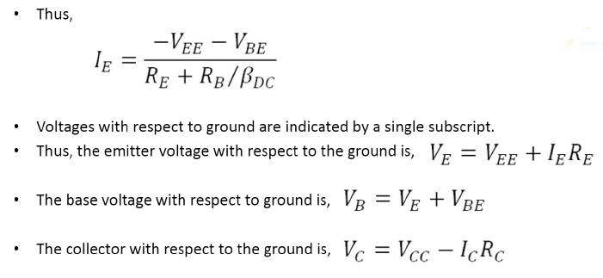
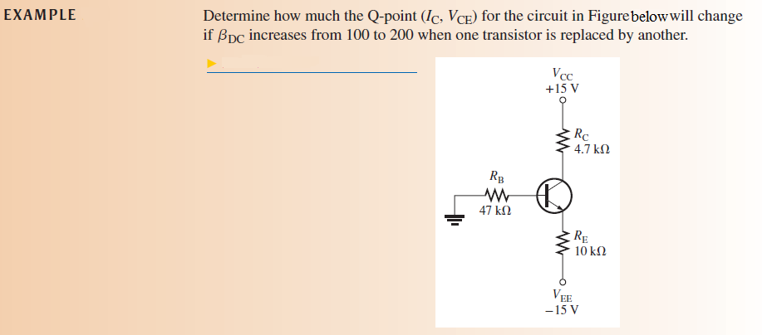
3

Slide 4
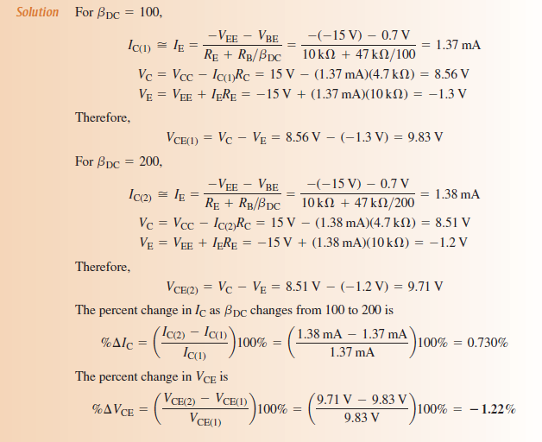
4

Slide 5
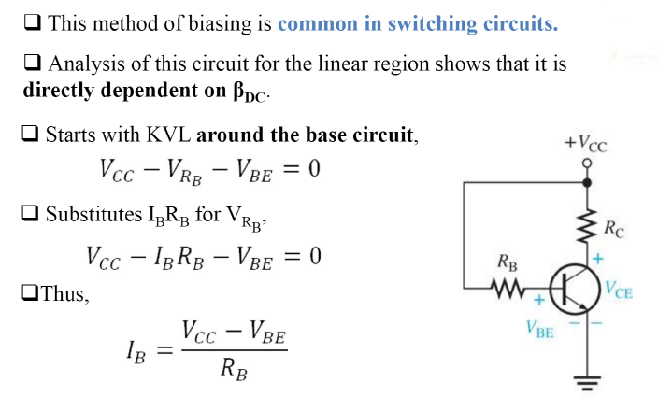
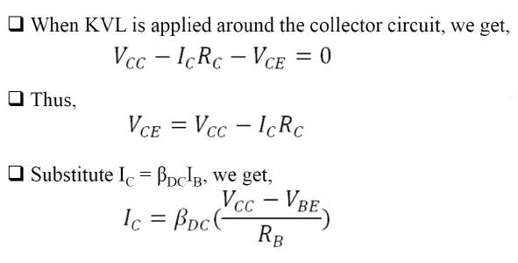
Base Bias:
5

Slide 6
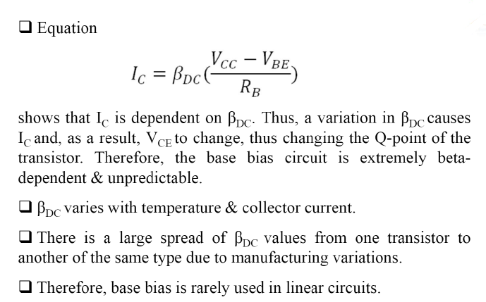
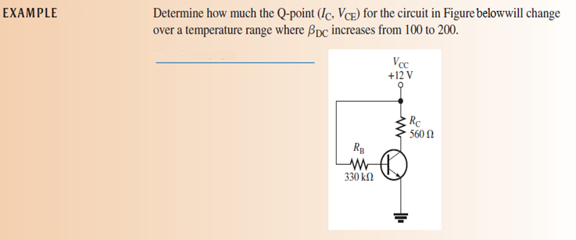
Q-Point Stability of base Bias:
6

Slide 7
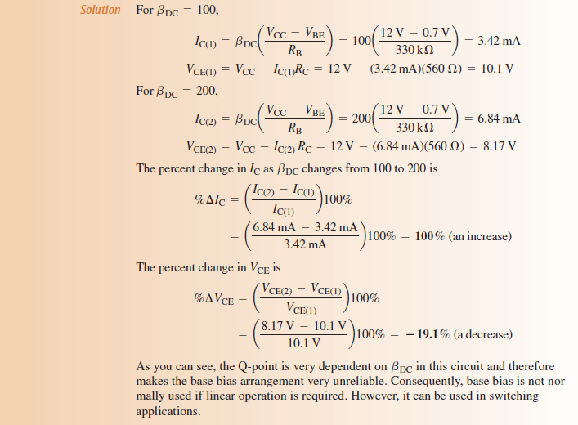
Review Questions:
1. Why is emitter bias more stable than base bias?
2. What is the main disadvantage of emitter bias?
3.What is the main disadvantage of the base bias method?
7

