Slide 1
Engineering Mechanics-Strength of Material
Lecture-2
Simple Strain
By
Dr. Moahmed N. Abdulah
Dr. Salah M. Swadi
Mustansiriyah University
College of Engineering
Dept. of Electrical Engineering
2020-2019

Slide 2
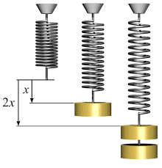
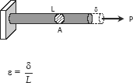
Simple Strain
Also known as unit deformation, strain is the ratio of the change in length caused by the applied force, to the original length.
where δ is the deformation and L is the original length, thus ε is dimensionless.

Slide 3
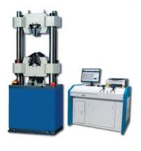
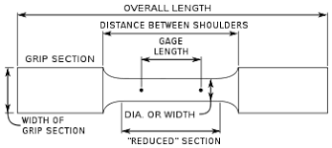
Stress-Strain Diagram
Suppose that a metal specimen be placed in tension-compression testing machine. As the axial load is gradually increased in increments, the total elongation over the gage length is measured at each increment of the load and this is continued until failure of the specimen takes place. Knowing the original cross-sectional area and length of the specimen, the normal stress σ and the strain ε can be obtained. The graph of these quantities with the stress σ along the y-axis and the strain ε along the x-axis is called the stress-strain diagram. The stress-strain diagram differs in form for various materials. The diagram shown below is that for a medium carbon structural steel.

Slide 4
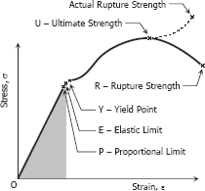

Metallic engineering materials are classified as either ductile or brittle materials. A ductile material is one having relatively large tensile strains up to the point of rupture like structural steel and aluminum, whereas brittle materials has a relatively small strain up to the point of rupture like cast iron and concrete. An arbitrary strain of 0.05 mm/mm is frequently taken as the dividing line between these two classes.
$$S.F= \frac{Yield Stress}{Allowable Stres}= \frac{σ_{y}}{σ_{all}}$$

Slide 5
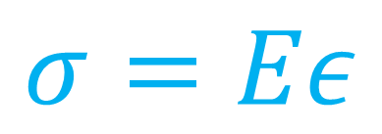
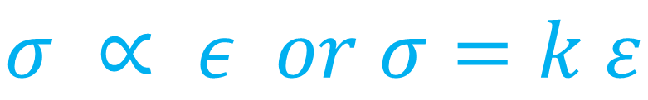
PROPORTIONAL LIMIT (HOOKE'S LAW)
From the origin O to the point called proportional limit, the stress-strain curve is a straight line. This linear relation between elongation and the axial force causing was first noticed by Sir Robert Hooke in 1678 and is called Hooke's Law that within the proportional limit, the stress is directly proportional to strain or The
$$σ ∝ ε or σ=k ε$$
The constant of proportionality k is called the Modulus of Elasticity E or Young's Modulus ( Thomas Young/ British Scientist) and is equal to the slope of the stress-strain diagram from O to P. Then
$$σ=Eε$$

Slide 6
ELASTIC LIMIT
The elastic limit is the limit beyond which the material will no longer go back to its original shape when the load is removed, or it is the maximum stress that may e developed such that there is no permanent or residual deformation when the load is entirely removed.
ELASTIC AND PLASTIC RANGES
The region in stress-strain diagram from O to P is called the elastic range. The region from P to R is called the plastic range.
YIELD POINT
Yield point is the point at which the material will have an appreciable elongation or yielding without any increase in load.

Slide 7
ULTIMATE STRENGTH
The maximum ordinate in the stress-strain diagram is the ultimate strength or tensile strength.
AXIAL DEFORMATION
In the linear portion of the stress-strain diagram, the tress is proportional to strain and is given by
σ = Eε
since σ = P / A and ε = δ / L, then P / A = E δ / L. Solving for δ,
To use this formula, the load must be axial, the bar must have a uniform cross-sectional area, and the stress must not exceed the proportional limit

Slide 8
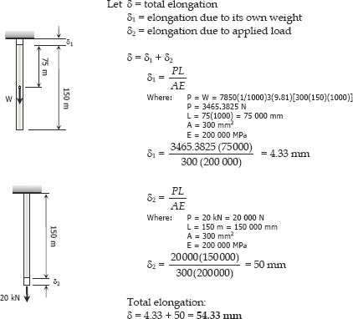
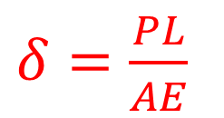
Example1/A steel rod having a cross-sectional area of 300 mm² and a length of 150 m is suspended vertically from one end. It supports a tensile load of 20 kN at the lower end. If the unit mass of steel is 7850 kg/m3 and E = 200 GN/m2, find the total elongation of the rod
$δ=\frac{PL}{AE}$

Slide 9
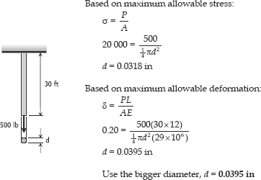
Example2/ A steel wire 30 ft long, hanging vertically, supports a load of 500 lb. Neglecting the weight of the wire, determine the required diameter if the stress is not to exceed 20 ksi and the total elongation is not to exceed 0.20 in. Assume E = 29 × 10⁶ psi.

Slide 10

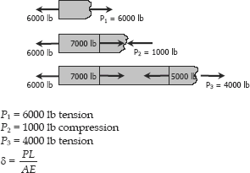

Example.3/ An aluminum bar having a cross-sectional area of 0.5 in² carries the axial loads applied at the positions shown in Fig. P-209. Compute the total change in length of the bar if E = 10 × 10 ⁶ psi. Assume the bar is suitably braced to prevent lateral buckling.

Slide 11
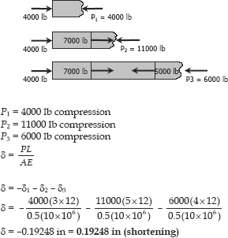
Example.4/ Solve Prob. 209 if the points of application of the 6000-lb and the 4000-lb forces are interchanged

Slide 12

Example. 5/ A bronze bar is fastened between a steel bar and an aluminum bar as shown in Fig. P-211. Axial loads are applied at the positions indicated. Find the largest value of P that will not exceed an overall deformation of 3.0 mm, or the following stresses: 140 MPa in the steel, 120 MPa in the bronze, and 80 MPa in the aluminum. Assume that the assembly is suitably braced to prevent buckling. Use Est = 200 GPa, Eal = 70 GPa, and Ebr = 83 GPa.

Slide 13
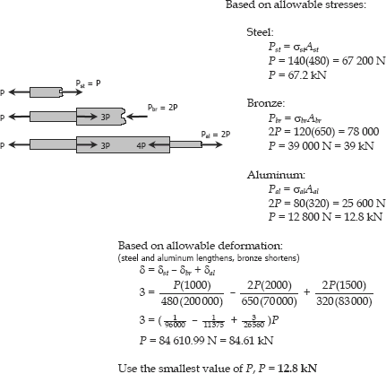

Slide 14
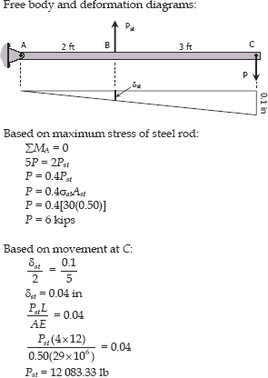
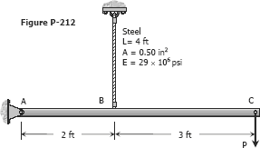
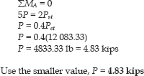
Example. 6/ The rigid bar ABC shown in Fig. P-212 is hinged at A and supported by a steel rod at B. Determine the largest load P that can be applied at C if the stress in the steel rod is limited to 30 ksi and the vertical movement of end C must not exceed 0.10 in.

Slide 15
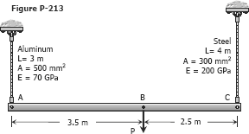
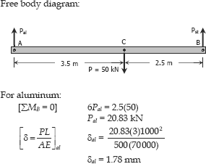
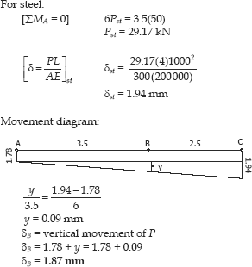
Example.7/ The rigid bar AB, attached to two vertical rods as shown in Fig. P-213, is horizontal before the load P is applied. Determine the vertical movement of P if its magnitude is 50 kN.

Slide 16
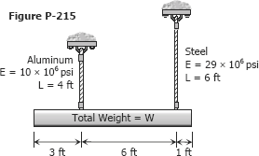
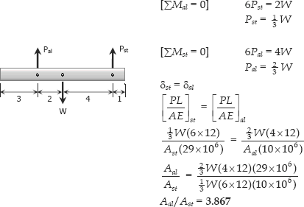
Example. 8/ A uniform concrete slab of total weight W is to be attached, as shown in Fig. P-215, to two rods whose lower ends are on the same level. Determine the ratio of the areas of the rods so that the slab will remain level.

