Slide 1
Ministry of Higher Education &scientific Research
Al-Mustansiriya University
College of Engineering
Energy management and applications
Heat Recovery Systems
(Section 5)
Asst. Prof. Dr. Hayder Mohammad Jaffal

Slide 2
1- Introduction
Several processes inherent to the operation of the heating, ventilating, and air-conditioning (HVAC) systems result in heat rejection to the outside. All or part of this heat can be recovered and used to perform other useful functions. Improvements in air-to-air heat exchangers have made the recovery of waste heat cost-effective for some building systems. In industrial applications, the concept of heat recovery is relatively old and common because heat is a by-product of several manufacturing processes. For instance, waste incinerators are commonly used in industrial facilities to generate steam or hot water. In this section, a brief description of common heat recovery systems used in buildings is provided. In particular, the thermal efficiencies and the applications of various heat reclaiming devices are presented. Moreover, simplified calculation procedures are outlined to estimate the potential energy use and cost savings due to addition or improvement of heat recovery devices.

Slide 3
2- Benefits of Waste Heat Recovery
Benefits of 'waste heat recovery' can be broadly classified in two categories:
Direct Benefits:
Recovery of waste heat has a direct effect on the efficiency of the process. This is reflected by reduction in the utility consumption & costs, and process cost.
Indirect Benefits:
a) Reduction in pollution: A number of toxic combustible wastes such as carbon monoxide gas, sour gas, carbon black off gases, oil sludge, Acrylonitrile and other plastic chemicals etc, releasing to atmosphere if/when burnt in the incinerators serves dual purpose i.e. recovers heat and reduces the environmental pollution levels.

Slide 4
b) Reduction in equipment sizes: Waste heat recovery reduces the fuel consumption, which leads to reduction in the flue gas produced. This results in reduction in equipment sizes of all flue gas handling equipment's such as fans, stacks, ducts, burners, etc.
c) Reduction in auxiliary energy consumption: Reduction in equipment sizes gives additional benefits in the form of reduction in auxiliary energy consumption like electricity for fans, pumps etc..

Slide 5
3- Types of Heat Recovery Systems
Waste heat recovery can be achieved by heat exchangers and can take several forms and shapes depending on the systems involved in the exchange of thermal energy. In particular, heat exchangers can be grouped into three categories depending on the temperature involved:
Low-temperature heat exchangers with fluid temperatures less than 230 ̊C. Applications of low-temperature heat exchangers are common in buildings such as preheating of ventilation air with exhaust air.
Medium-temperature heat exchangers with fluid temperatures ranging from 230 ̊C and 650 ̊C. Examples of medium-temperature heat recovery systems include incinerators.
High-temperature heat exchangers with fluid temperatures above 650 ̊C. Generally, the use of high-temperature heat exchangers is specific to industrial processes such as in steel/aluminum furnaces.

Slide 6
Moreover, the fluids involved in the exchange of heat can determine the type of waste heat recovery system that is the most suitable for a given application. Three common types of heat exchangers are considered:
1. Gas-to-gas waste heat recovery systems that include heat pipes, rotary thermal wheels, liquid coupled heat exchangers, and plate-fin heat exchangers.
2. Gas-to-liquid waste heat recovery systems such as fire-tube or water-tube boilers, heat pipes, and economizers.
3. Liquid-to-liquid waste heat recovery systems including shell-and-tube heat exchangers and plate heat exchangers.

Slide 7
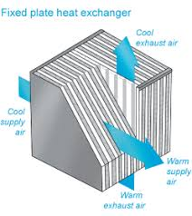
4- Air-to-air heat recovery systems
Plate-air-to-air heat exchangers: These heat recovery systems have the advantage that the exhaust air does not mix with intake air and thus they provide an effective method to retrieve heat virtually free of cross-contamination. The plate air-to-air heat exchangers are attractive for buildings that require large amounts of outside air. Therefore, the commercial applications for these heat recovery systems include hospitals and restaurants. Figure 1 illustrates one type of plate air-to air heat exchanger.
Figure 1.One configuration of plate air-to-air heat exchanger

Slide 8
Heat-pipes: Based on a concept developed for nuclear energy applications during the 1940s, heat pipes provide simple and effective devices to reclaim heat. A heat pipe consists of a copper tube lined with a wick medium and filled with refrigerant. When one end of the heat pipe is heated (by placing it in the exhaust air stream, for instance), the refrigerant is vaporized and flows to the other end to provide heat to the intake air by condensation of the refrigerant. Typically, the heat pipe has a recovery rate that ranges from 50 to 70 percent. Even though heat pipes are more expensive than the plate air-to-air heat exchangers, their maintenance requirements are small because they have no moving parts. The useful life expectancy of heat pipes can be over 25 years. Figure 2 presents a basic configuration of a heat exchanger equipped with heat pipes.

Slide 9
The heat pipes are used in following industrial applications:
a. Process to Space Heating: The heat pipe heat exchanger transfers the thermal energy from process exhaust for building heating. The preheated air can be blended if required. The requirement of additional heating equipment to deliver heated make up air is drastically reduced or eliminated.
b. Process to Process: The heat pipe heat exchangers recover waste thermal energy from the process exhaust and transfer this energy to the incoming process air. The incoming air thus become warm and can be used for the same process/other processes and reduces process energy consumption.
c. HVAC Applications:
Cooling: Heat pipe heat exchangers precools the building make up air in summer and thus reduces the total tons of refrigeration, apart from the operational saving of the cooling system. Thermal energy is supply recovered from the cool exhaust and transferred to the hot supply make up air.

Slide 10
Heating: The above process is reversed during winter to preheat the make up air.
The other applications in industries are:
• Preheating of boiler combustion air
• Recovery of Waste heat from furnaces
• Reheating of fresh air for hot air driers
• Recovery of waste heat from catalytic deodorizing equipment
• Reuse of Furnace waste heat as heat source for other oven
• Cooling of closed rooms with outside air
• Preheating of boiler feed water with waste heat recovery from flue gases in the heat pipe economizers.
• Drying, curing and baking ovens
• Waste steam reclamation
• Brick kilns (secondary recovery)
• Reverberatory furnaces (secondary recovery)
• Heating, ventilating and air-conditioning systems

Slide 11
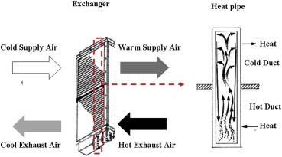
Fig. 2 construction details of heat pipe

Slide 12
Rotary thermal wheels: include a rotating cylinder filled with an air-permeable medium with a large internal surface area. The medium can be appropriately selected either to recover sensible heat only or to reclaim total heat (i.e., sensible and latent heat). Typically, the air streams flow in a counterflow configuration as depicted in Figure 3 to increase the heat transfer effectiveness. Generally, rotary thermal wheels include a purge section to reduce cross-contamination between air streams. This cross-contamination occurs by carryover air becoming entrained within the rotating heat exchanger medium or by leakage due to differential pressure across the two air streams.
A variation of the Heat Wheel is the rotary regenerator where the matrix is in a cylinder rotating across the waste gas and air streams. The heat or energy recovery wheel is a rotary gas heat regenerator, which can transfer heat from exhaust to incoming gases.
Its main area of application is where heat exchange between large masses of air having small temperature differences is required. Heating and ventilation systems and recovery of heat from dryer exhaust air are typical applications.

Slide 13
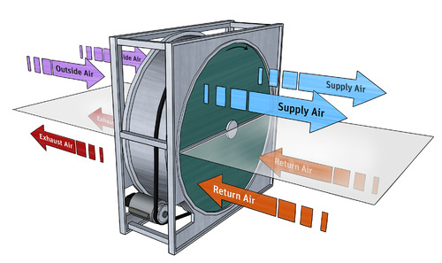
Fig. 3 Rotary thermal wheel

Slide 14
Glycol loop heat exchangers: consist generally of finned-tube water coils placed in the supply and exhaust air streams. These coils are part of a closed-loop system that transfers heat from one air stream to the other using a glycol (antifreeze) solution. These systems, often referred to as runaround coils, are suitable for sensible heat recovery applications. Figure 4 illustrates one configuration of runaround coil systems that is commonly used to preheat or precool fresh outdoor air with exhaust air.

Slide 15
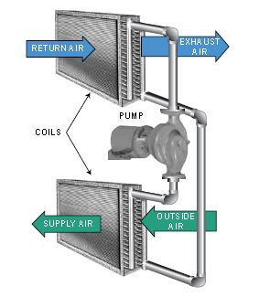
Fig. 4 Basic set-up of a glycol loop heat exchanger.

Slide 16
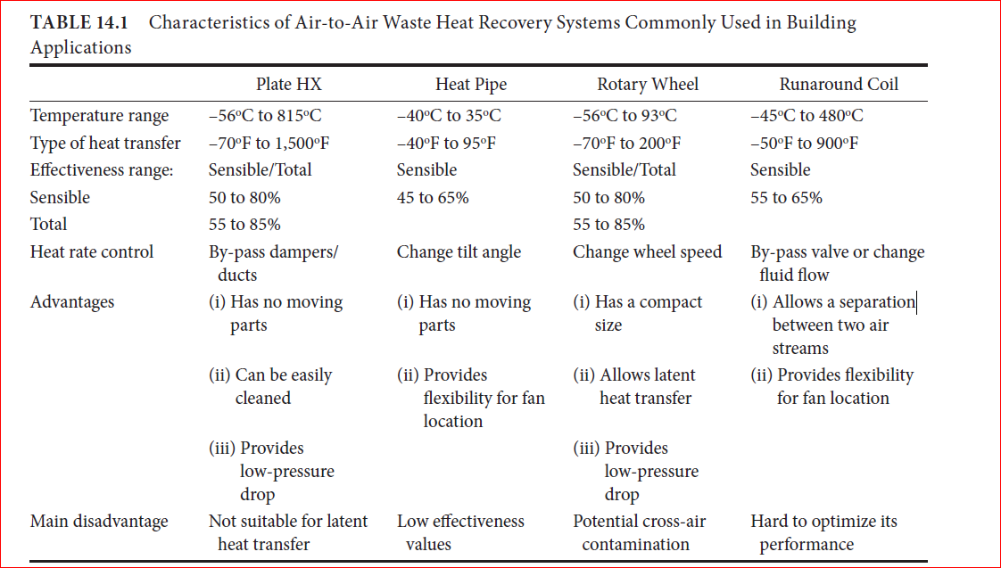
Table 1 summarizes some of the characteristics of the four heat recovery systems discussed above.

Slide 17
5- Performance of Heat Recovery Systems
The performance of heat recovery systems can be determined using laboratory testing. For instance, ASHRAE Standard 84 (ASHRAE-84, 2008) presents a systematic procedure for testing and evaluating the performance of air-to-air heat exchangers under controllable laboratory conditions. Moreover, ARI Standard 1060 (ARI, 2001) provides an industry-established standard to rate and verify the performance of air-to-air heat exchangers for use in energy recovery ventilation equipment. However, the in situ performance of heat recovery systems can be significantly different from that obtained through laboratory testing. Indeed, balances in mass airflow as required by both ASHRAE and ARI standards are generally not achieved in field operation of heat recovery systems. Therefore, the actual—rather than the rated—performance of the heat recovery systems should be used to determine their cost-effectiveness in retrofit applications.

Slide 18
The performance of air-to-air heat exchangers depends on the type of heat and mass transfer involved and is typically measured in terms of:
• Sensible energy transfer using dry-bulb temperature
• Latent energy transfer using humidity ratio
• Total energy transfer using enthalpy
Figure 5 illustrates a basic model for a heat exchanger between two streams of fluids (typically air).
The figure indicates the following parameters:
-Xi (i =1,2,3, and 4) is one of three possible characteristics of the fluid: temperature (for sensible heat), humidity ratio (for latent heat), and enthalpy (for total heat).
-min is the mass flow rate of the fluid stream from which heat is recovered.
-mout is the mass flow rate of the fluid stream that recovers heat.

Slide 19
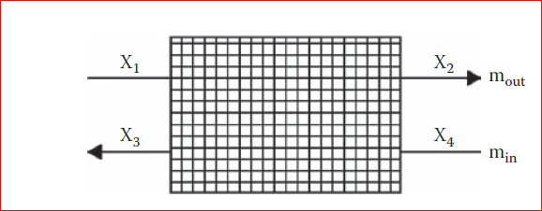
2
1
4
Fig. 5 Ventilation and air conditioning cycle with heat recovery.
Fig. 6 Typical air-handling unit for an air HVAC system.

Slide 20
To characterize the heat recovery capability of a heat exchanger, an index referred to as the effectiveness is usually provided and is defined as the ratio of the actual heat transfer and the maximum possible heat transfer that can occur between the two streams.
A typical configuration has been considered for the Air Handling Unit AHU (Figures 5,6),consisting of a set of heating/cooling and dehumidification, humidification, and reheating coils to achieve the required supply air (SA) condition. The return air (RA) (4) of the space is separated into a recirculated (CA) and an exhausted part (EA). The latter one is used for preconditioning the outside air (OA) (1) within the heat recovery (HR) device. After leaving the HR, the recovery air (R) (2) together with the CA are mixed (MA) and sent to the AHU coils.
Using the heat balance applied to the fluid streams as indicated in Figures 5,6, it can be shown that the effectiveness can be estimated using the following expression:

Slide 21
$$ε=\frac{m_{in}\left(X_{2}−X_{1}\right)}{M_{in}\left[m_{in},m_{out}\right]\left(X_{4}−X_{1}\right)}$$
It should be noted, when only sensible heat is recovered, the expression of above Eq. involves temperature, humidity ratio or enthalpy values as indicated in the following Eq.:
$$ε=\frac{m_{in}C_{p,in}\left(T_{2}−T_{1}\right)}{m_{min}C_{p,min}\left(T_{4}−T_{1}\right)}$$
$$ε=\frac{m_{in}\left(x_{2}−x_{1}\right)}{m_{min}\left(x_{4}−x_{1}\right)}$$
$$ε=\frac{m_{in}\left(h_{2}−h_{1}\right)}{m_{min}\left(h_{4}−h_{1}\right)}$$

Slide 22
It should be noted, when only sensible heat is recovered, the expression of above Eq. involves temperature values as indicated in the following Eq.:
where T is the temperature, x is the humidity ratio and h is the enthalpy, with the subscripts corresponding to the positions in Figure 5, and mOA and mmin are the outside and minimum air flow rates, respectively.
For air-to-air heat exchangers, when the two streams have the same mass flow (such as in the case of make-up air systems), the expression for the effectiveness (sometimes referred to as the efficiency) can be further simplified to:
$$ε=\frac{\left(T_{2}−T_{1}\right)}{\left(T_{4}−T_{1}\right)}$$

Slide 23
In general, the effectiveness of a heat recovery system depends on two main factors including:
1- The contact surface between the heat exchanger and the fluid streams. The higher this contact surface, the more heat is recovered. However, the increase in the surface area—using fins, plates, and coils—required to improve the heat recovery effectiveness results in an increase in the pressure drop across the heat exchanger which has to be overcome by additional fan/pump power. Another factor that significantly affects the performance of a heat recovery system is fouling which is basically the undesired accumulation of particulates such as dust on the contact surfaces. Fouling results in additional resistance to heat transfer and thus reduces the heat exchanger performance. Moreover, fouling increases surface roughness and increases the pressure drop, and thus may lead to higher fan or pump energy requirements. Therefore, it is important to clean the heat exchanger surfaces regularly in order to maintain a good performance of the heat exchanger.

Slide 24
2-Temperature difference between the two fluid streams. The higher the temperature difference, the more efficient is the heat recovery system. For instance, in cold climates where the temperature difference between air intake and air exhaust is higher than 30°F (20°C), the effectiveness of heat recovery systems is higher than in mild climates where the temperature difference may not exceed 15°F (10°C).

Slide 25
Example 1:
Calculate the supply air conditions leaving a total heat recovery wheel with 5.66 m3/s of outside air at 34.44 °C db and 25 °C wb; and 5.66 m3/s of return air at 23.88 °C db and 50% RH, if both the sensible & latent effectiveness of the wheel is 60%. Calculate the reduction in required cooling energy.
Solution:
At the conditions given above:
h1=75925 J/kg
h4=47499 J/kg
$$ε=\frac{m_{in}\left(h_{1}−h_{2}\right)}{m_{min}\left(h_{1}−h_{4}\right)}$$

Slide 26
$$h_{2}=h_{1}−ε\left(h_{1}−h_{4}\right)$$
$$h_{2}=75925−0.6×\left(75925−47499\right)=58869 J/kg$$
Also from this equation :
$$T_{2}=T_{1}−ε\left(T_{1}−T_{4}\right)$$
$$T_{2}=33.44−0.6\left(33.44−23.88\right)=27.7 \dot{C}$$
Therefore, the supply air leaving the heat recovery wheel will be:
T2=27.7 ̊ C db and 20.5 ̊ C

Slide 27
the reduction in required cooling energy is:
Q = $ε×m_{min}\left(h_{1}−h_{4}\right)$
Q =0$.6×1.13×5.66×\left(75925−47499\right)=109084 W$

Slide 28
Example 2:
Consider the unit from Example 1, but instead of balanced flow, the return airflow is only 4.53 m3/s due to exfiltration and/or exhaust air. What are the conditions of the supply air leaving the energy recovery wheel in this case? What is the new heat transfer rate? (Assume the outside air and return air conditions remain the same).
Solution:
At the conditions given above:
h1=75925 J/kg
h4=47499 J/kg
$$ε=\frac{m_{in}\left(h_{1}−h_{2}\right)}{m_{min}\left(h_{1}−h_{4}\right)}$$

Slide 29
$$h_{2}=h_{1}−ε\frac{m_{min}}{m_{in}}\left(h_{1}−h_{4}\right)$$
$$h_{2}=75925−0.6×\frac{4.53}{5.66}\left(75925−47499\right)=62274.5 J/kg$$
Also from this equation :
$$T_{2}=T_{1}−ε\frac{m_{min}}{m_{in}}\left(T_{1}−T_{4}\right)$$
$$T_{2}=33.44−0.6×\frac{4.53}{5.66}×\left(33.44−23.88\right)=28.37 \dot{C}$$
Therefore, the supply air leaving the heat recovery wheel will be:
T2=28.37 ̊ C db and 21 ̊ C

Slide 30
the reduction in required cooling energy is:
Q = $ε×m_{min}\left(h_{1}−h_{4}\right)$
Q =0$.6×1.13×4.53×\left(75925−47499\right)=87306 W$

Slide 31
Example 3:
Calculate the dimension of a metal counter flow plate heat exchanger to recover the heat from warm moist air from a drier which is used to preheat the incoming cold air. The moist air flow rate =0.1 kg/s at 60 ̊ C and the cold air flow rate =0.08 kg/s at 10 ̊ C. the specific heat of the gases is 1000 J/kg ̊ C. the cold air is required to be heated to 50 ̊ C . Heat transfer coefficients of 50 and 60 W/m2 ̊ C on the hot and cold sides may be anticipated.
Solution:
$$Q=m_{c}C_{p,c}{∆T}_{c}$$
$$Q=0.08×1000×\left(50−10\right)=3200W$$

Slide 32
$$Q=m_{h}C_{p,h}{∆T}_{h}$$
$$3200=0. 1×1000×\left(60−T_{h,o}\right)$$
$$T_{h,o}=28 \dot{C}$$
The overall U-value is given by :
$$U=\frac{1}{\frac{1}{h_{c}}+\frac{1}{h_{h}}}$$

Slide 33
$$U=\frac{1}{\frac{1}{50}+\frac{1}{60}}=27.27 W/m^{2}\dot{C}$$
To calculate the logarithmic mean temperature difference:
$$LMTD=\frac{{∆T}_{1}−{∆T}_{2}}{ln\left(\frac{{∆T}_{1}}{{∆T}_{2}}\right)}=\frac{\left(60−50\right)−\left(28−10\right)}{ln⁡\left(\frac{\left(60−50\right)}{\left(28−10\right)}\right)}=13.61 \dot{C}$$
$$Q=U×A×LMTD$$
$$A=\frac{Q}{U×LMTD}=\frac{3200}{27.27×13.61}=8.62 m^{2}$$

