Slide 1
Highway Pavement
Civil Engineering Department
4th stage, 2nd Semester, 2019-2020
1st Lecture: Vertical Alignment
Lecturer:
Dr. Maha Almumaiz
Dr. Abeer K. Jameel

Slide 2
Vertical Alignment
الاقواس الشاقولية
N.G.L

Slide 3
cut
fill
g₁
g₂
g₃
N.G.L

Slide 4
Grade line
Parabolic curve
نربط الطرق بمنحني محدب او مقعر و نحاول ان يكون (الحفر = الدفن)
Max grade: (for uniform operation of traffic)
Depends on: 1. Topography (Terrain)
2. Design speed
Max نحدد درجة الميل و السرعة التصميمية
Min لضمان تشكيل منتظم للمركبات و لضمان تصريف المياه

Slide 6
Topography | Design speed (Km/hr)
 | 60 | 70 | 80 | 90 | 100 | 110 | 120 | 130
Flat | 5% | 5% | 4% | 4% | 3% | 3% | 3% | 3%
Rolling | 6% | 6% | 5% | 5% | 4% | 4% | 4% | 4%
Mountain | 8% | 7% | 7% | 6% | 6% | 5% | 5% | 5%
Max design speed 130 km/hr = 5% (max grade)

Slide 7
Min grade: (control of drainage in flat area for curbed road)
في المناطق الخارجية يمكن ان يكون صفر اما في المدن فيجب ان نضع ميل طولي لتصريف مياه الامطار
Inlet
2%
2%
Min grade ≥ 0.5% for each 100m, rise (fill) = 0.5m

Slide 8
Min grade: (control of drainage in flat area for curbed road)
في المناطق الخارجية يمكن ان يكون صفر اما في المدن فيجب ان نضع ميل طولي لتصريف مياه الامطار
Inlet
2%
2%
Min grade ≥ 0.5% for each 100m, rise (fill) = 0.5m
Inlet
100m
100m
100m
100m
Longitudinal profile داخل المدن

Slide 9
Rural في الطرق الخارجية
2%
2%

Slide 10
Rural في الطرق الخارجية
2%
2%
Critical length of upgrade
Max length in the upgrade direction that causes a reduction of 15km/hr in the speed of loaded trucks in comparison with that at the approach.
45km/hr
60km/hr
Critical length of upgrade

Slide 11
Grade (%) | Critical length of upgrade (m)
3% | 420
4% | 300
5% | 240
6% | 180
7% | 150
3
100
420m
Climbing lane: additional lane in the direction of upgrade needed where the critical length of upgrade is exceeded.

Slide 12
Climbing lane: needed when the critical length of upgrade is exceeded and is commonly used on two-lane highways for freedom and safety of operations.

Slide 13
Climbing lane: needed when the critical length of upgrade is exceeded and is commonly used on two-lane highways for freedom and safety of operations.

Slide 14
Down grade Emergency Escape Ramp.
On long descending grade: Emergency escape ramp suggested to stop out of control vehicle.

Slide 15
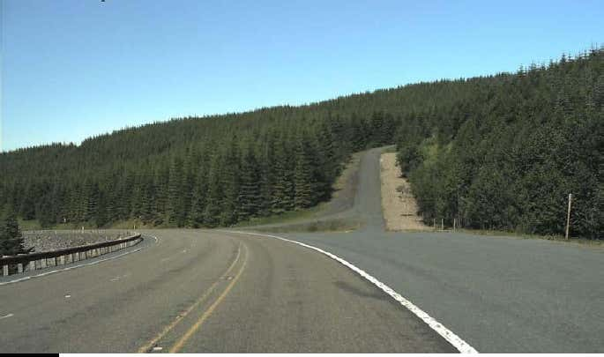

Slide 16
Types:

Slide 17
Types:
+
1. Ascending

Slide 18
Types:
+
1. Ascending
2. Level

Slide 19
Types:
+
1. Ascending
2. Level
3. Descending
-

Slide 20
Parabolic Vertical Curves:
Crest Sag

Slide 21
Parabolic Vertical Curves:
Crest Sag
Types: Symmetrical curve or unsymmetrical

Slide 22
Parabolic Vertical Curves:
Crest Sag
Types: Symmetrical curve or unsymmetrical
Symmetrical

Slide 23
Parabolic Vertical Curves:
Crest Sag
Types: Symmetrical curve or unsymmetrical
Symmetrical
Unsymmetrical

