Slide 1
Scientific Research and Research Methods
By
Assistant Professor
Raouf Mahmood

Slide 2
Lecture Outline
What is Scientific Research?
Fundamental Principles of Scientific Research?
Common Conceptions/Misconceptions About Scientific Research
Basic Elements of the Scientific Methods
Scientific Method of Research: Four Steps:
Understanding of Methodology and Methods

Slide 3
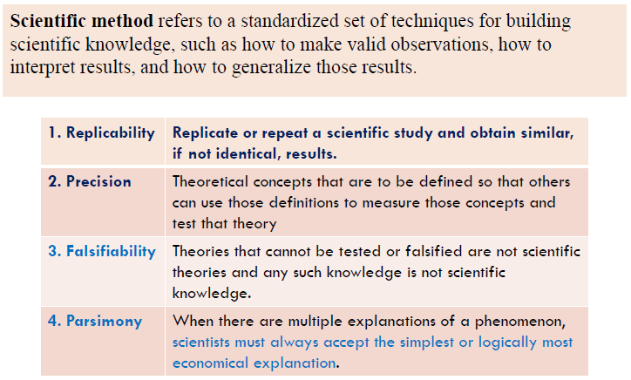
Basic Elements of the Scientific Methods

Slide 4
Types of Scientific Research

Slide 5
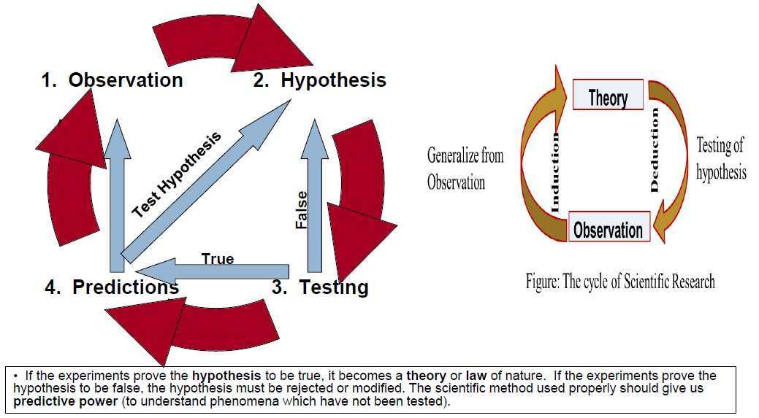
Scientific Method of Research: Four Steps:

Slide 6
1. Observation

Slide 7
2. Hypothesis

Slide 8
2. Hypothesis(Continuation…)

Slide 9
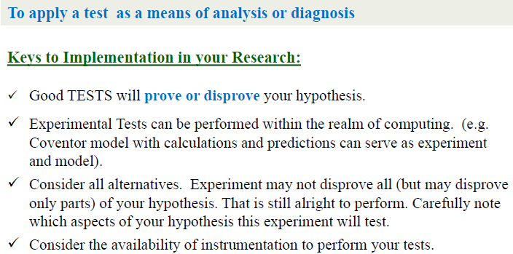
3. Experimental Testing

Slide 10
4. Predictions

Slide 11
Mathematical Models: Empirical vs. Deterministic

Slide 12
Understanding of Methodology and Methods:

Slide 13
Method?

Slide 14
Basic consideration!!!

Slide 15
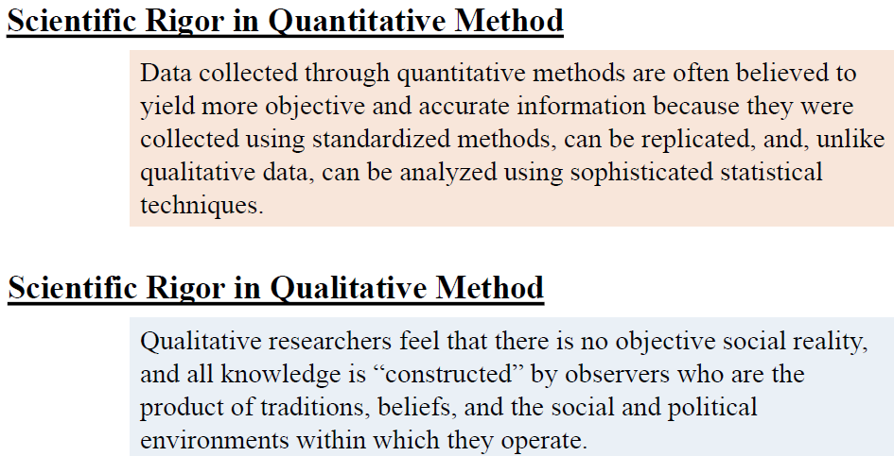
Quantitative vs Qualitative Methods

Slide 16
Quantitative vs Qualitative Methods(Continuation…)

Slide 17
Thank you
Asst. Prof. Dr. Raouf Mahmood Raouf

