Slide 1
Flow mass curve method and Arithmetic method

Slide 2
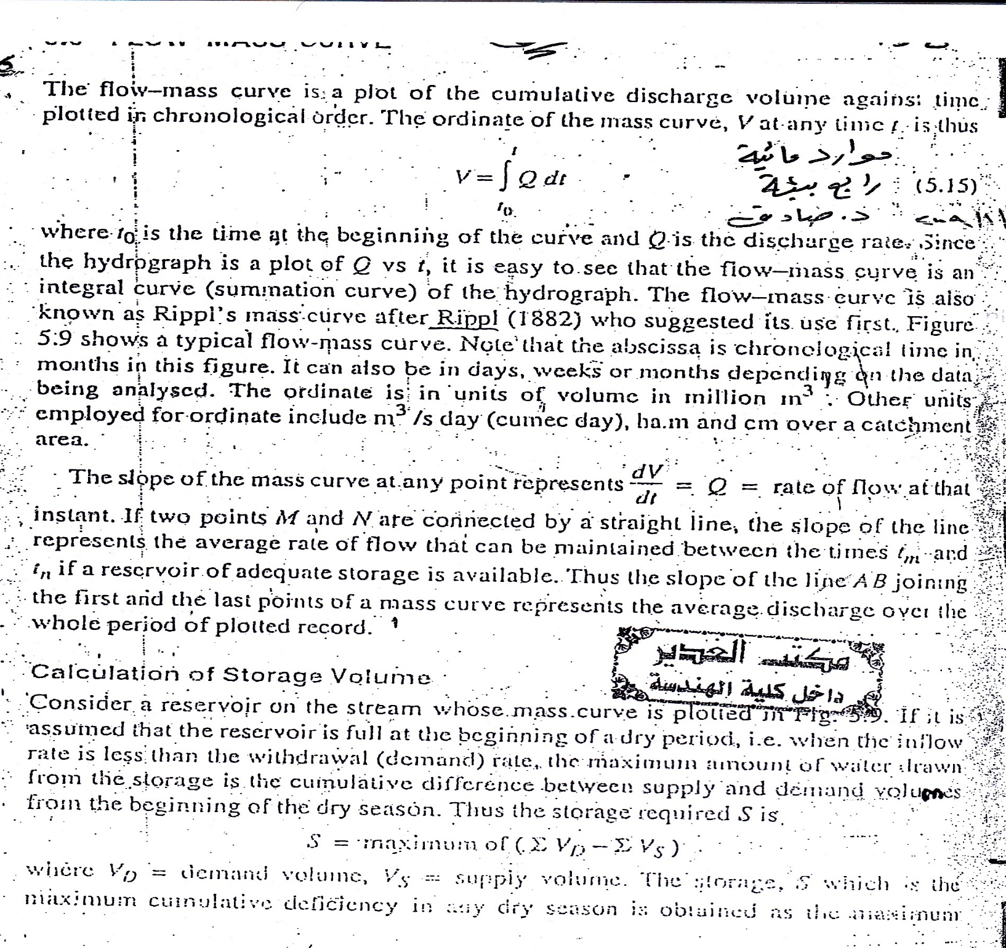

Slide 3
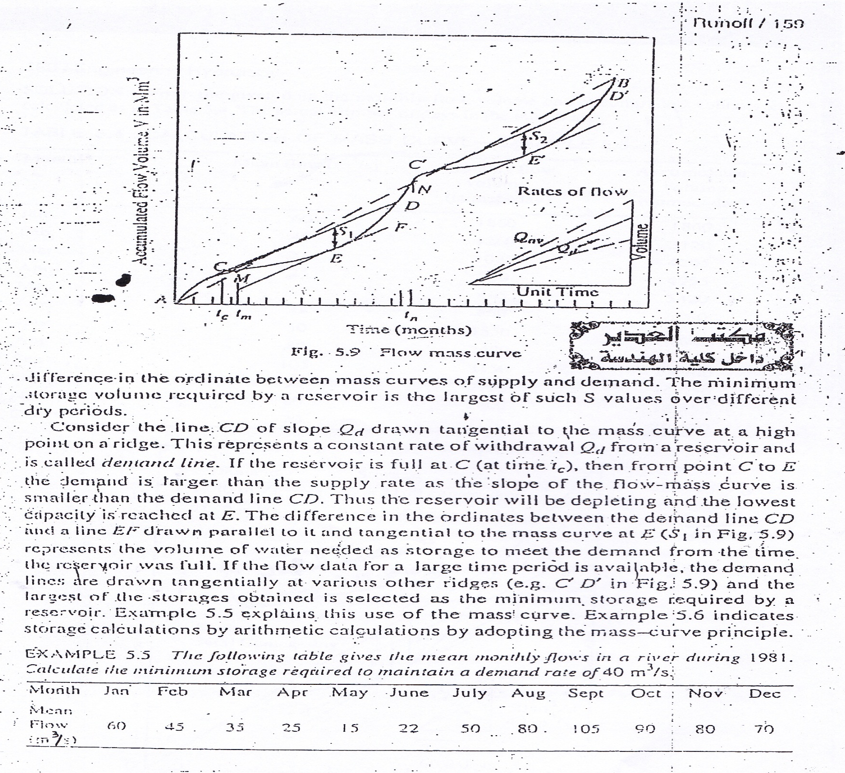

Slide 4
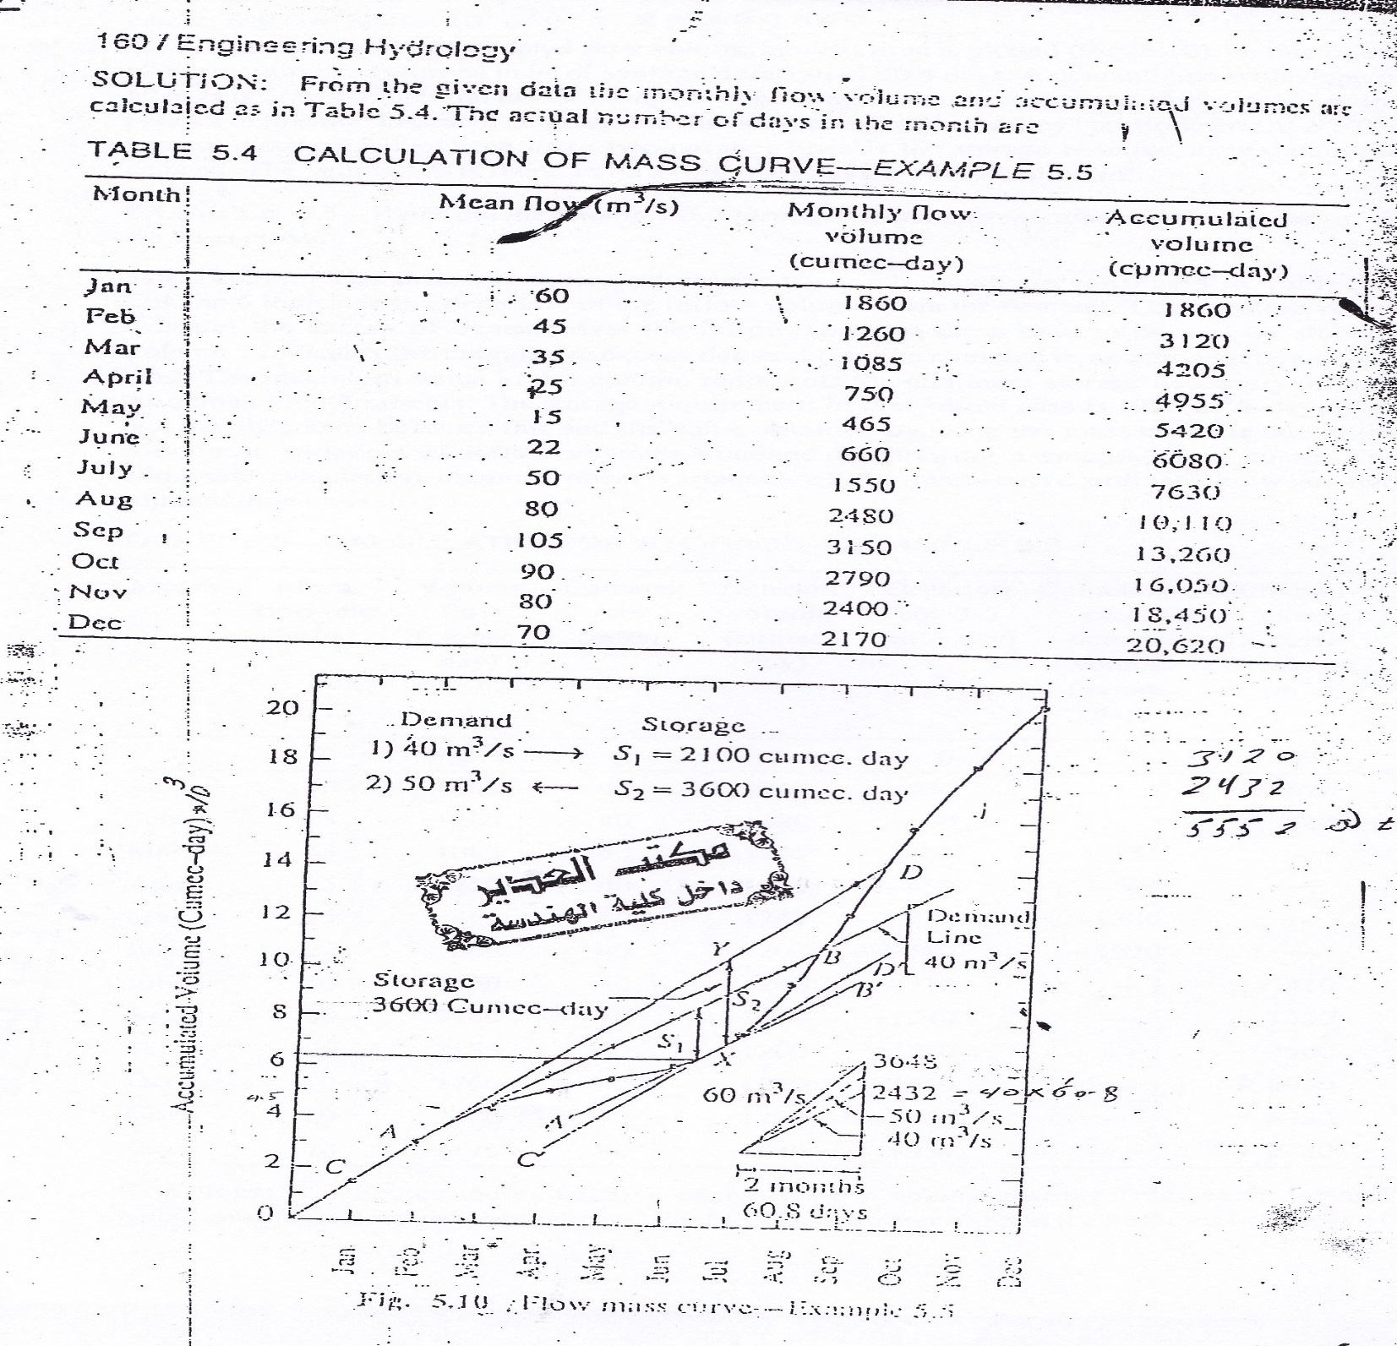

Slide 5
Given |  | Calculation
T =Time (Month) | Q (volume/time) | V=Volume = Q x time | Accumulative of volumes Y=∑V
1 | Q1 | V1 | V1
2 | Q2 | V2 | V1 + V2
3 | Q3 | V3 | V1 + V2 + V3
-- | -- | -- | --
-- | -- | -- | --
n | Qn | Vn | V1 + V2 + V3+…+Vn
Draw t verse Y.
Choose ∆t = 2 month = 60.8 days.
Choose two point P1 & P2 where p1 the first point of the inflow Q greater the demand (D).
So p1 = (t1, y1)
Now calculate p2 (t2, y2) such that
t2 = t1 + ∆t = t1 + 2 and y2 = y1 + D * ∆t= y1 + D * 60.8
Locate the points p1 and p2 on the graph and connect between them to draw the line L = p1p2
Find the maximum distance between the line L and the tangent line of the curve L’ to be the minimum required storage S. S = y3 – y4

Slide 6
Example:
Months | Days | Q | V | Y
Jan | 31 | 60 | 1860 | 1860
Feb | 28 | 45 | 1260 | 3120
Mar. | 31 | 35 | 1085 | 4205
April | 30 | 25 | 750 | 4955
May | 31 | 15 | 465 | 5420
June | 30 | 22 | 660 | 6080
July | 31 | 50 | 1550 | 7630
Aug. | 31 | 80 | 2480 | 10110
Sept. | 30 | 105 | 3150 | 13260
Oct. | 31 | 90 | 2790 | 16050
Nov. | 30 | 80 | 2400 | 18450
Dec. | 31 | 70 | 2170 | 20620
D= 40 m³/s
P1 (3, 4205)
Now calculate p2 (t2, y2) such that
t2 = t1 + ∆t = 3 + 2 = 5 and y2 = y1 + D * ∆t= 4205 + 40 * 60.8= 6637

Slide 7
D= 40 m³/s
P1 (3, 4205)
Now calculate p2 (t2, y2) such that
t2 = t1 + ∆t = 3 + 2 = 5 and y2 = y1 + D * ∆t
= 4205 + 40 * 60.8= 6637
y3 = 8,300 & y4 = 6,200
S = y3 – y4
so, S= 8,300 - 6,200
= 2100 m³/day
= 2100*24*60*60
= 2100*86,400
= 181,440,000 m³

Slide 8
