Slide 1
Finite differences method _partial Diff. Equations_ Water resources Eng. Applications Unsteady state Laplace Equation

Slide 2
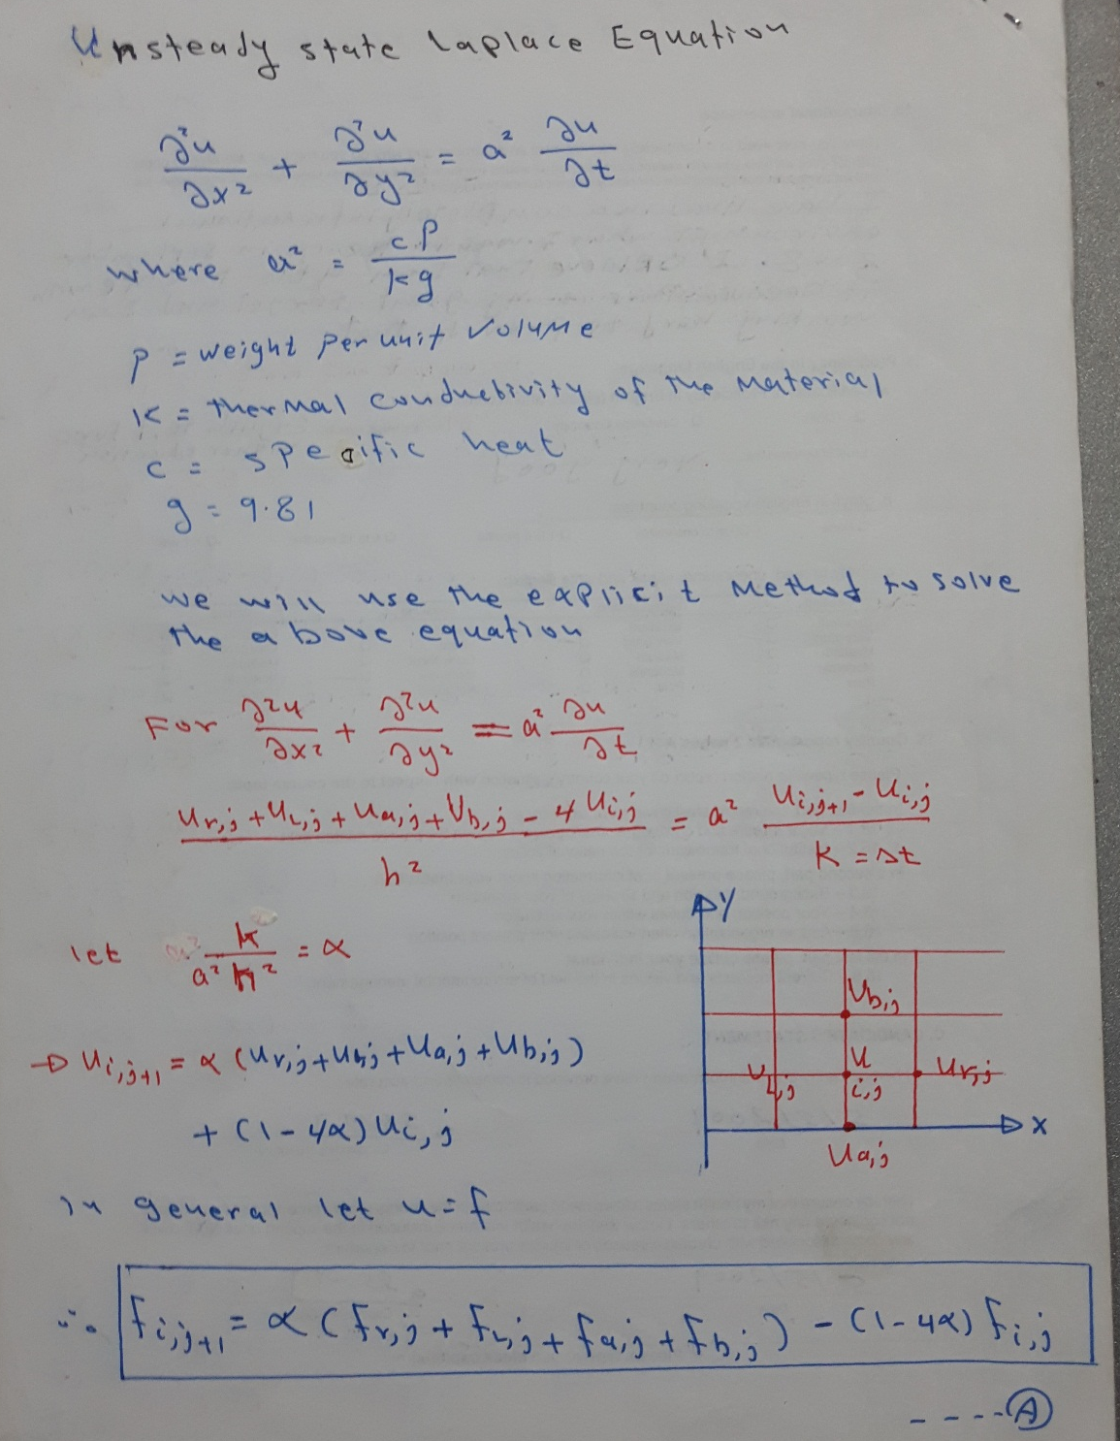

Slide 3
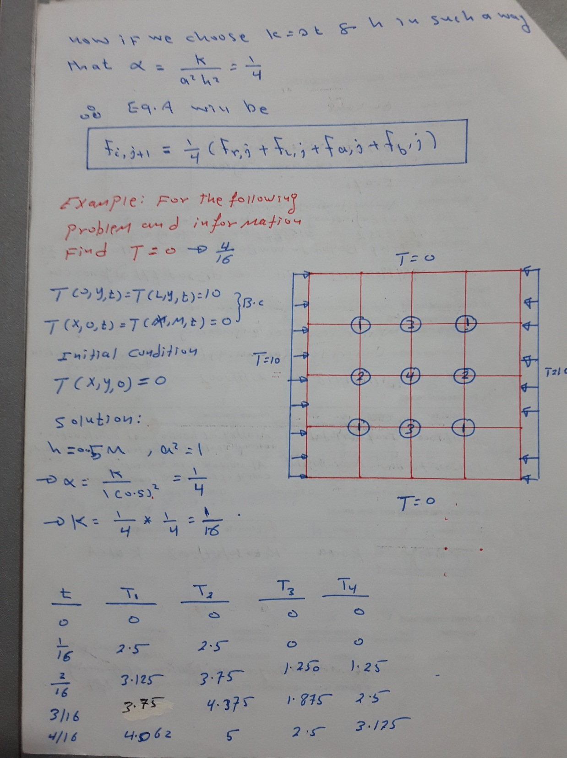

Slide 4
