Slide 1
Transportation Engineering
Civil Engineering Department
4th Stage, 1st Semester, 2019-2020
15th Lecture: Intersections
Lecturer
Dr Maha Osamah Dr Abeer K.Jameel

Slide 2
Intersections
Intersection is an area shared by two or more roads which meet or cross.
It is designated for vehicles to turn to different direction
Turning need specific space for vehicles
At grade and interchanges

Slide 3
Intersection Types
At grade Intersections
Grade separated Intersection (interchanges)

Slide 4
Intersection Types
At grade Intersections
may be classified by number of road segments, traffic controls or lane design.
By road segment :
three-leg, four-leg , and multi-leg
By traffic control:
uncontrolled, priority, stop-controlled, yield controlled, signalised intersection……
By Lane design : roundabout

Slide 5
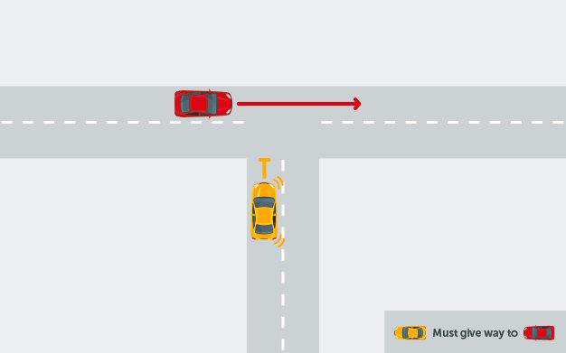
At Grade Intersections
three- leg intersection
T – intersection

Slide 6
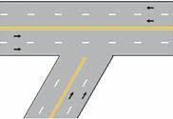
At Grade Intersections
three- leg intersection
Y – intersection

Slide 7
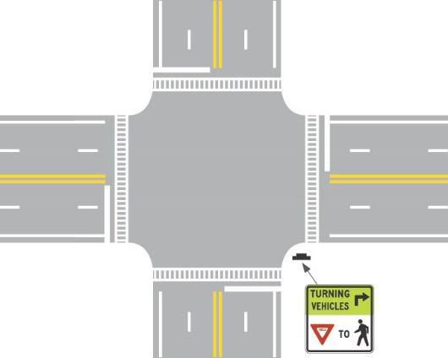
At Grade Intersections
Four- leg intersection

Slide 8
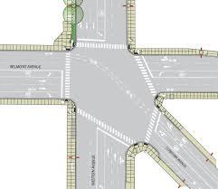
At Grade Intersections
four- leg intersection

Slide 9
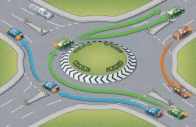
At Grade Intersections
Roundabout

Slide 10
At Grade Intersections
Warrants:
Traffic volume and conflicts
Land availability
Economy

Slide 11
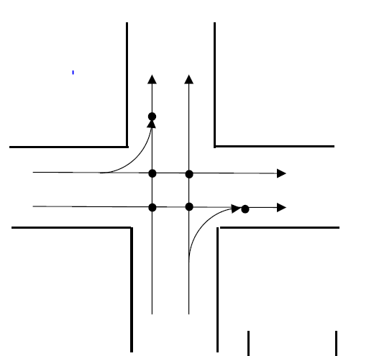
At Grade Intersections
Traffic conflicts
Both direction
One way
6 conflict points

Slide 12
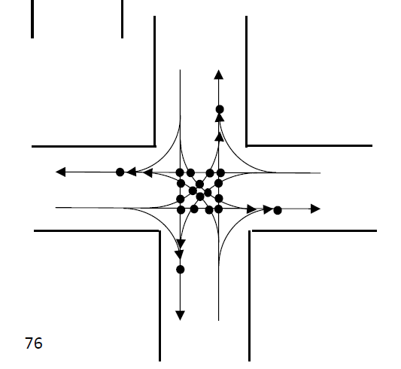
At Grade Intersections
Traffic conflicts
Both direction
Two way
24 conflict points

Slide 13
At Grade Intersections

Slide 14
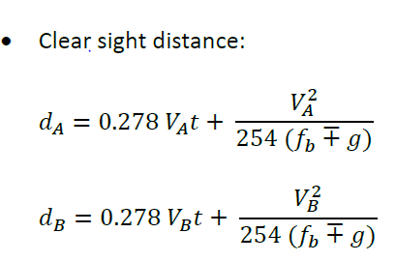
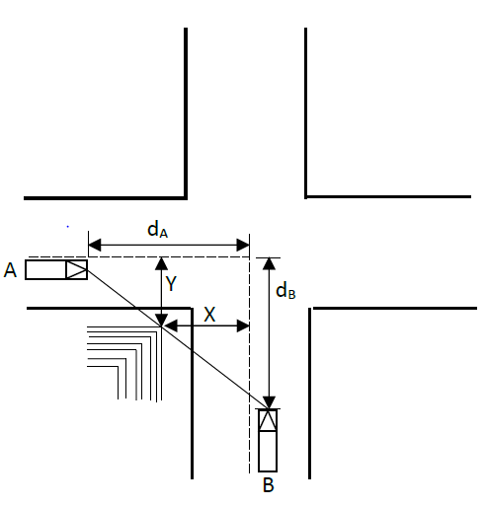
At Grade Intersections

Slide 15
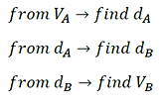
At Grade Intersections

Slide 16
At Grade Intersections

Slide 17
At Grade Intersections

Slide 18
At Grade Intersections

Slide 19
At Grade Intersections

Slide 20
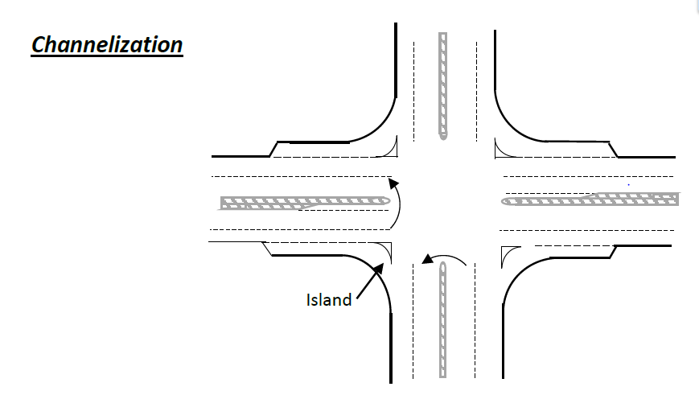
At Grade Intersections

Slide 21
Grade separated and Interchanges
Elimination of crossing conflicts at intersection by vertical separation of roadways
Route transfer at grade separation is accommodated by interchanges consisting of ramps

Slide 22
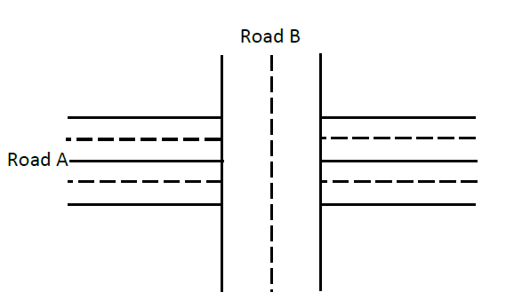
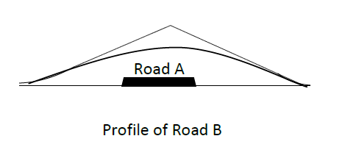
Grade separated and Interchanges
Grade separated

Slide 23
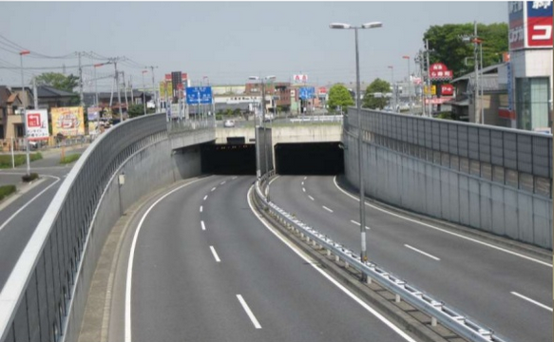
Grade separated and Interchanges
Grade separated , Underpass

Slide 24
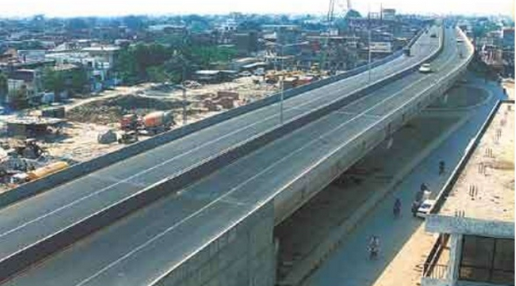
Grade separated and Interchanges
Grade separated , Overpass

Slide 25
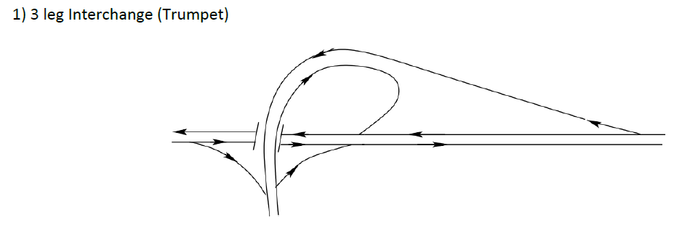
Grade separated and Interchanges
Interchanges

Slide 26
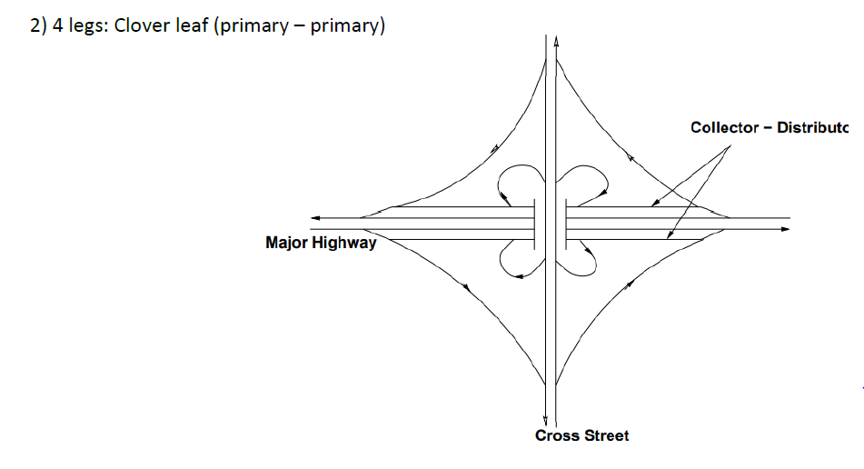
Grade separated and Interchanges
Interchanges

