Slide 1
Engineering Management
University of Mustansiriyah 2019-2020
College of Engineering 3rd Stage
High. & Trans Eng. Dep.
Lecture No.17: Programming Techniques, Programming Evaluation and Review Technique PERT, Example 3
Lecturers: Dr. Ali Jabbar
Dr. Abeer K. Jameel

Slide 2
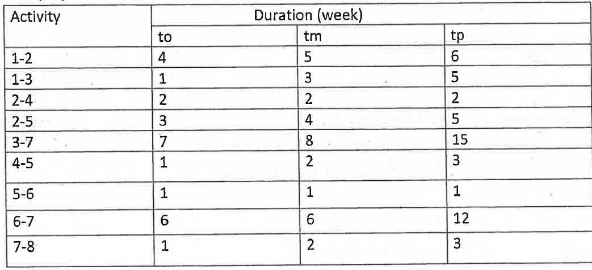

Slide 3
Solution
Activity | Duration (week)
 | to | tm | tp
1-2 | 4 | 5 | 6
1-3 | 1 | 3 | 5
2-4 | 2 | 2 | 2
2-5 | 3 | 4 | 5
3-7 | 7 | 8 | 15
4-5 | 1 | 2 | 3
5-6 | 1 | 1 | 1
6-7 | 6 | 6 | 12
7-8 | 1 | 2 | 3

Slide 4
Solution
Activity | Duration (week) |  |  | te
 | to | tm | tp
1-2 | 4 | 5 | 6
1-3 | 1 | 3 | 5
2-4 | 2 | 2 | 2
2-5 | 3 | 4 | 5
3-7 | 7 | 8 | 15
4-5 | 1 | 2 | 3
5-6 | 1 | 1 | 1
6-7 | 6 | 6 | 12
7-8 | 1 | 2 | 3

Slide 5
Solution
Activity | Duration (week) |  |  | te
 | to | tm | tp
1-2 | 4 | 5 | 6 | 5
1-3 | 1 | 3 | 5 | 3
2-4 | 2 | 2 | 2 | 2
2-5 | 3 | 4 | 5 | 4
3-7 | 7 | 8 | 15 | 10
4-5 | 1 | 2 | 3 | 2
5-6 | 1 | 1 | 1 | 1
6-7 | 6 | 6 | 12 | 7
7-8 | 1 | 2 | 3 | 2

Slide 6
Solution
Activity | Duration (week) |  |  | te
 | to | tm | tp
1-2 | 4 | 5 | 6 | 5
1-3 | 1 | 3 | 5 | 3
2-4 | 2 | 2 | 2 | 2
2-5 | 3 | 4 | 5 | 4
3-7 | 7 | 8 | 15 | 9
4-5 | 1 | 2 | 3 | 2
5-6 | 1 | 1 | 1 | 1
6-7 | 6 | 6 | 12 | 7
7-8 | 1 | 2 | 3 | 2
4
2
2
2
4
5
5
1
6
1
7
3
7
8
3
9
2

Slide 7
Solution
Activity | Duration (week) |  |  | te | Es | Ef | Ls | Lf | Tf
 | to | tm | tp
1-2 | 4 | 5 | 6 | 5
1-3 | 1 | 3 | 5 | 3
2-4 | 2 | 2 | 2 | 2
2-5 | 3 | 4 | 5 | 4
3-7 | 7 | 8 | 15 | 9
4-5 | 1 | 2 | 3 | 2
5-6 | 1 | 1 | 1 | 1
6-7 | 6 | 6 | 12 | 7
7-8 | 1 | 2 | 3 | 2
4
2
2
2
4
5
5
1
6
1
7
3
7
8
3
9
2

Slide 8
Solution
Activity | Duration (week) |  |  | te | Es | Ef | Ls | Lf | Tf
 | to | tm | tp
1-2 | 4 | 5 | 6 | 5 | 0
1-3 | 1 | 3 | 5 | 3 | 0
2-4 | 2 | 2 | 2 | 2
2-5 | 3 | 4 | 5 | 4
3-7 | 7 | 8 | 15 | 9
4-5 | 1 | 2 | 3 | 2
5-6 | 1 | 1 | 1 | 1
6-7 | 6 | 6 | 12 | 7
7-8 | 1 | 2 | 3 | 2
4
2
2
2
4
5
5
1
6
1
7
3
7
8
3
9
2

Slide 9
Solution
Activity | Duration (week) |  |  | te | Es | Ef | Ls | Lf | Tf
 | to | tm | tp
1-2 | 4 | 5 | 6 | 5 | 0 | 5
1-3 | 1 | 3 | 5 | 3 | 0 | 3
2-4 | 2 | 2 | 2 | 2
2-5 | 3 | 4 | 5 | 4
3-7 | 7 | 8 | 15 | 9
4-5 | 1 | 2 | 3 | 2
5-6 | 1 | 1 | 1 | 1
6-7 | 6 | 6 | 12 | 7
7-8 | 1 | 2 | 3 | 2
4
2
2
2
4
5
5
1
6
1
7
3
7
8
3
9
2

Slide 10
Solution
Activity | Duration (week) |  |  | te | Es | Ef | Ls | Lf | Tf
 | to | tm | tp
1-2 | 4 | 5 | 6 | 5 | 0 | 5
1-3 | 1 | 3 | 5 | 3 | 0 | 3
2-4 | 2 | 2 | 2 | 2 | 5 | 7
2-5 | 3 | 4 | 5 | 4 | 5 | 9
3-7 | 7 | 8 | 15 | 9
4-5 | 1 | 2 | 3 | 2
5-6 | 1 | 1 | 1 | 1
6-7 | 6 | 6 | 12 | 7
7-8 | 1 | 2 | 3 | 2
4
2
2
2
4
5
5
1
6
1
7
3
7
8
3
9
2

Slide 11
Solution
Activity | Duration (week) |  |  | te | Es | Ef | Ls | Lf | Tf
 | to | tm | tp
1-2 | 4 | 5 | 6 | 5 | 0 | 5
1-3 | 1 | 3 | 5 | 3 | 0 | 3
2-4 | 2 | 2 | 2 | 2 | 5 | 7
2-5 | 3 | 4 | 5 | 4 | 5 | 9
3-7 | 7 | 8 | 15 | 9 | 3 | 12
4-5 | 1 | 2 | 3 | 2
5-6 | 1 | 1 | 1 | 1
6-7 | 6 | 6 | 12 | 7
7-8 | 1 | 2 | 3 | 2
4
2
2
2
4
5
5
1
6
1
7
3
7
8
3
9
2

Slide 12
Solution
Activity | Duration (week) |  |  | te | Es | Ef | Ls | Lf | Tf
 | to | tm | tp
1-2 | 4 | 5 | 6 | 5 | 0 | 5
1-3 | 1 | 3 | 5 | 3 | 0 | 3
2-4 | 2 | 2 | 2 | 2 | 5 | 7
2-5 | 3 | 4 | 5 | 4 | 5 | 9
3-7 | 7 | 8 | 15 | 9 | 3 | 12
4-5 | 1 | 2 | 3 | 2 | 7 | 9
5-6 | 1 | 1 | 1 | 1
6-7 | 6 | 6 | 12 | 7
7-8 | 1 | 2 | 3 | 2 | 17
4
2
2
2
4
5
5
1
6
1
7
3
7
8
3
9
2

Slide 13
Solution
Activity | Duration (week) |  |  | te | Es | Ef | Ls | Lf | Tf
 | to | tm | tp
1-2 | 4 | 5 | 6 | 5 | 0 | 5
1-3 | 1 | 3 | 5 | 3 | 0 | 3
2-4 | 2 | 2 | 2 | 2 | 5 | 7
2-5 | 3 | 4 | 5 | 4 | 5 | 9
3-7 | 7 | 8 | 15 | 9 | 3 | 12
4-5 | 1 | 2 | 3 | 2 | 7 | 9
5-6 | 1 | 1 | 1 | 1 | 9 | 10
6-7 | 6 | 6 | 12 | 7 | 10 | 17
7-8 | 1 | 2 | 3 | 2 | 17 | 19
4
2
2
2
4
5
5
1
6
1
7
3
7
8
3
9
2

Slide 14
Solution
Activity | Duration (week) |  |  | te | Es | Ef | Ls | Lf | Tf
 | to | tm | tp
1-2 | 4 | 5 | 6 | 5 | 0 | 5
1-3 | 1 | 3 | 5 | 3 | 0 | 3
2-4 | 2 | 2 | 2 | 2 | 5 | 7
2-5 | 3 | 4 | 5 | 4 | 5 | 9
3-7 | 7 | 8 | 15 | 9 | 3 | 12
4-5 | 1 | 2 | 3 | 2 | 7 | 9
5-6 | 1 | 1 | 1 | 1 | 9 | 10
6-7 | 6 | 6 | 12 | 7 | 10 | 17
7-8* | 1 | 2 | 3 | 2 | 17 | 19 | 17 | 19 | 0
4
2
2
2
4
5
5
1
6
1
7
3
7
8
3
9
2

Slide 15
Solution
Activity | Duration (week) |  |  | te | Es | Ef | Ls | Lf | Tf
 | to | tm | tp
1-2 | 4 | 5 | 6 | 5 | 0 | 5
1-3 | 1 | 3 | 5 | 3 | 0 | 3
2-4 | 2 | 2 | 2 | 2 | 5 | 7
2-5 | 3 | 4 | 5 | 4 | 5 | 9
3-7 | 7 | 8 | 15 | 9 | 3 | 12
4-5 | 1 | 2 | 3 | 2 | 7 | 9
5-6 | 1 | 1 | 1 | 1 | 9 | 10
6-7* | 6 | 6 | 12 | 7 | 10 | 17 | 10 | 17 | 0
7-8* | 1 | 2 | 3 | 2 | 17 | 19 | 17 | 19 | 0
4
2
2
2
4
5
5
1
6
1
7
3
7
8
3
9
2

Slide 16
Solution
Activity | Duration (week) |  |  | te | Es | Ef | Ls | Lf | Tf
 | to | tm | tp
1-2 | 4 | 5 | 6 | 5 | 0 | 5
1-3 | 1 | 3 | 5 | 3 | 0 | 3 | 5 | 8 | 5
2-4* | 2 | 2 | 2 | 2 | 5 | 7 | 5 | 7 | 0
2-5* | 3 | 4 | 5 | 4 | 5 | 9 | 5 | 9 | 0
3-7 | 7 | 8 | 15 | 9 | 3 | 12 | 8 | 17 | 5
4-5* | 1 | 2 | 3 | 2 | 7 | 9 | 7 | 9 | 0
5-6* | 1 | 1 | 1 | 1 | 9 | 10 | 9 | 10 | 0
6-7* | 6 | 6 | 12 | 7 | 10 | 17 | 10 | 17 | 0
7-8* | 1 | 2 | 3 | 2 | 17 | 19 | 17 | 19 | 0
4
2
2
2
4
5
5
1
6
1
7
3
7
8
3
9
2

Slide 17
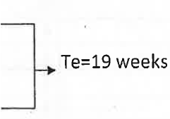
Solution
Activity | Duration (week) |  |  | te | Es | Ef | Ls | Lf | Tf
 | to | tm | tp
1-2* | 4 | 5 | 6 | 5 | 0 | 5 | 0 | 5 | 0
1-3 | 1 | 3 | 5 | 3 | 0 | 3 | 5 | 8 | 5
2-4* | 2 | 2 | 2 | 2 | 5 | 7 | 5 | 7 | 0
2-5* | 3 | 4 | 5 | 4 | 5 | 9 | 5 | 9 | 0
3-7 | 7 | 8 | 15 | 9 | 3 | 12 | 8 | 17 | 5
4-5* | 1 | 2 | 3 | 2 | 7 | 9 | 7 | 9 | 0
5-6* | 1 | 1 | 1 | 1 | 9 | 10 | 9 | 10 | 0
6-7* | 6 | 6 | 12 | 7 | 10 | 17 | 10 | 17 | 0
7-8* | 1 | 2 | 3 | 2 | 17 | 19 | 17 | 19 | 0
4
2
2
2
4
5
5
1
6
1
7
3
7
8
3
9
2

Slide 18
Solution
Activity | Duration (week) |  |  | te | Es | Ef | Ls | Lf | Tf | S
 | to | tm | tp
1-2* | 4 | 5 | 6 | 5 | 0 | 5 | 0 | 5 | 0
1-3 | 1 | 3 | 5 | 3 | 0 | 3 | 5 | 8 | 5
2-4* | 2 | 2 | 2 | 2 | 5 | 7 | 5 | 7 | 0
2-5* | 3 | 4 | 5 | 4 | 5 | 9 | 5 | 9 | 0
3-7 | 7 | 8 | 15 | 9 | 3 | 12 | 8 | 17 | 5
4-5* | 1 | 2 | 3 | 2 | 7 | 9 | 7 | 9 | 0
5-6* | 1 | 1 | 1 | 1 | 9 | 10 | 9 | 10 | 0
6-7* | 6 | 6 | 12 | 7 | 10 | 17 | 10 | 17 | 0
7-8* | 1 | 2 | 3 | 2 | 17 | 19 | 17 | 19 | 0

Slide 19
Solution
Activity | Duration (week) |  |  | te | Es | Ef | Ls | Lf | Tf | S
 | to | tm | tp
1-2* | 4 | 5 | 6 | 5 | 0 | 5 | 0 | 5 | 0 | 1/3
1-3 | 1 | 3 | 5 | 3 | 0 | 3 | 5 | 8 | 5
2-4* | 2 | 2 | 2 | 2 | 5 | 7 | 5 | 7 | 0
2-5* | 3 | 4 | 5 | 4 | 5 | 9 | 5 | 9 | 0
3-7 | 7 | 8 | 15 | 9 | 3 | 12 | 8 | 17 | 5
4-5* | 1 | 2 | 3 | 2 | 7 | 9 | 7 | 9 | 0
5-6* | 1 | 1 | 1 | 1 | 9 | 10 | 9 | 10 | 0
6-7* | 6 | 6 | 12 | 7 | 10 | 17 | 10 | 17 | 0
7-8* | 1 | 2 | 3 | 2 | 17 | 19 | 17 | 19 | 0

Slide 20
Solution
Activity | Duration (week) |  |  | te | Es | Ef | Ls | Lf | Tf | S
 | to | tm | tp
1-2* | 4 | 5 | 6 | 5 | 0 | 5 | 0 | 5 | 0 | 1/3
1-3 | 1 | 3 | 5 | 3 | 0 | 3 | 5 | 8 | 5
2-4* | 2 | 2 | 2 | 2 | 5 | 7 | 5 | 7 | 0 | 0
2-5* | 3 | 4 | 5 | 4 | 5 | 9 | 5 | 9 | 0
3-7 | 7 | 8 | 15 | 9 | 3 | 12 | 8 | 17 | 5
4-5* | 1 | 2 | 3 | 2 | 7 | 9 | 7 | 9 | 0
5-6* | 1 | 1 | 1 | 1 | 9 | 10 | 9 | 10 | 0
6-7* | 6 | 6 | 12 | 7 | 10 | 17 | 10 | 17 | 0
7-8* | 1 | 2 | 3 | 2 | 17 | 19 | 17 | 19 | 0

Slide 21
Solution
Activity | Duration (week) |  |  | te | Es | Ef | Ls | Lf | Tf | S
 | to | tm | tp
1-2* | 4 | 5 | 6 | 5 | 0 | 5 | 0 | 5 | 0 | 1/3
1-3 | 1 | 3 | 5 | 3 | 0 | 3 | 5 | 8 | 5
2-4* | 2 | 2 | 2 | 2 | 5 | 7 | 5 | 7 | 0 | 0
2-5* | 3 | 4 | 5 | 4 | 5 | 9 | 5 | 9 | 0 | 1/3
3-7 | 7 | 8 | 15 | 9 | 3 | 12 | 8 | 17 | 5
4-5* | 1 | 2 | 3 | 2 | 7 | 9 | 7 | 9 | 0 | 1/3
5-6* | 1 | 1 | 1 | 1 | 9 | 10 | 9 | 10 | 0 | 0
6-7* | 6 | 6 | 12 | 7 | 10 | 17 | 10 | 17 | 0 | 1
7-8* | 1 | 2 | 3 | 2 | 17 | 19 | 17 | 19 | 0 | 1/3

Slide 22
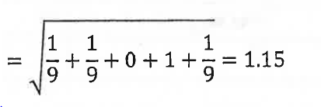
Solution
Activity | Duration (week) |  |  | te | Es | Ef | Ls | Lf | Tf | S
 | to | tm | tp
1-2* | 4 | 5 | 6 | 5 | 0 | 5 | 0 | 5 | 0 | 1/3
1-3 | 1 | 3 | 5 | 3 | 0 | 3 | 5 | 8 | 5
2-4* | 2 | 2 | 2 | 2 | 5 | 7 | 5 | 7 | 0 | 0
2-5* | 3 | 4 | 5 | 4 | 5 | 9 | 5 | 9 | 0 | 1/3
3-7 | 7 | 8 | 15 | 9 | 3 | 12 | 8 | 17 | 5
4-5* | 1 | 2 | 3 | 2 | 7 | 9 | 7 | 9 | 0 | 1/3
5-6* | 1 | 1 | 1 | 1 | 9 | 10 | 9 | 10 | 0 | 0
6-7* | 6 | 6 | 12 | 7 | 10 | 17 | 10 | 17 | 0 | 1
7-8* | 1 | 2 | 3 | 2 | 17 | 19 | 17 | 19 | 0 | 1/3

Slide 23
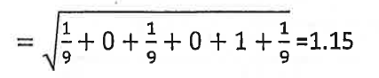
Solution
Activity | Duration (week) |  |  | te | Es | Ef | Ls | Lf | Tf | S
 | to | tm | tp
1-2* | 4 | 5 | 6 | 5 | 0 | 5 | 0 | 5 | 0 | 1/3
1-3 | 1 | 3 | 5 | 3 | 0 | 3 | 5 | 8 | 5
2-4* | 2 | 2 | 2 | 2 | 5 | 7 | 5 | 7 | 0 | 0
2-5* | 3 | 4 | 5 | 4 | 5 | 9 | 5 | 9 | 0 | 1/3
3-7 | 7 | 8 | 15 | 9 | 3 | 12 | 8 | 17 | 5
4-5* | 1 | 2 | 3 | 2 | 7 | 9 | 7 | 9 | 0 | 1/3
5-6* | 1 | 1 | 1 | 1 | 9 | 10 | 9 | 10 | 0 | 0
6-7* | 6 | 6 | 12 | 7 | 10 | 17 | 10 | 17 | 0 | 1
7-8* | 1 | 2 | 3 | 2 | 17 | 19 | 17 | 19 | 0 | 1/3

Slide 24
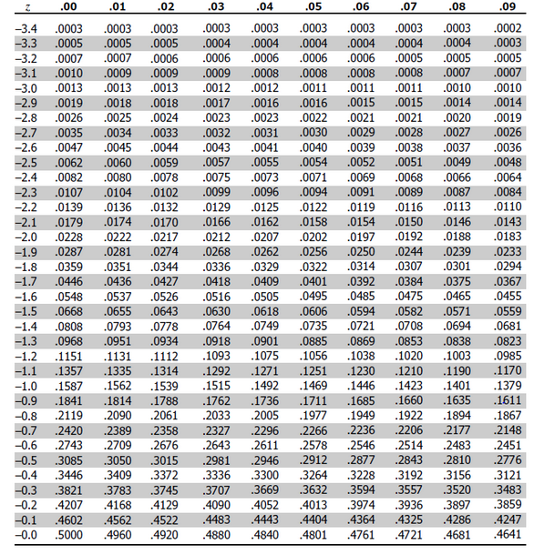

Slide 25
