Slide 1

Chapter 5
Operating Systems
By: Lecturer Raoof Talal

Slide 2
5.2.2 Schedulers
A process migrates among the various scheduling queues throughout its lifetime. The operating system must select, for scheduling purposes, processes from these queues in some fashion. The selection process is carried out by the appropriate scheduler.
Often, in a batch system, more processes are submitted than can be executed immediately. These processes are spooled to a mass-storage device (typically a disk), where they are kept for later execution.

Slide 3
The long-term scheduler, or job scheduler, selects processes from this pool and loads them into memory for execution.
The short-term scheduler, or CPU scheduler, selects from among the processes that are ready to execute and allocates the CPU to one of them.

Slide 4
Some operating systems, such as time-sharing systems, may introduce an additional, intermediate level of scheduling. This is called medium-term scheduler. The key idea behind a medium-term scheduler is that sometimes it can be advantageous to remove processes from memory (and from active contention for the CPU) and thus reduce the degree of multiprogramming. Later, the process can be reintroduced into memory, and its execution can be continued where it left off. This scheme is called swapping.

Slide 5
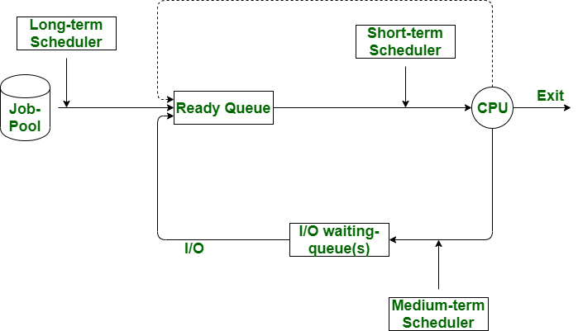

Slide 6
5.2.3 Context Switch
Switching the CPU to another process requires performing a state save of the current process and a state restore of a different process. This task is known as a context switch. When a context switch occurs, the kernel saves the context of the old process in its PCB and loads the saved context of the new process scheduled to run. Context-switch speed varies from machine to machine, depending on the memory speed, the number of registers that must be copied, and the existence of special instructions (such as a single instruction to load or store all registers).

Slide 7
5.3 Operations on Processes
The processes in most systems can execute concurrently, and they may be created and deleted dynamically. Thus, these systems must provide a mechanism for process creation and termination.
5.3.1 Process Creation
A process may create several new processes, via a create-process system call, during the course of execution. The creating process is called a parent process, and the new processes are called the children of that process. Each of these new processes may in turn create other processes, forming a tree of processes.

Slide 8
Most operating systems identify processes according to a unique process identifier (or pid), which is typically an integer number.
In Solaris, the process at the top of the tree is the sched process, with pid of 0. The sched process creates several children processes—including pageout, fsflush and init. The init process serves as the root parent process for all user processes.

Slide 10
In general, a process will need certain resources (CPU time, memory, files, and I/O devices) to accomplish its task. When a process creates a sub-process,
that sub-process may be able to obtain its resources directly from the operating system, or it may be constrained to a subset of the resources of the parent process.
The parent may have to partition its resources among its children, or it may be able to share some resources (such as memory or files) among several of its children.

Slide 11
When a process creates a new process, two possibilities exist in terms of execution:
1. The parent continues to execute concurrently with its children.
2. The parent waits until some or all of its children have terminated.

Slide 12
5.3.2 Process Termination
A process terminates when it finishes executing its final statement and asks the operating system to delete it by using the exit ( ) system call. At that point, the process may return a status value (typically an integer) to its parent process. All the resources of the process—including physical and virtual memory, open files and I/O buffers—are de-allocated by the operating system.

Slide 13
A parent may terminate the execution of one of its children for a variety of reasons, such as these:
The child has exceeded its usage of some of the resources that it has been allocated.
The parent is exiting, and the operating system does not allow a child to continue if its parent terminates.
The task assigned to the child is no longer required.

Slide 14
5.4 Inter-process Communication
Processes executing concurrently in the operating system may be either independent processes or cooperating processes.
A process is independent if it cannot affect or be affected by the other processes executing in the system. Any process that does not share data with any other process is independent.
A process is cooperating if it can affect or be affected by the other processes executing in the system. Clearly, any process that shares data with other processes is a cooperating process.
There are several reasons for providing an environment that allows process cooperation:

Slide 15
Convenience: Even an individual user may work on many tasks at the same time. For instance, a user may be editing, printing, and compiling in parallel.
Modularity: We may want to construct the system in a modular fashion, dividing the system functions into separate processes or threads.
Computation speedup: If we want a particular task to run faster, we must break it into subtasks, each of which will be executing in parallel with the others.
Information sharing: Since several users may be interested in the same piece of information (for instance, a shared file), we must provide an environment to allow concurrent access to such information.

Slide 16
Cooperating processes require an inter-process communication (IPC) mechanism that will allow them to exchange data and information.
There are two fundamental models of inter-process communication:
shared memory
message passing.
In the shared memory model, a region of memory that is shared by cooperating processes is established. Processes can then exchange information by reading and writing data to the shared region.
In the message passing model, communication takes place by means of messages exchanged between the cooperating processes. The two communications models are contrasted in Figure 5.7.

