Slide 1
Transportation Engineering
Civil Engineering Department
4th Stage, 1st Semester, 2019-2020
Traffic Characteristics, Examples
Lecturer
Dr Abeer K.Jameel, Dr Maha Osamah

Slide 2
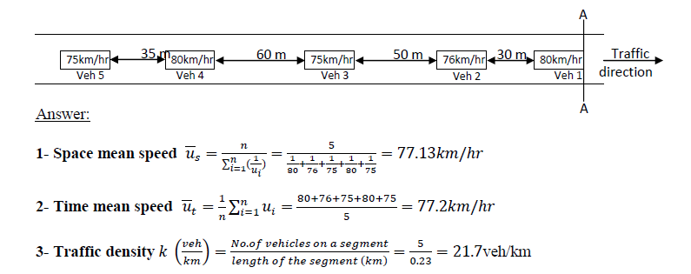
Traffic Characteristics: Examples
Question
Five vehicles, as shown in the figure below, are traveling at constant speeds on section of 230m length. Assuming that all vehicles have a same length of 4m and if speeds and clear spacing between vehicles are as shown in the figure, estimate the following:
1) Average space mean speed
2) Average time mean speed
3) Traffic density
4) Average time headway arriving a section A-A

Slide 3
Traffic Characteristics: Examples
Solution
11.04
10.35
11.04
10.90
10.35
Average passing time= 10.716
Space mean speed = (230/1000)/(10.716/3600)=77.26 km/hr
or

Slide 4
Traffic Characteristics: Examples
Solution
11.04
10.35
11.04
10.90
10.35
4- Estimation of average time headway:
Arrival of vehicle 2 (t2)=(30+4)/(76*1000/3600)=1.61 sec
Headway of vehicle 1-2 (h2)=1.61
Arrival of vehicle 3 (t3) =(80+8)/(75*1000/3600)=4.224 sec
Headway of vehicle 2-3 (h3)=4.224-1.61=2.614 sec
Arrival of vehicle 4 (t4)= (140+12)/(80*1000/3600)=6.84sec
Headway of vehicle 4 (h4)=6.84-4.224=2.616sec
Arrival of vehicle 5 (t5)= (175+16)/(75*1000/3600)=9.168 sec
Headway of vehicle 5 (h5)=9.168-6.84=2.232sec
Average time headway=(1.61+2.614+2.616+2.232)/4 = 2.268sec

