Slide 1
Engineering Management
University of Mustansiriyah 2019-2020
College of Engineering 3rd Stage
High. & Trans Eng. Dep.
Lecture No.17: Programming Evaluation and Review Technique (PERT)
Lecturers: Dr. Ali Jabbar
Dr. Abeer K. Jameel

Slide 2
Programming Evaluation and Review Technique (PERT)

Slide 3
Programming Evaluation and Review Technique (PERT)

Slide 4
Programming Evaluation and Review Technique (PERT)

Slide 5
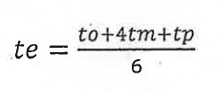
Programming Evaluation and Review Technique (PERT)

Slide 6
Programming Evaluation and Review Technique (PERT)

Slide 7
Programming Evaluation and Review Technique (PERT)

Slide 8
Programming Evaluation and Review Technique (PERT)

Slide 9
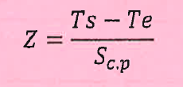
Programming Evaluation and Review Technique (PERT)

Slide 10
Programming Evaluation and Review Technique (PERT)

Slide 11
Programming Evaluation and Review Technique (PERT)

Slide 12
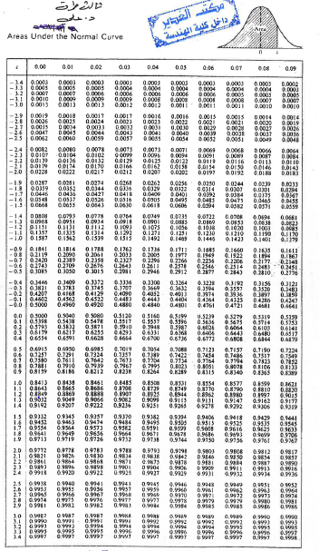
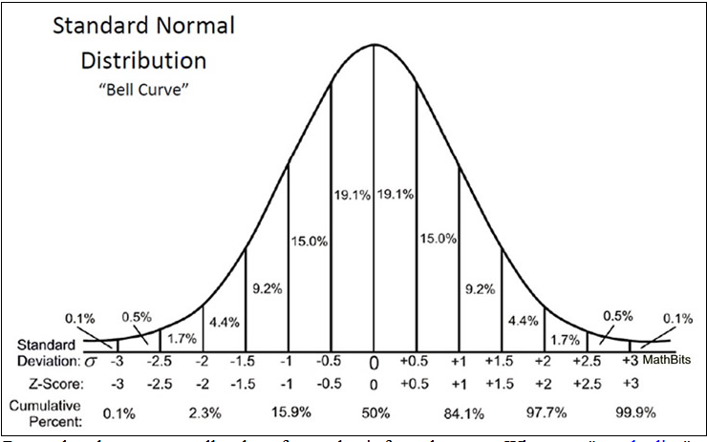

Slide 13
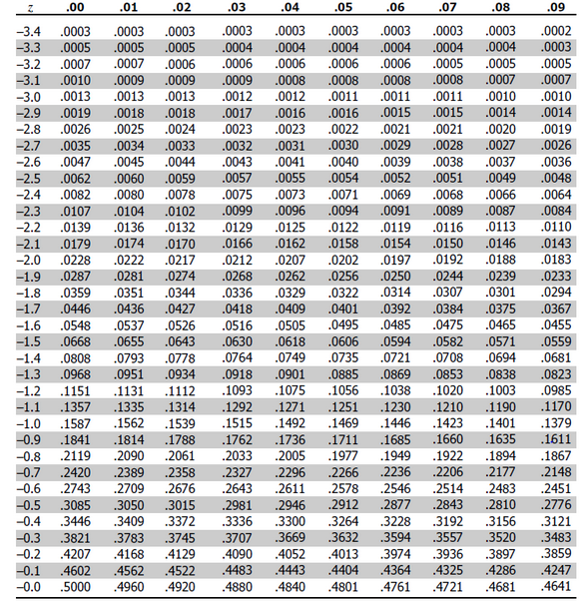

Slide 14
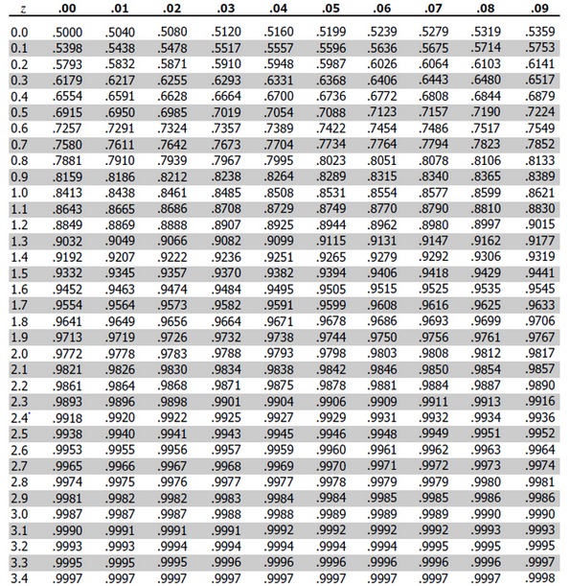

Slide 15
Z=1.29
=1.2+0.09
P(Z=1.29)=0.9015
90.15%
Z=3.1
=3.1+0.0
P(Z=3.1)=0.9990
99.90%

Slide 16
P=99%
P=0.99
P1=0.9901
Z1=2.3+0.03=2.33

Slide 17
P1=0.9901
Z1=2.3+0.03=2.33
P=99%
P=0.99
P2=0.9898
Z2=2.3+0.02=2.32
Through interpolation:

Slide 18
Calculate the interpolation of Z1 and Z2
$$\frac{P1−P2}{Z1−Z2}=$$
$$\frac{P −P2}{Z−Z2}$$
P1
P=99%
P=0.99
P1=0.9901
Z1=2.33
P2=0.9898
Z2=2.32
P
P2
$\frac{o.9901−0.9898}{2.33−2.32}=\frac{0.99−0.9898}{Z−2.32}$
Z2
Z
Z1
$Z=2.3267$

Slide 19
Find Ts
$Z=2.3267$
Ts = (Sc.p *Z)+Te

