Slide 1
Pavement Structural Analysis
Three-Layer System (Peattie's Charts)
Highway and Transportation Engineering
Al-Mustansiriyah University
2019-2020
Dr. Rana Amir Yousif & Dr. Abeer K. Jameel

Slide 2
References
Nicholas J. Garber and Lester A. Hoel.”Traffic and Highway Engineering”, Fourth Edition.
Yoder; E. J. and M. W. Witczak, “Principles of Pavement Design”, A Wiley- Interscience Publication, John Wiley & Sons Inc., U.S.A., 1975.
Yaug H. Huang, “Pavement Analysis and Design”, Prentic Hall Inc., U.S.A., 1993.
“AASHTO Guide for Design of Pavement Structures 1993”, AASHTO, American Association of State Highway and Transportation Officials, U.S.A., 1993.
Oglesby Clarkson H., “Highway Engineering”, John Wiley & Sons Inc., U.S.A., 1975.

Slide 3

Three-Layer Systems (Peattie's Charts)
Peattie (1962) plotted Jones' table in graphical forms:
Figure ( 2.31) shows one set of charts for radial strain factors, (RR1 - ZZ1)/2, at the bottom of layer.
1 . As indicated by Eq . 2.20b, the radial strain can be determined from

Slide 4
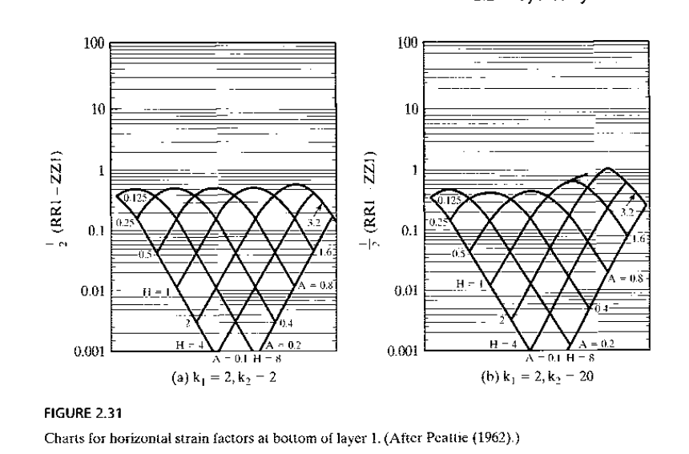
Look for the different in the figures
k1 and k2

Slide 5
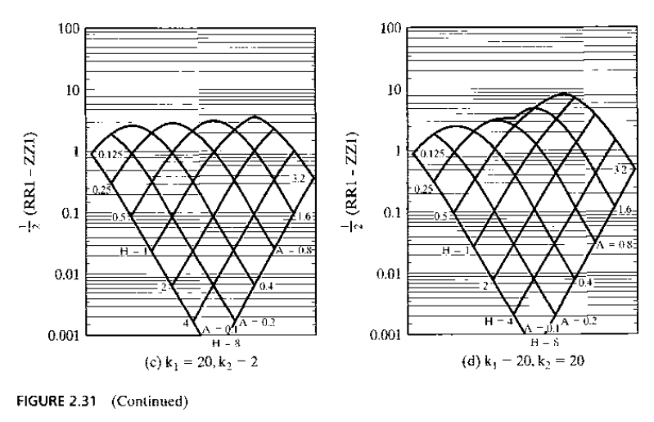
Get (RR1-ZZ1)/2 (step 6)
Look for the different in the figures
Curve junction point (step 5)
Follow the line, please (step 4)
H1 (step 3)
A (step 2)
Ex:2:12
k1 and k2
K1 and k2 (step 1)

Slide 6
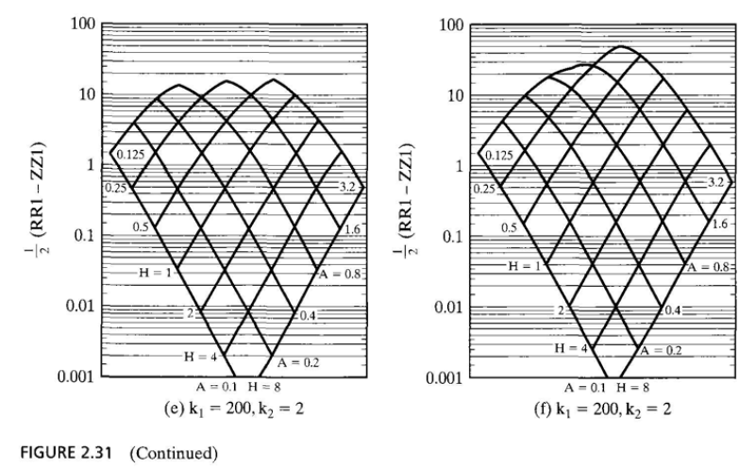
Look for the different in the figures
k1 and k2

Slide 7
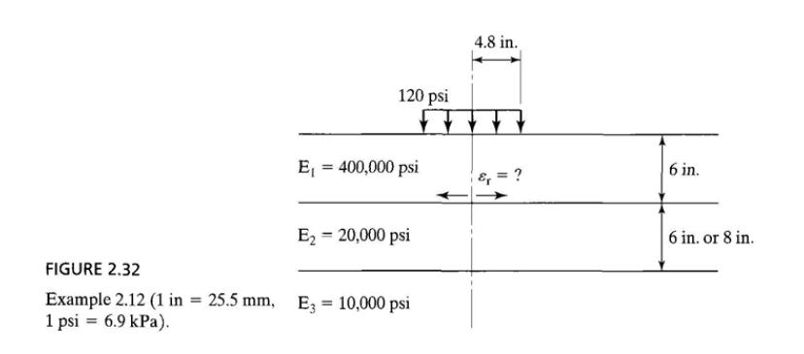
Three-Layer Systems (Peattie's Charts)
Example (2,12) Page 75:
For the same case as example (2.11) Given the three-layer system shown in Figure 2 .30 with a = 4 .8 in. (122 mm), q = 120 psi (828 kPa), h1 = 6 in. (152 mm), h2 = 6 in. (203 mm), E1 = 400,000 psi (2.8 GPa), E2 = 20,000 psi (138 MPa), and E3 = 10,000 psi (69 MPa), determine the radial strain at the bottom of layer 1,as shown in figure 2.32 . If h2= 8 in. , what is the radial strain at the bottom of layer 1?

Slide 8
Three-Layer Systems (Peattie's Charts)
Solution: (1)
Given k1= 20 H= 1.0
k2= 2 A= 0.8
from Figure 2.31c
(RR1-ZZ1) / 2 = 1 As shown by the steps installed on the figure.

Slide 9

Three-Layer Systems (Peattie's Charts)
Solution:
From Eq. 2.25

Slide 10
Three-Layer Systems (Peattie's Charts)
Solution: (2)
Given h2 = 8 in H= 6/8 = 0.75
A= 4.8/8 = 0.6
from Figure 2.31c (the strain factor is still close to 1)
Indicating that the thickness of layer 2 has very little effect on the tensile strain due to the predominant effect of layer 1.

Slide 23
Three-Layer Systems (Peattie's Charts)
Thanks for ATTENSION
Dr. Rana Amir Yousif & Dr. Abeer K. Jameel

