Slide 1
Characterization Techniques “Tutorial”
By
Assistant Processor
Dr. Raouf Mahmood

Slide 2
Characterization techniques
Characterization techniques are classified as a chemical characterization and Structural characterization:
a) Chemical characterization:
1. Optical Spectroscopy
2. Electron Spectroscopy
3. Ionic Spectrometry
4. Rutherford Backscattering Spectrometry (RBS)
5. Secondary Ion Mass Spectrometry (SIMS)

Slide 3
Characterization techniques
b) Structural characterization:
1. X-ray diffraction technique
2. Electron microscopy
3. Dynamic light Scattering

Slide 4
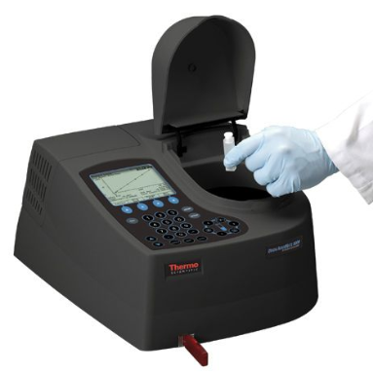
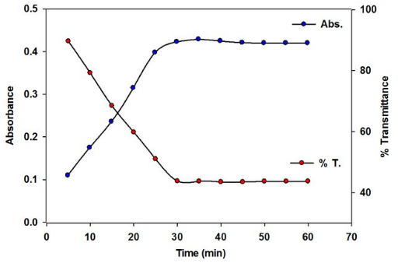
Chemical characterization
Optical Spectroscopy:
An Optical spectrophotometer is an instrument containing a monochromator, a device which produces a light beam containing wavelengths in a narrow band around a selected wavelength, and a means of measuring the ratio of that beam's intensity as it enters and leaves a cuvette. It is a non-contact, non-destructive method of investigative materials.

Slide 5
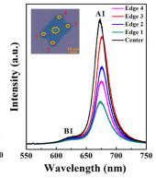
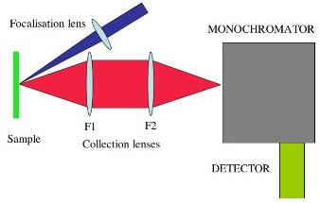
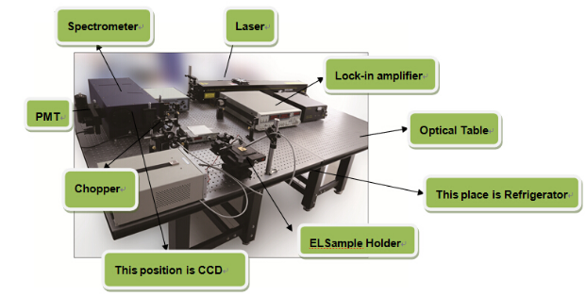
Chemical characterization
Photoluminescence spectroscopy (PL): when light energy, or photons, stimulate the emission of a photon from any matter. It is a non-contact, non-destructive method of investigative materials. The photo-excitation causes the material to jump to a higher electronic state, and will then release energy, (photons) as it relaxes and returns to back to a lower energy level.

Slide 6
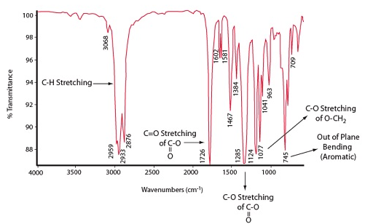
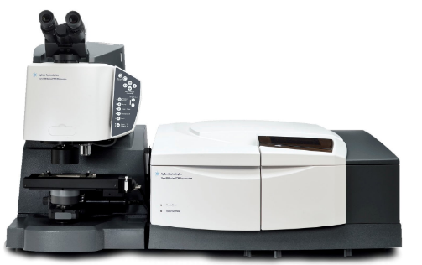
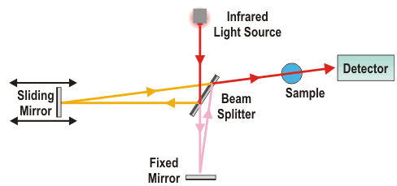
Chemical characterization
Fourier transform infrared spectroscopy (FTIR) is a technique that is used to obtain an infrared spectrum of absorption, emission, photoconductivity or Raman scattering of a solid, liquid or gas.

Slide 7
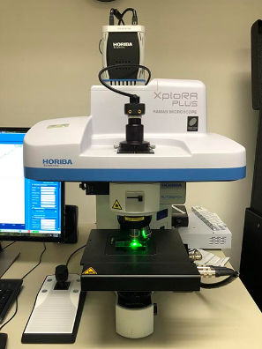
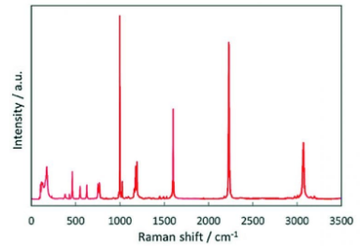
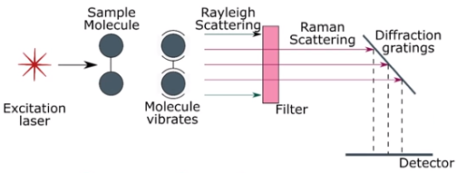
Chemical characterization
Raman Spectroscopy is a non-destructive chemical analysis technique which provides detailed information about chemical structure, phase and polymorphy, crystallinity and molecular interactions. It is based upon the interaction of light with the chemical bonds within a material. Raman is a light scattering technique, whereby a molecule scatters incident light from a high intensity laser light source. Most of the scattered light is at the same wavelength as the laser source.

Slide 8
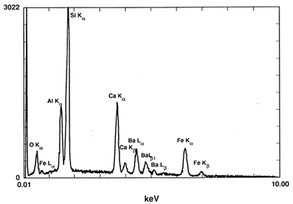
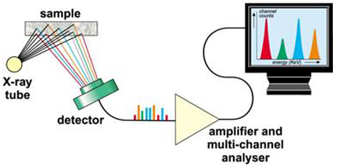
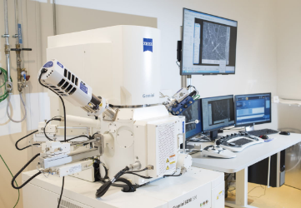
Chemical characterization
2. Electron Spectroscopy:
Energy Dispersive X-ray Spectroscopy (EDS): is used to determine the composition of a sample, relative amounts of each atom and the distribution of the atoms in the samples (such as thin films) can be mapped. EDX is an extension of the Scanning Electron Microscope in the Molecular Analysis Facility.

Slide 9
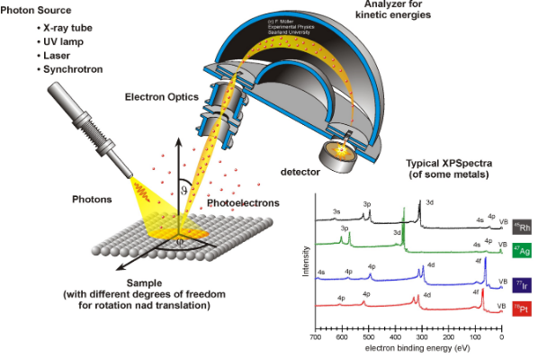
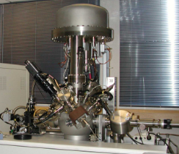
Chemical characterization
X-ray Photoelectron Spectroscopy (XPS) also known as Electron Spectroscopy for Chemical Analysis (ESCA) is the most widely used surface analysis technique because it can be applied to a broad range of materials and provides valuable quantitative and chemical state information from the surface of the material being studied. The average depth of analysis for an XPS measurement is approximately 5 nm.

Slide 10
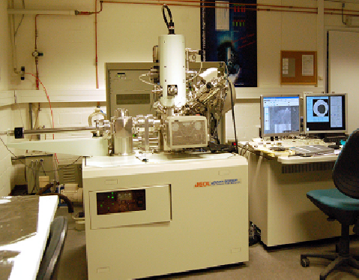
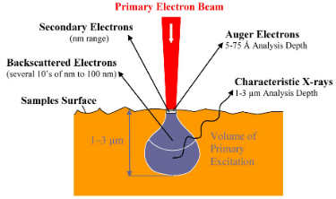
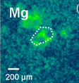
Chemical characterization
Auger Electron Spectroscopy (AES) Auger spectroscopy is a vacuum technique where a stream of primary electrons is focused onto the sample surface resulting in a number of different particles or waves being emitted (secondary electrons, back-scattered electrons, X-rays, photons, Auger electrons…). The kinetic energy of the escaping Auger electron is characteristic for the emitting atom. The Auger electrons are emitted from the first 5-75 Å of the sample surface which results in a very surface sensitive analysis technique.

Slide 11
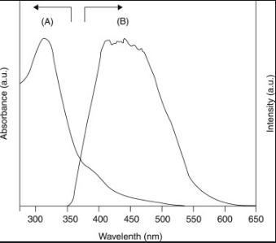
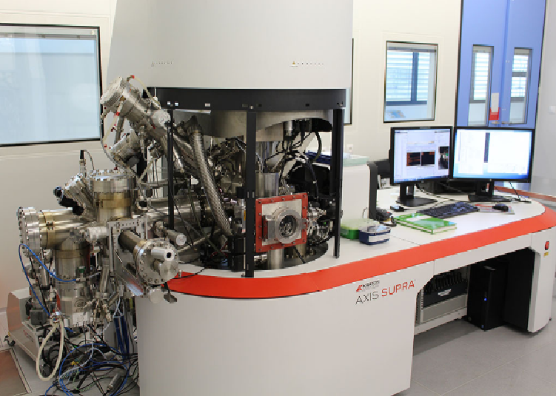
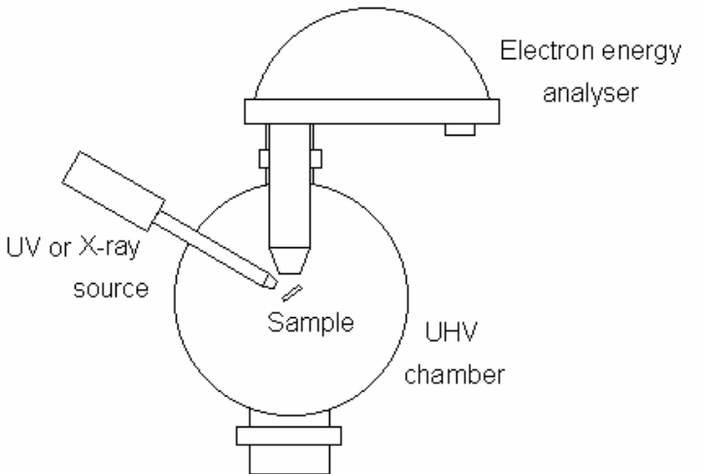
Chemical characterization
Ultraviolet photoelectron spectroscopy (UPS) it measures the kinetic energy spectra of photoelectrons emitted by molecules which have absorbed ultraviolet photons, so as to determine molecular orbital energies in the valence region.

