Slide 1
What Is Linear Algebra?

Slide 2
Suppose you travel on an airplane between two cities that are 5000 kilometers apart.
If the trip one way against a headwind takes (6.25) hours and the return trip the same day in the direction of the wind takes only (5) hours.

Slide 3
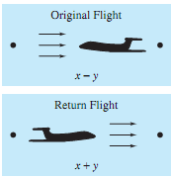

Slide 4

If you let x represent the speed of the plane and y the speed of the wind, then the following system models the problem.

Slide 5

This system of two equations and two unknowns simplifies to.
The solution is x = 900 km/h and y = 100km/h

Slide 6
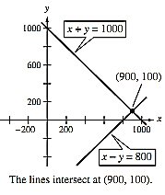

Slide 7
# Solving systems of linear equations is one of the most important applications of linear algebra.
# Linear applications arise in such diverse areas as engineering, chemistry, economics, business, ecology, biology, and psychology.
# In real-world situations, it is not unusual to have to solve systems of hundreds or even thousands of equations.

