Slide 1
Pavement Structural Analysis
Three-Layer System
Highway and Transportation Engineering
Al-Mustansiriyah University
2019-2020
Dr. Rana Amir Yousif & Dr. Abeer K. Jameel

Slide 2
References
Nicholas J. Garber and Lester A. Hoel.”Traffic and Highway Engineering”, Fourth Edition.
Yoder; E. J. and M. W. Witczak, “Principles of Pavement Design”, A Wiley- Interscience Publication, John Wiley & Sons Inc., U.S.A., 1975.
Yaug H. Huang, “Pavement Analysis and Design”, Prentic Hall Inc., U.S.A., 1993.
“AASHTO Guide for Design of Pavement Structures 1993”, AASHTO, American Association of State Highway and Transportation Officials, U.S.A., 1993.
Oglesby Clarkson H., “Highway Engineering”, John Wiley & Sons Inc., U.S.A., 1975.

Slide 3
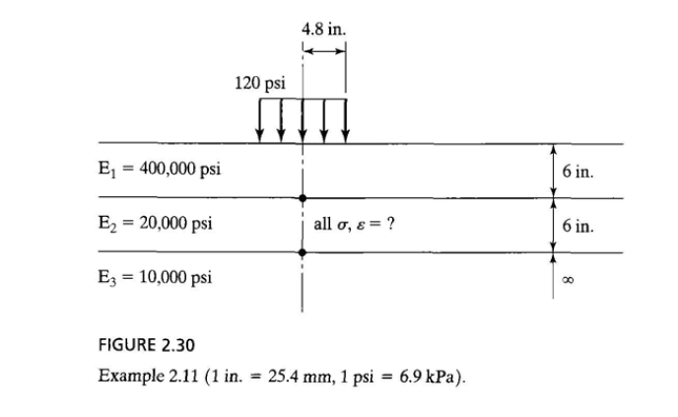
Three-Layer Systems
Example (2,11) Page 71:
Given the three-layer system shown in Figure 2.30 with a = 4.8 in. (122 mm), q = 120 psi (828 kPa), h1 = 6 in. (152 mm), h2 = 6 in. (203 mm), E1 = 400,000 psi (2.8 GPa), E2 = 20,000 psi (138 MPa), and E3 = 10,000 psi (69 MPa), determine all the stresses and strains at the two interfaces on the axis of symmetry .

Slide 4
Three-Layer Systems
Solution:
Given k1= 400,000/20,000
= 20
k2= 20,000/10,000
= 2
A=4.8/6 = 0.8
H= 6/6 = 1.0

Slide 5
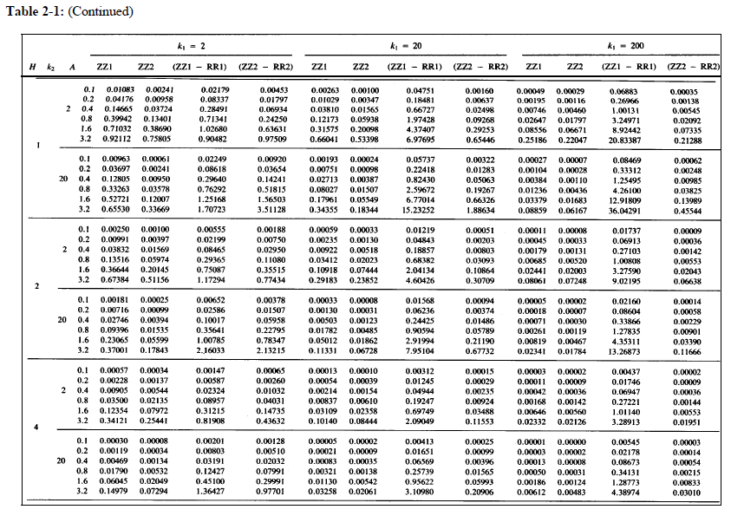
Three-Layer Systems
From Table (2.3)
ZZ1= 0.12173
ZZ2= 0.05938
ZZ1-RR1=1.97428
ZZ2-RR2= 0.09268
k1=20
k2=2
A=0.8
H=1.0

Slide 6
Three-Layer Systems
From Eq. 2 .24
= 120* 0.12173 = 14.61 psi
= 120 * 0.05938 = 7.12 psi
= 120 * 1.97428 = 236.91 psi
= 120 * 0.09268 = 11.12 psi
ZZ1= 0.12173
ZZ2= 0.05938
ZZ1-RR1=1.97428
ZZ2-RR2= 0.09268

Slide 7
Three-Layer Systems
K1 =20
K2 = 2
= 236.91 psi
= 11.12 psi
From Eq. 2 .23
= 236.91/20 = 11.85 psi
= 11.12/2 = 5.56 psi

Slide 8
Three-Layer Systems
At bottom of layer 1,
= 14.61 – 236.91 = - 222.3 psi.
From Eq. 2 .20
= 236 .91/400,000 = 5 .92 x 10^-4
= -2 .96 X 10^ -4
= 236.91 psi
= 14.61 psi
E1=400000

Slide 9
Three-Layer Systems
At top of layer 2
= 14.61 – 11.85 = 2.76 psi.
From Eq. 2 .20
= 11.85/20,000 = 5.92 x 10^-4
= -2.96 X 10^-4
=11.85
= 14.61 psi
E2 = 20000

Slide 10
Three-Layer Systems
At bottom of layer 2
= 7.12 - 11.12 = -4.0 psi.
From Eq. 2 .20
= 11.12/20,000 = 5.56 * 10^-4
= -2.78 * 10^-4
=11.12
= 7.12 psi
E2 = 20000

Slide 11
Three-Layer Systems
At top of layer 3
= 7.12 - 5.56 = 1.56 psi.
From Eq. 2 .20
= 5.56/10,000 = 5.56 * 10^-4
= -2.78 * 10^-4
=5.56
= 7.12 psi
E3 = 10000

Slide 12
Three-Layer Systems
Thanks for ATTENSION
Dr. Rana Amir Yousif & Dr. Abeer K. Jameel

