Slide 1
Pavement Structural Analysis
Three-Layer System, Jones Tables
Highway and Transportation Engineering
Al-Mustansiriyah University
2019-2020
Dr. Rana Amir Yousif & Dr. Abeer K. Jameel

Slide 2
References
Nicholas J. Garber and Lester A. Hoel.”Traffic and Highway Engineering”, Fourth Edition.
Yoder; E. J. and M. W. Witczak, “Principles of Pavement Design”, A Wiley- Interscience Publication, John Wiley & Sons Inc., U.S.A., 1975.
Yaug H. Huang, “Pavement Analysis and Design”, Prentic Hall Inc., U.S.A., 1993.
“AASHTO Guide for Design of Pavement Structures 1993”, AASHTO, American Association of State Highway and Transportation Officials, U.S.A., 1993.
Oglesby Clarkson H., “Highway Engineering”, John Wiley & Sons Inc., U.S.A., 1975.

Slide 3


Three-Layer Systems
Steps to Solve Three-Layer System:
By using Jones' Tables
Step 1
Find k1 value
Find k2 value

Slide 4


Three-Layer Systems
Steps to Solve Three-Layer System:
Step 2
Find A value
Find H value

Slide 5
Three-Layer Systems
Steps to Solve Three-Layer System:
Step 3
Go to Table below to get
ZZ1, ZZ2, ( ZZ1-RR1), and (ZZ2-RR2)
As shown below

Slide 6
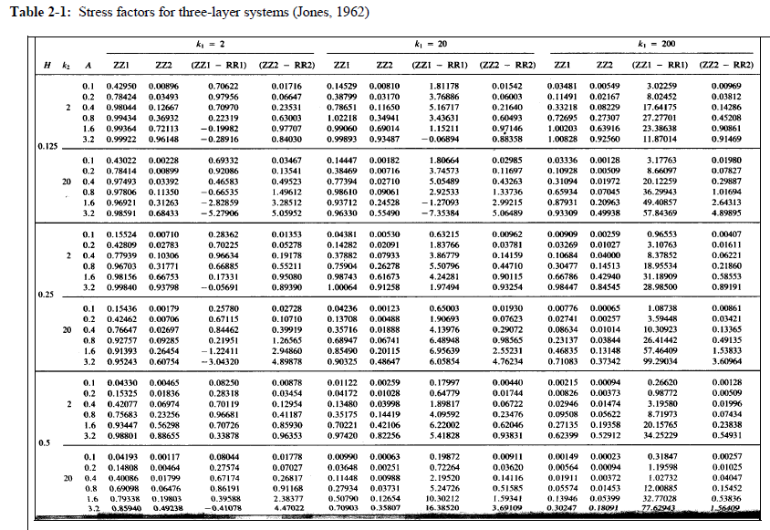
Step 2
A
Step 1 (k1)
Step 1 (k2)
Step 2 H
For example:
If k1=20
k2= 20
For example:
If H=0.25
A= 1.6
Then we can get:
ZZ1=0.85490
ZZ2=0.20115
(ZZ1-RR1)=6.95639
(ZZ2-RR2)=2.55231

Slide 7
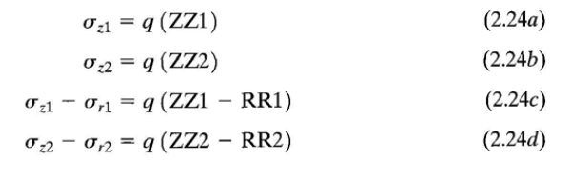

Three-Layer Systems
Steps to Solve Three-Layer System:
Step 4
Find
As shown in equations.
2

Slide 8
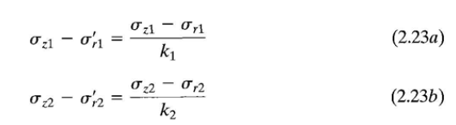
Three-Layer Systems
Steps to Solve Three-Layer System:
Step 5
Find
As shown in equations.

Slide 9
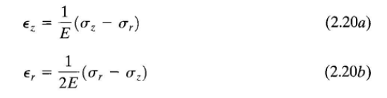
Three-Layer Systems
Steps to Solve Three-Layer System:
Step 6
Find
As shown in equations.

Slide 10
Three-Layer Systems
Thanks for ATTENSION
Dr. Rana Amir Yousif & Dr. Abeer K. Jameel

