Slide 1
Pavement Structural Analysis
Three-Layer System, Jones Tables
Highway and Transportation Engineering
Al-Mustansiriyah University
2019-2020
Dr. Rana Amir Yousif & Dr. Abeer K. Jameel

Slide 2
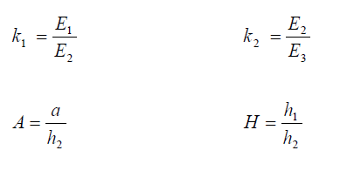
Three-Layer Systems
Jones has developed a series of tables for determining the stresses in a three-layer system for the following dimensionless parameters
Jones' Tables: The stresses in a three-layer system depend on the ratios k1, k2, A, and H, defined as

Slide 3
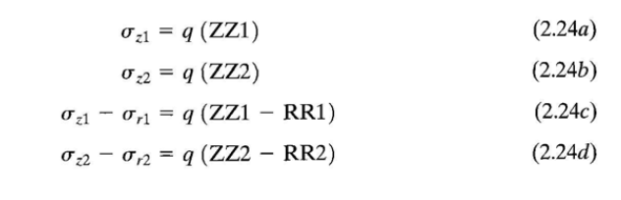
Three-Layer Systems
Once the stresses at the interfaces are calculated, strains can be computed from the equations of strains. 2.20a, 2.20b, and 2.21

Slide 4
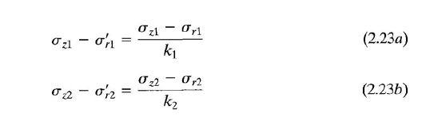
Three-Layer Systems
Once the stresses at the interfaces are calculated, strains can be computed from the equations of strains. 2.20a, 2.20b, and 2.21

Slide 5
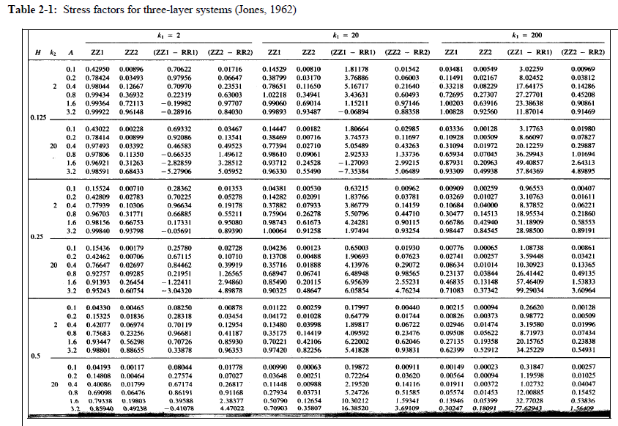

Slide 6
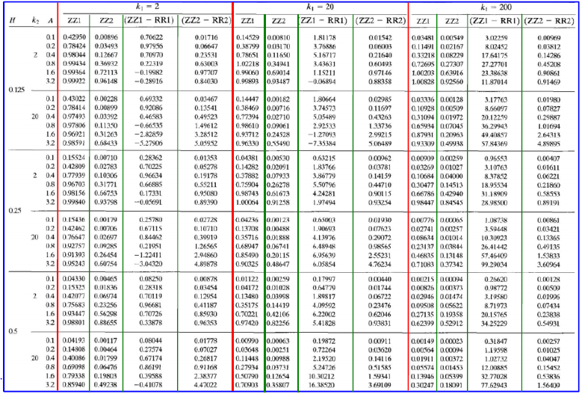
Three-Layer system

Slide 7
