Slide 1
Pavement Structural Analysis
Three-Layer System
Highway and Transportation Engineering
Al-Mustansiriyah University
2019-2020
Dr. Rana Amir Yousif & Dr. Abeer K. Jameel

Slide 2
Pavement Structural Analysis
Three-Layer System
Highway and Transportation Engineering
Al-Mustansiriyah University
2019-2020
Dr. Rana Amir Yousif & Dr. Abeer K. Jameel

Slide 3
Pavement Structural Analysis
Three-Layer System
Highway and Transportation Engineering
Al-Mustansiriyah University
2019-2020
Dr. Rana Amir Yousif & Dr. Abeer K. Jameel

Slide 4
References
Nicholas J. Garber and Lester A. Hoel.”Traffic and Highway Engineering”, Fourth Edition.
Yoder; E. J. and M. W. Witczak, “Principles of Pavement Design”, A Wiley- Interscience Publication, John Wiley & Sons Inc., U.S.A., 1975.
Yaug H. Huang, “Pavement Analysis and Design”, Prentic Hall Inc., U.S.A., 1993.
“AASHTO Guide for Design of Pavement Structures 1993”, AASHTO, American Association of State Highway and Transportation Officials, U.S.A., 1993.
Oglesby Clarkson H., “Highway Engineering”, John Wiley & Sons Inc., U.S.A., 1975.

Slide 5
Three-Layer Systems
With quick computational facilities available, the analysis of three or more layers is no more a difficult task. The three-layer system can be conceived as follows:
Top layer, representing all the bituminous layers taken together,
Second layer, representing the unbound base and subbase courses, and
Third layer, representing the sub-grade.

Slide 6
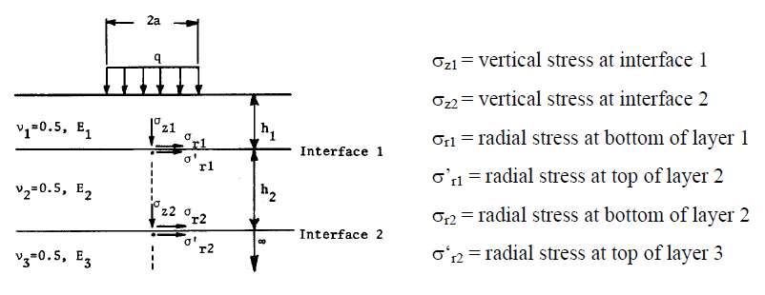
Three-Layer Systems
Figure 2-13 shows a three-layer system and the stresses at the interfaces on the axis of symmetry.

Slide 7
Three-Layer Systems
At the axis of symmetry, tangential and radial stresses are identical and the shear stress is equal to 0.

