Slide 1
Engineering Management
University of Mustansiriyah 2019-2020
College of Engineering 3rd Stage
High. & Trans Eng. Dep.
Lecture No.13: Network Analysis, AON
Lecturers: Dr. Ali Jabbar
Dr. Abeer K. Jameel

Slide 2
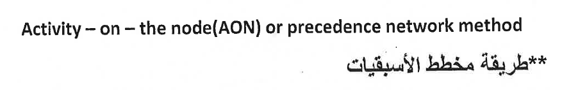
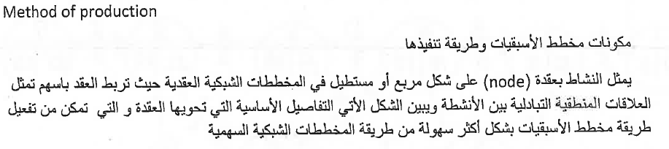
Network Analysis: AON

Slide 3
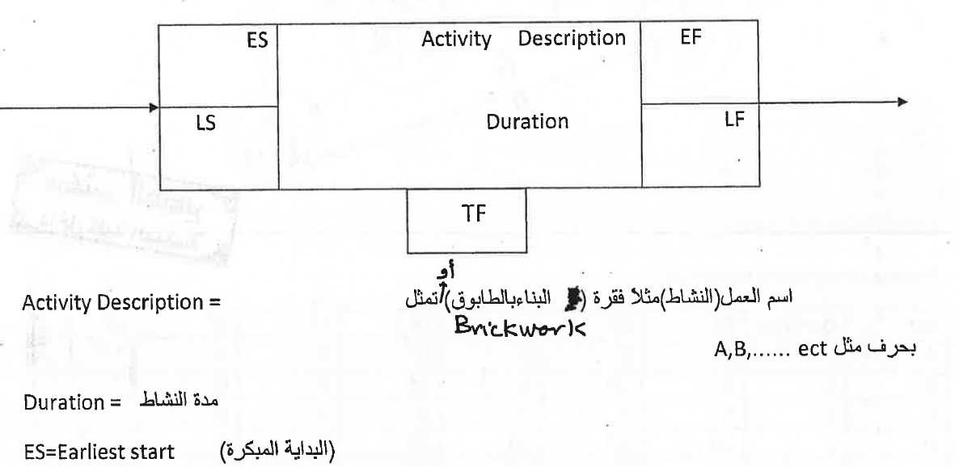
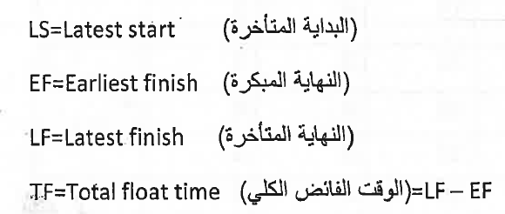
Network Analysis: AON

Slide 4
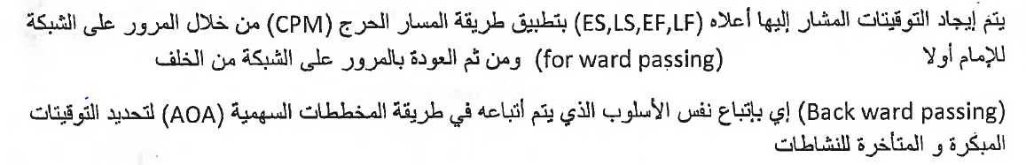
Network Analysis: AON

Slide 5
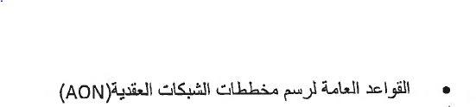
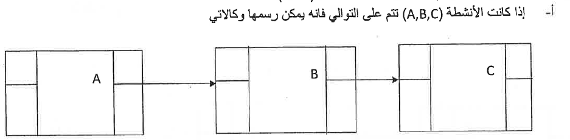
Network Analysis: AON

Slide 6
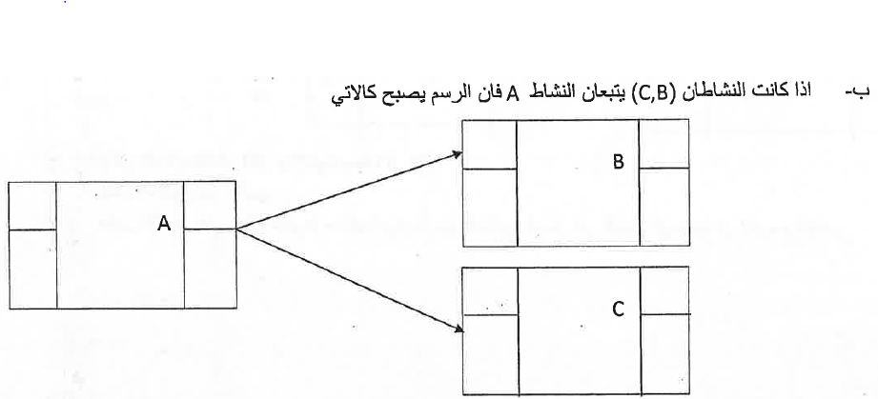
Network Analysis: AON

Slide 7
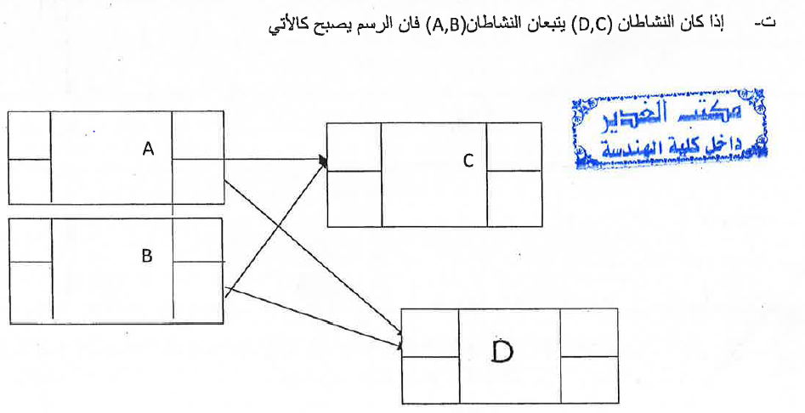
Network Analysis: AON

Slide 8
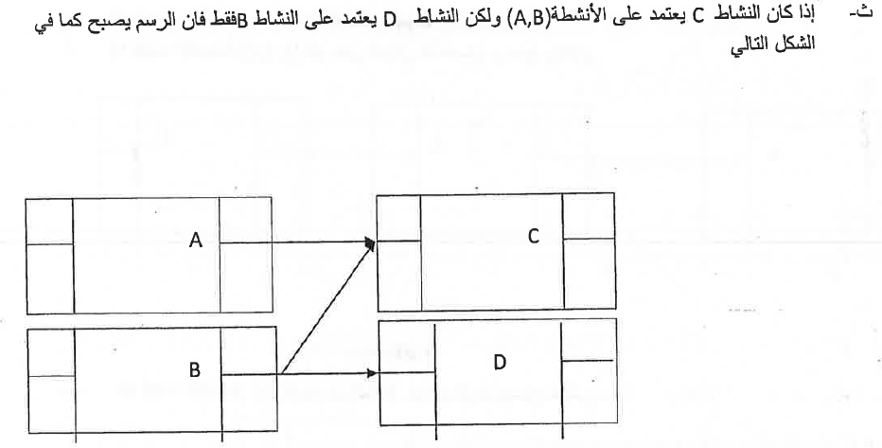
Network Analysis: AON

Slide 9
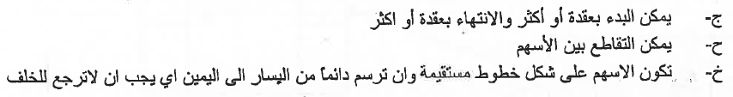
Network Analysis: AON

