Slide 1
Engineering Management
University of Mustansiriyah 2019-2020
College of Engineering 3rd Stage
High. & Trans Eng. Dep.
Lecture No.8, Programming Techniques: Gantt Chart, Example 2
Lecturers: Dr. Ali Jabbar
Dr Abeer K. Jameel

Slide 2
Programming Techniques: Gantt Chart
Gantt Chart Example 2
Activity | A | B | C | D | E | F | G | H | I | J | K | L | M | N | Q | R
Duration (week) | 11 | 10 | 8 | 7 | 10 | 7 | 9 | 10 | 11 | 9 | 8 | 8 | 9 | 11 | 10 | 7
Depend on | - | A | J,G | C | R,D,F | L | H | I | - | B | G | M | Q | - | N | K,L

Slide 3
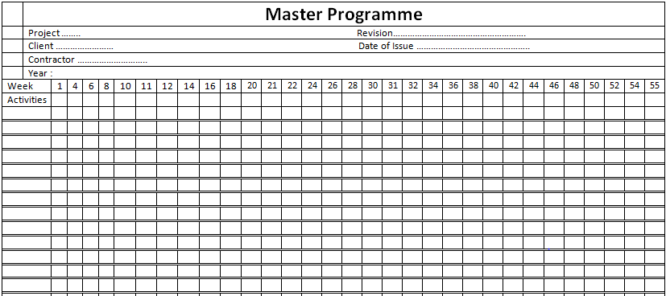
A
I
N
B
H
Q
J
G
N
C
Activity | A | B | C | D | E | F | G | H | I | J | K | L | M | N | Q | R
Duration (week) | 11 | 10 | 8 | 7 | 10 | 7 | 9 | 10 | 11 | 9 | 8 | 8 | 9 | 11 | 10 | 7
Depend on | - | A | J,G | C | R,D,F | L | H | I | - | B | G | M | Q | - | N | K,L

Slide 4
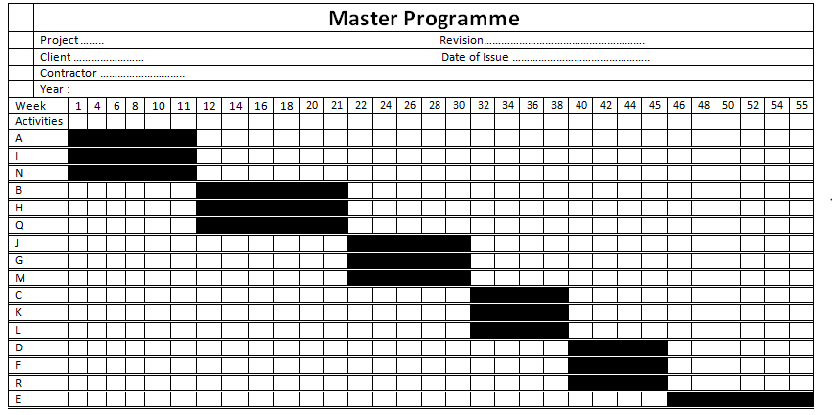
Completion time: 55

