Slide 1
Engineering Management
University of Mustansiriyah 2019-2020
College of Engineering 3rd Stage
High. & Trans Eng. Dep.
Lecture No.8, Programming Techniques: Gantt Chart, Examples
Lecturers: Dr. Ali Jabbar
Dr Abeer K. Jameel

Slide 2
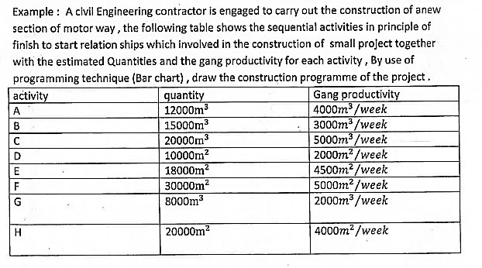
Programming Techniques: Gantt Chart
Gantt Chart : Example 1

Slide 3
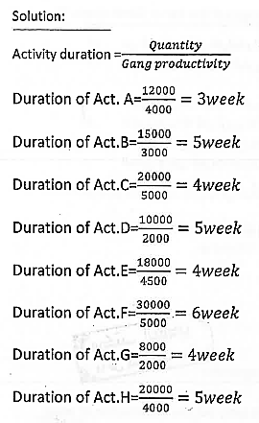
Programming Techniques: Gantt Chart

Slide 4
Solution (continue )
Master Programme
Project …….. Revision……………………...
Client …………………… Date of Issue ………………………………………..
Contractor ……………..
Year :
Month | Jan |  |  |  |  | Feb |  |  |  |  | Mar |  |  |  |  | April |  |  |  |  | May |  |  |  |  | Jun |  |  |  |  | July |  |  |  |  | Aug |  |  |  |  |  | Sep
Week | 1 | 2 | 3 | 4 | 5 |  | 6 | 7 | 8 | 9 |  | 10 | 11 | 12 | 13 | 14 | 15 | 16 | 17 | 18 |  | 19 | 20 | 21 | 22 |  | 23 | 24 | 25 | 26 | 27 | 28 | 29 | 30 | 31 |  | 32 | 33 | 34 | 35 | 36 |  | 37 | 38
activity
A
B
C
D
E
F
G
H

Slide 5
Solution (continue )
Master Programme
Project …….. Revision
Client …………………… Date of Issue ………………………………………..
Contractor
Year :
Month | Jan |  |  |  |  | Feb |  |  |  |  | Mar |  |  |  |  | April |  |  |  |  | May |  |  |  |  | Jun |  |  |  |  | July |  |  |  |  | Aug |  |  |  |  |  | Sep
Week | 1 | 2 | 3 | 4 | 5 |  | 6 | 7 | 8 | 9 |  | 10 | 11 | 12 | 13 | 14 | 15 | 16 | 17 | 18 |  | 19 | 20 | 21 | 22 |  | 23 | 24 | 25 | 26 | 27 | 28 | 29 | 30 | 31 |  | 32 | 33 | 34 | 35 | 36 |  | 37
activity
A
B
C
D
E
F
G
H
Completion time: 36

