Slide 1
Engineering Management
University of Mustansiriyah 2019-2020
College of Engineering 3rd Stage
High. & Trans Eng. Dep.
Lecture No.2: Introduction, Project Phases
Lecturers: Dr. Ali Jabbar
Dr. Abeer K. Jameel

Slide 2
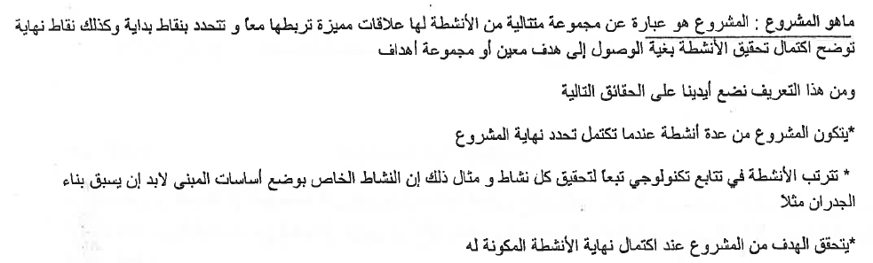
Introduction: Project Phases

Slide 3
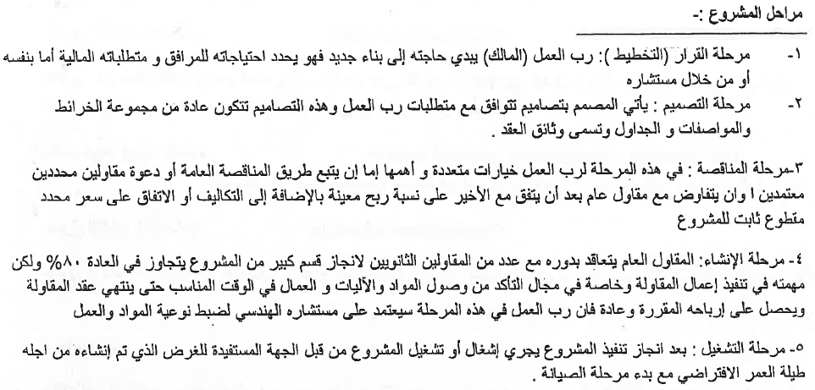
Introduction: Construction Management Functions

Slide 4
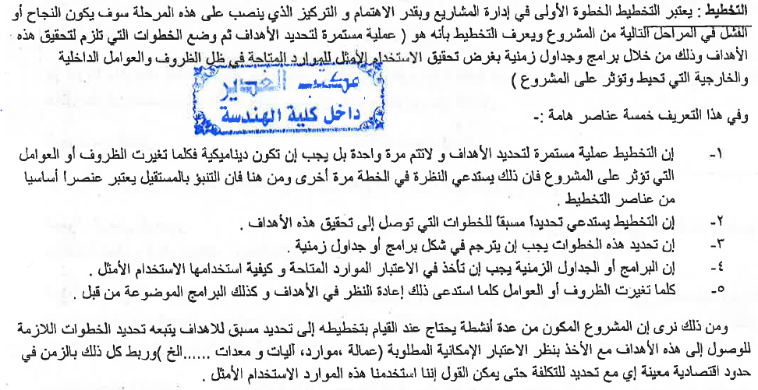
Introduction: Construction Management Functions

