Slide 1
Engineering Management
University of Mustansiriyah 2019-2020
College of Engineering 3rd Stage
High. & Trans Eng. Dep.
Lecture No.1 (Week 1): Introduction, Construction Management Principles and Functions
Lecturers: Dr. Ali Jabbar
Dr. Abeer K. Jameel

Slide 2
Syllabus
1.Introduction
Construction Management Principles and functions
Project life cycle and resources
Types of contracts
2. Bar Charts
3. Network Analysis
AOA [C.P.M] method
AON method
4. Programme Evaluation and Review Technique (PERT)
5. Line of Balance
6. Resource allocation

Slide 3
Basic References
Principle of construction management ; By Roy Pilcher
These lectures has been edited by Dr. Ali Jabbar

Slide 4
Introduction: Construction Management Principles
Cost
Quality
Time

Slide 5
Introduction: Construction Management Principles
Cost
Quality
Time

Slide 6
Introduction: Construction Management Principles
Cost
Quality
Time

Slide 7
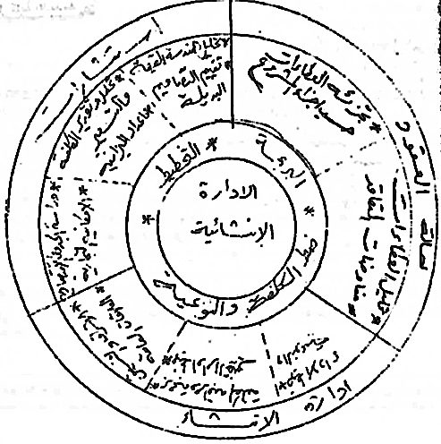
Introduction: Construction Management Functions
Construction management functions

Slide 8
Introduction: Construction Management Functions

Slide 9
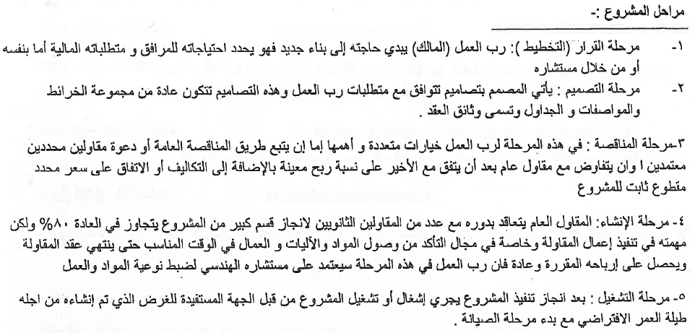
Introduction: Construction Management Functions

Slide 10
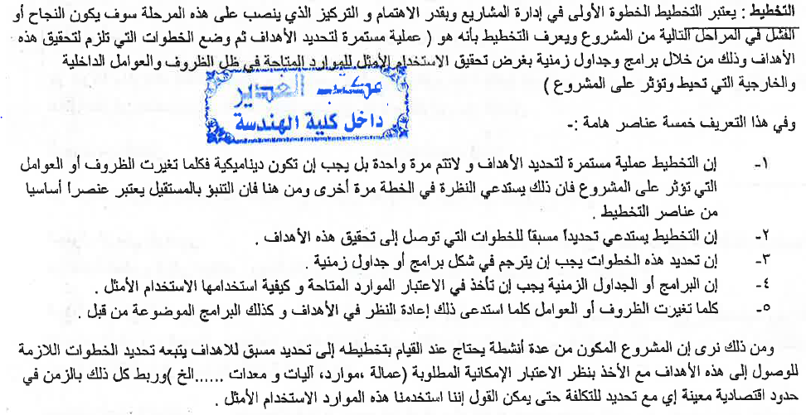
Introduction: Construction Management Functions

Slide 11
Introduction: Construction Management Functions

Slide 12
Introduction: Construction Management Functions

Slide 13
Introduction: Construction Management Functions

Slide 14
Introduction: Construction Management Functions

Slide 15
Introduction: Construction Management Functions

Slide 16
Introduction: Construction Management Functions

