Slide 1
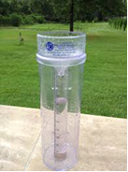

Hydrology lecture 2 (precipitation)
Precipitation is the general terms for all forms of moisture emanating from the clouds and falling to the ground, from the time of its formation in the atmosphere until it reaches to the ground. Forms of precipitations: Rain, snow, drizzle, glaze, sleet, hail and storm.
Measurement of precipitation
Recording rain gage and non recording rain gage

Slide 2
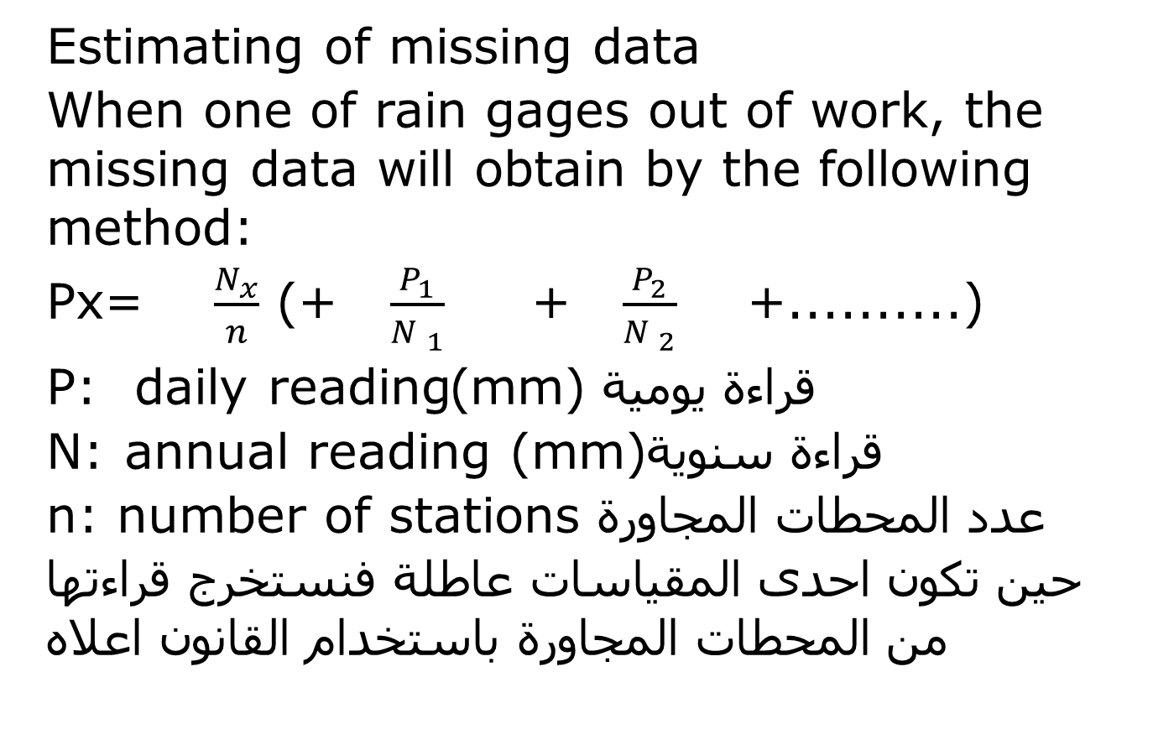
Estimating of missing data
When one of rain gages out of work, the missing data will obtain by the following method:
Px= $\frac{N_{x}}{n}$ (+ $\frac{P_{1}}{N _{1}}$ + $\frac{P_{2}}{N _{2}}$ +..........)
قراءة يومية mm))P: daily reading
قراءة سنويةN: annual reading (mm)
عدد المحطات المجاورة n: number of stations
حين تكون احدى المقياسات عاطلة فنستخرج قراءتها من المحطات المجاورة باستخدام القانون اعلاه

Slide 3




Example
Example.1-The normal annual P of five stations (A,B,C,D&E)arerespectively (125,102,76,118,137)cm during a storm the P recorded for stations (A,B,C,&D) are (13.2,9.2,6.8, &10.2)cm ,estimate the missing data @ sta. E?
?

