Slide 1
Operating Systems
By: Lecturer Raoof Talal

Slide 2
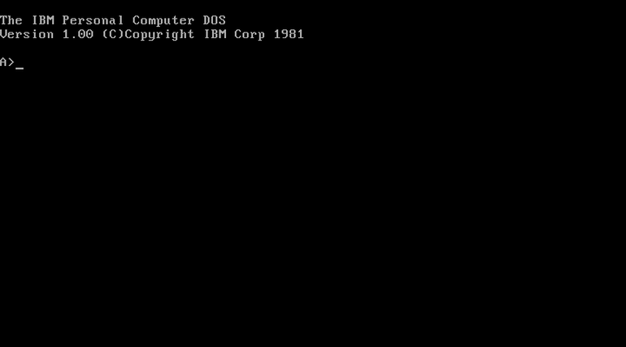

Slide 3
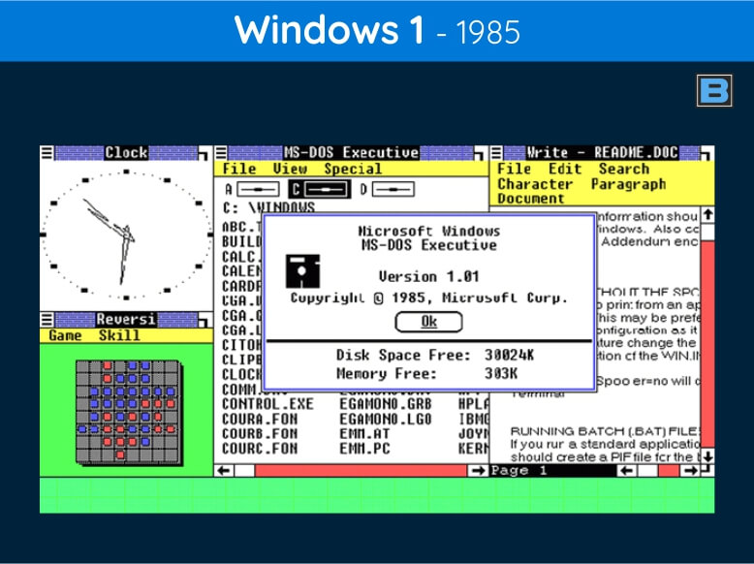

Slide 4
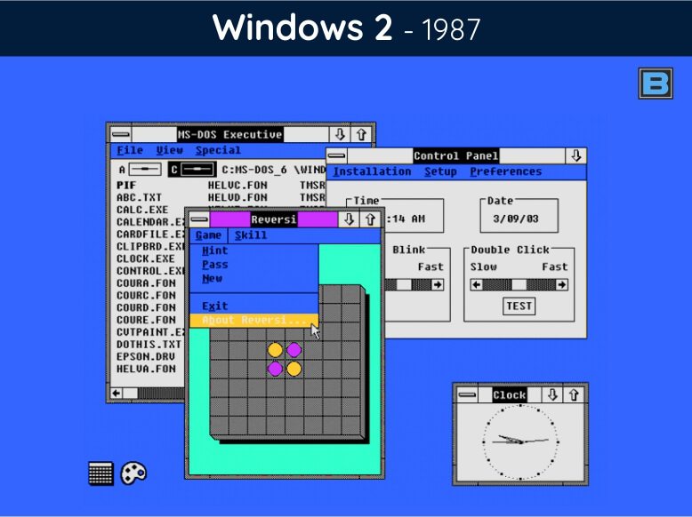

Slide 5
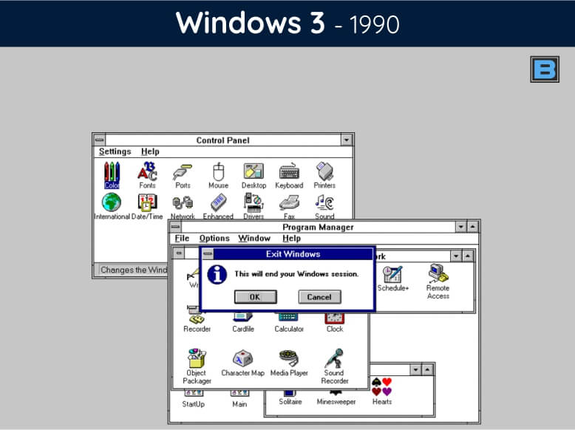

Slide 6
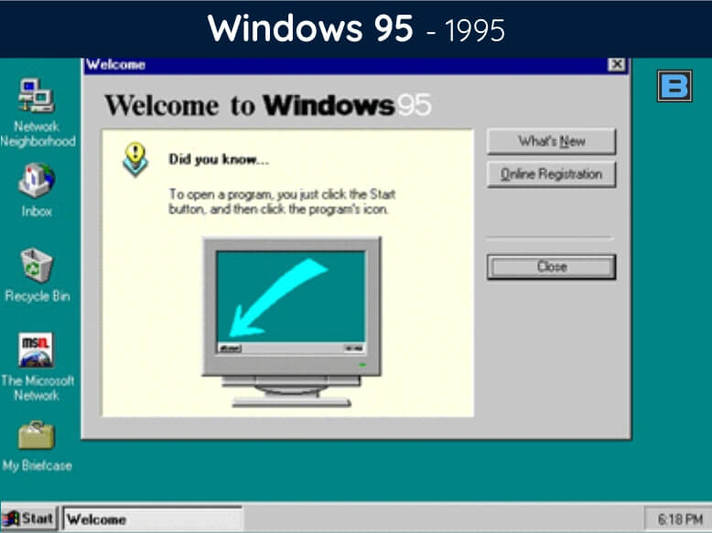

Slide 7
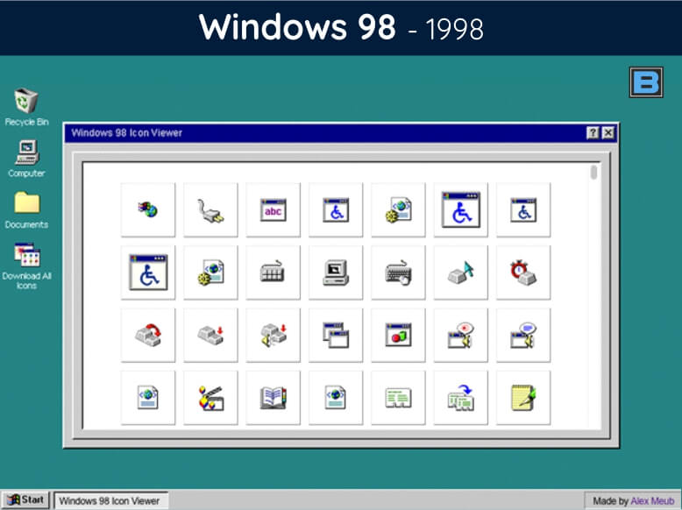

Slide 8
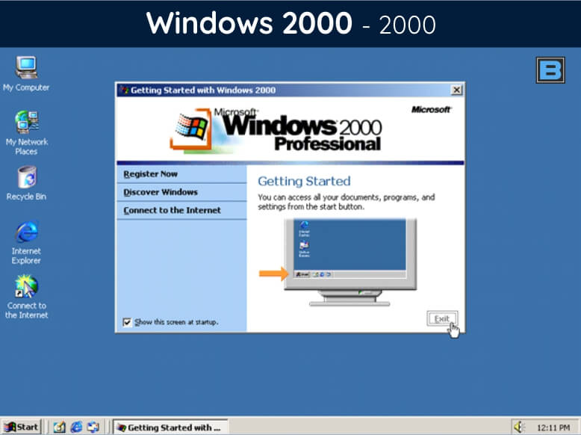

Slide 9
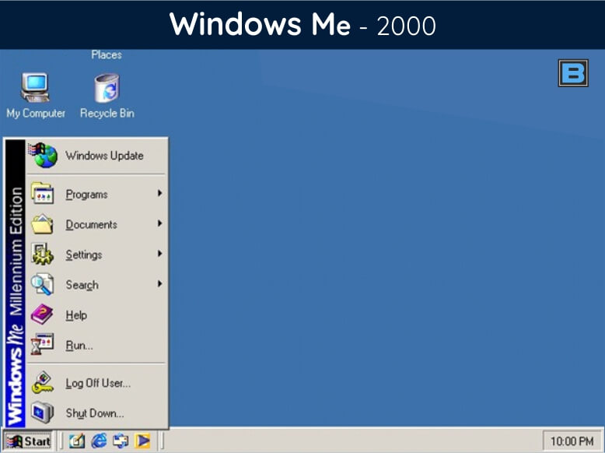

Slide 10
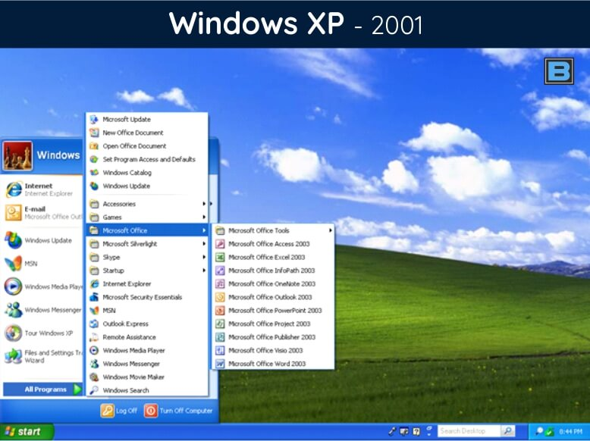

Slide 11
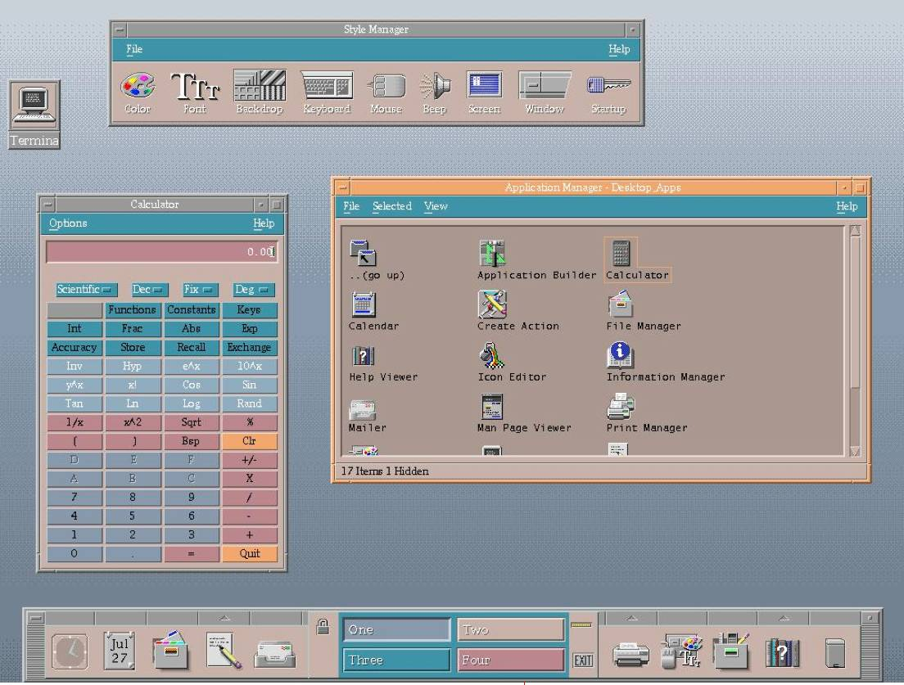
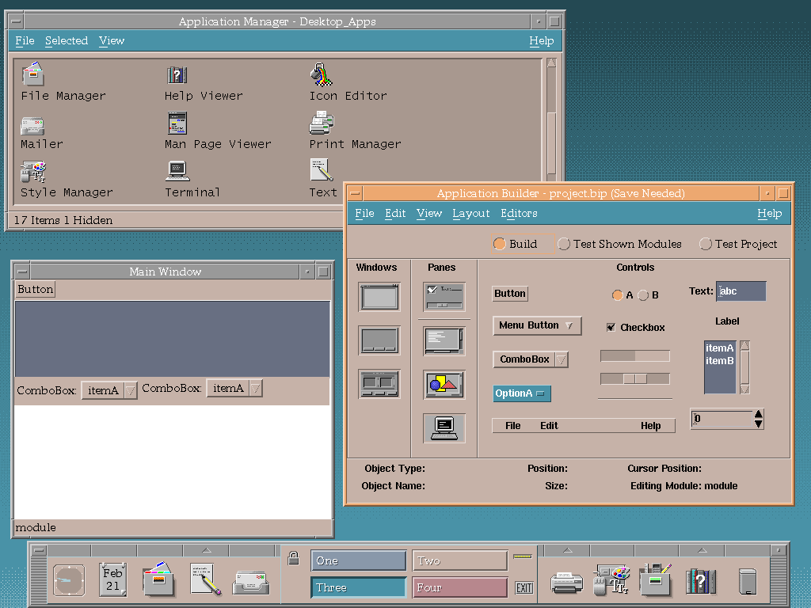
CDE Unix

Slide 12
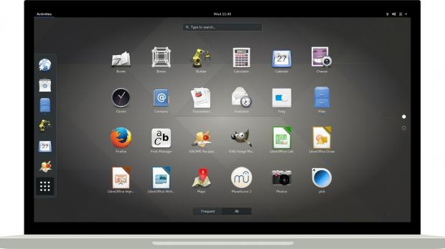
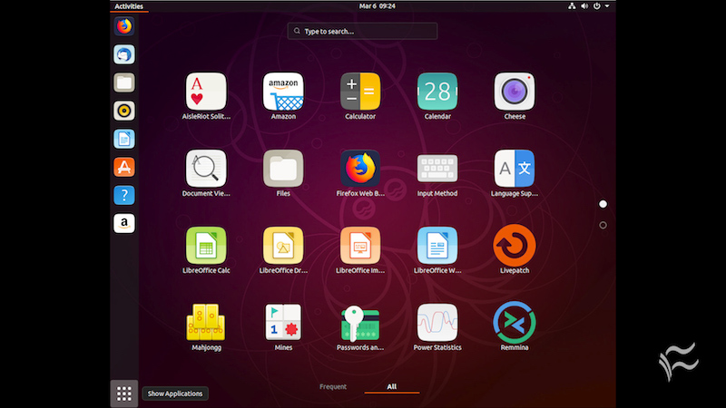
linux

Slide 13
Textbooks[الكتاب المنهجي ]
  1. Operating System Concepts 7 Edition, Silberschatz, Galvin and Gagne, 2005.
Suggested references[ المصادر المساعدة]
  Operating System Concepts 9 Edition, Silberschatz, Galvin and Gagne, 2012.
  Operating Systems, by William Stallings, 5th Edition, Prentice Hall, 2004..

Slide 14
Chapter 1
introduction

Slide 15
Chapter 2
Operating-System Structures

Slide 16
Chapter 3
File System Interface

Slide 17
Chapter 4
File System Implementation

Slide 18
Chapter 5
Process

Slide 19
Chapter 6
Threads

Slide 20
Chapter 7
CPU scheduling

Slide 21
Chapter 8
Process Synchronization

Slide 22
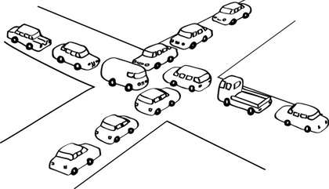
Chapter 9
Deadlocks

Slide 23
Chapter 10
Main Memory

Slide 24
Chapter 11
Mass-storage Structures

Slide 25
THANK YOU

