Slide 1
Pipe Network Analysis
A pipe network is analyzed for the determination of the nodal pressure heads and the link discharges. The network is analyzed for the worst combination of discharge withdrawals that may result in low pressure heads in some areas.
Pipe Network Geometry
The water distribution networks have mainly the following three types of configurations:
1-branched or tree-like configuration
2- looped configuration
3- branched and looped configuration
Analysis of Looped Networks
Analysis of a looped network consists of the determination of pipe discharges and the nodal heads. The following laws are used:
1- the algebraic sum of inflow and outflow discharges at node is zero.
2- the algebraic sum of the head loss around a loop is zero.
The most commonly used looped network analysis methods are:

Slide 2
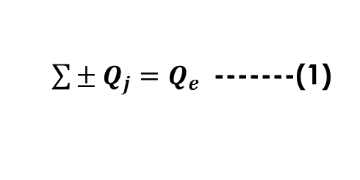
1- Hardy Cross Method
The following figure shows a relatively simple network consisting of seven pipes, two reservoirs, and one pump. The hydraulic grade lines at A and F are assumed known; these locations are termed fixed-grade nodes. Outflow demands are present at nodes C and D. Nodes C and D, along with nodes B and E are called interior nodes or junctions. Flow directions, even though not initially known, are assumed to be in the directions shown.
1-1- Generalized Network Equations
Networks of piping, such as those shown in the figure can be represented by the following equations.
1. Continuity at the jth interior node:
$\sum{{± Q}_{j}}=Q_{e}$ -------(1)
Representative piping network:
(a) assumed flow directions and numbering scheme
(b) designated interior loops
(c) path between two fixed-grade nodes
in which the subscript j refers to the pipes connected to a node, and Qe is the external demand. Use the positive sign for flow into the junction, and the negative sign for flow out of the junction.

Slide 3
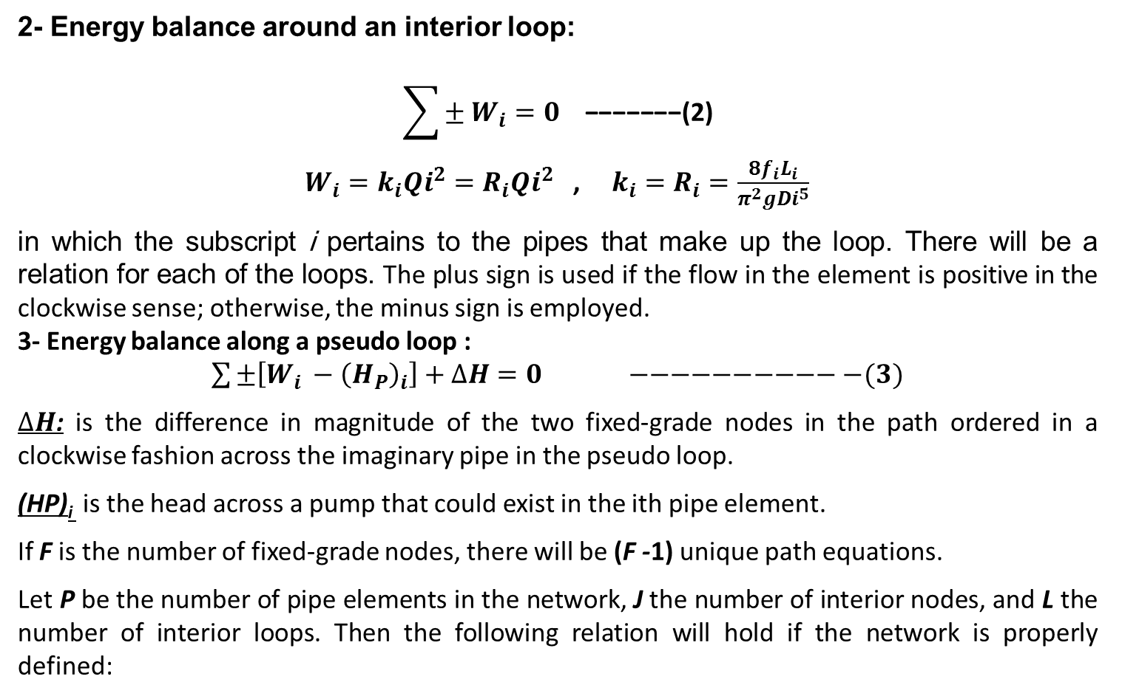
2- Energy balance around an interior loop:
$$\sum{± W_{i}}=0 \text{−−−−−−−(}\text{2}\text{)}$$
$W_{i}=k_{i}{Qi}^{2}=R_{i}{Qi}^{2}$ , ${k_{i}=R}_{i}=\frac{8f_{i}L_{i}}{π^{2}g{Di}^{5}}$
in which the subscript i pertains to the pipes that make up the loop. There will be a relation for each of the loops. The plus sign is used if the flow in the element is positive in the clockwise sense; otherwise, the minus sign is employed.
3- Energy balance along a pseudo loop :
$\sum{±\left[W_{i }−{\left(H_{P}\right)}_{i}\right]+∆H=0 −−−−−−−−−−−(3)}$
$∆H$: is the difference in magnitude of the two fixed-grade nodes in the path ordered in a clockwise fashion across the imaginary pipe in the pseudo loop.
(HP)_{i} is the head across a pump that could exist in the ith pipe element.
If F is the number of fixed-grade nodes, there will be (F -1) unique path equations.
Let P be the number of pipe elements in the network, J the number of interior nodes, and L the number of interior loops. Then the following relation will hold if the network is properly defined:
P = J + L + F – 1 -------(3)
In the figure above note that , J = 4, L = 2, F = 2, so that P = 4 + 2 + 2 -1 = 7

Slide 4
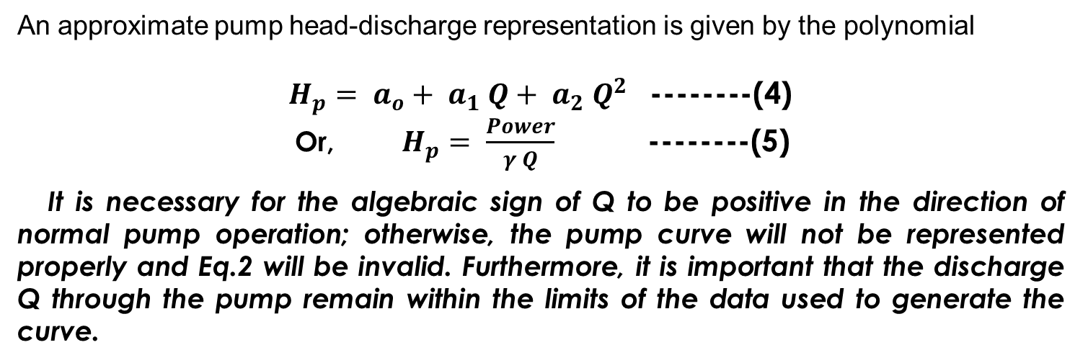
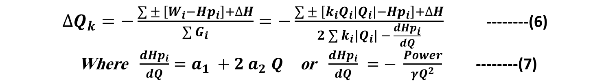
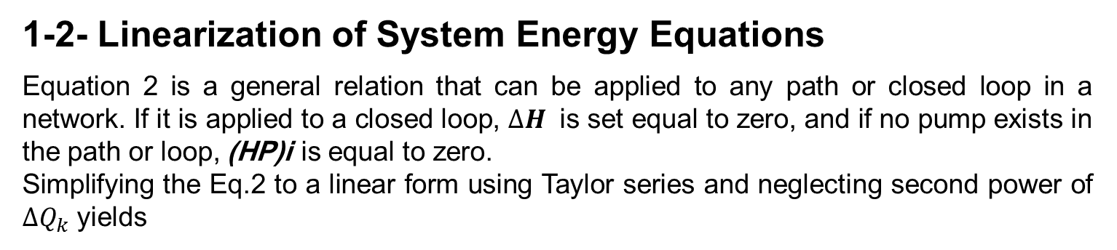
An approximate pump head-discharge representation is given by the polynomial
$H_{p}= a_{o}+ a_{1} Q+ a_{2} Q^{2}$ --------(4)
Or, $H_{p}= \frac{Power}{γ Q}$ --------(5)
It is necessary for the algebraic sign of Q to be positive in the direction of normal pump operation; otherwise, the pump curve will not be represented properly and Eq.2 will be invalid. Furthermore, it is important that the discharge Q through the pump remain within the limits of the data used to generate the curve.
1-2- Linearization of System Energy Equations
Equation 2 is a general relation that can be applied to any path or closed loop in a network. If it is applied to a closed loop, $∆H$ is set equal to zero, and if no pump exists in the path or loop, (HP)i is equal to zero.
Simplifying the Eq.2 to a linear form using Taylor series and neglecting second power of $∆Q_{k}$ yields
$∆Q_{k}=−\frac{\sum{± \left[W_{i}−{Hp}_{i}\right]+∆H}}{\sum{G_{i}}}=−\frac{\sum{± \left[{k_{i}Q}_{i}\left|Q_{i}\right|−{Hp}_{i}\right]+∆H}}{2\sum{k_{i}\left|Q_{i}\right|} − \frac{d{Hp}_{i}}{dQ}}$ --------(6)
Where $\frac{d{Hp}_{i}}{dQ}=a_{1} +2 a_{2}$ $Q$ or $\frac{d{Hp}_{i}}{dQ}$ $=− \frac{Power}{γQ^{2}}$ --------(7)

Slide 5
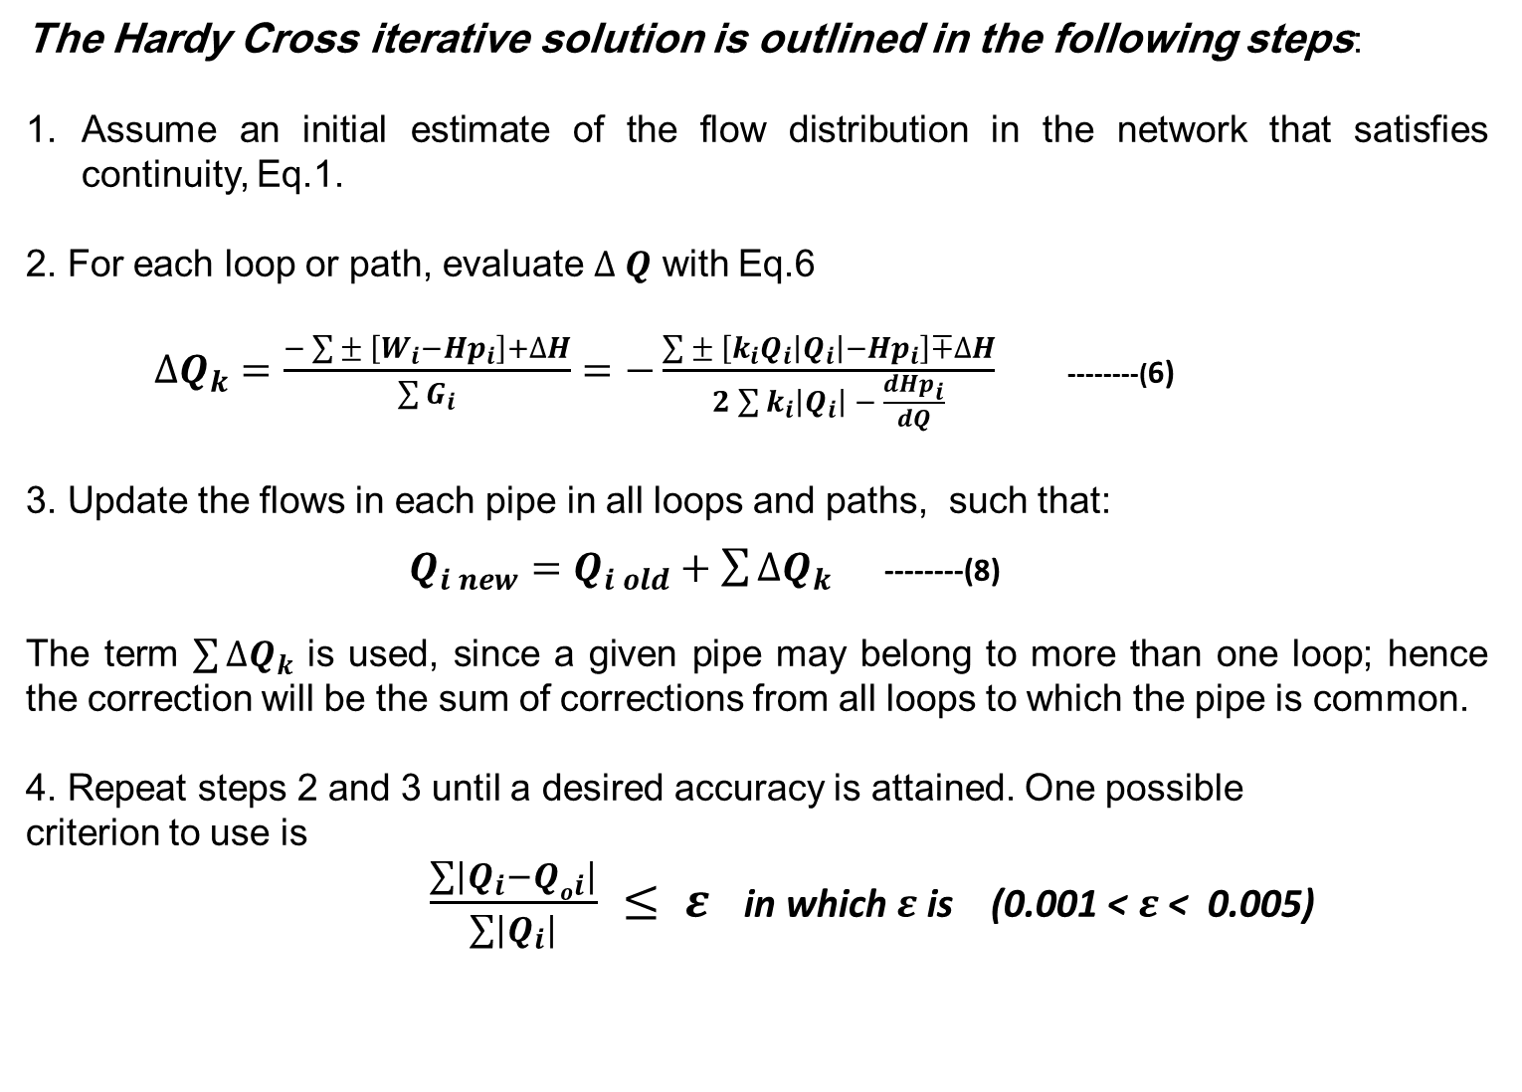
The Hardy Cross iterative solution is outlined in the following steps:
Assume an initial estimate of the flow distribution in the network that satisfies continuity, Eq.1.
2. For each loop or path, evaluate $∆ Q$ with Eq.6
$∆Q_{k}=\frac{−\sum{± \left[W_{i}−{Hp}_{i}\right]+∆H}}{\sum{G_{i}}}=−\frac{\sum{± \left[{k_{i}Q}_{i}\left|Q_{i}\right|−{Hp}_{i}\right]∓∆H}}{2\sum{k_{i}\left|Q_{i}\right|} − \frac{d{Hp}_{i}}{dQ}}$ --------(6)
3. Update the flows in each pipe in all loops and paths, such that:
$Q_{i new}=Q_{i old}+\sum{∆Q_{k}}$ --------(8)
The term $\sum{∆Q_{k}}$ is used, since a given pipe may belong to more than one loop; hence the correction will be the sum of corrections from all loops to which the pipe is common.
4. Repeat steps 2 and 3 until a desired accuracy is attained. One possible
criterion to use is
$\frac{\sum{\left|Q_{i}−{Qo}_{i}\right|}}{\sum{\left|Q_{i}\right|}} ≤ ε$ in which $ε$ is (0.001 < $ε$ < 0.005)

Slide 6
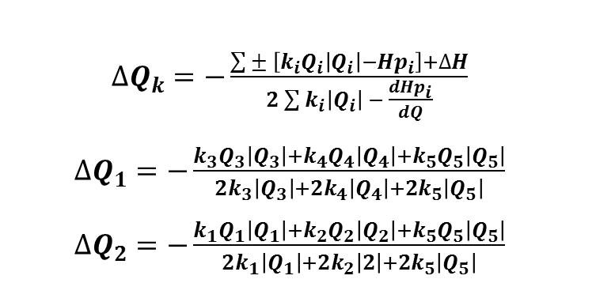


Example 1: The pipe network of two loops as shown in Fig. 3.11 has to be analyzed by the Hardy Cross method for pipe flows for given pipe lengths L and pipe diameters D. The nodal inflow at node 1 and nodal outflow at node 3 are shown in the figure. Assume a constant friction factor f = 0.02.
Solution
There are four junctions (J = 4), five pipes (P = 5), and (F= 0). Hence the number of closed loops is : L = P - J - F + 1
L = 5 - 4 - 0 + 1 = 2. The two loops and assumed flow directions are as shown. Equation 6 is applied to each loop as follows:
To apply continuity equation for initial pipe discharges, the discharges in pipes 1 and 5 equal to 0.1 m³/s are assumed. The obtained discharges are
Q1 = 0.1 m³/s (flow from node 1 to node 2)
Q2 = 0.1 m³/s (flow from node 2 to node 3)
Q3 = 0.4 m³/s (flow from node 4 to node 3)
Q4 = 0.4 m³/s (flow from node 1 to node 4)
Q5 = 0.1 m³/s (flow from node 1 to node 3)
$∆Q_{k}=−\frac{\sum{± \left[{k_{i}Q}_{i}\left|Q_{i}\right|−{Hp}_{i}\right]+∆H}}{2\sum{k_{i}\left|Q_{i}\right|} − \frac{d{Hp}_{i}}{dQ}}$
$∆Q_{1}=−\frac{k_{3}Q_{3}\left|Q_{3}\right|+k_{4}Q_{4}\left|Q_{4}\right|+k_{5}Q_{5}\left|Q_{5}\right|}{2k_{3}\left|Q_{3}\right|+2k_{4}\left|Q_{4}\right|+2k_{5}\left|Q_{5}\right|}$
$∆Q_{2}=−\frac{k_{1}Q_{1}\left|Q_{1}\right|+k_{2}Q_{2}\left|Q_{2}\right|+k_{5}Q_{5}\left|Q_{5}\right|}{2k_{1}\left|Q_{1}\right|+2k_{2}\left|2\right|+2k_{5}\left|Q_{5}\right|}$
$$For common pipe 5$$
$$Q_{5 new}=Q_{5 old}±∆Q_{1}∓∆Q_{2}$$

Slide 11
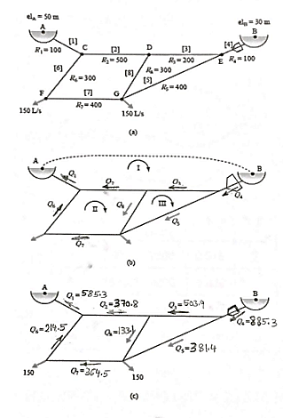

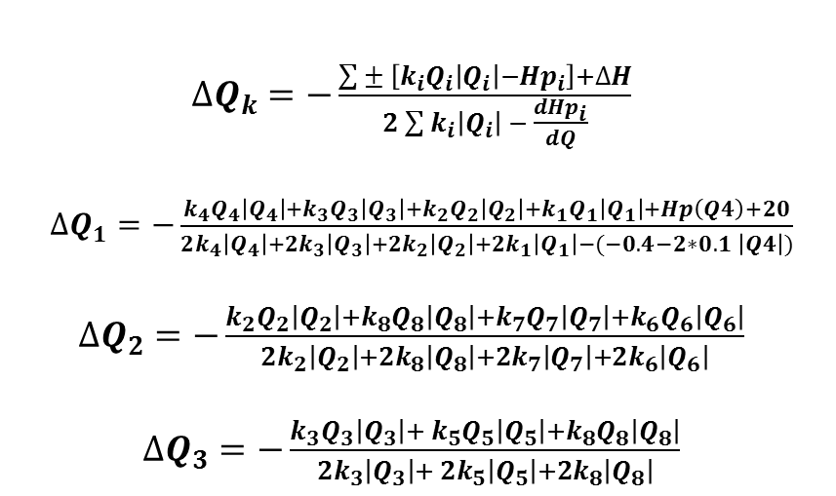
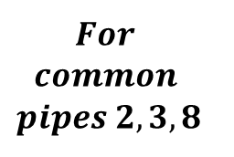


Example 2: for the piping system shown below, determine the flow distribution and piezometric heads at the junctions using Hardy Cross method, the pump head equation is Hp = 250 – 0.4 Q – 0.1 Q ²
Solution
$∆Q_{k}=−\frac{\sum{± \left[{k_{i}Q}_{i}\left|Q_{i}\right|−{Hp}_{i}\right]+∆H}}{2\sum{k_{i}\left|Q_{i}\right|} − \frac{d{Hp}_{i}}{dQ}}$
$∆Q_{1}=−\frac{k_{4}Q_{4}\left|Q_{4}\right|+k_{3}Q_{3}\left|Q_{3}\right|+k_{2}Q_{2}\left|Q_{2}\right|+k_{1}Q_{1}\left|Q_{1}\right|+Hp\left(Q4\right)+20}{2k_{4}\left|Q_{4}\right|+{2k}_{3}\left|Q_{3}\right|+2k_{2}\left|Q_{2}\right|+{2k}_{1}\left|Q_{1}\right|−(−0.4−2∗0.1 \left|Q4\right|)}$
$∆Q_{2}=−\frac{k_{2}Q_{2}\left|Q_{2}\right|+k_{8}Q_{8}\left|Q_{8}\right|+k_{7}Q_{7}\left|Q_{7}\right|+k_{6}Q_{6}\left|Q_{6}\right|}{2k_{2}\left|Q_{2}\right|+2k_{8}\left|Q_{8}\right|+{2k}_{7}\left|Q_{7}\right|+{2k}_{6}\left|Q_{6}\right|}$
$∆Q_{3}=−\frac{k_{3}Q_{3}\left|Q_{3}\right|+{ k}_{5}Q_{5}\left|Q_{5}\right|+k_{8}Q_{8}\left|Q_{8}\right|}{{2k}_{3}\left|Q_{3}\right|+ 2k_{5}\left|Q_{5}\right|+2k_{8}\left|Q_{8}\right|}$
$$Q_{2 new}=Q_{2 old}±∆Q_{1}∓∆Q_{2}$$
$$For$$
$$common$$
$$pipes 2,3,8$$
$$Q_{3 new}=Q_{3 old}±∆Q_{3}∓∆Q_{1}$$
$$Q_{8 new}=Q_{8 old}±∆Q_{2}∓∆Q_{3}$$

Slide 17
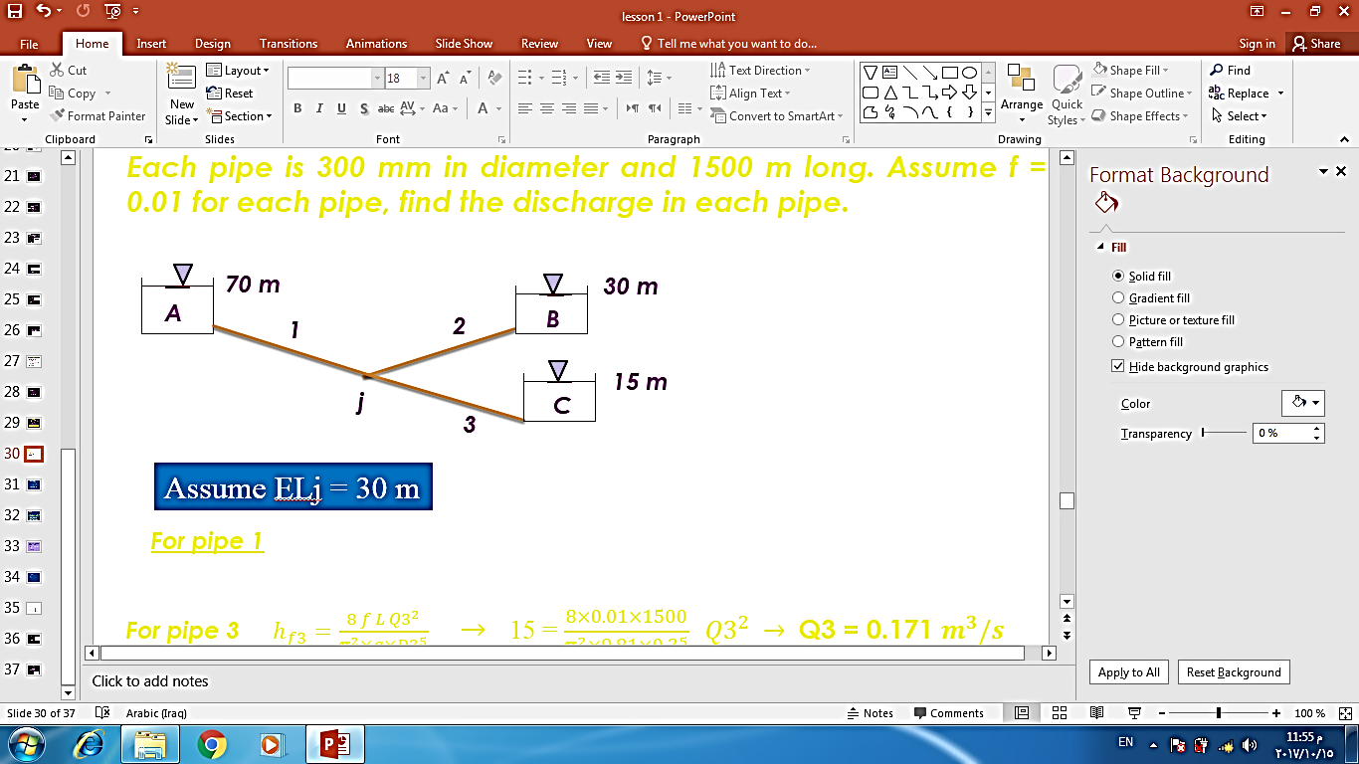
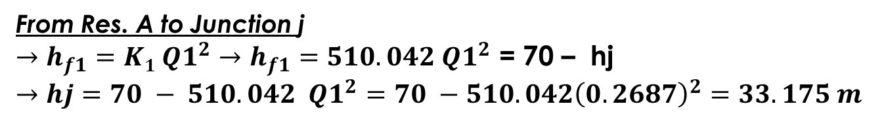

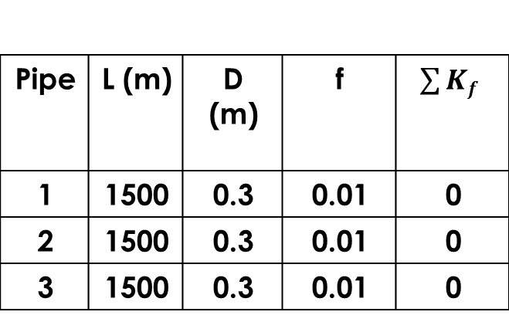
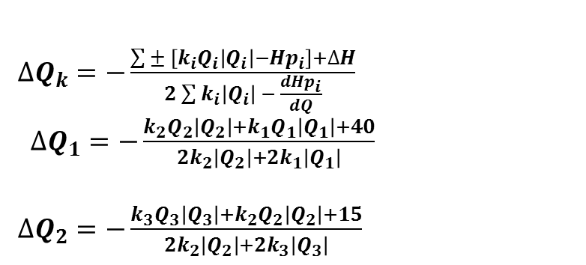

Example 3: For the piping system shown below, determine the flow distribution and piezometric heads at the junction J using the Hardy Cross method of solution
Solution
There are one junction (J = 1), three pipes (P = 3), and three fixed-grade nodes (F= 3). Hence the number of closed loops is : L = P - J - F + 1
L = 3 - 1 - 3 + 1 = 0 . There are two pseudo loop (F-1) only. The two pseudo loop and assumed flow directions are as shown. Equation 6 is applied to each loop as follows:
[1]
[2]
$∆Q_{k}=−\frac{\sum{± \left[{k_{i}Q}_{i}\left|Q_{i}\right|−{Hp}_{i}\right]+∆H}}{2\sum{k_{i}\left|Q_{i}\right|} − \frac{d{Hp}_{i}}{dQ}}$
$∆Q_{1}=−\frac{k_{2}Q_{2}\left|Q_{2}\right|+k_{1}Q_{1}\left|Q_{1}\right|+40}{2k_{2}\left|Q_{2}\right|+{2k}_{1}\left|Q_{1}\right|}$
$∆Q_{2}=−\frac{k_{3}Q_{3}\left|Q_{3}\right|+k_{2}Q_{2}\left|Q_{2}\right|+15}{2k_{2}\left|Q_{2}\right|+{2k}_{3}\left|Q_{3}\right|}$
$\sum{Kf}$ | f | D (m) | L (m) | Pipe
0 | 0.01 | 0.3 | 1500 | 1
0 | 0.01 | 0.3 | 1500 | 2
0 | 0.01 | 0.3 | 1500 | 3
$$For common pipe 2$$
$$Q_{2 new}=Q_{2 old}±∆Q_{1} ∓∆Q_{2}$$
From Res. A to Junction j
$→h_{f1}=K1{ Q1}^{2}→h_{f1}=510.042 {Q1}^{2}$ = 70 – hj
$→hj=70 − 510.042 {Q1}^{2}$ $=70 −510.042{\left(0.2687\right)}^{2}=33.175 m$

Slide 21
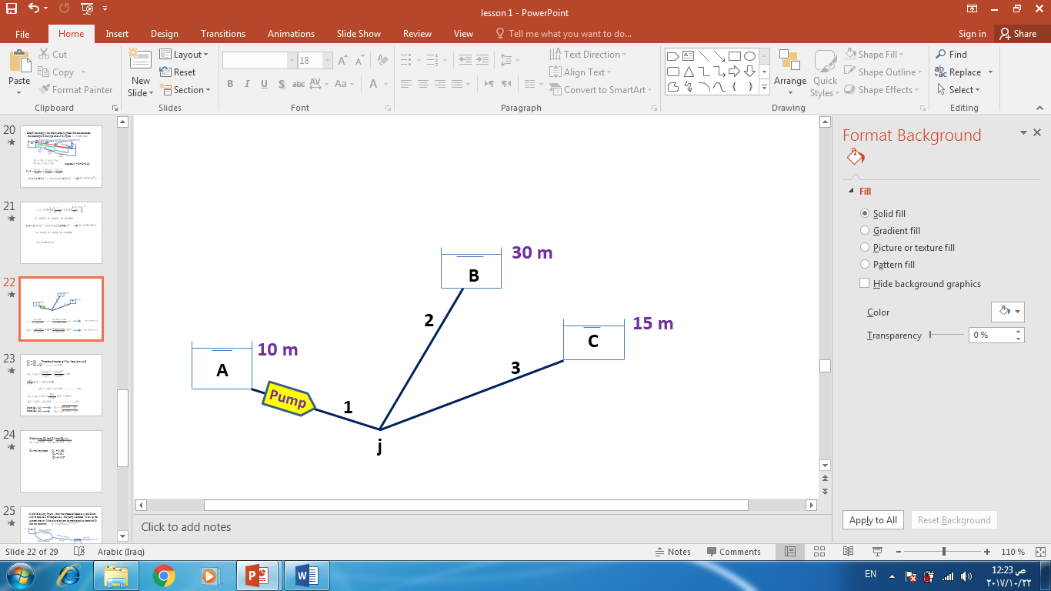

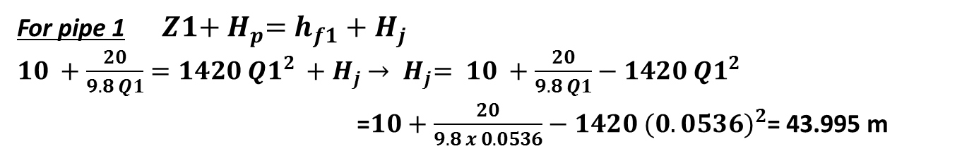
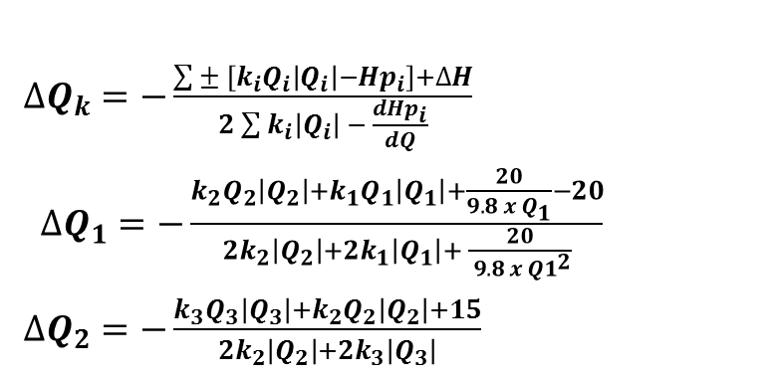
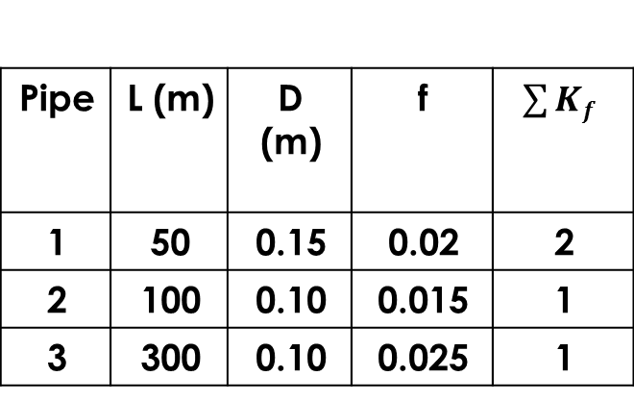
Example 4: For the piping system shown below, determine the flow distribution and piezometric heads at the junction J using the Hardy Cross method of solution, power=20 Kw
Solution
There are one junction (J = 1), three pipes (P = 3), and three fixed-grade nodes (F= 3). Hence the number of closed loops is : L = P - J - F + 1
L = 3 - 1 - 3 + 1 = 0 . There are two pseudo loop (F-1) only. The two pseudo loop and assumed flow directions are as shown. Equation 6 is applied to each loop as follows:
[1]
[2]
$∆Q_{k}=−\frac{\sum{± \left[{k_{i}Q}_{i}\left|Q_{i}\right|−{Hp}_{i}\right]+∆H}}{2\sum{k_{i}\left|Q_{i}\right|} − \frac{d{Hp}_{i}}{dQ}}$
$∆Q_{1}=−\frac{k_{2}Q_{2}\left|Q_{2}\right|+k_{1}Q_{1}\left|Q_{1}\right|+\frac{20}{9.8 x{ Q}_{1}}−20}{2k_{2}\left|Q_{2}\right|+{2k}_{1}\left|Q_{1}\right|+ \frac{20}{{ 9.8 x Q1}^{2}}}$
$∆Q_{2}=−\frac{k_{3}Q_{3}\left|Q_{3}\right|+k_{2}Q_{2}\left|Q_{2}\right|+15}{2k_{2}\left|Q_{2}\right|+{2k}_{3}\left|Q_{3}\right|}$
$\sum{Kf}$ | f | D (m) | L (m) | Pipe
2 | 0.02 | 0.15 | 50 | 1
1 | 0.015 | 0.10 | 100 | 2
1 | 0.025 | 0.10 | 300 | 3
$$For common pipe 2$$
$$Q_{2 new}=Q_{2 old}±∆Q_{1} ∓∆Q_{2}$$
For pipe 1 ${Z1+{ H}_{p}=h}_{f1}+{ H}_{j}$
${10 +\frac{20}{9.8 Q1}=1420{ Q1}^{2}}_{ }+{ H}_{j}$ $→{{ H}_{j}= 10 +\frac{20}{9.8 Q1}−1420{ Q1}^{2}}_{ }$
=$10+\frac{20}{9.8 x 0.0536}−1420{ (0.0536)}^{2}$= 43.995 m

Slide 24
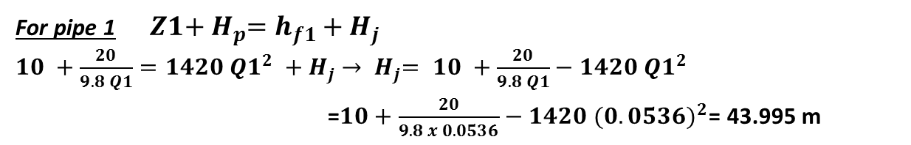
For pipe 1 ${Z1+{ H}_{p}=h}_{f1}+{ H}_{j}$
${10 +\frac{20}{9.8 Q1}=1420{ Q1}^{2}}_{ }+{ H}_{j}$ $→{{ H}_{j}= 10 +\frac{20}{9.8 Q1}−1420{ Q1}^{2}}_{ }$
=$10+\frac{20}{9.8 x 0.0536}−1420{ (0.0536)}^{2}$= 43.995 m

