Slide 1
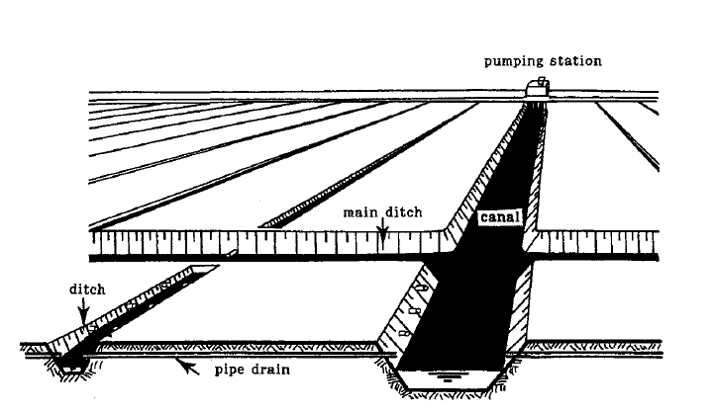
Open-Channel Flow and Its Classification
CH-1

Slide 2
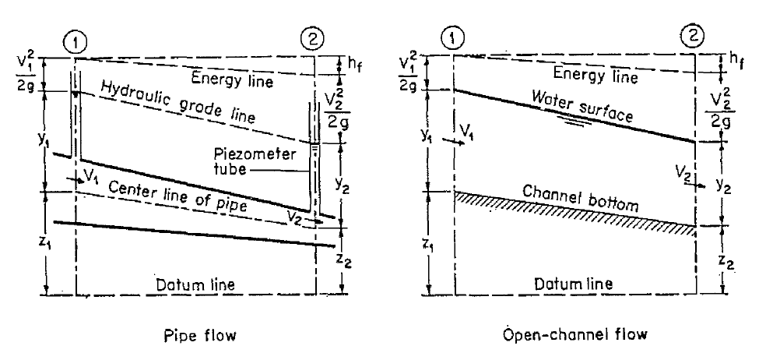
Basic Principles
The flow of water in a conduit may be either open channel
open channel flow or pipe flow

Slide 3
Basic Principles
Types of Flow:
Steady Flow and Unsteady flow
Flow is said to be steady if the depth of flow does not change during the time interval
The flow is unsteady if the depth changes with time.
In most open-channel problems it is necessary to study flow behavior only under steady conditions.

Slide 4
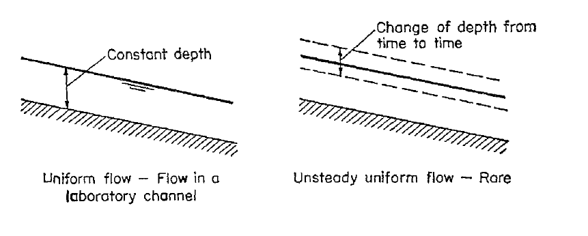
Basic Principles
Uniform Flow and Varied Flow:
Open-channel flow is said to be uniform if the depth of flow is the same at every section of the channel.
A uniform flow may be steady or unsteady, depending on whether or not the depth changes with time.

Slide 5
Basic Principles
Uniform Flow and Varied Flow:
Open-channel flow is said to be uniform if the depth of flow is the same at every section of the channel.
A uniform flow may be steady or unsteady, depending on whether or not the depth changes with time.

Slide 6
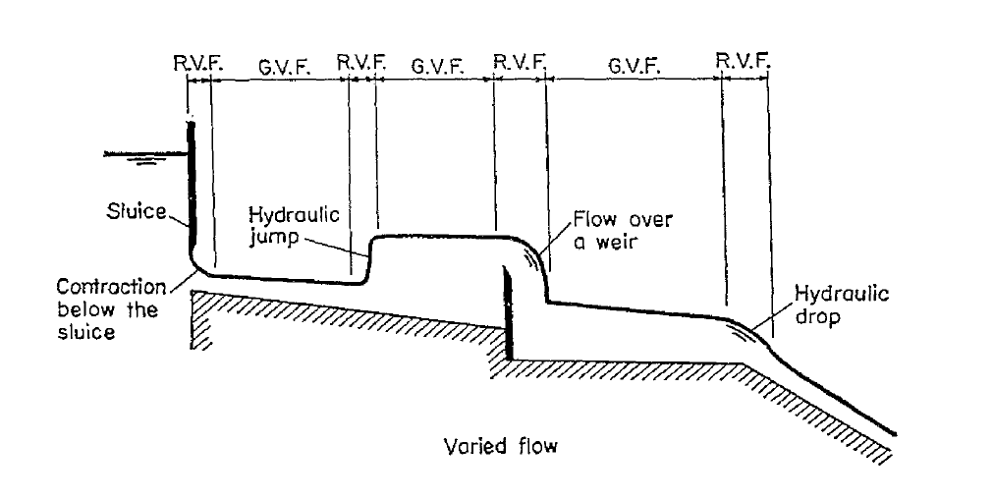
Basic Principles
Varied Flow:
Flow is varied if the depth of flow changes along the length of the channel.
Varied flow may be either steady or unsteady

Slide 7
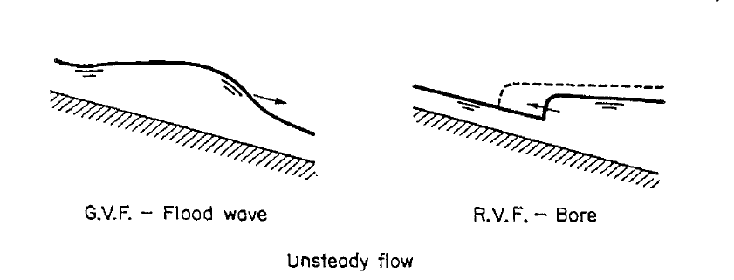
Basic Principles
Gradually varied flow and Rapidly varied flow
The flow is rapidly varied if the depth changes abruptly over a comparatively short distance; otherwise, it is gradually varied.

Slide 8
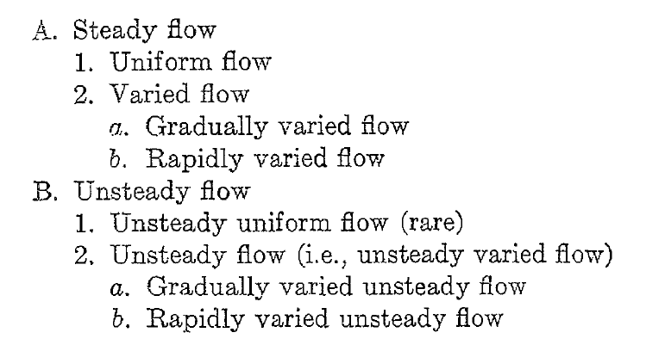
Basic Principles
Summary:

Slide 9
State of Flow
Effect of Viscosity:
The flow is laminar if the viscous forces are so strong relative to the inertial forces that viscosity plays a significant part in determining flow behavior.
The flow is turbulent if the viscous forces are weak relative to the inertial forces.
In turbulent flow, the water particles move in irregular paths which are neither smooth nor fixed but which in the aggregate still represent the forward motion of the entire stream.

Slide 10
Re – Laminar/Transition/Turbulent
Pipe Flow – Critical Re = 2000
Open-Channel Flow:
Laminar – Re’ < 500
Transition – 500 < Re’ < 2000
Turbulent – Re’ > 2000
Open-channel flow is almost always TURBULENT!

Slide 11
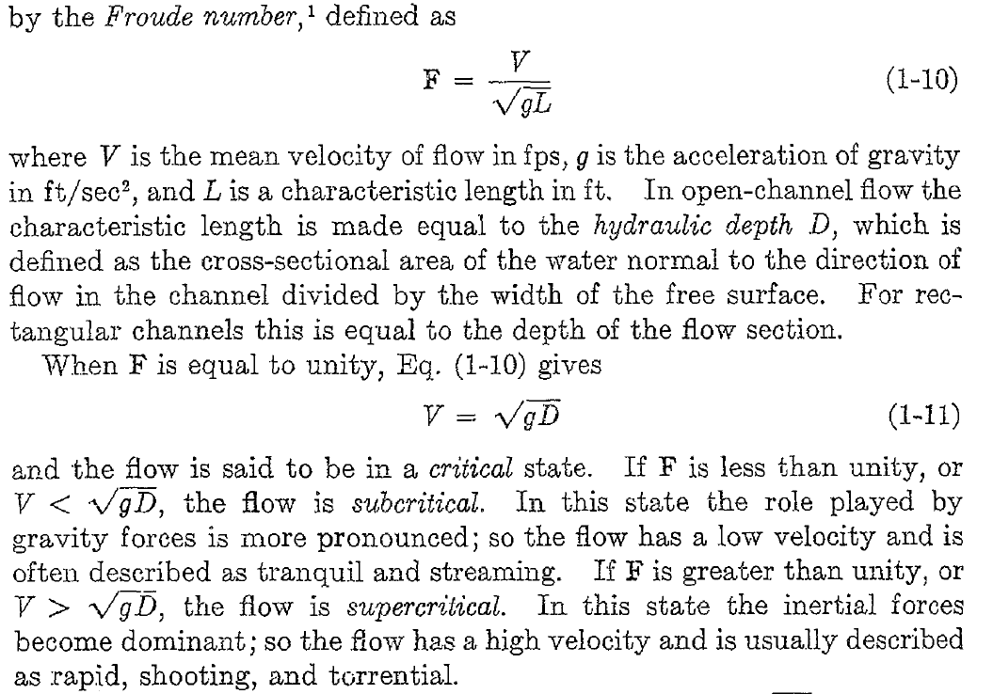
State of Flow
Effect of Gravity:

Slide 12
Fr – Subcritical or Supercritical
Open-Channel Flow:
Subcritical (fluvial) Flow – Fr < 1 (Disturbance waves can not be transferred upstream against flow)
Critical Flow – Fr = 1
Supercritical (Torrential) Flow – Fr > 1

Slide 13
Open channels and their properties
CH-2

Slide 14
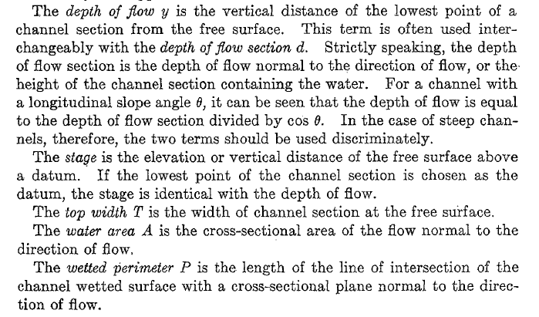
Channel Geometry

Slide 15
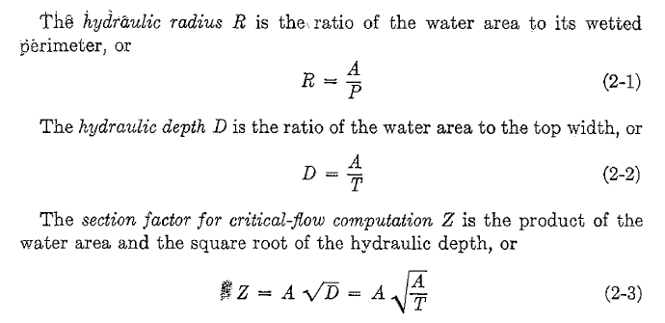
Channel Geometry

Slide 16
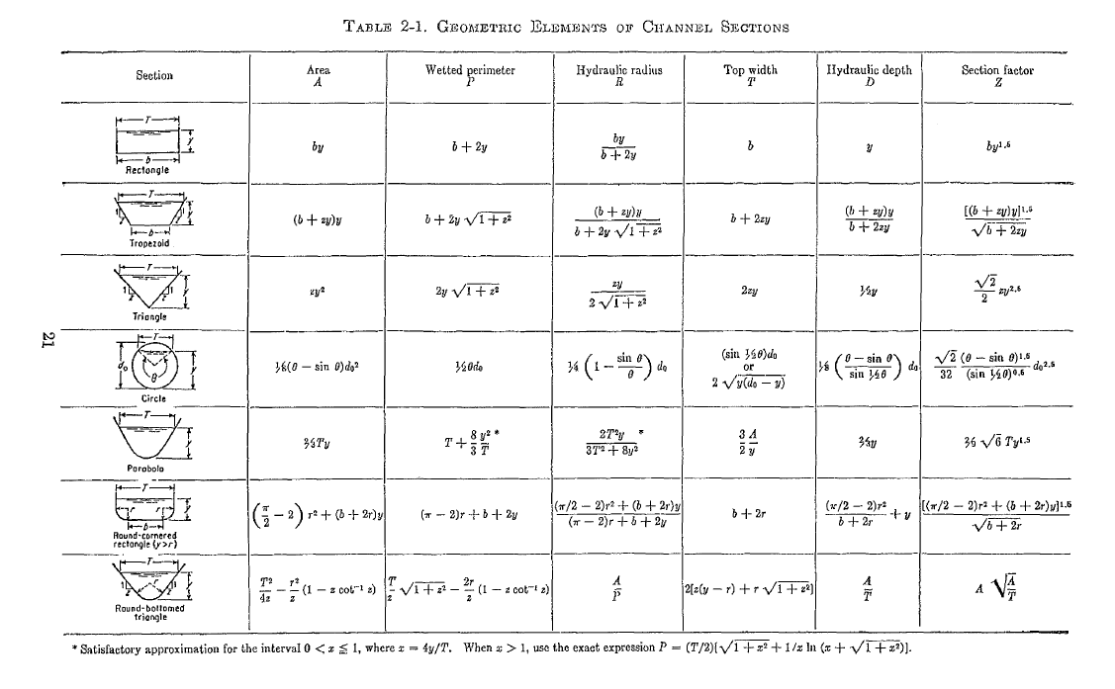

Slide 17
