Slide 1
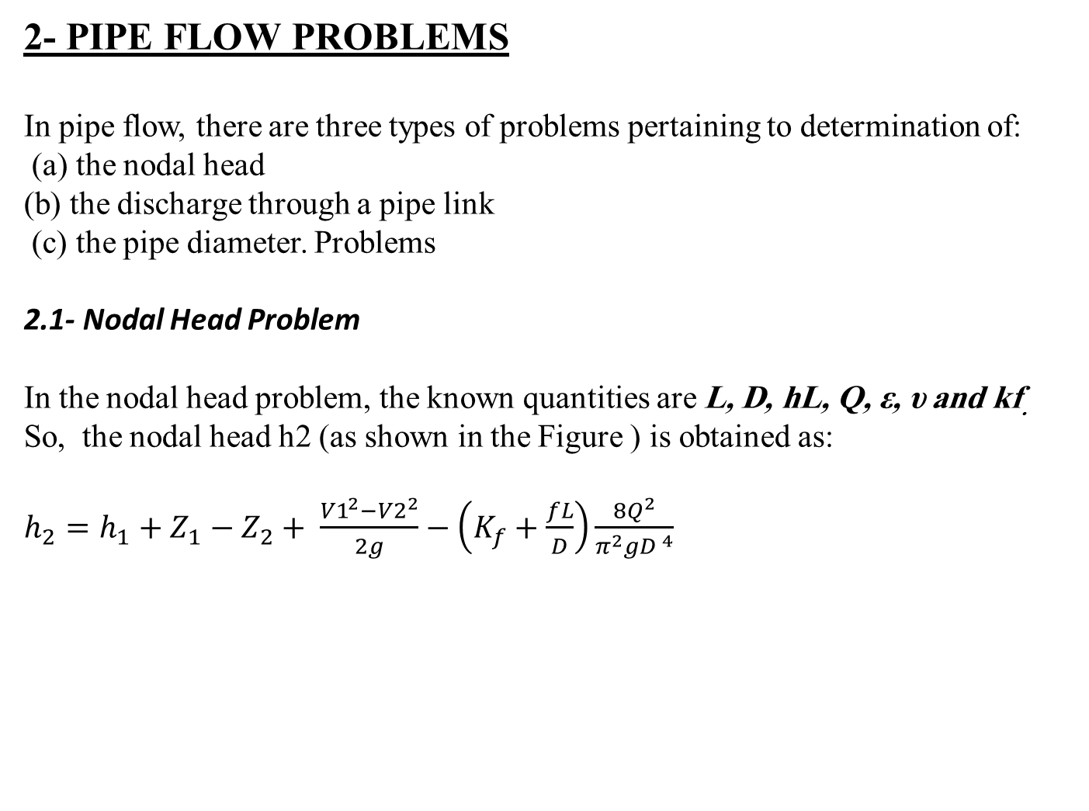
2- PIPE FLOW PROBLEMS
In pipe flow, there are three types of problems pertaining to determination of:
(a) the nodal head
(b) the discharge through a pipe link
(c) the pipe diameter. Problems
2.1- Nodal Head Problem
In the nodal head problem, the known quantities are L, D, hL, Q, ε, υ and kf.
So, the nodal head h2 (as shown in the Figure ) is obtained as:
$h_{2}=h_{1}+Z_{1}−Z_{2}+ \frac{{V1}^{2}−{V2}^{2}}{2g}−\left(K_{f}+\frac{fL}{D}\right)\frac{8Q^{2}}{π^{2}gD^{ 4}}$

Slide 2
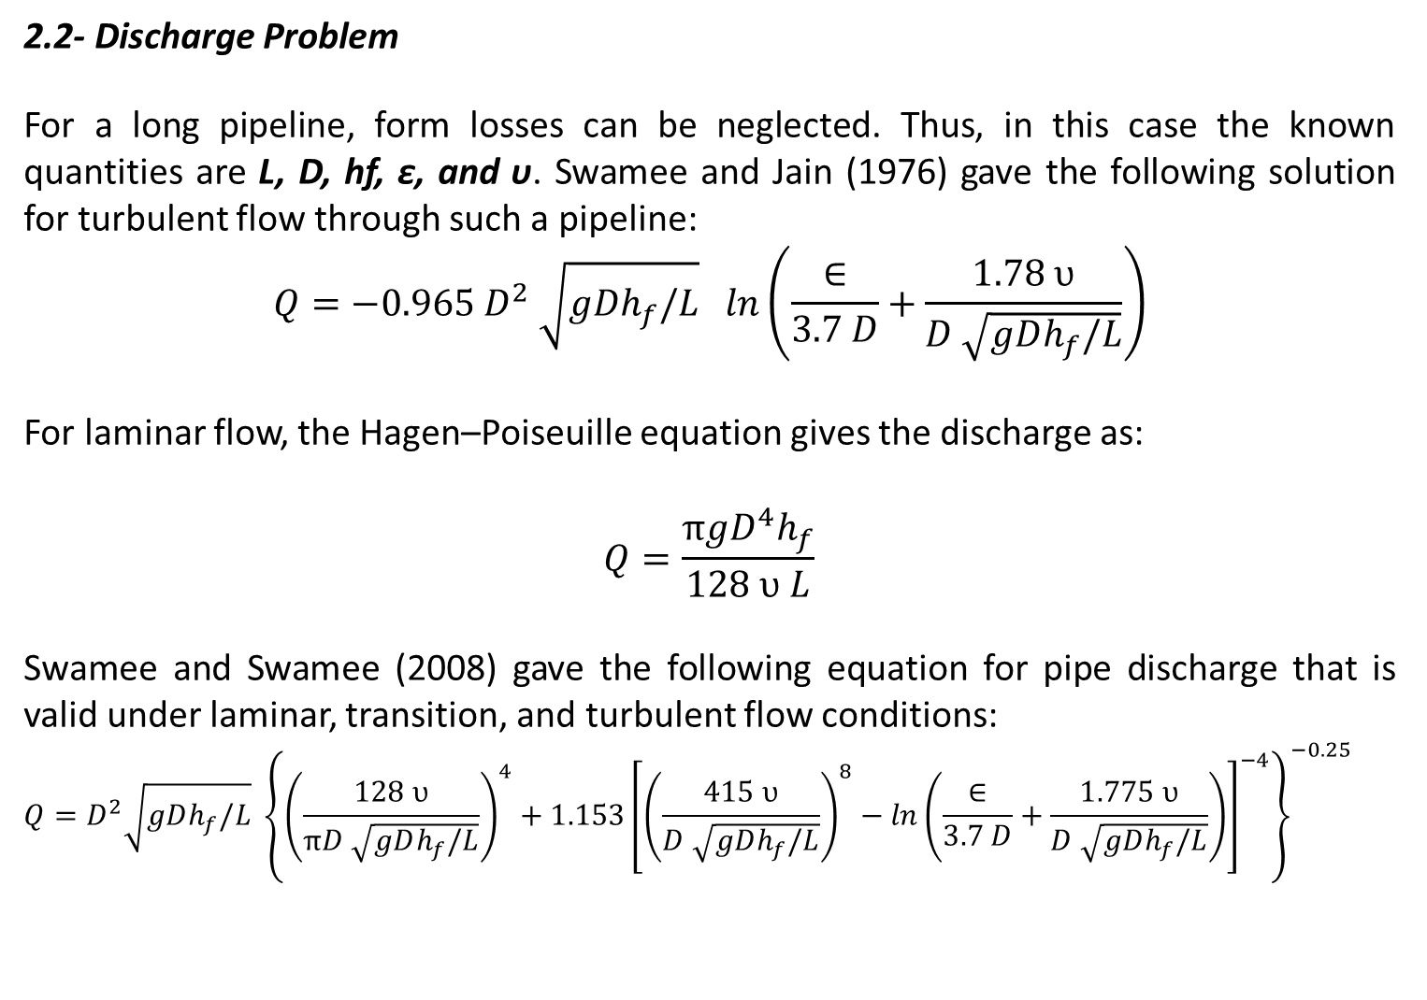
2.2- Discharge Problem
For a long pipeline, form losses can be neglected. Thus, in this case the known quantities are L, D, hf, ε, and υ. Swamee and Jain (1976) gave the following solution for turbulent flow through such a pipeline:
$$Q=−0.965 D^{2} \sqrt{gDh_{f}/L} ln\left(\frac{∈}{3.7 D}+\frac{1.78 υ}{D \sqrt{gDh_{f}/L}}\right)$$
For laminar flow, the Hagen–Poiseuille equation gives the discharge as:
$$Q=\frac{πgD^{4}h_{f}}{128 υ L}$$
Swamee and Swamee (2008) gave the following equation for pipe discharge that is valid under laminar, transition, and turbulent flow conditions:
$$Q=D^{2}\sqrt{gDh_{f}/L} {\left\{{\left(\frac{128 υ}{πD \sqrt{gDh_{f}/L}}\right)}^{4}+1.153{\left[{\left(\frac{415 υ}{D \sqrt{gDh_{f}/L}}\right)}^{8}−ln\left(\frac{∈}{3.7 D}+\frac{1.775 υ}{D \sqrt{gDh_{f}/L}}\right)\right]}^{−4}\right\}}^{−0.25}$$

Slide 3
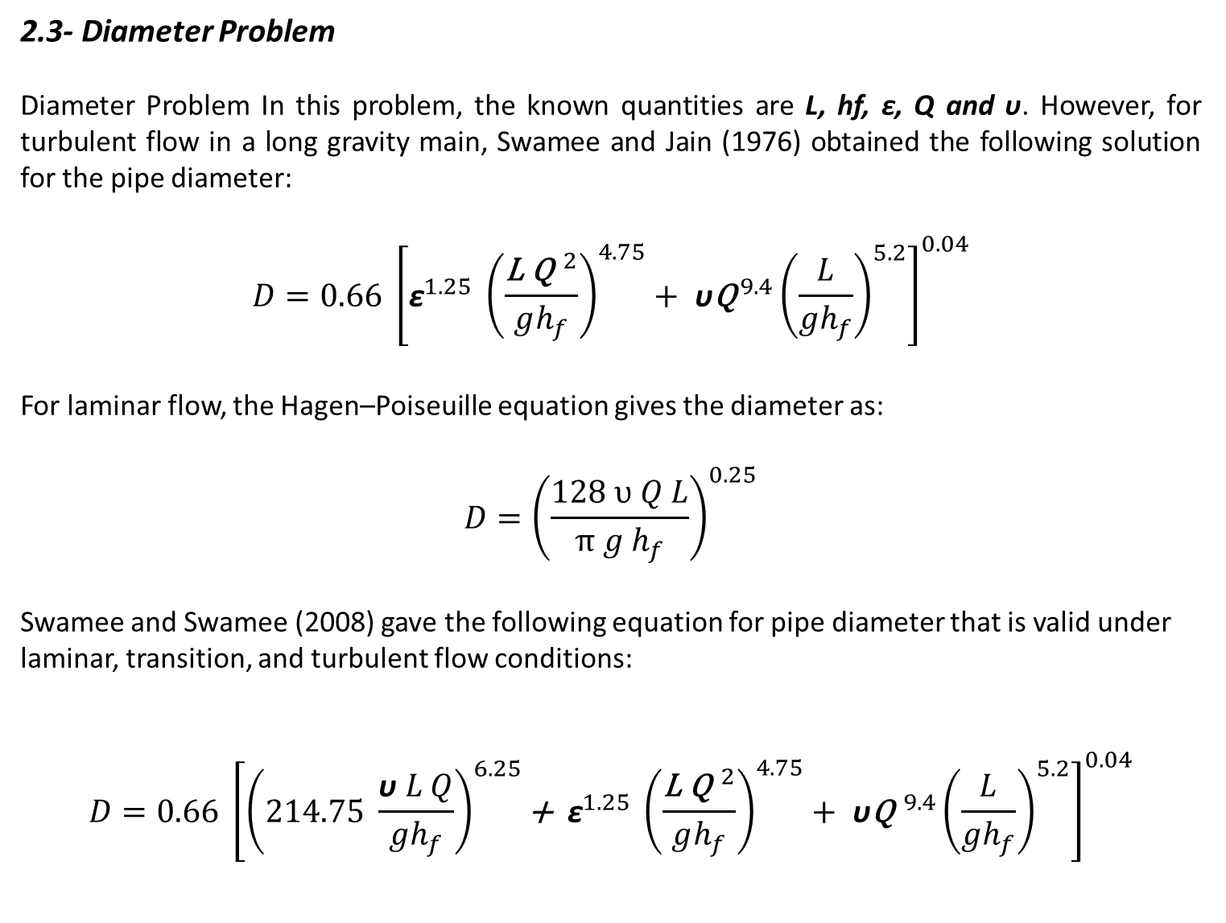
2.3- Diameter Problem
Diameter Problem In this problem, the known quantities are L, hf, ε, Q and υ. However, for turbulent flow in a long gravity main, Swamee and Jain (1976) obtained the following solution for the pipe diameter:
$$D=0.66 {\left[{\text{ε}}^{1.25} {\left(\frac{{\text{L} \text{Q}}^{ 2}}{gh_{f}}\right)}^{4.75}+ \text{υ}{{\text{Q}}^{ 9.4}\left(\frac{L}{gh_{f}}\right)}^{5.2}\right]}^{0.04}$$
For laminar flow, the Hagen–Poiseuille equation gives the diameter as:
$$D={\left(\frac{128 υ Q L}{π g h_{f}}\right)}^{0.25}$$
Swamee and Swamee (2008) gave the following equation for pipe diameter that is valid under laminar, transition, and turbulent flow conditions:
$$D=0.66 {\left[{{\left(214.75 \frac{\text{υ} L Q}{gh_{f}}\right)}^{6.25}\text{+ }\text{ε}}^{1.25} {\left(\frac{{\text{L} \text{Q}}^{ 2}}{gh_{f}}\right)}^{4.75}+ \text{υ}{{\text{Q}}^{ 9.4}\left(\frac{L}{gh_{f}}\right)}^{5.2}\right]}^{0.04}$$

Slide 4
Example 3
As shown in figure, a discharge of 0.1 m³/s flows through a CI pipe main of 1000 m in length having a pipe diameter 0.3 m. A sluice valve of 0.3 m. (K_{f} = 0.15) size is placed close to point B. The elevations of points A and B are 10 m. and 5 m. respectively. Assume water temperature at 20º c. Calculate the following:
Terminal pressure h₂ at point B and head loss in the pipe if the terminal pressure h₁ at point A is 25 m.
The discharge in the pipe if the head loss is 10 m.
The CI gravity main diameter if the head loss in the pipe is 10 m. and a discharge of 0.1 m³/s flows in the pipe.

Slide 5
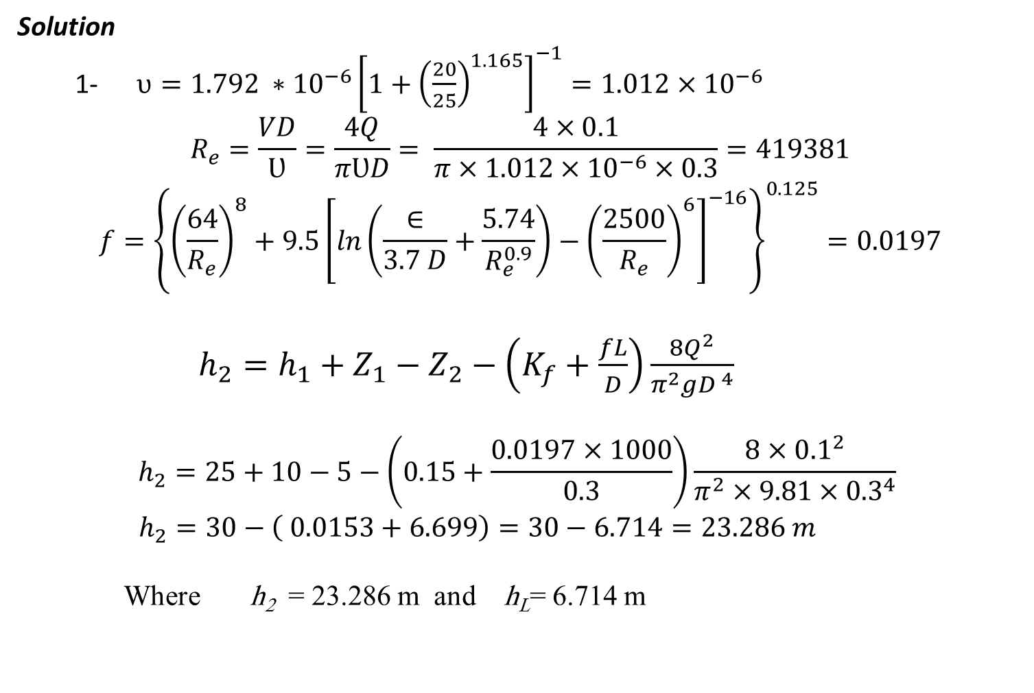
Solution
1- $υ=1.792 ∗{10}^{−6}{\left[1+{\left(\frac{20}{25}\right)}^{1.165}\right]}^{−1}=1.012×{10}^{−6}$
$$R_{e}=\frac{VD}{Ʋ}=\frac{4Q}{πƲD}= \frac{4×0.1}{π×{1.012×10}^{−6}×0.3}=419381$$
$$f={\left\{{\left(\frac{64}{R_{e}}\right)}^{8}+9.5{\left[ln\left(\frac{∈}{3.7 D}+\frac{5.74}{R_{e}^{0.9}}\right)−{\left(\frac{2500}{R_{e}}\right)}^{6}\right]}^{−16}\right\}}^{0.125}=0.0197$$
$h_{2}=h_{1}+Z_{1}−Z_{2}−\left(K_{f}+\frac{fL}{D}\right)\frac{8Q^{2}}{π^{2}gD^{ 4}}$
$$h_{2}=25+10−5−\left(0.15+\frac{0.0197×1000}{0.3}\right)\frac{8×{0.1}^{2}}{π^{2}×9.81×{0.3}^{4}}$$
$h_{2}=30−\left( 0.0153+6.699\right)=30−6.714=23.286 m$
Where h₂ = 23.286 m and h_{L}= 6.714 m

Slide 6
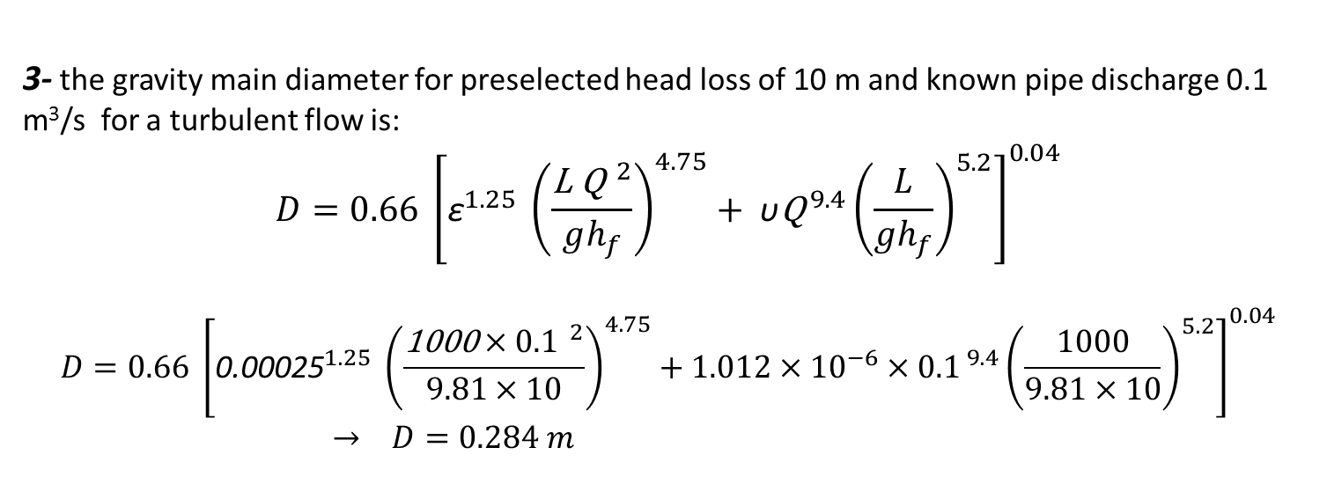
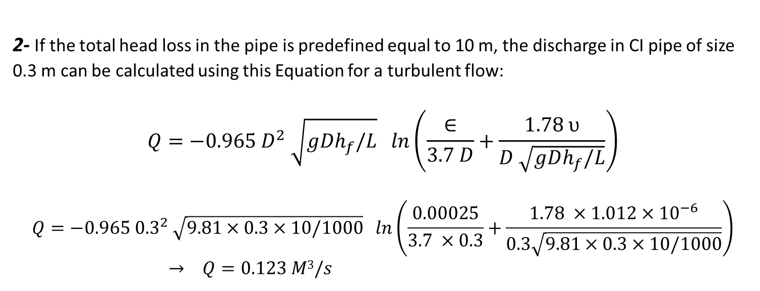
2- If the total head loss in the pipe is predefined equal to 10 m, the discharge in CI pipe of size 0.3 m can be calculated using this Equation for a turbulent flow:
$$Q=−0.965 D^{2} \sqrt{gDh_{f}/L} ln\left(\frac{∈}{3.7 D}+\frac{1.78 υ}{D \sqrt{gDh_{f}/L}}\right)$$
$$Q=−0.965 {0.3}^{2} \sqrt{9.81×0.3×10/1000} ln\left(\frac{0.00025}{3.7 ×0.3}+\frac{1.78 ×1.012×{10}^{−6}}{0.3\sqrt{9.81×0.3×10/1000}}\right)$$
$→$ $Q=0.123 M3/s$
3- the gravity main diameter for preselected head loss of 10 m and known pipe discharge 0.1 m³/s for a turbulent flow is:
$$D=0.66 {\left[{\text{ε}}^{1.25} {\left(\frac{{\text{L} \text{Q}}^{ 2}}{gh_{f}}\right)}^{4.75}+ \text{υ}{{\text{Q}}^{ 9.4}\left(\frac{L}{gh_{f}}\right)}^{5.2}\right]}^{0.04}$$
$$D=0.66 {\left[{\text{0}\text{.}\text{00025}}^{1.25} {\left(\frac{{\text{1000}×0.1}^{ 2}}{9.81×10}\right)}^{4.75}+1.012×{10}^{−6}{×{0.1}^{ 9.4}\left(\frac{1000}{9.81×10}\right)}^{5.2}\right]}^{0.04}$$
$→$ $D=0.284 m$

Slide 7
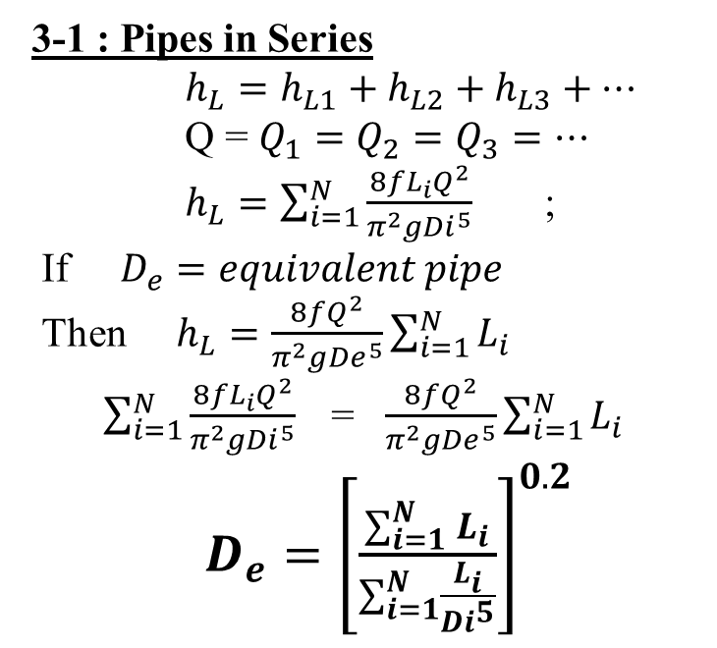
3- Equivalent Pipe
In the water supply networks, the pipe link between two nodes may consist of a single uniform pipe size or a combination of pipes in series or in parallel.
The set of pipes arranged in parallel and series can be replaced with a single pipe having the same head loss across points A and B and also the same total discharge Q. Such a pipe is defined as an equivalent pipe.
3-1 : Pipes in Series
$h_{L}=h_{L1}+h_{L2}+h_{L3}+…$
Q = $Q_{1}=Q_{2}=Q_{3}=…$
$h_{L}=\sum_{i=1}^{N}{\frac{8fL_{i}Q^{2}}{π^{2}g{Di}^{5}}}$ ;
If $D_{e}=equivalent pipe$
Then $h_{L}=\frac{8fQ^{2}}{π^{2}g{De}^{5}}\sum_{i=1}^{N}{L_{i}}$
$\sum_{i=1}^{N}{\frac{8fL_{i}Q^{2}}{π^{2}g{Di}^{5}} }$= $\frac{8fQ^{2}}{π^{2}g{De}^{5}}\sum_{i=1}^{N}{L_{i}}$
$D_{e}={\left[\frac{\sum_{i=1}^{N}{L_{i}}}{\sum_{i=1}^{N}{\frac{L_{i}}{{Di}^{5}}}}\right]}^{0.2}$

Slide 8
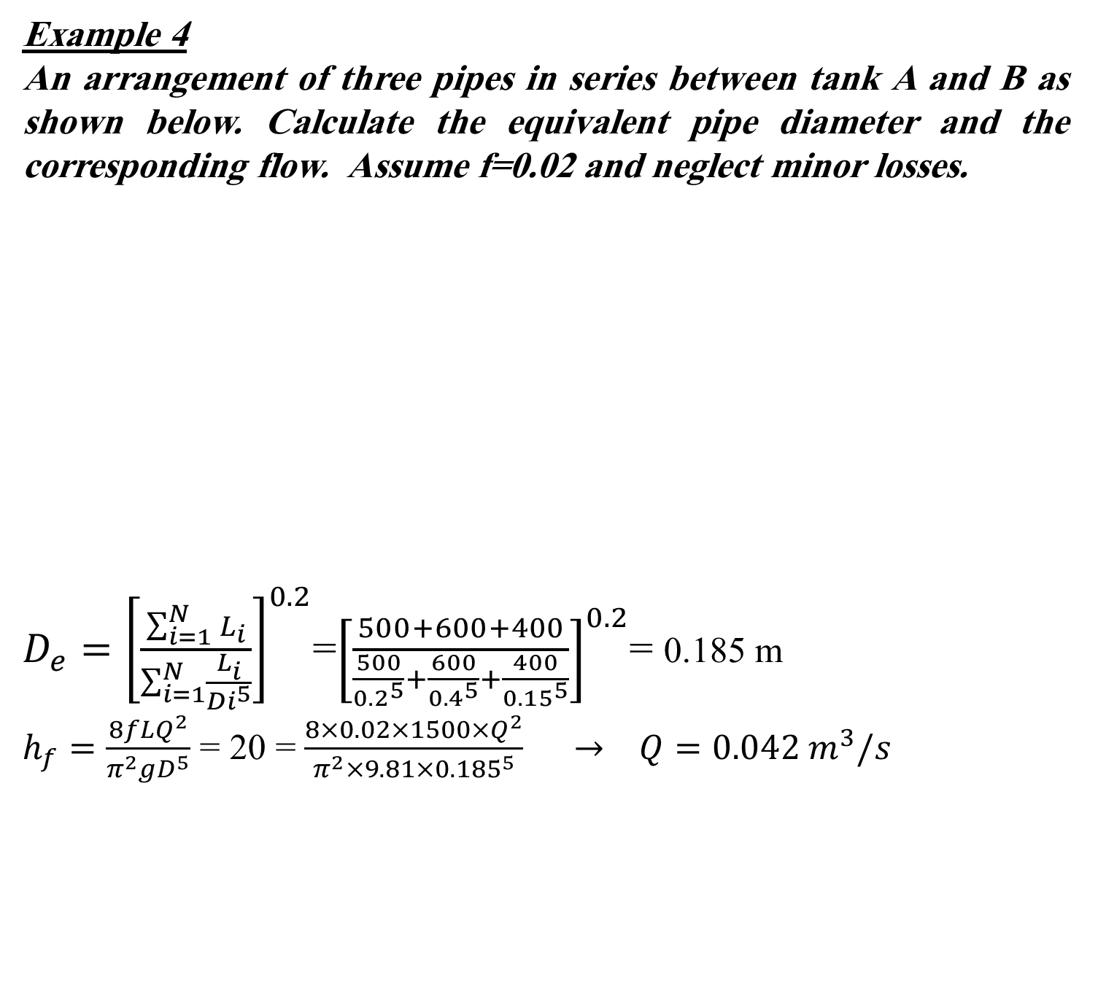
Example 4
An arrangement of three pipes in series between tank A and B as shown below. Calculate the equivalent pipe diameter and the corresponding flow. Assume f=0.02 and neglect minor losses.
$D_{e}={\left[\frac{\sum_{i=1}^{N}{L_{i}}}{\sum_{i=1}^{N}{\frac{L_{i}}{{Di}^{5}}}}\right]}^{0.2}$=${\left[\frac{500+600+400}{\frac{500}{{0.2}^{5}}+\frac{600}{{0.4}^{5}}+\frac{400}{{0.15}^{5}}}\right]}^{0.2}$= 0.185 m
$h_{f}=\frac{8fLQ^{2}}{π^{2}gD^{5}}$ = 20 = $\frac{8×0.02×1500×Q^{2}}{π^{2}×9.81×{0.185}^{5}} → Q=0.042 m^{3}/s$

Slide 9
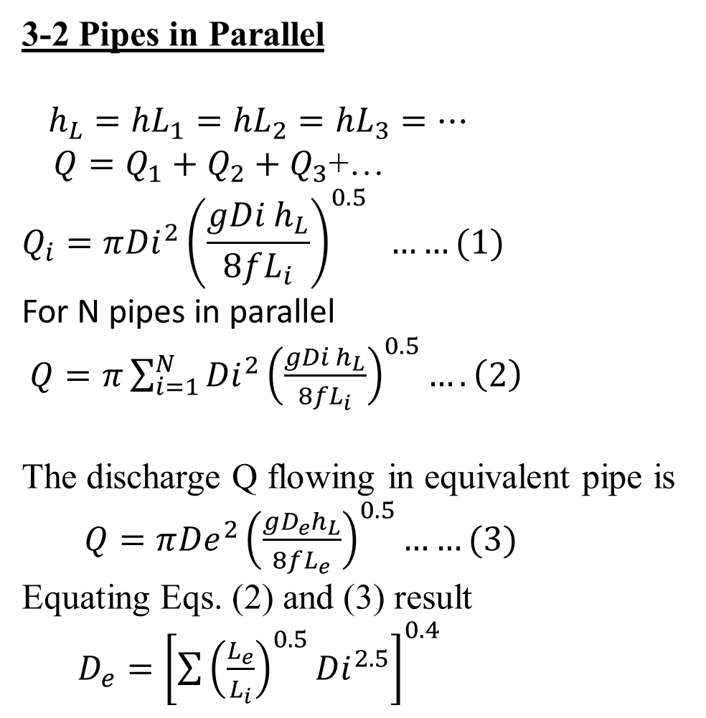
3-2 Pipes in Parallel
$h_{L}={hL}_{1}={hL}_{2}={hL}_{3}=…$
$Q=Q_{1}+Q_{2}+Q_{3}$+…
$$Q_{i}=π{Di}^{2}{\left(\frac{gDi h_{L}}{8fL_{i}}\right)}^{0.5} ……(1)$$
For N pipes in parallel
$Q=π\sum_{i=1}^{N}{{Di}^{2}{\left(\frac{gDi h_{L}}{8fL_{i}}\right)}^{0.5}}….\left(2\right)$
The discharge Q flowing in equivalent pipe is
$Q=π{De}^{2}{\left(\frac{gD_{e}h_{L}}{8fL_{e}}\right)}^{0.5}……(3)$
Equating Eqs. (2) and (3) result
$D_{e}={\left[\sum{{\left(\frac{L_{e}}{L_{i}}\right)}^{0.5}{Di}^{2.5}}\right]}^{0.4}$

Slide 10
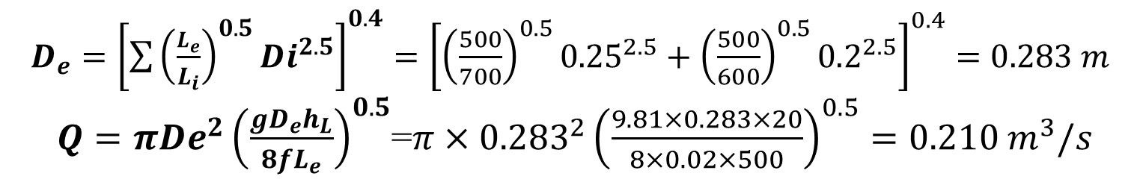
Example 5
For a given parallel pipe arrangement below, calculate equivalent
pipe diameter and corresponding flow. Assume Darcy–Weisbach’s friction factor f = 0.02 and neglect entry and exit (minor) losses. Length of equivalent pipe can be assumed as 500 m.
$D_{e}={\left[\sum{{\left(\frac{L_{e}}{L_{i}}\right)}^{0.5}{Di}^{2.5}}\right]}^{0.4}={\left[{\left(\frac{500}{700}\right)}^{0.5}{0.25}^{2.5}+{\left(\frac{500}{600}\right)}^{0.5}{0.2}^{2.5}\right]}^{0.4}=0.283 m$
$Q=π{De}^{2}{\left(\frac{gD_{e}h_{L}}{8fL_{e}}\right)}^{0.5}$=$π×{0.283}^{2}{\left(\frac{9.81×0.283×20}{8×0.02×500}\right)}^{0.5}=0.210 m^{3}/s$

Slide 11

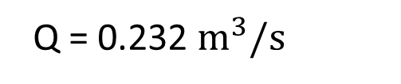
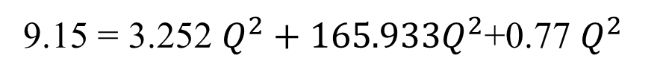
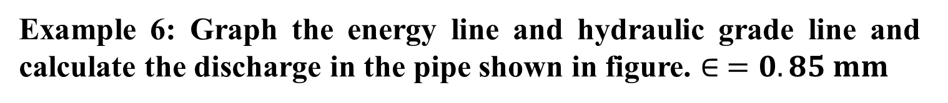
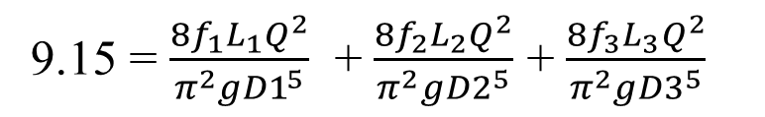
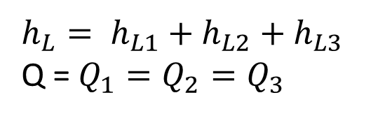
Example 6: Graph the energy line and hydraulic grade line and calculate the discharge in the pipe shown in figure. $∈ =0.85 mm$
Entrance loss
Contraction loss
Enlargement loss
E.L
H.G.L
Exit loss
hL= 9.15 m
153 m
0.6 m
244 m
0.3 m
275 m
0.9 m
$$h_{L}= h_{L1}+h_{L2}+h_{L3}$$
Q = $Q_{1}=Q_{2}=Q_{3}$
Assume f₁= f₂ = f₃ = 0.02
9.15 = $\frac{8f_{1}L_{1}Q^{2}}{π^{2}g{D1}^{5}}$ + $\frac{8f_{2}L_{2}Q^{2}}{π^{2}g{D2}^{5}}$ + $\frac{8f_{3}L_{3}Q^{2}}{π^{2}g{D3}^{5}}$
9.15 = 3.252 $Q^{2}+165.933Q^{2}$+0.77 $Q^{2}$
Q = 0.232 $m^{3}/s$

Slide 12
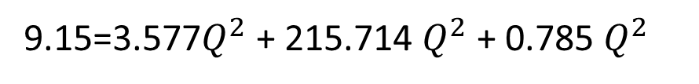
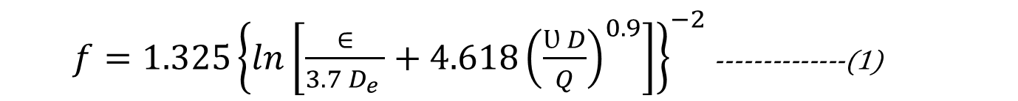
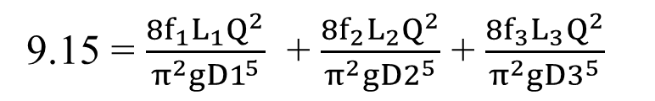
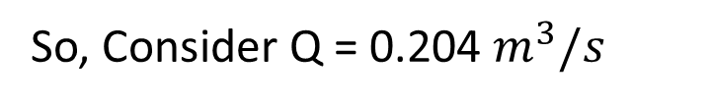

For checking calculate f₁ , f₂ and f₃ From Eq. 1
$f=1.325{\left\{ln\left[\frac{∈}{3.7 D_{e} }+4.618{\left(\frac{Ʋ D}{Q}\right)}^{0.9}\right]\right\}}^{−2}$ --------------(1)
f₁ = 0.022, f₂ = 0.026 , f₃ = 0.0204
9.15 = $\frac{8f_{1}L_{1}Q^{2}}{π^{2}g{D1}^{5}}$ + $\frac{8f_{2}L_{2}Q^{2}}{π^{2}g{D2}^{5}}$ + $\frac{8f_{3}L_{3}Q^{2}}{π^{2}g{D3}^{5}}$
9.15=3.577$Q^{2}$ + 215.714 $Q^{2}$ + 0.785 $Q^{2}$
Q = 0.204 $m^{3}/s$
Next, for checking calculate f₁ , f₂ and f₃ From Eq. 1
f₁ = 0.022, f₂ = 0.026, f₃ = 0.0205
Say ok
So, Consider Q = 0.204 $m^{3}/s$

Slide 13


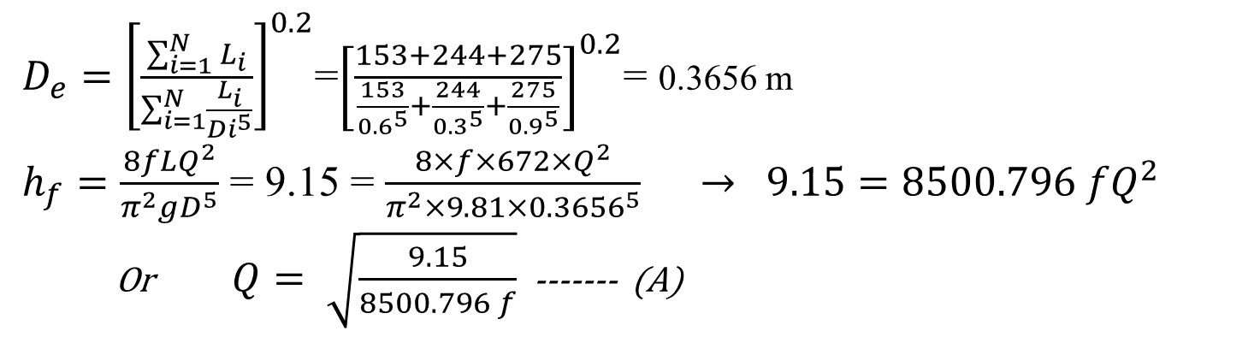
Another Solution :
$D_{e}={\left[\frac{\sum_{i=1}^{N}{L_{i}}}{\sum_{i=1}^{N}{\frac{L_{i}}{{Di}^{5}}}}\right]}^{0.2}$=${\left[\frac{153+244+275}{\frac{153}{{0.6}^{5}}+\frac{244}{{0.3}^{5}}+\frac{275}{{0.9}^{5}}}\right]}^{0.2}$= 0.3656 m
$h_{f}=\frac{8fLQ^{2}}{π^{2}gD^{5}}$ = 9.15 = $\frac{8×f×672×Q^{2}}{π^{2}×9.81×{0.3656}^{5}} → 9.15=8500.796 fQ^{2}$
Or $Q= \sqrt{\frac{9.15}{8500.796 f}}$ ------- (A)
$f=1.325{\left\{ln\left[\frac{∈}{3.7 D_{e} }+4.618{\left(\frac{Ʋ D}{Q}\right)}^{0.9}\right]\right\}}^{−2}$ ------- (B)
Remark | Calculated f from Eq.B | Q from Eq.A | Assumed f | It.
Use f= 0.02467 | 0.02467 | 0.2320 | 0.02 | 1
Use f= 0.0247 | 0.02470 | 0.2089 | 0.02467 | 2
Ok | 0.0247 | 0.2088 | 0.02470 | 3
So, consider Q = 0.2088 $m^{3}/s$

Slide 14
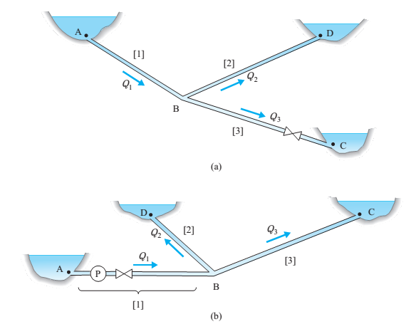
3- Branch Piping
Branching network illustrated in Figure below is made of three elements connected to a single junction. In contrast to parallel system , no closed loops exist.
Figure: Branch piping systems: (a) gravity flow; (b) pump driven flow

Slide 15
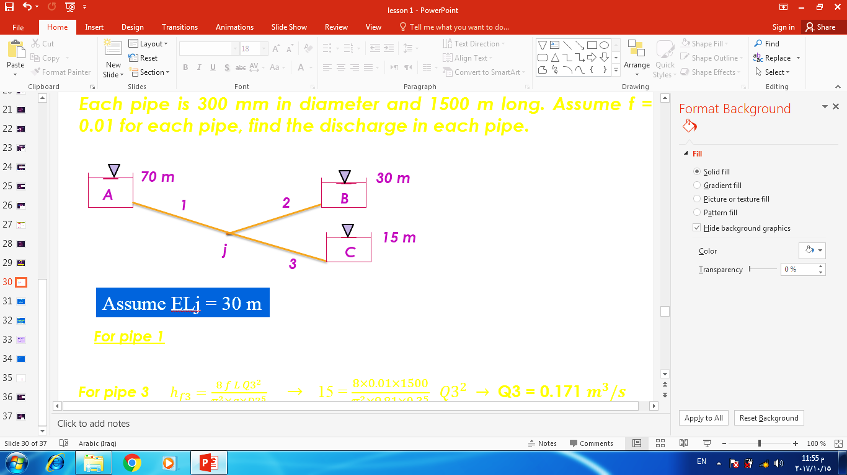
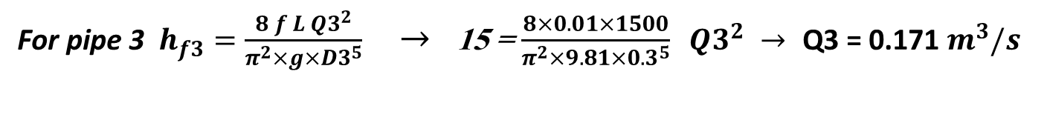
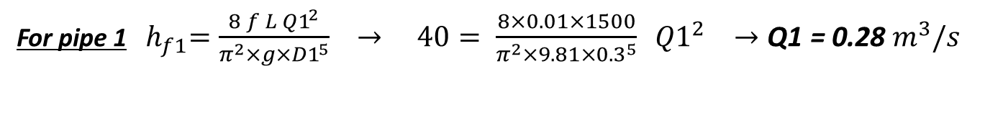
Example: 7
The following figure shows three reservoirs connected by pipes. Each pipe is 300 mm in diameter and 1500 m long. Assume f = 0.01 for each pipe, find the discharge in each pipe.
Solution
Assume ELj = 30 m
For pipe 1 ${ h}_{f1}=\frac{8 f L {Q1}^{2}}{π^{2}×g×{D1}^{5}} → 40= \frac{8×0.01×1500}{π^{2}×9.81×{0.3}^{5}} {Q1}^{2} →\text{Q}\text{1 }\text{= }\text{0.28} m^{3}/s$
${\text{For} \text{pipe} \text{3 }h}_{f3}=\frac{8 f L {Q3}^{2}}{π^{2}×g×{D3}^{5}}$ $→$ 15 = $\frac{8×0.01×1500}{π^{2}×9.81×{0.3}^{5}} {Q3}^{2} → \text{Q}\text{3 }\text{= }\text{0.171 }m^{3}/s$
Since Q1 ≠ Q3 and Q1 > Q3 therefore a direction of flow must be from joint j to reservoir B

Slide 16

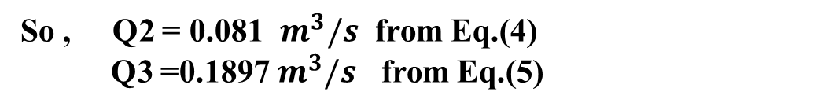
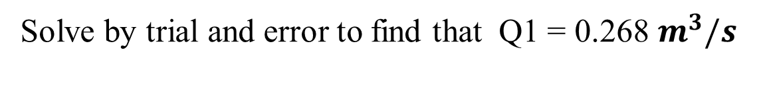




So, Assume flow for Q2 Such that: Q1 = Q2 + Q3 ……….. (1)
From Res. A to Res. B $h_{f1}+h_{f2}=\frac{8fL{Q1}^{2}}{π^{2}g{D1}^{5}}+\frac{8fL{Q2}^{2}}{π^{2}g{D2}^{5}}=40$
$\frac{8fL}{π^{2}gD^{5}}\left({Q1}^{2}+{Q2}^{2}\right)$ = 40
$${Q1}^{2}+{Q2}^{2}=0.0784 …………..(2)$$
From Res. A to Res. c $h_{f1}+h_{f3}=55=\frac{8fL}{π^{2}gD^{5}}\left({Q1}^{2}+{Q3}^{2}\right)$
$${Q1}^{2}+{Q3}^{2}=0.1078 …………………….(3)$$
From Eq. (2)
$Q_{2}=\sqrt{0.0784−{Q1}^{2}}$ $…………(4)$
From Eq. (3)
$Q_{3}=\sqrt{0.1078−{Q1}^{2}}$ $…………(5)$
Substituting Q2 and Q3 into Eq. (1) yields
$Q_{1}=\sqrt{0.0784−{Q1}^{2}}$ +$\sqrt{0.1078−{Q1}^{2}}$ $……….(6)$
Solve by trial and error to find that Q1 = 0.268 $m^{3}/s$
So , Q2 = 0.081 $m^{3}/s$ from Eq.(4)
Q3 =0.1897 $m^{3}/s$ from Eq.(5)

Slide 17
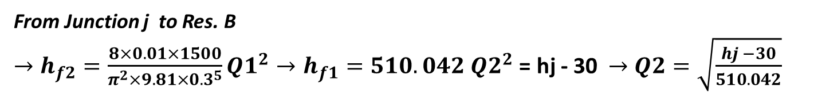
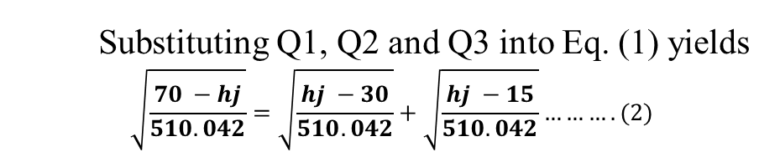
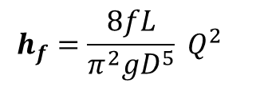
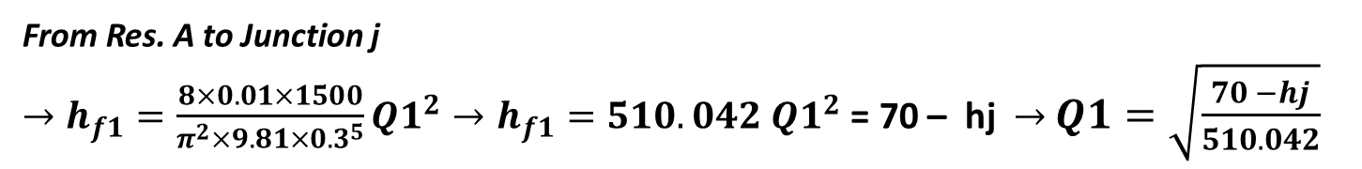
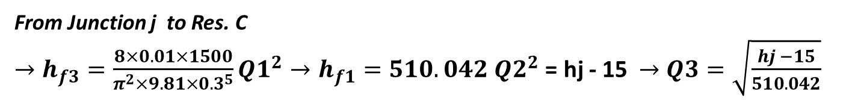
Another solution
From Q1 = Q2 + Q3 ……….. (1)
$$h_{f}=\frac{8fL}{π^{2}gD^{5}} Q^{2}$$
From Res. A to Junction j
$→h_{f1}=\frac{8×0.01×1500}{π^{2}×9.81×{0.3}^{5}}{Q1}^{2}→h_{f1}=510.042 {Q1}^{2}$ = 70 – hj $→$ $Q1=\sqrt{\frac{70 −hj}{510.042}}$
From Junction j to Res. B
$→h_{f2}=\frac{8×0.01×1500}{π^{2}×9.81×{0.3}^{5}}{Q1}^{2}→h_{f1}=510.042 {Q2}^{2}$ = hj - 30 $→$ $Q2=\sqrt{\frac{hj −30}{510.042}}$
From Junction j to Res. C
$→h_{f3}=\frac{8×0.01×1500}{π^{2}×9.81×{0.3}^{5}}{Q1}^{2}→h_{f1}=510.042 {Q2}^{2}$ = hj - 15 $→$ $Q3=\sqrt{\frac{hj −15}{510.042}}$
Substituting Q1, Q2 and Q3 into Eq. (1) yields
$$\sqrt{\frac{70 −hj}{510.042}}=\sqrt{\frac{hj −30}{510.042}}+\sqrt{\frac{hj −15}{510.042}}……….(2)$$
Solve by trial and error to find that hj = 33.224 $m$
So , Q1 = 0.269 $m^{3}/s$ , Q2 = 0.080 $m^{3}/s$ & Q3 =0.1890 $m^{3}/s$

Slide 18


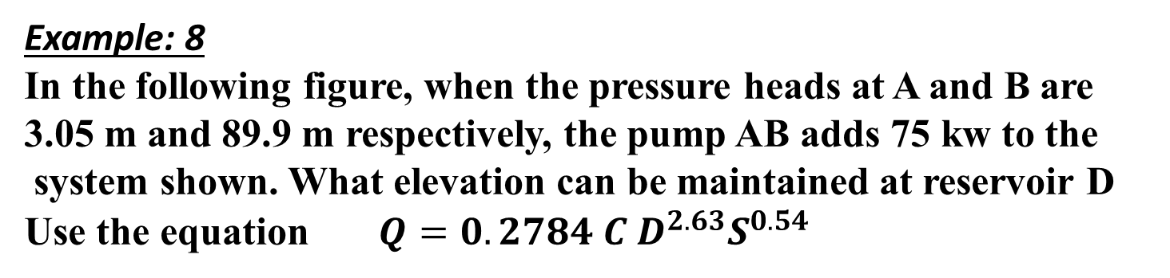


Example: 8
In the following figure, when the pressure heads at A and B are
3.05 m and 89.9 m respectively, the pump AB adds 75 kw to the
system shown. What elevation can be maintained at reservoir D
Use the equation $Q=0.2784 C D^{2.63}S^{0.54}$
D
$$D=1.626 C^{−0.38} Q^{0.38}S^{−0.205}$$
1830 m-200mm
C=130
1220 m-250mm
250 mm
EL=3. m
1520 m-150mm
C=130
C=120
B A
P = $γQE_{p}$
75 = 9.8 x Q x (89.9 – 3.05 )
Q= 0.088 $m^{3}/s$
$0.088=0.2784×120×{0.25}^{2.63}×{\left(\frac{hf1}{1220}\right)}^{0.54}→ hf1=17.46$
$$Q=0.2784 C D^{2.63}S^{0.54}$$
For parallel pipes, Q1 + Q2 = 0.088
$0.2784×130×{0.2}^{2.63}{\left(\frac{hf}{1830}\right)}^{0.54}+0.2784×130×{0.15}^{2.63}{\left(\frac{hf}{1520}\right)}^{0.54}$ = 0.088
hf = 30.89 m
So, EL = 3+ 89.9 -17.46-30 89 = 44.55 m

Slide 19

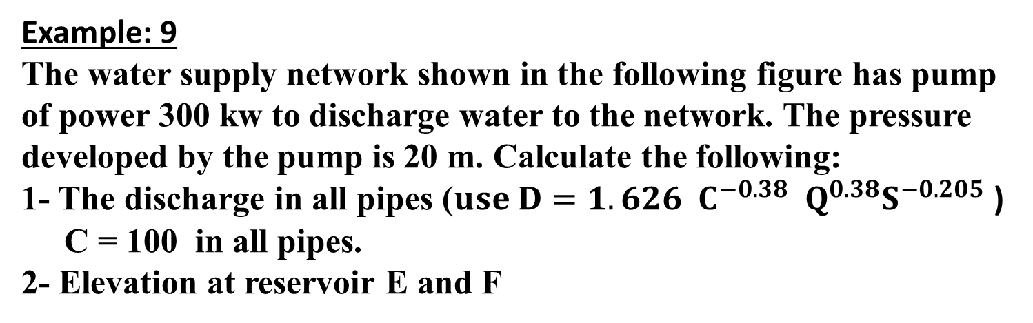

Example: 9
The water supply network shown in the following figure has pump
of power 300 kw to discharge water to the network. The pressure
developed by the pump is 20 m. Calculate the following:
1- The discharge in all pipes ($use D=1.626 C^{−0.38} Q^{0.38}S^{−0.205}$)
C = 100 in all pipes.
2- Elevation at reservoir E and F
E
337 m
0.4 $m^{3}/s$
F
B
800 mm
C
150 m
200 m
500 mm
400 mm
pump
0.5 $m^{3}/s$
EL = 3 m
A
500 m
D
350 mm

Slide 20
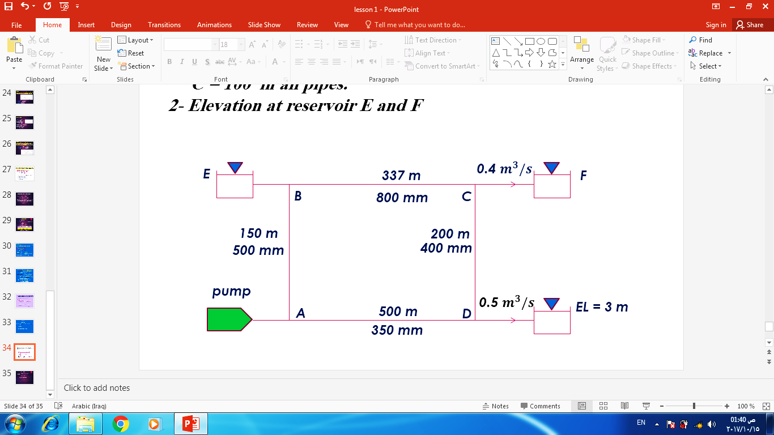
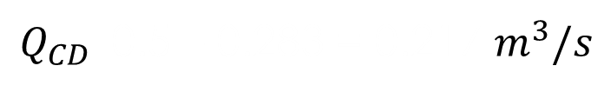

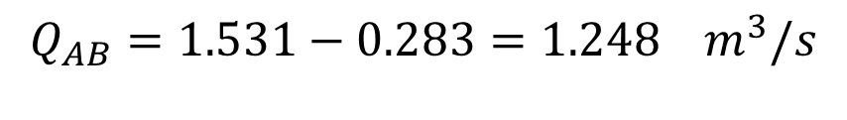
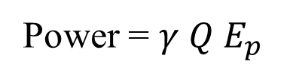
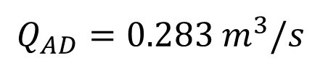
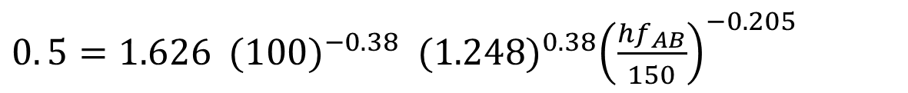
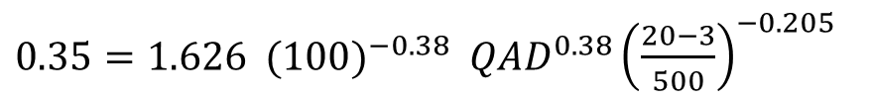



Power = $γ Q E_{p}$
300 = 9.8 Qp x 20
Qp = 1.531 $m^{3}/s$
$D=1.626 C^{−0.38} Q^{0.38}S^{−0.205}$
Line AD
$0.35=1.626 {(100)}^{−0.38} {QAD}^{0.38}{\left(\frac{20−3}{500}\right)}^{−0.205}$
$$Q_{AD}=0.283 m^{3}/s$$
$$Q_{AB}=1.531−0.283=1.248 m^{3}/s$$
$Q_{CD}$=0.5 – 0.283 = 0.217 $m^{3}/s$
$$Q_{BC}=0.4+0.217=0.617m^{3}/s$$
$$Q_{B−E}=1.248−0.617=0.631 m^{3}/s$$
For Line AB
$0. 5=1.626 {(100)}^{−0.38} {(1.248)}^{0.38}{\left(\frac{{hf}_{AB}}{150}\right)}^{−0.205}$

Slide 21
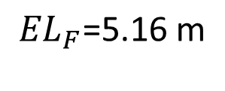
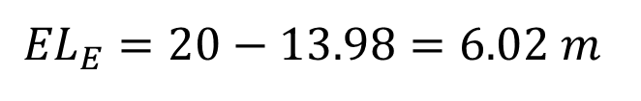
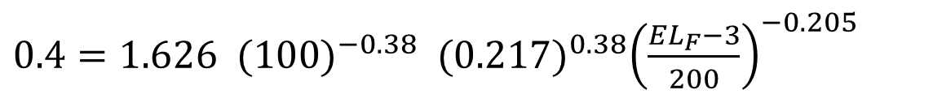
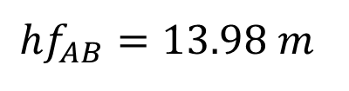
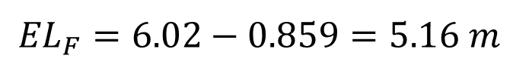

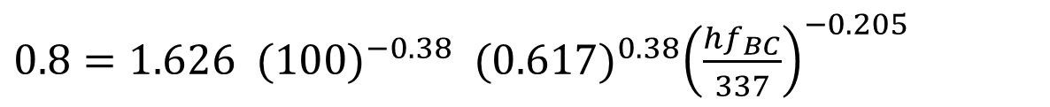
$${hf}_{AB}=13.98 m$$
$${EL}_{E}=20−13.98=6.02 m$$
For Line BC
$0.8=1.626 {(100)}^{−0.38} {(0.617)}^{0.38}{\left(\frac{{hf}_{BC}}{337}\right)}^{−0.205}$
$${hf}_{BC}=0.859 m$$
$${EL}_{F}=6.02−0.859=5.16 m$$
$0.4=1.626 {(100)}^{−0.38} {(0.217)}^{0.38}{\left(\frac{{EL}_{F}−3}{200}\right)}^{−0.205}$
Or
$${EL}_{F}\text{=}\text{5}\text{.}\text{16 }\text{m}$$

Slide 22
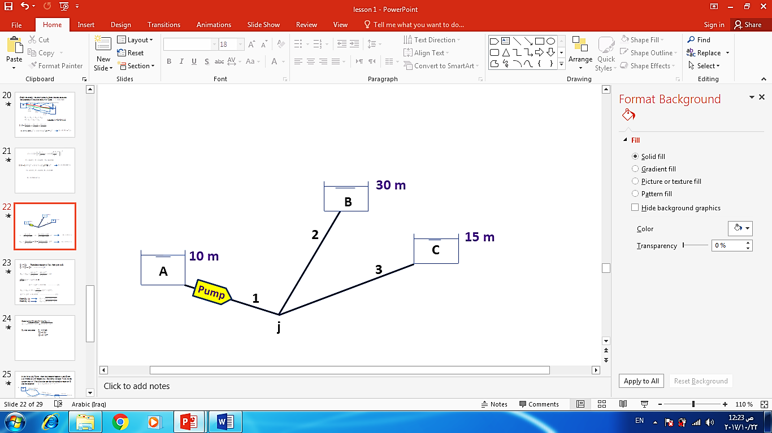

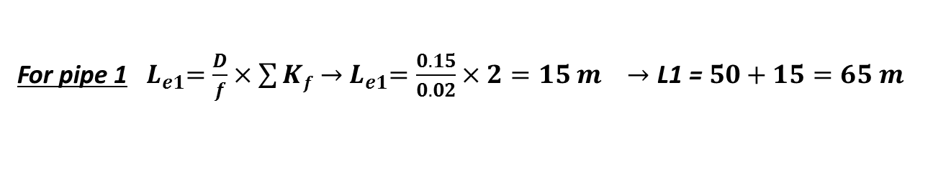
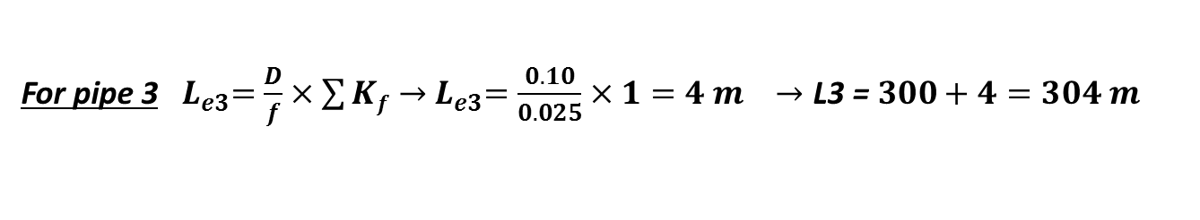
Example: 10
The following figure shows three reservoirs connected by pipes. Find the discharge in each pipe and the piezometric head H at the junction. The fluid power input by the pump is constant equal to $γQH_{p}=20 Kw$
$\sum{Kf}$ | f | D (m) | L (m) | Pipe
2 | 0.02 | 0.15 | 50 | 1
1 | 0.015 | 0.10 | 100 | 2
1 | 0.025 | 0.10 | 300 | 3
Solution
For pipe 1 ${ L}_{e1}=\frac{D}{f}×\sum{Kf}→{ L}_{e1}=\frac{0.15}{0.02}×2=15 m →\text{L}\text{1 }\text{= }50+15=65 m$
For pipe 2 ${ L}_{e2}=\frac{D}{f}×\sum{Kf}→{ L}_{e2}=\frac{0.10}{0.015}×1=6.7 m→\text{L}\text{2 }\text{= }100+6.7=106.7 m$
For pipe 3 ${ L}_{e3}=\frac{D}{f}×\sum{Kf}→{ L}_{e3}=\frac{0.10}{0.025}×1=4 m →\text{L}\text{3 }\text{= }300+4=304 m$

Slide 23


$h_{f}=\frac{8fL}{π^{2}gD^{5}} Q^{2}$ = $Ki {Qi}^{2}$
${ K}_{1}=\frac{8 f L1 }{π^{2}×g×{D1}^{5}}$ = $\frac{8×0.02×65}{π^{2}×9.81×{0.15}^{5}}$ = 1420
${ K}_{2}=\frac{8 f L2 }{π^{2}×g×{D2}^{5}}$ = $\frac{8×0.015×106.7}{π^{2}×9.81×{0.10}^{5}}$ = 13200
${ K}_{3}=\frac{8 f L3 }{π^{2}×g×{D3}^{5}}$ = $\frac{8×0.025×304}{π^{2}×9.81×{0.10}^{5}}$ = 62800
Assume ELj = 30 m
For pipe 1 ${Z1+{ H}_{p}=h}_{f1}+{ H}_{j}$
So, ${10 +\frac{20}{9.8 Q1}=1420{ Q1}^{2}}_{ }+30 →{\frac{20}{9.8 Q1} −1420{ Q1}^{2}=20}_{ }$ -------(1)
Solve Eq.(1) by trial and error to find that Q1 = 0.0736 m³/s
For pipe 3
${{ H}_{j}=15+{ h}_{f2} →{ H}_{j}=15+\text{62800} { Q3}^{2}}_{ }→$ $Q3=\sqrt{\frac{Hj −15}{62800}}$ $=\sqrt{\frac{30−15}{62800}}$ = 0.015 m³/s
Since Q1 ≠ Q3 and Q1 > Q3 therefore a direction of flow must be from joint j to reservoir B

Slide 24


So, Assume flow for Q2 Such that: Q1 = Q2 + Q3 ……….. (2)
For pipe 1 ${Z1+{ H}_{p}=h}_{f1}+{ H}_{j}$
${10 +\frac{20}{9.8 Q1}=1420{ Q1}^{2}}_{ }+{ H}_{j}$
Or, ${{ H}_{j}= 10 +\frac{20}{9.8 Q1}−1420{ Q1}^{2}}_{ }$…… (3)
For pipe 2
${{ H}_{j}=30+{ h}_{f2} →{ H}_{j}=30+13200{ Q2}^{2}}_{ }$ $→Q2=\sqrt{\frac{Hj −30}{13200}}$ ……….. (4)
For pipe 3 ${{ H}_{j}=15+{ h}_{f3} →{ H}_{j}=15+\text{62800} { Q3}^{2}}_{ }→$ $Q3=\sqrt{\frac{Hj −15}{62800}}$ ……….. (5)
Solve Eqs.(3, 4 & 5) by trial and error to as follows
So, the solution is
Q1 = 0.054 m³/s
Q2 = 0.0322 m³/s
Q3 = 0.0214 m³/s
H_{j} = 43.64 m
$$∆Q=Q1−Q2−Q3$$ | $$Q3$$ $$\text{Eq}\text{.}5$$ | Q2 Eq.4 | H_{j} Eq.3 | Assume Q1 | Iter.
- 0.0089 | 0.0227 | 0.0362 | 47.25 | 0.050 | 1
+ 0.0029 | 0.0210 | 0.0311 | 42.80 | 0.055 | 2
+ 0.0004 | 0.0214 | 0.0322 | 43.64 | 0.054 | 3

