Slide 1
Chapter 10 test
Software engineering
By: Lecturer Raoof Talal

Slide 2
10.1 Software Testing Fundamentals
During earlier software engineering activities, the engineer attempts to build software from an abstract concept to an actual product. Now comes testing. The engineer creates a series of test cases to test the software that has been built.

Slide 3
10.1.1 Testing Objectives
Testing objectives are:
Testing is a process of executing a program with the intent of finding an error.
A good test case is one that has a high probability of finding an as-yet undiscovered error.
A successful test is one that uncovers an as-yet-undiscovered error.

Slide 4
10.1.2 Testing Principles
Here is a set of testing principles that have been adapted for use in software testing:
All tests should be traceable to customer requirements.
Tests should be planned long before testing begins.
Testing should begin “in the small” and progress toward testing “in the large”.
Exhaustive (full-scale) testing is not possible.
To be most effective, testing should be conducted by an independent third party.

Slide 5
10.1.3 Testability
In ideal circumstances, a software engineer designs a computer program, a system, or a product with “testability” in mind. This enables the individuals charged with testing to design effective test cases more easily. Software testability is simply how easily a computer program can be tested.

Slide 6
10.2 White-Box Testing
White-box testing, sometimes called glass-box testing is a test case design method that uses the control structure of the procedural design to derive test cases. Using white-box testing methods, the software engineer can derive test cases that:
Guarantee that all independent paths within a module have been exercised at least once.
Exercise all logical decisions on their true and false sides.
Execute all loops at their boundaries and within their operational bounds.
Exercise internal data structures to ensure their validity.

Slide 7
Black-box testing, no matter how thorough, may miss the kinds of errors noted here while White-box testing is far more likely to uncover them.

Slide 8
10.3 Basis Path Testing
Basis path testing is a white-box testing technique that enables the test case designer to derive a logical complexity measure of a procedural design and use this measure as a guide for defining a basis set of execution paths.
Test cases derived to exercise the basis set are guaranteed to execute every statement in the program at least one time during testing.

Slide 9
10.3.1 Flow Graph Notation
Before the basis path method can be introduced, a simple notation for the representation of control flow, called a flow graph (or program graph) must be introduced. The flow graph depicts logical control flow using the notation illustrated in Figure 10.1. Where each circle represents one or more non-branching program design language (PDL) or source code statements.

Slide 10
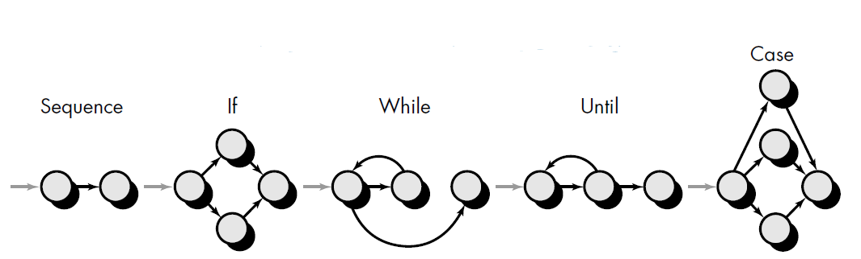

Slide 11
To illustrate the use of a flow graph, we consider the procedural design representation in Figure 10.2A. Here, a flowchart is used to depict program control structure.
Figure 10.2 B maps the flowchart into a corresponding flow graph (assuming that no compound conditions are contained in the decision diamonds of the flowchart). Referring to Figure 10.2B,

Slide 12
Each circle, called a flow graph node, represents one or more procedural statements.
A sequence of process boxes and a decision diamond can map into a single node.
The arrows on the flow graph, called edges or links, represent flow of control and are analogous to flowchart arrows.
An edge must terminate at a node, even if the node does not represent any procedural statements (e.g., see the symbol for the if-then-else construct).
Areas bounded by edges and nodes are called regions. When counting regions, we include the area outside the graph as a region.

Slide 13
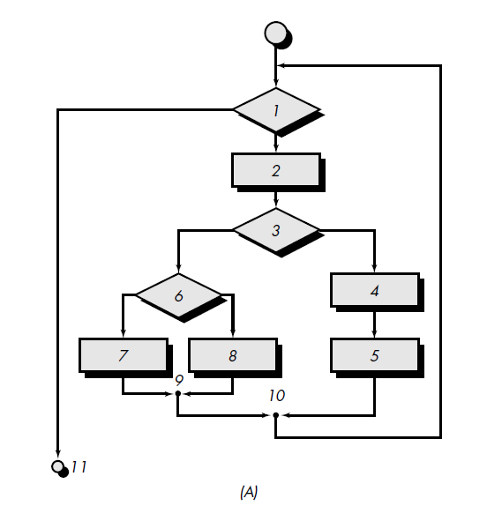

Slide 14
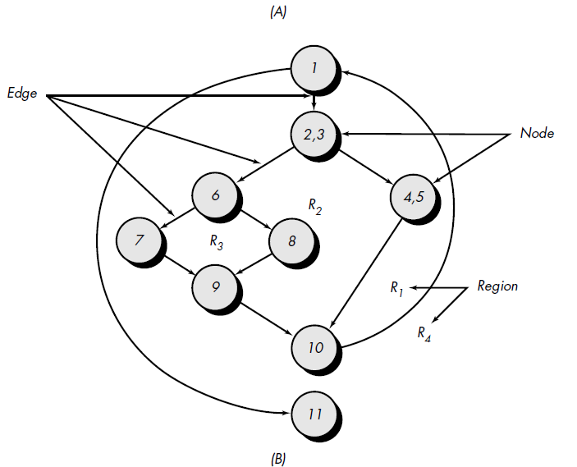

Slide 15
When compound conditions are encountered in a procedural design, the generation of a flow graph becomes slightly more complicated. A compound condition occurs when one or more Boolean operators (logical OR, AND, NAND, NOR) is present in a conditional statement. Referring to Figure 10.3, the PDL segment translates into the flow graph shown. Note that a separate node is created for each of the conditions a and b in the statement IF a OR b.
Each node that contains a condition is called a predicate node and is characterized by two or more edges emanating from it.

Slide 16
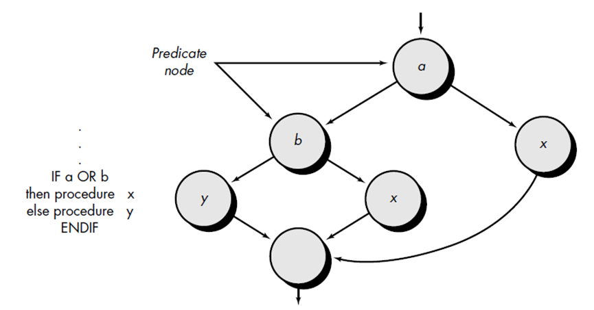

Slide 17
10.3.2 Cyclomatic Complexity
Cyclomatic complexity is software metric that provides a quantitative measure of the logical complexity of a program. When used in the context of the basis path testing method, the value computed for cyclomatic complexity defines the number of independent paths in the basis set of a program and provides us with an upper bound for the number of tests that must be conducted to ensure that all statements have been executed at least once.

Slide 18
An independent path is any path through the program that introduces at least one new set of processing statements or a new condition.
When stated in terms of a flow graph, an independent path must move along at least one edge that has not been traversed before the path is defined. For example, a set of independent paths for the flow graph illustrated in Figure 10.2B is:

Slide 19
Path 1: 1-11
Path 2: 1-2-3-4-5-10-1-11
Path 3: 1-2-3-6-8-9-10-1-11
Path 4: 1-2-3-6-7-9-10-1-11
Note that each new path introduces a new edge. The path
1-2-3-4-5-10-1-2-3-6-8-9-10-1-11
is not considered to be an independent path because it is simply a combination of already specified paths and does not traverse any new edges.

Slide 20
Paths 1, 2, 3, and 4 constitute a basis set for the flow graph in Figure 10.2B. That is, if tests can be designed to force execution of these paths (a basis set), every statement in the program will have been guaranteed to be executed at least one time and every condition will have been executed on its true and false sides. It should be noted that the basis set is not unique. In fact, a number of different basis sets can be derived for a given procedural design.
Cyclomatic complexity has a foundation in graph theory and provides us with extremely useful software metric. Complexity is computed in one of three ways:

Slide 21
The number of regions of the flow graph corresponds to the cyclomatic complexity.
Cyclomatic complexity, V (G), for a flow graph, G, is defined as
V (G) = E - N + 2
Where E is the number of flow graph edges, N is the number of flow graph nodes.
Cyclomatic complexity, V(G), for a flow graph, G, is also defined as
V (G) = P + 1
Where P is the number of predicate nodes contained in the flow graph G.

Slide 22
Referring once more to the flow graph in Figure 10.2B, the cyclomatic complexity can be computed using each of the algorithms just noted:
1. The flow graph has four regions.
2. V(G) = 11 edges - 9 nodes + 2 = 4.
3. V(G) = 3 predicate nodes + 1 = 4.
Therefore, the cyclomatic complexity of the flow graph in Figure 10.2B is 4.

Slide 23
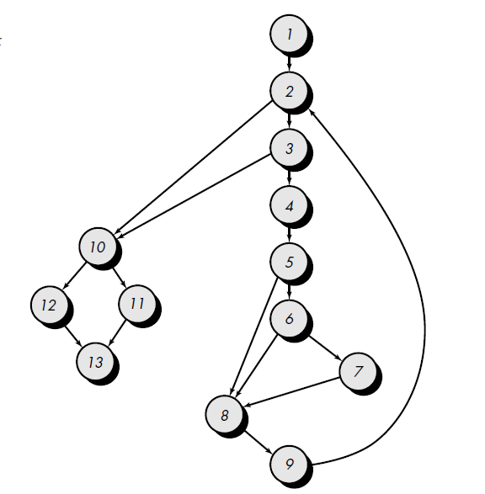
Example 1
Referring to Figure 10.4 find the cyclomatic complexity, and determine a basis set of linearly independent paths.

Slide 24
Sol
1- V(G) = 6 regions
2- V(G) = 17 edges _ 13 nodes + 2 = 6
3- V(G) = 5 predicate nodes + 1 = 6
We expect to specify six paths:
path 1: 1-2-10-11-13
path 2: 1-2-10-12-13
path 3: 1-2-3-10-11-13
path 4: 1-2-3-4-5-8-9-2-. . .
path 5: 1-2-3-4-5-6-8-9-2-. . .
path 6: 1-2-3-4-5-6-7-8-9-2-. . .
The ellipsis (. . .) following paths 4, 5, and 6 indicates that any path through the remainder of the control structure is acceptable.

Slide 25
10.4 Black-Box Testing
Black-box testing, also called behavioral testing, focuses on the functional requirements of the software. That is, black-box testing enables the software engineer to derive sets of input conditions that will fully exercise all functional requirements for a program.
Black-box testing is not an alternative to white-box techniques. Rather, it is a complementary approach that is likely to uncover a different class of errors than white-box methods.

Slide 26
Black-box testing attempts to find errors in the following categories:
(1) Incorrect or missing functions.
(2) Interface errors.
(3) Errors in data structures or external data base access.
(4) Behavior or performance errors.
(5) Initialization and termination errors.
Unlike white-box testing, which is performed early in the testing process, black box testing tends to be applied during later stages of testing.

Slide 27
10.5 Other Testing
As computer software has become more complex, the need for specialized testing approaches has also grown. The white-box and black-box testing methods are applicable across all environments, architectures, and applications, but unique approaches to testing are sometimes warranted. In this section we consider testing guidelines for specialized environments, architectures, and applications that are commonly encountered by software engineers.

Slide 28
10.5.1 Testing GUIs
Graphical user interfaces (GUIs) present interesting challenges for software engineers. Because of reusable components provided as part of GUI development environments, the creation of the user interface has become less time consuming and more precise. But, at the same time, the complexity of GUIs has grown, leading to more difficulty in the design and execution of test cases. Due to the large number of permutations associated with GUI operations, testing should be approached using automated tools. A wide array of GUI testing tools has appeared on the market over the past few years.

Slide 29
10.5.2 Testing of Client/Server Architectures
Client/server (C/S) architectures represent a significant challenge for software testers. The distributed nature of client/server environments, the complexities of network communication, the need to service multiple clients from a centralized (or in some cases, distributed) database, all combine to make testing of C/S architectures and the software that reside within them considerably more difficult than stand-alone applications

Slide 30
10.5.3 Testing Documentation and Help Facilities
Errors in documentation can be as destructing to the acceptance of the program as errors in data or source code. Nothing is more frustrating than following a user guide or an on-line help facility exactly and getting results or behaviors that do not coincide with those predicted by the documentation. It is for this reason that that documentation testing should be a meaningful part of every software test plan.
Documentation testing can be approached in two phases. The first phase, review and inspection, examines the document for editorial clarity. The second phase, live test, uses the documentation in conjunction with the use of the actual program.

