Slide 1
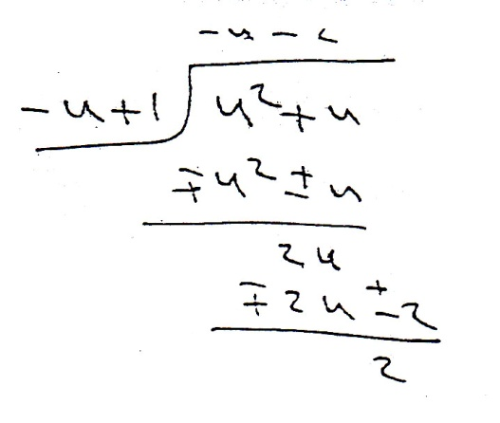
Integrals involving rational exponents

Slide 2
