Slide 1
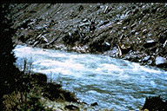
Fluvial Hydraulics CH-6
Total Load Transport

Slide 2
Total Load
Total Load = total bed-material load + wash load
Wash load is commonly neglected
In fact, Graf refers more to total load transport as being total bed-material load transport
We have already derived Einstein’s equation for total bed-material load:
Note: for non-uniform sediments, two options:
Calculate for each grain size and sum over all fractions
Use equivalent diameter (d₃₅)

Slide 3
Total Bed-Load Transport Equations
Indirect Methods: determine bed-material load by addition of the calculated bed load and calculated suspended load
Different hydrodynamics of each mode of transport
Einstein’s method
Direct Methods: determine bed-material load directly without making a distinction between two modes of transport

Slide 4
Direct Total Bed-Load Transport Equations
Graf et al. (1968):
Defined parameter of shear intensity:
Proposed a parameter of transport:
Functional relationship exists between these two parameters:

Slide 5
Direct Total Bed-Load Transport Equations
Graf et al. (1968):
Used some 800 experiments from laboratory and 80 experiments in the field:
Graf et al. (1987) evaluated above relationship and suggested slightly modified form:

Slide 6
Direct Total Bed-Load Transport Equations
Ackers and White (1973):
Proposed parameter of mobility of sediments:
Proposed a parameter of transport of sediments:
Total-load transport becomes…

Slide 7
Direct Total Bed-Load Transport Equations
Ackers and White (1973):
Note: h_{m} = A/B (average flow depth)
Coefficients in above relations determined by regression analysis (1000 experiments in lab and 250 experiments in field):
Range of validity: 0.04 < d₅₀ [mm] < 4.0 and Fr < 0.8
For non-uniform material, use d = d₃₅

Slide 8
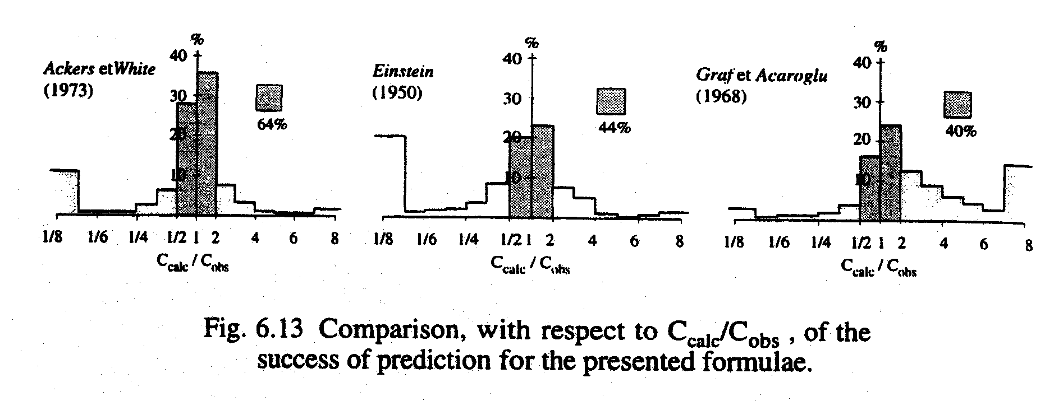
Evaluation of Total Bed-Material Load Transport Equations
White et al. (1973) compared over 19 equations with experimental results from 1000 lab experiments and 270 field experiments:
Lab: 0.04 < d₅₀ [mm] < 4.9 and h < 0.4 m
Field: 0.1 < d₅₀ [mm] < 68.0 and 9 < B/h < 160
Approximately 10 formulas had success rates of less than 40%

Slide 9
Evaluation of Total Bed-Material Load Transport Equations
Conclusion is that these formulas give guidance to engineer (not true value)
Advised to consult more than one formula and consider potential range in transport rates

Slide 10
Wash Load Component
Wash Load (q_{sw}) – particles that are never in contact with the bed (washed through the channel by the flow)
Limited to very finest particles which make up very small portion of the bed material
Distribution of particles rather uniform over the entire flow depth
Attempts to define wash load component:
Einstein (1950) – wash load corresponds to fraction of PSD smaller than 10%
Raudkivi (1976) – particles with diameter less than 0.06 mm
No physical relationship to flow ←→ No analytical method
In order to obtain quantitative information on wash load, measurements in the field must be performed
Measures q_{ss} + q_{sw}
To get q_{sw}, you must then calculate q_{ss} and back calculate q_{sw}
Graf: When wash load is a greater contributor to total sediment load (q_{sw} > q_{sw}), the problem of sediment transport becomes “hopelessly complicated”

Slide 11
Graf – Example 6.F
We established the stage-discharge curve for a range of 10 < Q [m³/s] < 1000 for a river in an earlier example (remember the first use of the Einstein-Barbossa curve). The width of the river is 90 m, bed slope is 0.0005, and the non-erodible banks have a slope of 1:1.
Sediment forming the bed has a s_{s} = 2.65, d₅₀ = 0.32 mm, d₃₅ = 0.29 mm, and d₉₀ = 0.48 mm. Water temperature is 14ºC. Determine the stage/sediment-discharge curve (sedimentological rating curve) using Einstein, Graf et al. (1968) and Ackers and White methods.

Slide 13
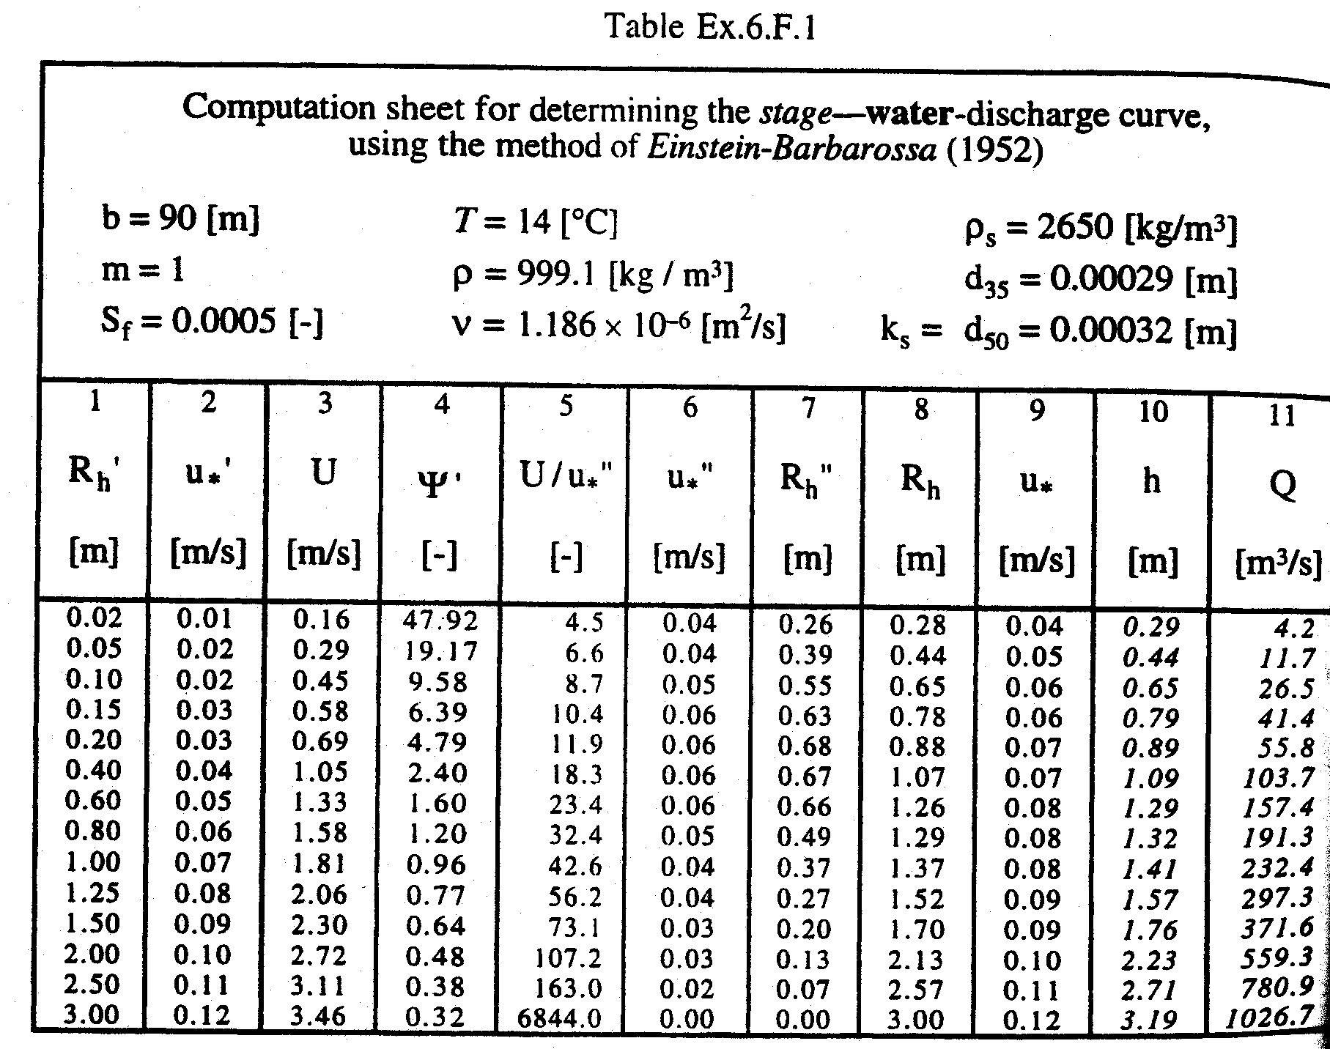
Solution for Discharge

Slide 14
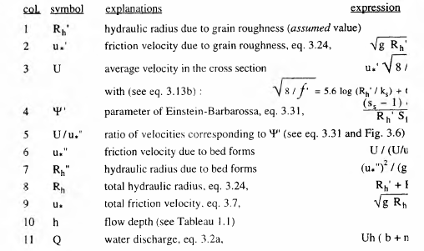

Slide 15
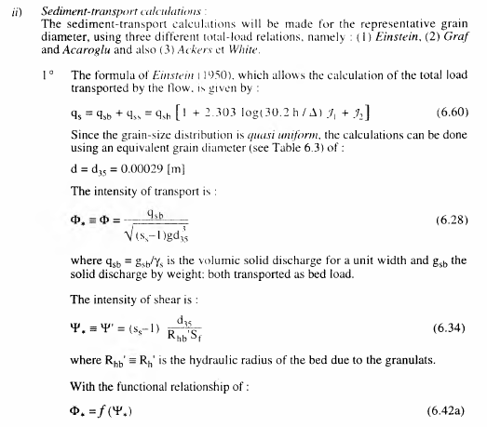

Slide 16
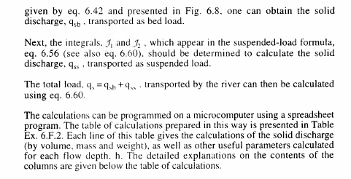

Slide 17
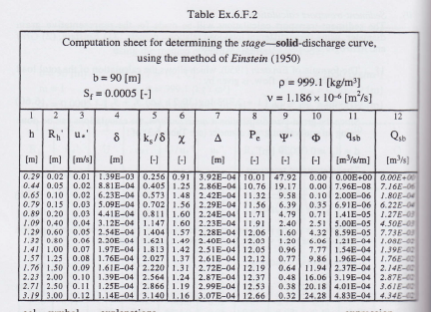

Slide 18
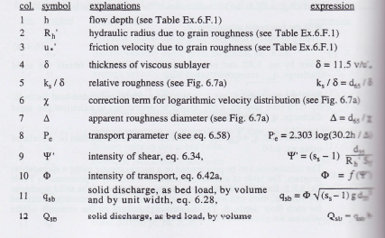

Slide 19
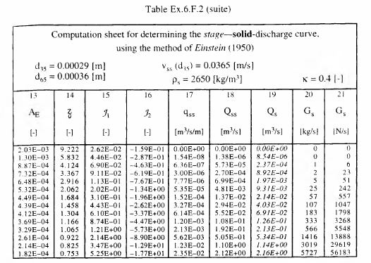

Slide 20
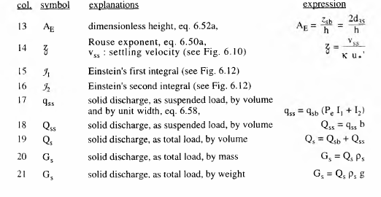

Slide 21
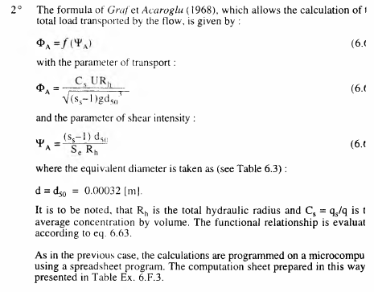

Slide 22
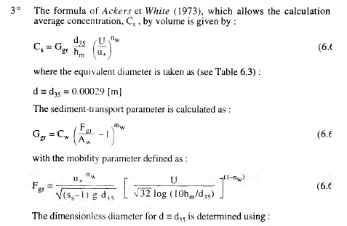

Slide 23
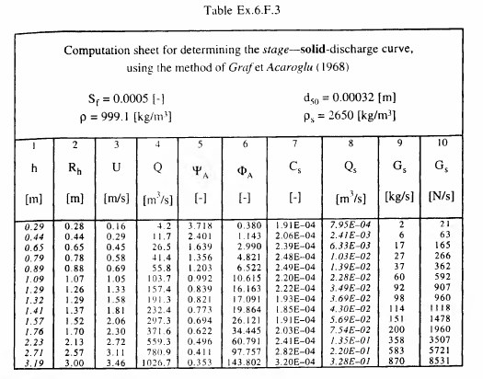

Slide 24
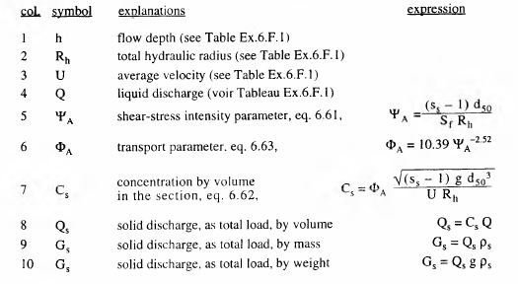

Slide 25
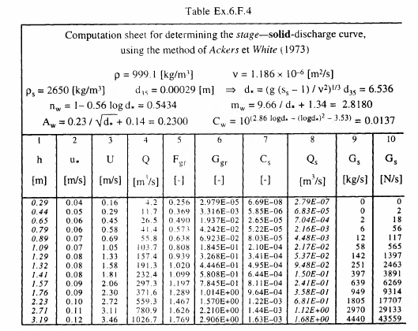

Slide 26
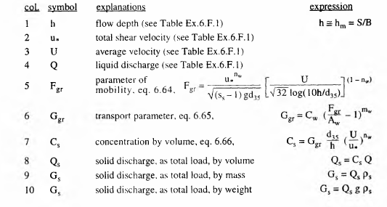

Slide 27
