Slide 1
Review of Last Lesson
Assume $∅=f\left(x,y\right)$ such that :
${u=V}_{x}=−\frac{∂∅}{∂x} and {v=V}_{y}=−\frac{∂∅}{∂y}$
$d∅=\frac{∂∅}{∂x}dx+\frac{∂∅}{∂y}d$y= - $u$ dx - $v$ dy
$∅=\int{\frac{∂∅}{∂x}dx}+\int{\frac{∂∅}{∂y}d\text{y}}$ + C = $\int{−u dx }$- $\int{v \text{dy}}+C$
Or $in \text{polar} \text{coordinate} ∅=f\left(r,θ\right) \text{such} \text{that}\text{:}$
With $v_{r}=−\frac{∂∅}{∂r} and v_{t}=−\frac{∂∅}{r∂θ}$
$d∅=\frac{∂∅}{r∂θ}rdθ+\frac{∂∅}{∂r}dr$= -$v_{t}$ $rdθ$- $v_{r}$dr
$∅=\int{\frac{∂∅}{r∂θ}rdθ}+\int{\frac{∂∅}{∂r}dr}$ + C =$\text{−}\int{v_{t}}$ $rdθ$- $\int{v_{r}}$ dr + C
Notes:
The potential is related to the velocity components. Equations describing the velocity potential are given above.

Slide 2
Flow in a porous Medium
For one-dimentional flow of an incompressible real fluid in a streamtube, the Bernoulli equation written in differential form is:
$d\left(z+\frac{v^{2}}{2g}+\frac{p}{γ}\right)=−dh_{L}$ ------------- 1
Suppose that V is small so that $d\left(\frac{v^{2}}{2g}\right)$may be neglected
$dh_{L}=\frac{1}{K}Vdl$ ------------- 2
$∴ d\left(z+\frac{p}{γ}\right)=−\frac{1}{K}Vdl$
or $V=−\frac{d}{dl}K\left(z+\frac{p}{γ}\right)=−K\frac{d}{dl}\left(z+\frac{p}{γ}\right)$ ------------- 3
Let $h=\left(z+\frac{p}{γ}\right)$ $∴$ $V=−K\frac{dh}{dl}=− K i$ (Darcy’s law) ------------- 4
If this will be extended to the two –dimensional case:
$u=− \frac{∂}{∂x} K\left(z+\frac{p}{γ}\right)=−K\frac{∂h}{∂x}=−\frac{∂∅}{∂x}$ ------------- 5
$v=− \frac{∂}{∂y} K\left(z+\frac{p}{γ}\right)=−K\frac{∂h}{∂y}=−\frac{∂∅}{∂y}$ ------------- 6
Or in general $V=−K\frac{∂h}{∂l}=−\frac{∂∅}{∂l}$ ------------- 7
$∴K\left(z+\frac{p}{γ}\right)=∅$ is seen to be the velocity potential of such a flowfield where K is a coefficient of permeability has a dimensions of velocity and ranges from: 3 x 10⁻¹¹ m/s for clay to 0.3 m/s for gravel
Notes:
The potential is related to the velocity components. Equations describing the velocity potential are given above.

Slide 3
Flow in a porous Medium
This is satisfied for laminar condition through a homogeneous porous medium.
$R= \frac{Vd}{υ}$ ---------------8
R= Reynolds number for porous media
V = apparent velocity = Q/A
d= effevtive or mediam grain size in sand
When R < 1 , the flow is surely laminar and Darcy’s linear law is valid. If R >>>1 , it is likely that the flow is turbulent and that $\frac{v^{2}}{2g}$ is not negligible and equation 4 is not valid.
Actual velocity v_{p}
The apparent velocity V= Q/A is not the actual vgelocity in the pores. The average velocity in the pores is :
$V_{p}=\frac{V}{n}$ --------9
with $n=\frac{Volume of voids }{total volume }$ --------10
Where n is porosity
Notes:
The potential is related to the velocity components. Equations describing the velocity potential are given above.

Slide 4
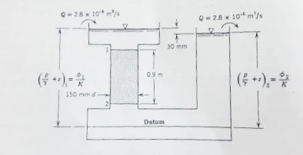
Flow in a porous Medium
Example: Calculate the coefficient of permeability K for the following problem if the flowrate is 2.8 m/s
Solution: from Eq.7
$V=−K\frac{∂h}{∂l}=−\frac{∂∅}{∂l}$ ------------- 7
Or $V=−K\frac{∂h}{∂l}=−K\frac{∆h}{∆l}=−K\frac{h2−h1}{∆l}$
note that $h1=\left(z1+\frac{p1}{γ}\right)$ = $\frac{∅\text{1}}{K}$
and $h2=\left(z2+\frac{p2}{γ}\right)$= $\frac{∅2}{K}$
$∴$ h₁ – h₂ = $\left(z2+\frac{p2}{γ}\right)$ - $\left(z1+\frac{p1}{γ}\right)$
$=\frac{∅\text{2}}{K}$- $\frac{∅\text{1}}{K}$ = - 0.3
$∴$ $V=−K\frac{h2−h1}{∆l}=−K \frac{−0.03}{0.9}$
But $V=\frac{Q}{A}=\frac{2.8 x{10}^{−6}}{\frac{π}{4}{(0.15)}^{2}}=0.15853x{10}^{−3}$ m/s
$∴0.15853x{10}^{−3}=−K \frac{−0.03}{0.9}$ ,
K = $4.756x{10}^{−3}$ m/s
Notes:
The potential is related to the velocity components. Equations describing the velocity potential are given above.

Slide 5
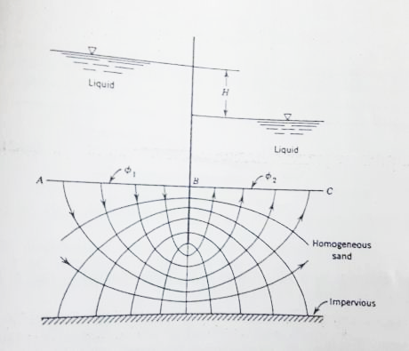
Flow in a porous Medium
Example: For the following problem, calculate the flowrate using flow net method.
Solution:
$∅\text{1}$ = $Kh1=K\left(z1+\frac{p1}{γ}\right)$
$∅\text{2}$ = $Kh2=K\left(z2+\frac{p2}{γ}\right)$
$$∆∅=\frac{∅_{2}−∅_{1}}{N_{∅}}=\frac{{Kh}_{2}−{Kh}_{1}}{N_{∅}}$$
$$∆∅=−\frac{KH}{N_{∅}}$$
$N_{∅}$ = no. of equipotential lines
$$∅_{i}=∅_{1}+i ∆∅$$
$∆$q = v $∆A=− \frac{∆∅ }{∆l}(∆l$ x 1)
$∆$q= $−∆∅$ =$− (−\frac{KH}{N_{∅}})$= $\frac{KH}{N_{∅}}$
$$q=\sum{∆\text{q}= N_{s} ∆\text{q}\text{ =}N_{s}\frac{KH}{N_{∅}}}$$
$N_{s}$ = no. of stream lines
Notes:
The potential is related to the velocity components. Equations describing the velocity potential are given above.

